Slide 1

Design and Implementation of LED Pattern Generator
An exploration of creating visual masterpieces with LEDs.
A project of showcasing the beauty of discrete ICs.

Slide 2

Project Objective: LED Pattern Generation
Visual Patterns
Discrete ICs
No Microcontrollers
Generate dynamic LED patterns, like numbers and stars.
Employ 555 timer and CD4017 counter ICs.
Achieve pattern control without complex microcontrollers.

Slide 3
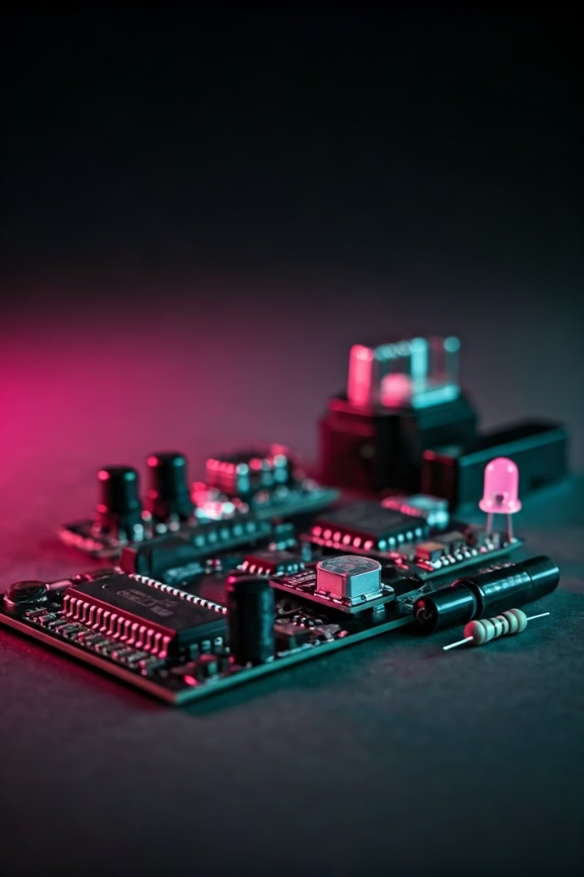




Key Components for LED Control
555 Timer IC
CD4017 IC
LEDs
Resistors

Slide 4
555 Timer Circuit Design
Astable Mode
Frequency
Example Values
Generates continuous clock pulses for timing.
Calculated by f = 1.44 / ((R1 + 2R2) * C).
R1 = 1kΩ, R2 = 10kΩ, C = 0.1μF for ~700 Hz.

Slide 5
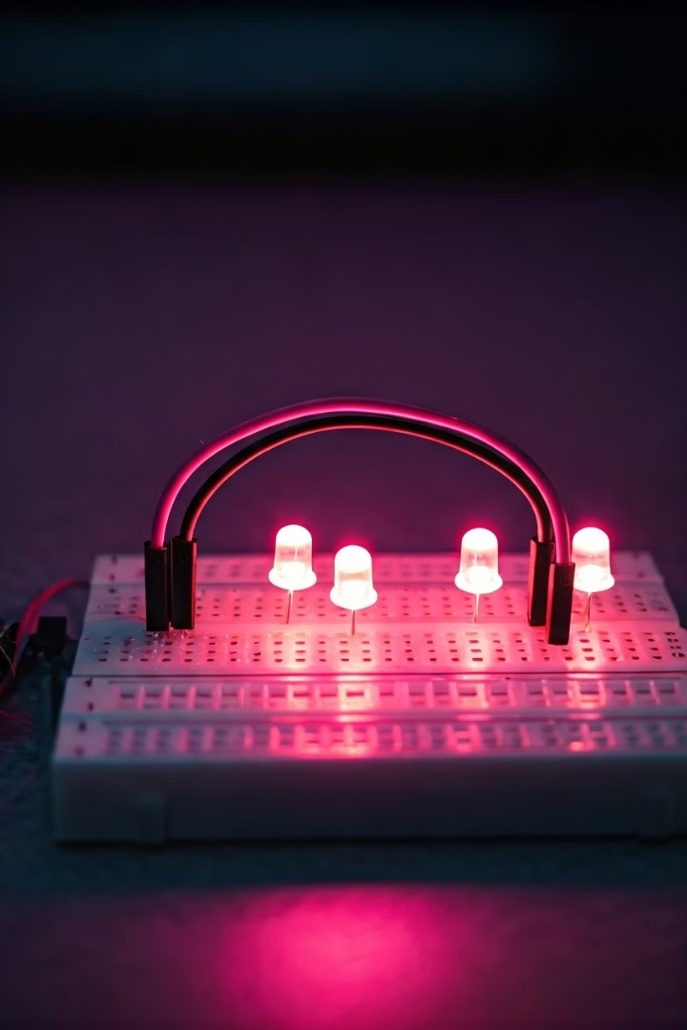
CD4017 Decade Counter Operation
1
Sequential Activation
Outputs activate in sequence upon each clock pulse.
2
LED Connections
Each output directly connected to an LED.
3
Pattern Control
Reset pin controls pattern length and sequence.

Slide 6
Custom PCB Implementation Process
Design
1
Use Eagle or KiCad for PCB layout.
Placement
2
Optimize component placement for signal flow.
Routing
3
Minimize signal interference, ensure grounding.

Slide 7



Generating LED Patterns Visually
Resistors
2
Select for LED brightness.
LED Array
1
Connect to CD4017 outputs.
Example
3
Create a star shape sequence.

Slide 8



Project Results and Demonstration
1
Visuals
2
Metrics
3
Accuracy

Slide 9
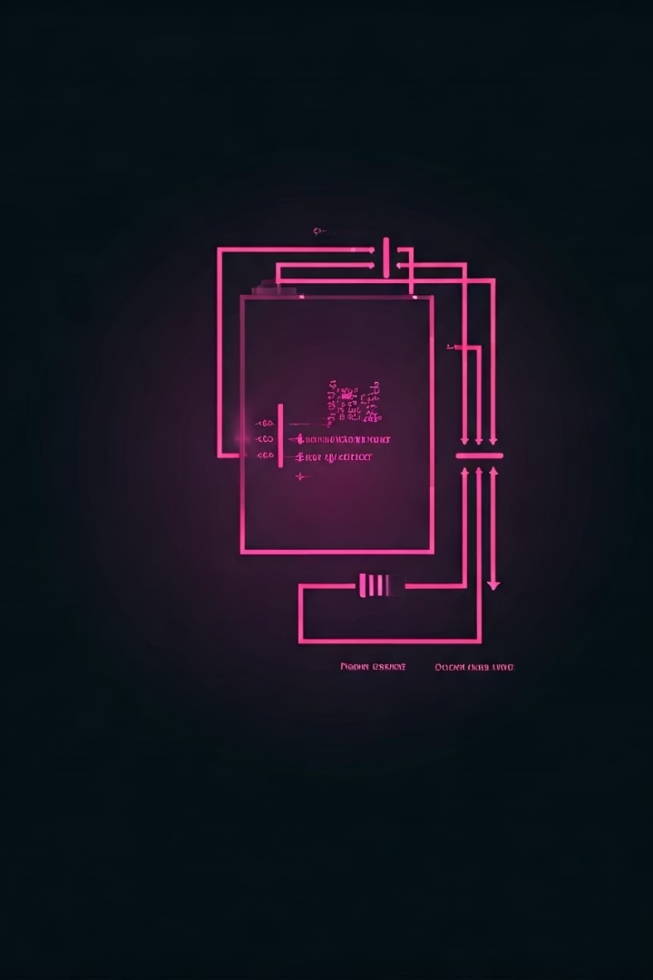
Advantages and Applications
Cost-Effective
Educational
Lower cost than microcontroller options.
Teaches basic digital logic concepts.
Simple Design
Easy to understand and replicate.

Slide 10




Conclusion: Project Success
Outcome
Achieved LED pattern generation.
Learning
Reinforced timer and counter concepts.
Future
Explore complex patterns/control.

