Slide 1

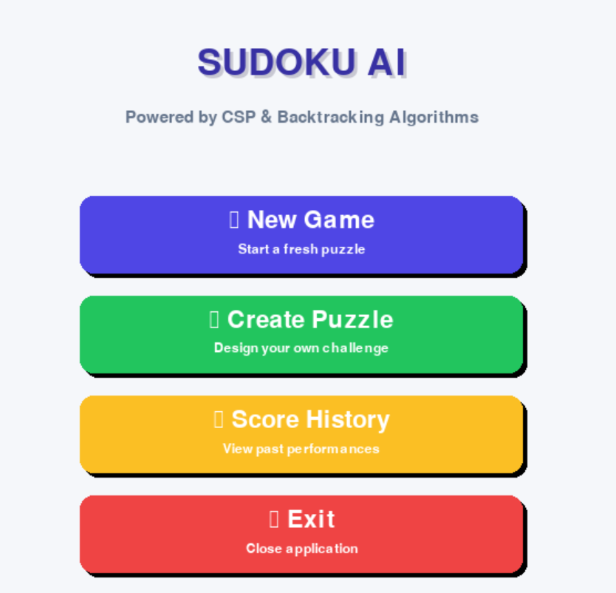
GROUP 11
SUDUKO
AI
PRESENT BY:
ABDULLAH MAJEED
SYED TURRAB HAIDER
SYED YOUSAF RASHEED

Slide 2


CONTENTS
1
Introduction
6
Puzzle Generation
2
System Architecture
7
Hint & Warnings
3
CSP
8
Data Layers
4
CSP - AC3 Algorithm
9
File Handling
5
CSP - MRV Heuristic
10
Conclusions

Slide 3
GROUP 11
INTRODUCTION
Sudoku is a 9 x 9 grid that requires filling every cell with numbers 1 to 9 while satisfying strict constraints.
The real goal of our project was to move beyond simple brute force and build an AI that solves the puzzle using logic, constraints, and human-like deduction.

Slide 4

Logic over Brute Force
PROJECT GOALS
Develop a game that uses human-like constraint logic rather than blind guessing, focusing on intelligent problem-solving.
Mathematical Validity
Ensure every generated puzzle has exactly one unique solution, guaranteeing a fair and solvable challenge.
Educational Value
Lower the learning curve for users by providing context-aware hints and logic warnings, fostering skill development.

Slide 5
LIBRARIES
TECHNOLOGY USED
PyGame
Time
DateTime
Json
DeQue
ALGORITHMS
CSP MiniMax
Minimum Remaining Values
Heuristics
AC-3 Algorithm
Iterative DFS
IDE
PyCharm & VsCode

Slide 6





SYSTEM ARCHITECTURE
Logic Layer
Presentation Layer
Data Layer
Constraint Satisfaction Problem (CSP) using AC-3 Algorithm, randomized puzzle generator, and backtracking solver for validation.
Built with Python Pygame, handling grid rendering and user inputs for an interactive experience.
JSON-based storage for game history, persisting statistics like score, time, and mistakes locally.

Slide 7

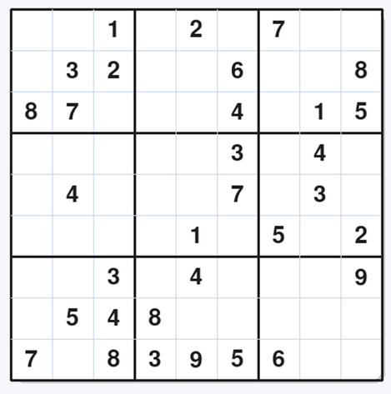
CSP
THE CSP DEFINITION
HOW THE AI THINKS
•Variables: The 81 cells on the board.
•Domains: The possible numbers (1-9) for each cell.
•Constraints: The rules of Sudoku (Row, Column, Box uniqueness).
•The AI strictly avoids random guessing.
•It analyzes the Domain of a cell and excludes any number that breaks a Constraint.
•Goal is to assign a value to every variable while satisfying all constraints

Slide 8

AC - 3 ALGORITHM
Pre-Processing Algorithm
We have used AC-3 as a pre-processing step to reduce the domain values thus optimizing AI solving of our program & validating user suduko board
Domain constriction
Used this to prune and shrink domains according to constraints
Optimization
It Optimizes the solution finding for the AI solving module
Example
Cell A has value 3.
Neighboring Cell B has domain {1,2,3,4,5}.
AC-3 detects the conflict and removes 3 from the domain of Cell B.

Slide 9
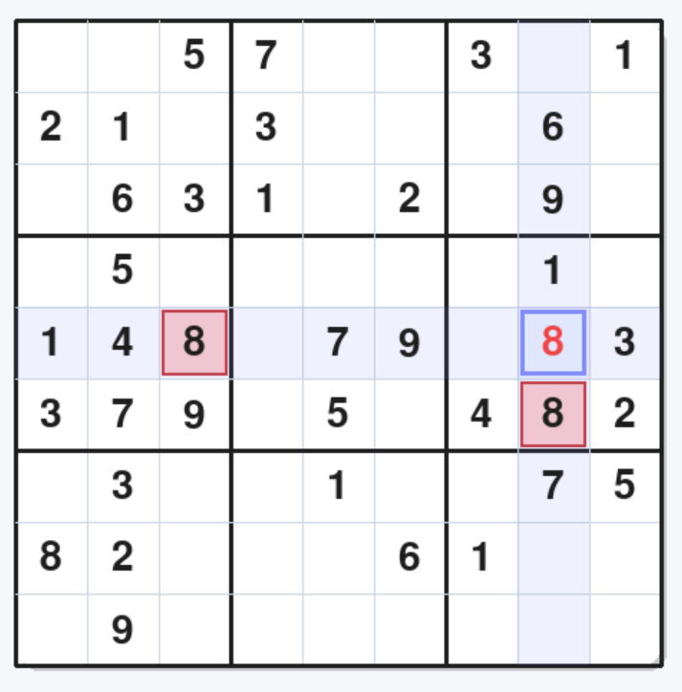
Constraint Violation

Slide 10
CSP vs BACKTRACKING
Naive Backtracking: Is "blind." It fills the grid sequentially. It will often fill 50 squares before realizing it made a mistake at square 2.
Our CSP Approach: Is "informed." By using AC-3, it prunes invalid options before trying them.
Why we chose CSP: Efficiency and speed. CSP solves hard puzzles in milliseconds, whereas naive backtracking can hang for seconds or minutes on pathological cases.

Slide 11
THE FAIL SAFE STRATEGY
MRV Heuristic
Our skilled team brings specialized knowledge and experience to provide top-notch solutions tailored to our clients' needs.
Strategy Overview
The Logic
The AI scans the board and picks the cell with the fewest possible legal moves. This approach increases the probability of making a correct guess and reduces backtracking.
A cell with 2 options has a 50% probability of being right.
A cell with 9 options has only an 11% probability.
Conclusion: We solve the hardest cells first to minimize errors.

Slide 12
PUZZLE GENERATION
Generate Solved Board
Remove Numbers
Validate Uniqueness
Create a fully solved, valid Sudoku board using the Constraint Satisfaction Problem (CSP) algorithm
Randomly remove numbers to create holes or clues, gradually increasing the puzzle's difficulty.
After every removal, use a Backtracking Solver to ensure the puzzle still has exactly one unique solution.

Slide 13


Hints & Warnings
CONTEXT AWARE HINTS
MINIMAX WARNINGS
Before user plays, AI runs a simulation.
It clones the board, places your number and runs the AC-3 check.
If the check fails, it warns the user.
AI Checks the Domain of all empty Cells.
If a Cell has only possible number left, It gets highlighted

Slide 14
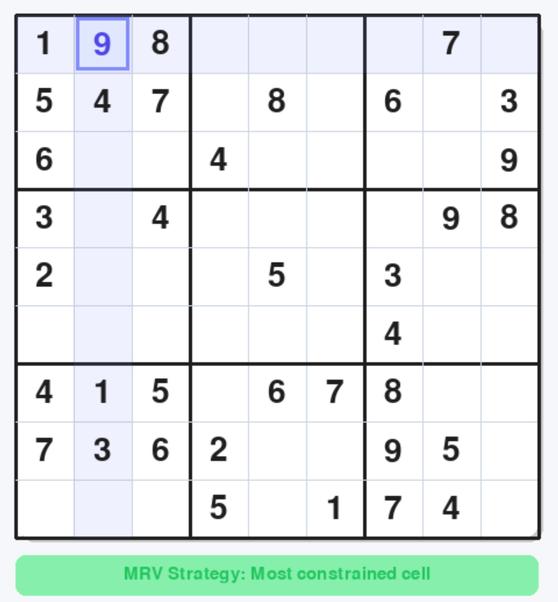
Hint Generation

Slide 15
THE DATA LAYER
Why JSON? | Lightweight, text-based, and crash-resistant, JSON provides a robust solution for data persistence.
Functionality | Persists user progress, including scores, time taken, and win rates, even after the application closes.

Slide 16
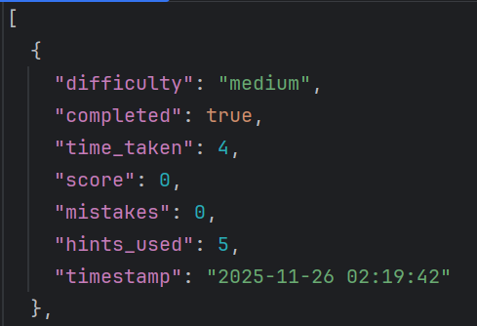
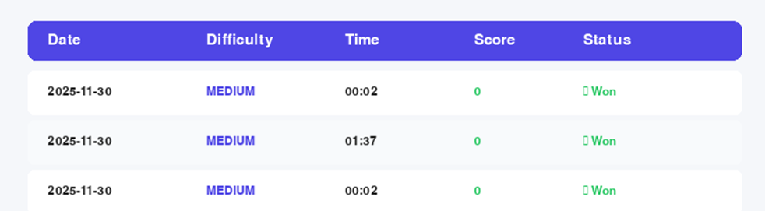
JSON FILE FORMATS

Slide 17
CONCLUSION
&
FUTURE SCOPE
Achievements
Limitations
Future Work
• Implemented CSP (AC-3) for sub-second puzzle solving.
• Created a Generator guaranteeing unique solutions.
• Built a responsive GUI with vertical scrolling and history.
• Expert puzzle generation is computationally expensive (1-2 seconds).
• AI hints rely on raw logic, not human-named strategies (e.g. "X-Wing").
• OCR Integration: Upload newspaper puzzles for digitization and solving.
• Advanced Tutorials: Teach AI to recognize complex patterns for better coaching.

Slide 18
GROUP 11
THANK YOU !
for your time and attention

