Slide 1

Dick B. Anderson
Police Detective

Slide 2

Directed
by
Martijn van Iersel
Orsika Labuda
Directed
by
Martijn van Iersel
Orsika Labuda

Slide 3
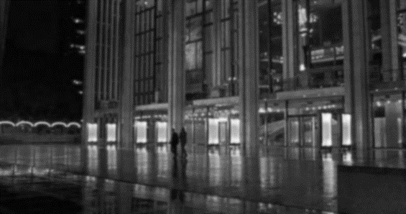
Presented
by
Martijn van Iersel
Joep Weijers

Slide 4
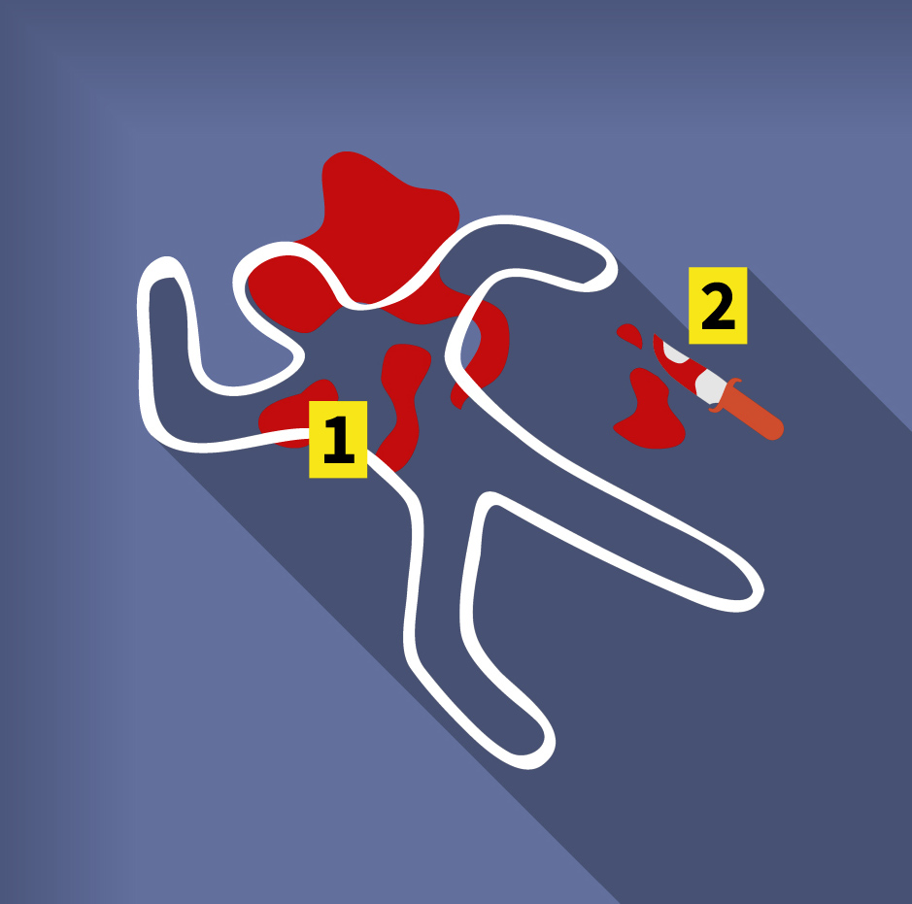
Rain was falling and slowly washed away the blood in the gutter. The forensic team was making photos and preparing to take away the body for autopsy. Such a shame, this young fellow had his whole life ahead of him. But now that's over. A knife through the chest will do that to you.
Simmons was interviewing bystanders. "Dick, come quick. I think we've got something". Anderson was surprised, usually interviews didn't produce quick results like that.
A woman saw a man fleeing the crime scene. Tall, male, black hair, between 20 and 30 years old. It's not much to go on, but it's enough to query the police database and make a list of suspects. It's time for the geeks from forensics to stop playing tetris and start doing something useful…

Slide 5

The Police Database
Persons
Cars with license plates
Phone call records
Financial records

Slide 6
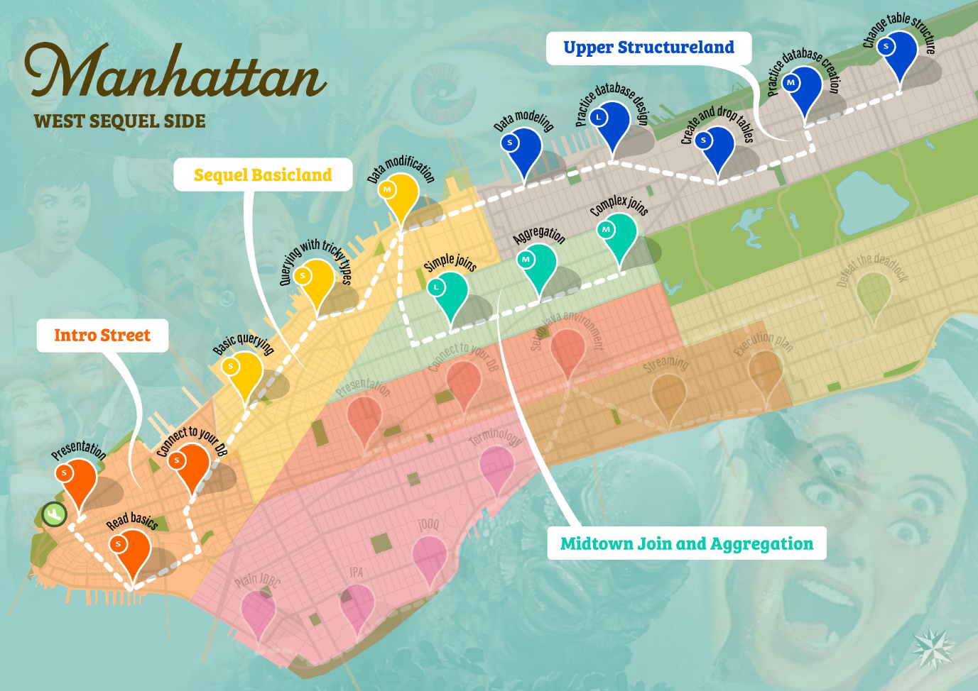
The Map

Slide 7
The Districts

Slide 8

Go! Travel! Investigate murders!
https://topdesk.github.io/database-detective/

Slide 9

Story by . . .
Cartographer . . .
Design by . . .
Graphics . . .
Assistants . . .
Martijn van Iersel
Orsika Labuda
Péter Vajda
Farideh Soltani Nejad
Bogdán Bikics
Kamilla Bukta
László Szentesi

Slide 10

Design by . . .
Story by . . .
Cartographer . . .
Graphics . . .
Assistants . . .
The End

