Slide 1
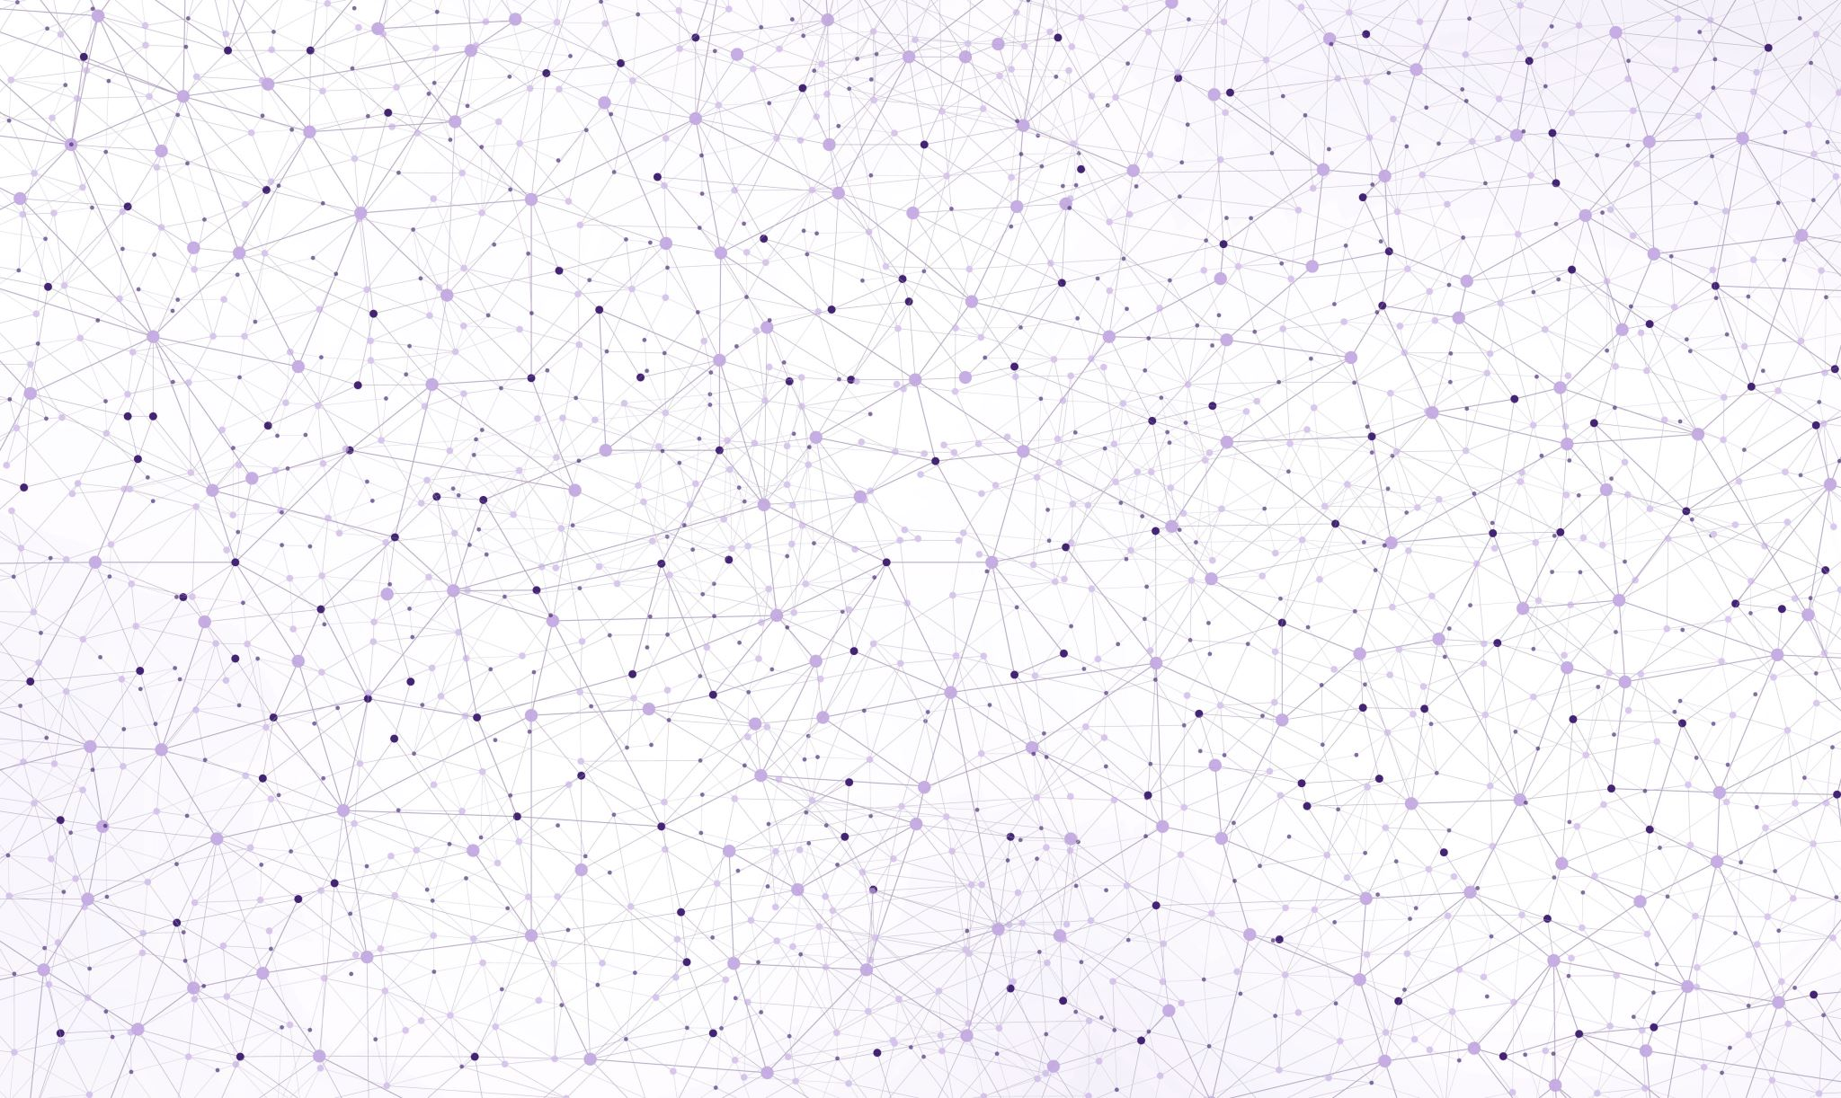
BiomeFUN-2025 Metabolic Flux Analysis
Timmy Paez Watson

Slide 2
Learning Objective Calculate the possible intracellular fluxes of a metabolic model using Python
To do that, we will need to:
Discuss the basic concepts of stoichiometric modelling.
Examine basic properties from metabolic models.
Calculate intracellular fluxes of a metabolic network using the Python package of COBRA.

Slide 3
Unit structure
Metabolic Flux Analysis
Basic Theory of Metabolic Stoichiometry
Properties of a Stoichiometric Matrix
Solving a Metabolic Model with Flux Balance Analysis

Slide 4
Metabolic Flux Analysis
1. Basic theory of metabolic stoichiometry

Slide 5
Why do we want to know cell fluxes?
Questions that can be addressed:
Theoretical maximum yield for a product from a given substrate
All the possible routes of a cellular metabolic network
Strain analysis: Which routes are used & how strong

Slide 6
What is a metabolic flux?
A metabolic flux is a metabolic reaction rate or the rate of a given enzymatic reaction taking place in the cell, in units of e.g. mmol/(gDW.h)

Slide 7
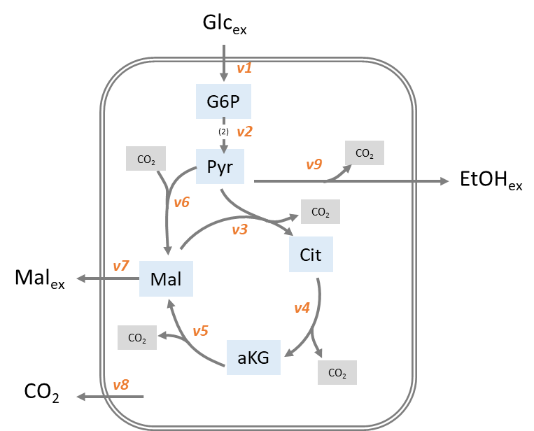
Example: Produce Malate from Glucose
Maximal malate production rate that could be achieved with this network?

Slide 8
Solve it
Glc_{ex}
v1 (1)
Option 1?
CO₂ from the cycle:
3 x CO₂ (v3, v4, v5)
‘sacrifice’ 0.5 Pyr
G6P
(2)
v2 (1)
CO₂
Pyr
v9 (0)
CO₂
EtOH_{ex}
v6 (1,5)
v3 (0,5)
CO₂
Cit
Mal_{ex}
v7 (1,5)
Mal
v4 (0,5)
CO₂
v5 (0,5)
aKG
CO₂
v8 (0)
CO₂

Slide 9
Solve it
Glc_{ex}
v1 (1)
Option 2?
CO₂ from v9:
1 x CO₂ (v9)
‘sacrifice’ 1 Pyr
G6P
(2)
v2 (1)
CO₂
Pyr
v9 (1)
CO₂
EtOH_{ex}
v6 (1)
v3 (0)
CO₂
Cit
Mal_{ex}
v7 (1)
Mal
v4 (0)
CO₂
v5 (0)
aKG
CO₂
v8 (0)
CO₂

Slide 10
Optimum
Glc_{ex}
v1 (1)
G6P
(2)
v2 (1)
CO₂
Pyr
v9 (0)
CO₂
EtOH_{ex}
v6 (1,5)
CO₂
v3 (0,5)
Cit
Mal_{ex}
v7 (1,5)
Mal
v4 (0,5)
CO₂
v5 (0,5)
aKG
CO₂
v8 (0)
CO₂
1.5 Malate / Glucose

Slide 11
What did we do?
Information:
Sum of in- and outflows from the pools are equal
Mass balances! Write it down for pyruvate…

Slide 12
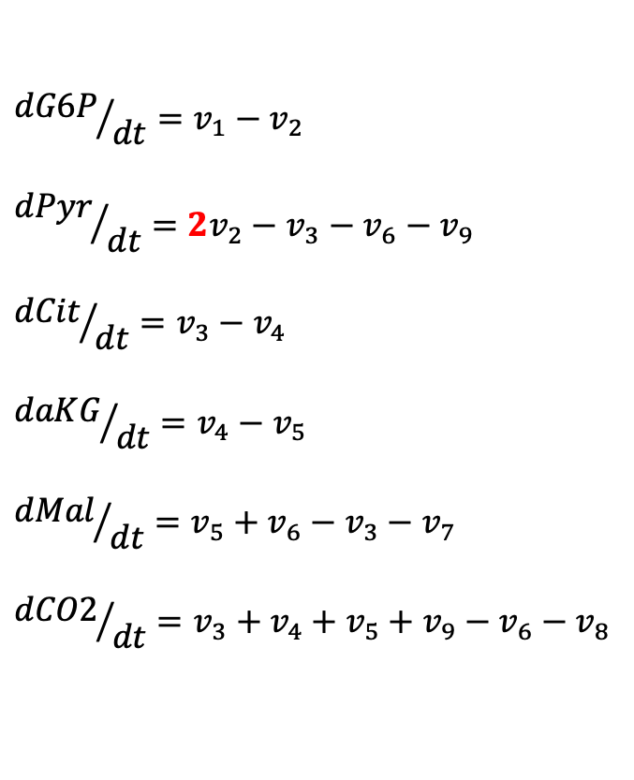
Balances of intracellular metabolites
$${dG6P}/{dt}=v_{1}−v_{2}$$
$${dPyr}/{dt}={2v}_{2}−v_{3}−v_{6}−v_{9}$$
$${dCit}/{dt}=v_{3}−v_{4}$$
$${daKG}/{dt}=v_{4}−v_{5}$$
$${dMal}/{dt}=v_{5}+v_{6}−v_{3}−v_{7}$$
$${dCO2}/{dt}=v_{3}+v_{4}+v_{5}+v_{9}−v_{6}−v_{8}$$

Slide 13
Balances of intracellular metabolites
$${dG6P}/{dt}=v_{1}−v_{2}$$
$${dPyr}/{dt}={2v}_{2}−v_{3}−v_{6}−v_{9}$$
$${dCit}/{dt}=v_{3}−v_{4}$$
$${daKG}/{dt}=v_{4}−v_{5}$$
$${dMal}/{dt}=v_{5}+v_{6}−v_{3}−v_{7}$$
$${dCO2}/{dt}=v_{3}+v_{4}+v_{5}+v_{9}−v_{6}−v_{8}$$

Slide 14
Balances of intracellular metabolites
$${dG6P}/{dt}=v_{1}−v_{2}$$
$${dPyr}/{dt}={2v}_{2}−v_{3}−v_{6}−v_{9}$$
$${dCit}/{dt}=v_{3}−v_{4}$$
$${daKG}/{dt}=v_{4}−v_{5}$$
$${dMal}/{dt}=v_{5}+v_{6}−v_{3}−v_{7}$$
$${dCO2}/{dt}=v_{3}+v_{4}+v_{5}+v_{9}−v_{6}−v_{8}$$

Slide 15
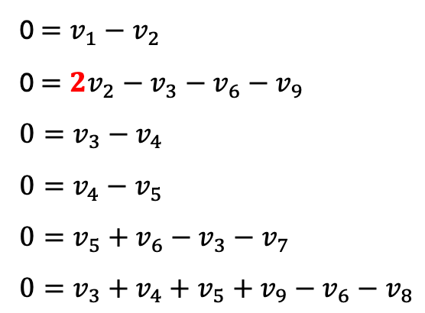
Balances of intracellular metabolites
Since we assume steady-state:
0 $=v_{1}−v_{2}$
0 $={2v}_{2}−v_{3}−v_{6}−v_{9}$
$$0=v_{3}−v_{4}$$
$$0=v_{4}−v_{5}$$
$$0=v_{5}+v_{6}−v_{3}−v_{7}$$
$$0=v_{3}+v_{4}+v_{5}+v_{9}−v_{6}−v_{8}$$

Slide 16

Network into matrix notation
0 $=v_{1}−v_{2}$
0 $={2v}_{2}−v_{3}−v_{6}−v_{9}$
$$0=v_{3}−v_{4}$$
$$0=v_{4}−v_{5}$$
$$0=v_{5}+v_{6}−v_{3}−v_{7}$$
$$0=v_{3}+v_{4}+v_{5}+v_{9}−v_{6}−v_{8}$$
We can build these equations into a matrix.

Slide 17
Network into matrix notation
v₁ v₂ v₃ v₄ v₅ v₆ v₇ v₈ v₉
G6P
Pyr
Cit
aKG
Mal
EtOH
CO₂
Stoichiometric matrix

Slide 18
Network into matrix notation
v₁ v₂ v₃ v₄ v₅ v₆ v₇ v₈ v₉

Slide 19
What about extracellular metabolites?
Two options
If modelled explicitly, they need to be produced and consumed.
If not modelled explicitly, they need to be provided to the system.
In both cases, we need exchange reactions.

Slide 20
What about extracellular metabolites?
Questions:
Are the extracellular metabolites explicitly modelled?
Can you identify exchange reactions?
v₁ v₂ v₃ v₄ v₅ v₆ v₇ v₈ v₉
G6P
Pyr
Cit
aKG
Mal
EtOH
CO₂

Slide 21
Metabolic Flux Analysis
2. Properties of a Stoichiometric matrix

Slide 22
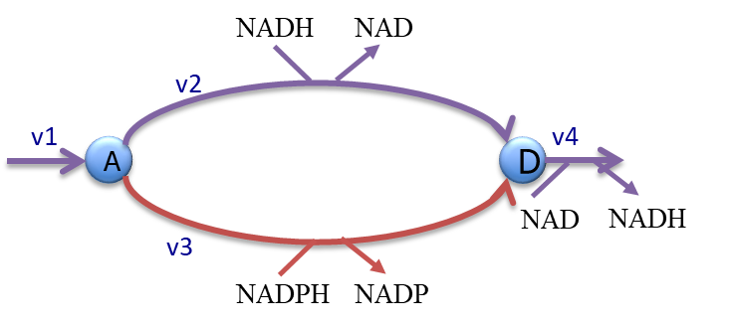

Look at a simple metabolic network
Build your own S matrix
on paper or whatever

Slide 23
Look at a simple metabolic network
Reaction v3 is a blocked reaction
Do you see any issues with this model?

Slide 24
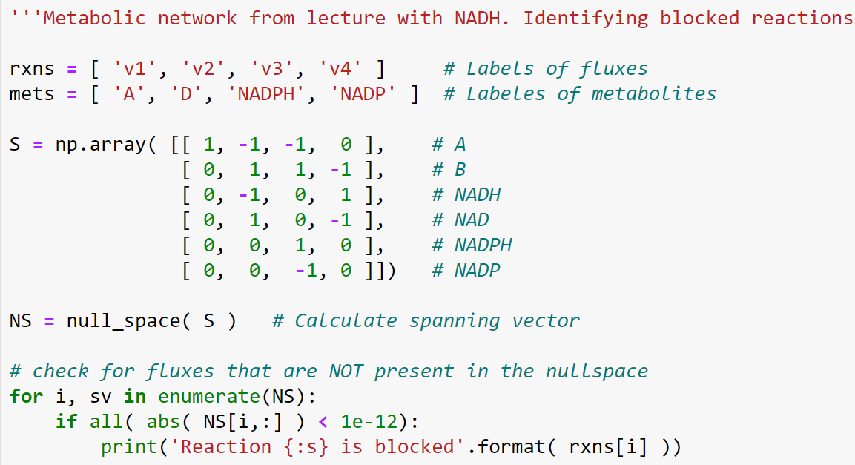

Blocked reactions
Formulate as mathematical question
Tool -> spanning vectors, the nullspace analysis
Are there reaction which cannot carry flux?

Slide 25

The Null Space
For a given matrix A, the null space is the set of all vectors x such that
A x = 0
where 0 is the zero vector.
Remember before…

Slide 26
Basic properties of a Network
Blocked Reactions

Slide 27
Look at a simple metabolic network
If v1 = 1
Can you solve v2, v3 and v4?

Slide 28
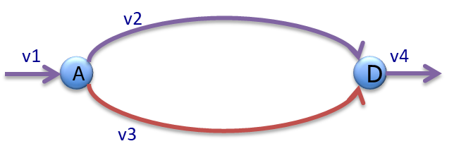
Look at a simple metabolic network
If v1 = 1
Can you solve v2, v3 and v4?

Slide 29
Non-identifiable fluxes
Fluxes that occur without any input to the system: e.g. internal cycles.

Slide 30
Detect non-identifiable fluxes
Reformulate to a mathematical question:
Add constraints: v1 = 0 (measured)
Find fluxes that although constraints are given (measurements) can be expressed as combination of non-zero vectors

Slide 31
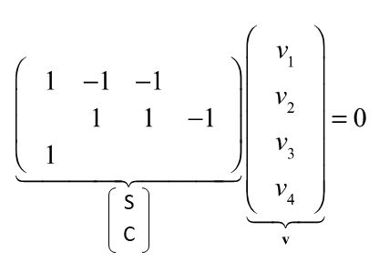
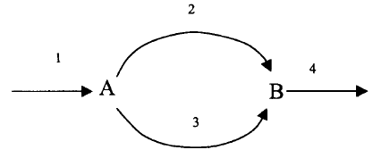
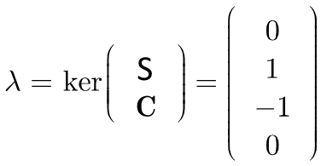
Detect non-identifiable fluxes
1
0
0
-1
Not all fluxes are 0!

Slide 32
Detect non-identifiable fluxes
1
0
0
-1
The internal cycle can run without any exchange reactions.

Slide 33
Basic properties of a Network
Blocked Reactions
Internal
Cycles

Slide 34
Metabolic Flux Analysis
3. Solving a Metabolic Model with Flux Balance Analysis

Slide 35
Back to our first model
Maximal malate production rate that could be achieved with this network?

Slide 36
Back to our first model
This model has 3 degrees of freedom.
If we set glucose uptake (v1) = 1 mmol/h, can we determine all the fluxes?
How can we define a flux solution?

Slide 37
Degrees of Freedom
For a network with n reactions and stoichiometric matrix S:
Degrees of freedom = n - rank(S)
It tells us how many fluxes we can freely choose while still satisfying steady state (S v = 0).

Slide 38
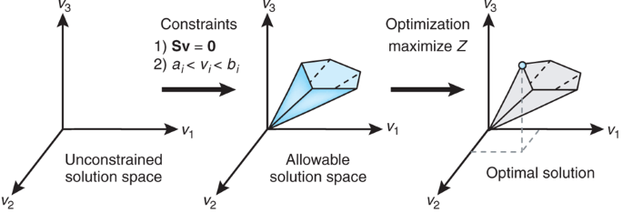
The solution space

Slide 39
The solution space
Upper and lower bounds of reactions.
Why would we (the modelers) constrain them?
Reversibilities
Observed rates
Knock outs

Slide 40

The solution space
Let’s set glucose uptake.

Slide 41
The solution space
And optimize for ethanol production.

Slide 42
The solution space
Let’s do it on our Jupyter notebooks.

Slide 43
Let’s look at two different optimization targets
And optimize for ethanol production.

Slide 44
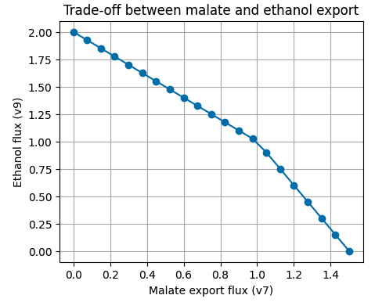
Let’s look at two different optimization targets
And optimize for ethanol production.

Slide 45
Metabolic Flux Analysis
3. Solving a Metabolic Model with Flux Balance Analysis

Slide 46
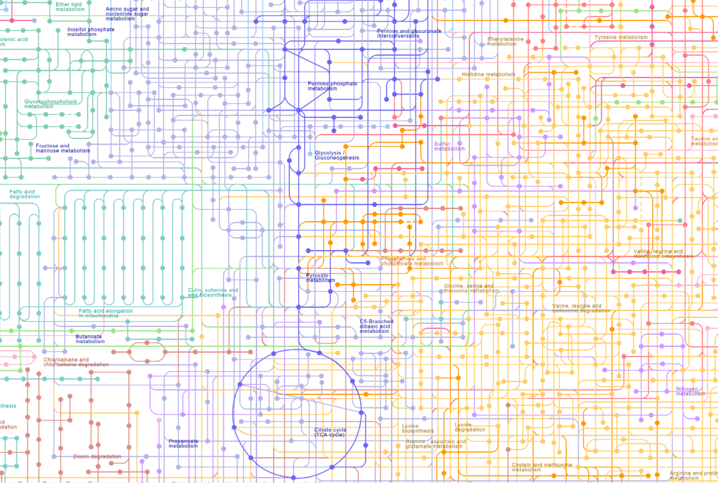
What should cells optimize?

Slide 47
What about a community of species?

Slide 48
Models including Biomass reaction
Biomass consists of
Proteins (10 – 90% of the dry matter)
Lipids (3 - 20%)
RNA (3-10 %)
DNA (0.5-3%)
Carbohydrates (1 – 40%)
Ions, Metals, Metabolites (<1%)

Slide 49
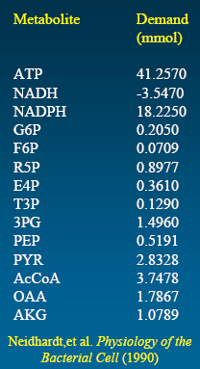
Biomass Production Optimization
Metabolic demands of precursors and cofactors required for 1g of biomass of E. coli
Classes of macromolecules:
Amino Acids, Carbohydrates
Ribonucleotides, Deoxyribonucleotides
Lipids, Phospholipids
Sterol, Fatty acids
These precursors are removed from the metabolic network in the corresponding ratios
We define a growth reaction
41.257 ATP + 18.225 NADPH + 0.205 G6P …. -> 1 BM + ….

Slide 50
Why can MFA be useful?
Some questions that can be addressed:
Which routes in the cell are used & how strong? e.g. split of carbon flux between glycolysis and the pentose-phosphate pathway would be difficult (or even impossible) to be determined from extracellular measurements only
Theoretical (maximum) yields for products and biomass from a given substrate
What is the full potential (all working possibilities) of a given metabolic network? e.g. a genome-scale metabolic model

Slide 51
Let’s explore a model
Escherichia coli core model.
Simulate maximum growth with oxygen, and then limiting oxygen uptake

