Slide 1


DEVELOPMENT PROPOSAL
Billig365
In-house infrastructure for complete technological independence
Customer
TP Global - Regional
status
In Progress

Slide 2





Our Current Strategic Challenge
Critical Latency
Microsoft's current workflows are experiencing significant slowdowns that are impacting daily tasks.
Document Management
The file upload and organization process is complex, manual, and susceptible to human error.
User friction Unintuitive interfaces increase the learning curve and generate resistance within work teams.
Migration Risk
Reliance on platforms that may be blocked or restricted during the future migration to Google.

Slide 3
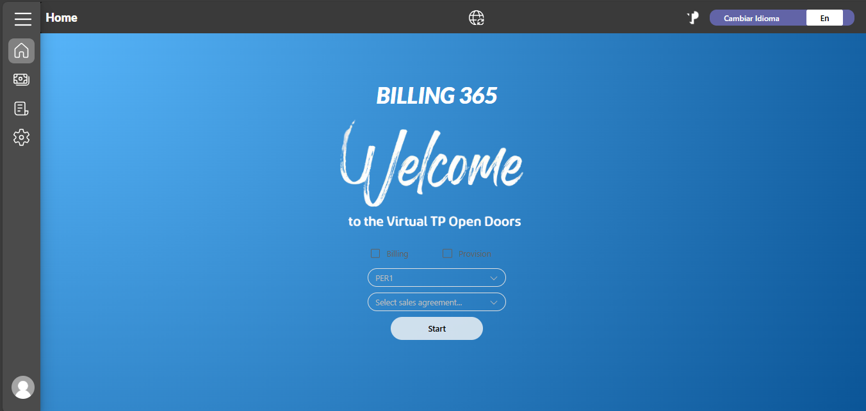
Technological Sovereignty
Build a robust and modern tool designed to be scalable and fully configurable outside of cloud services.
Cloud Decoupling: Full independence from Microsoft/Google environments
Strategic Anticipation: Prepared today for tomorrow’s migration
Business Continuity: Minimizing the impact on current developments.

Slide 4
Design Pillars
VERSATIlity
scalability
maintainability
A flexible architecture capable of pivoting quickly in response to regulatory or business changes
Configurable by Country.
A single core with multiple local regulatory and legislative configurations.
A clean and modular codebase designed for adaptability and easy maintenance
Peru (Fase I)
Colombia (Fase I)
Rollout Global

Slide 5

Data Intelligence
Big Data
Optimized system architecture designed to scale to millions of records while maintaining consistent performance
Multi-Tenant & Multi-Source
Ability to connect simultaneously to several database servers located across different regions
Document Federation
Documentation resides on servers managed by each department, while only the metadata is centralized

Slide 6




Modern Stack
Technology choices guided by the principles of performance, security, and efficiency
TP - Process Automation
Backend: Django
High‑security standards, rapid development cycles, and a well‑established ecosystem.
Frontend: Angular
A solid enterprise architecture featuring strict typing and modular, reusable components.
Projected development duration: around 6 months, give or take

Slide 7
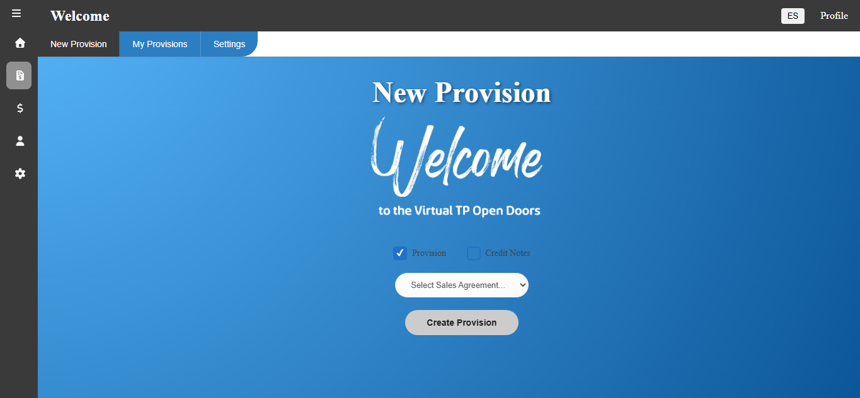

Slide 8
TP - Process Automation
Thanks!
Billig365 goes beyond being a software solution; it represents a strategic capability for the company

