Slide 1
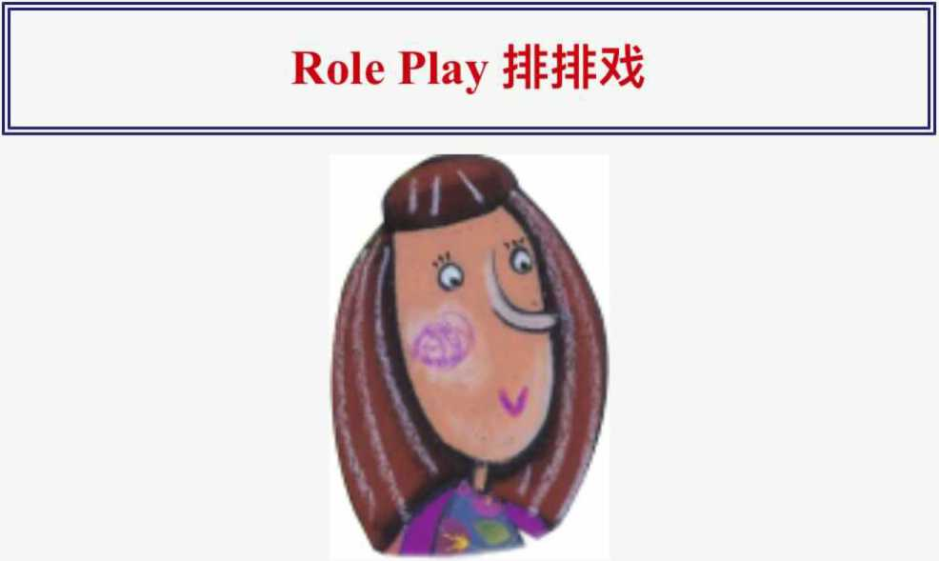
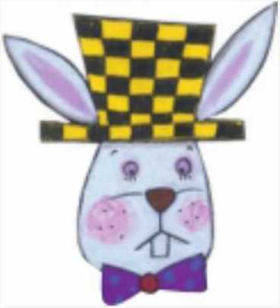
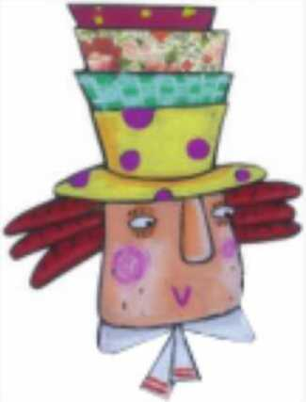
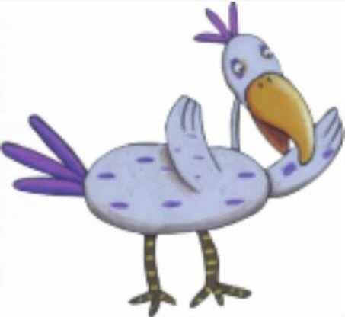
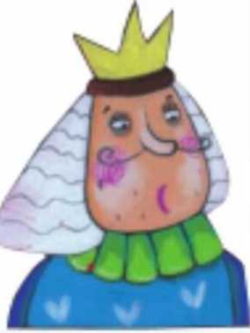
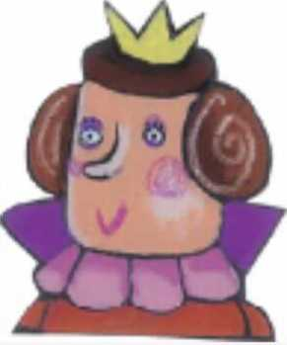
爱丽丝
白兔
帽匠
渡渡鸟
国王
女王

Slide 2
无赖
睡鼠
三月兔
第一幕下兔子洞
（爱丽丝很无聊。那时，一只白兔从她身边跑过。）
白兔:哦！我要迟到了！
爱丽丝:（兴奋地）一只会说话的兔子！我简直不敢相信。（白兔跳进一个洞里，爱丽丝跟着他。）（砰！爱丽丝在一个长长的门厅里，有许多锁着的门。）
爱丽丝（WJR）:（好奇地）我在哪里？哦，这是什么？（爱丽丝从一张玻璃桌上拿起一把小金钥匙。）（打开一扇门）钥匙打开了这扇小门。（透过门口看）多漂亮的花园啊！我想进花园，但是我太大了。（环顾四周）哦，那个瓶子上面写着“喝我”。（从瓶子里喝）哦，我越来越小了！我小得可以穿进门，但是门上锁了！（再环顾四周）那个蛋糕盒上面写着“吃男人”（吃一块蛋糕）哦，不！我越来越大了！现在我太大了！我不能进花园！

Slide 3
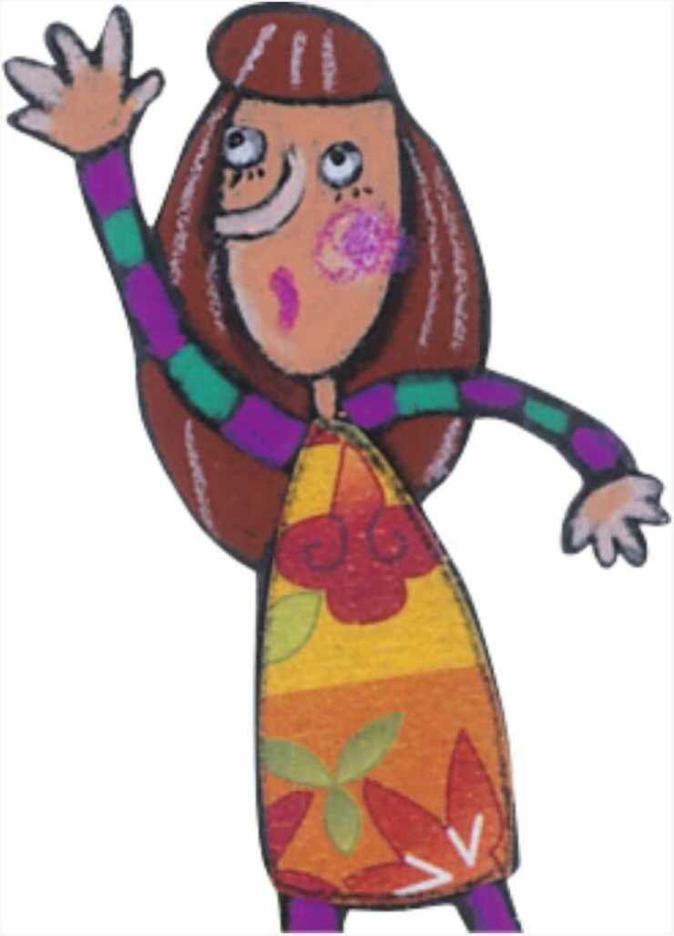
（爱丽丝哭了起来。很快她的眼泪就变大了
泳池。突然，白兔从爱丽丝身边跑过。）
（轻声）先生，请帮帮我。（白兔大吃一惊，丢下手套和扇子跑开了。）
很热！（爱丽丝拿起手套和扇子开始扇自己。）哦，我又变小了！
（爱丽丝跑去拿钥匙，却滑进了自己的泪池。）（爱丽丝看见一只小老鼠在水里泼水。老鼠和爱丽丝游到岸边。岸上坐着许多奇怪的鸟兽。每个人都湿透了。）
多多:让我们来一场党团竞赛吧！那会让我们干涸的。（飞禽走兽围着圈跑。）停下来！比赛结束了！每个人现在都干了
爱丽丝（WJR）:（悲伤地）我想念黛娜
朵朵:黛娜是谁？
爱丽丝:黛娜是我的猫。她是个很棒的猎鸟人哦
我很抱歉。
（所有的鸟兽都离开了•爱丽丝又一个人了。）

Slide 4
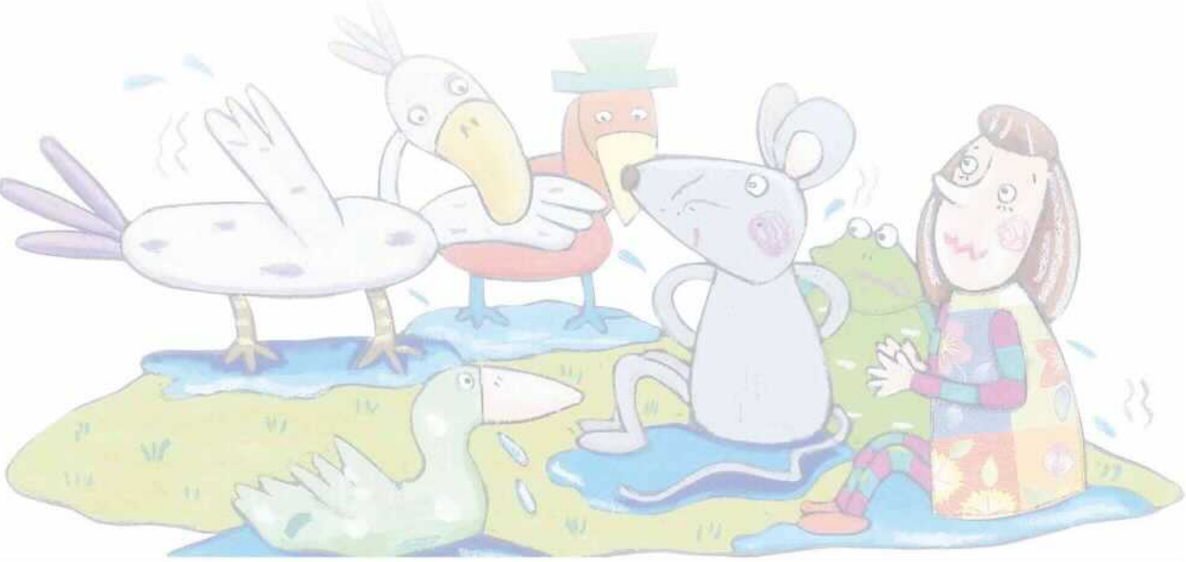
第二幕疯狂的茶话会
三月兔和帽匠在树下喝茶
他们正把胳膊肘搁在一只熟睡的睡鼠身上。）
爱丽丝:我可以坐下吗？
马奇:（生气地）不，你不能。没有地方了！
艾丽斯（WJR）:（坐下来）有很多地方！（帽匠拿起他的手表看了看。）
帽子:（转向爱丽丝）今天星期几？
爱丽丝（WJR）:今天是星期三
帽匠:（伤心地）哦，我的表说星期一！
爱丽丝（WJR）:真奇怪。表告诉你日期，但它不告诉你时间

Slide 5
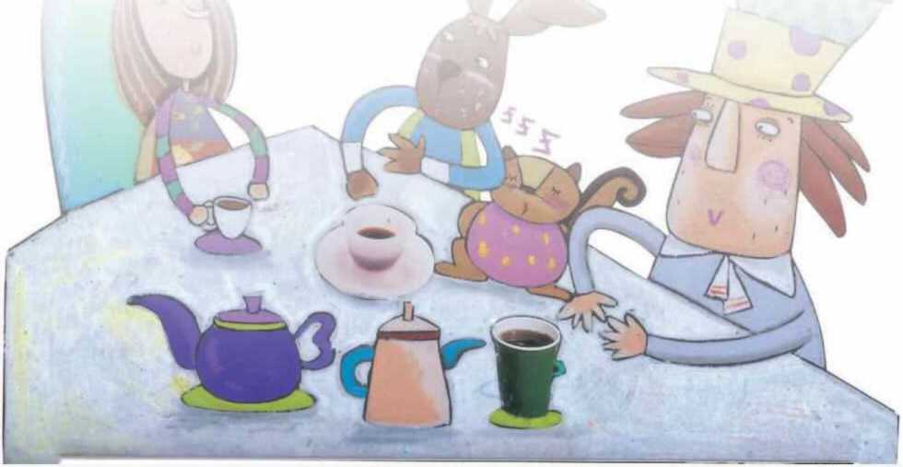
帽匠:
你这么认为吗？那你的表告诉你年份吗？
艾丽斯:没有，但很长一段时间都是同一年
哈特:而且我的表不报时间，因为现在总是喝茶时间
爱丽丝（WJR）:（自言自语）嗯，我真的不明白
March Hare&Hatter:睡鼠，我们很无聊。给我们讲个故事！
Dormouse:(sleepily) Once upon a time, there were three sisters.
Their names were Elsie, Lacie, and Tillie.They were learning to draw.
Alice(WJR): What did they draw?

Slide 6
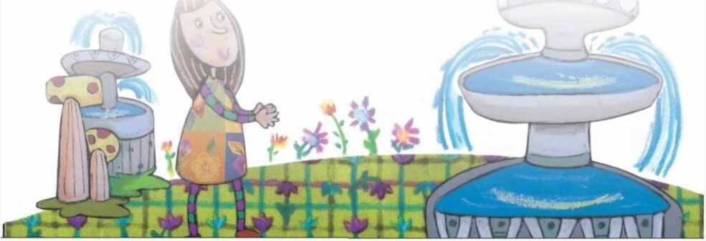
Dormouse: (yawning) They drew things beginning with the letter M.Like mousetraps, the moon, and muchness.(The Dormouse falls asleep.)
Alice(WJR): What is muchness? (Nobody answers.)I've never heard of muchness!This is a stupid tea party! (Alice gets up and walks away.)(Alice sees a big tree with a door in it.)
Alice(WJR): How strange! Anyway, I'll go into the door.
(Alice is back in the long hallway again.)(excitedly) Now I can get the key, unlock the door, and go into the garden!

Slide 7
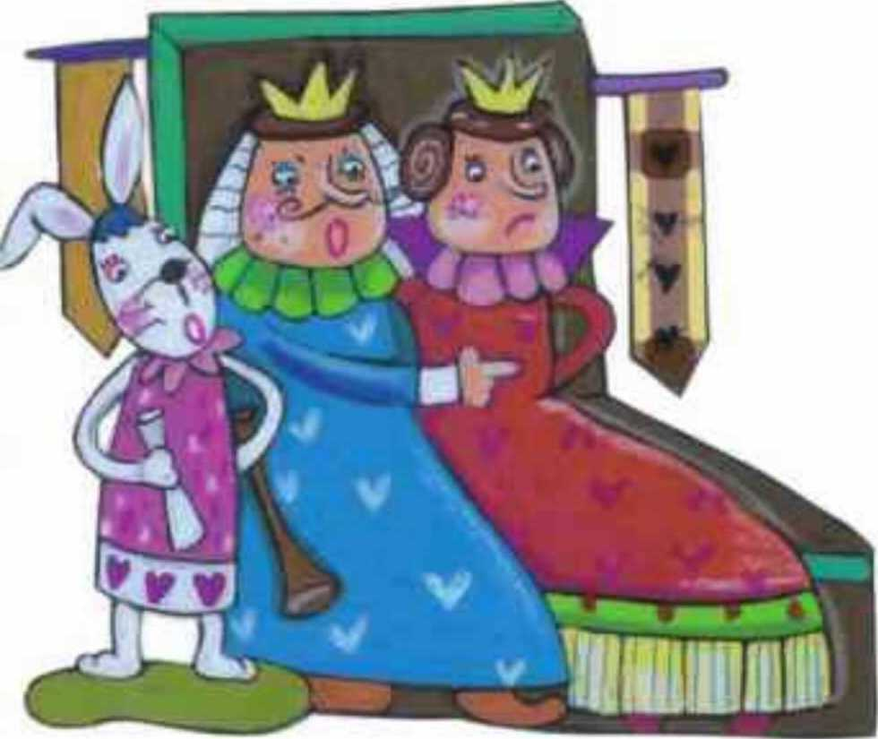
Act III Who Stole the Tarts?
(In the garden, there are the King and Queen of Hearts, many little birds and animals, and a pack of cards.The Knave of Hearts is standing in chains before the King and Queen.The White Rabbit is standing next to the King.In the middle of the room, there is a large dish of tarts.)
Alice(WJR): Ah-ha! This must be a courtroom!Maybe the Knave of Hearts stole some tarts.The King must be the judge and the twelve birds and animals must be the jury.
King: (loudly) Read the paper!
White Rabbit:(blows his trumpet three times)The Queen of Hearts, she made some tarts, all on a summer day;The Knave of Hearts, he stole those tarts, and took them quite away.
Queen:Cut off the Knave of Hearts¹ head!
White Rabbit:Not yet, not yet! We have to call people and ask them questions.

Slide 8
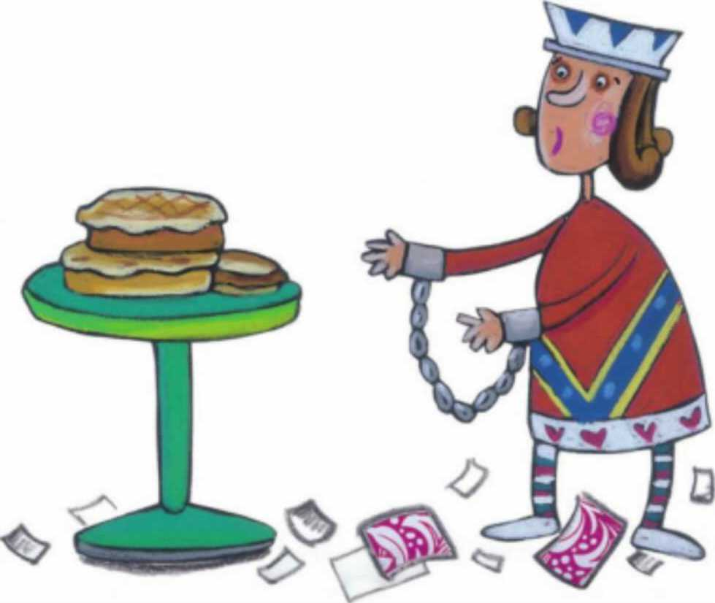
(The White Rabbit blows his trumpet three times and shouts a name.)
The Hatter!
(The Hatter comes in with a teacup and some bread- and-butter.)
King: Take off your hat!
Hatter: (shivering) It's not mine.
King: (angrily) Stolen!
Hatter: (nervously) No, no! I keep hats to sell. I'm a hatter.
King: (angrily) Don't be afraid, or Ill cut off your head!(The Hatter says something, but nobody could understand him.)You can go.
(Alice is getting bigger again.)
Dormouse: Oh, I can't breathe! You're growing too fast.
Alice(WJR): I can't help it! (The Dormouse suddenly falls asleep.)
King: Call the next person!
White Rabbit: Alice!

Slide 9
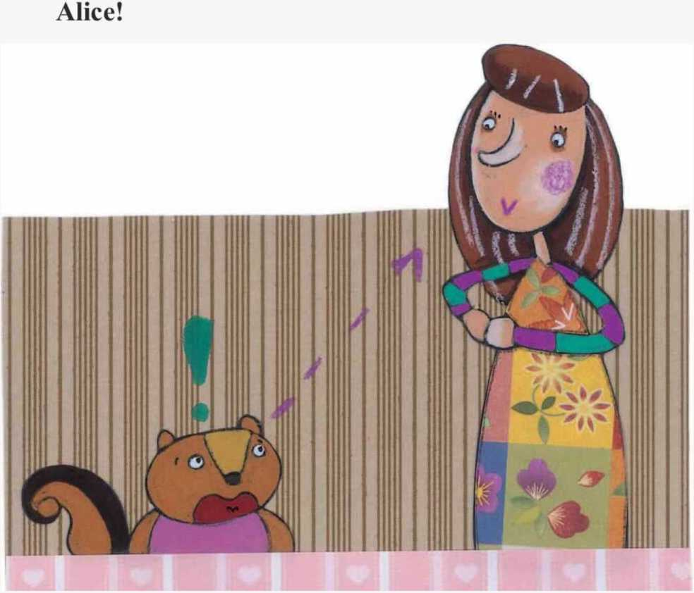
Act IV Alice's Evidence
(Alice is standing in front of the King and Queen.)
King:What do you know about these tarts?
Alice(WJR): Nothing.(The King looks at Alice carefully.)
King:Rule forty-two! All people over a mile high mustleave the court.
Alice(WJR): I'm not a mile high, so I'm not leaving! You made that rule just now.
King:That's the oldest rule in the book.
Alice(WJR): Then it should be Rule Number One! (The King's face goes white, but he says nothing.)
White Rabbit:(waving a piece of paper) Oh, we've just found this letter.

Slide 10
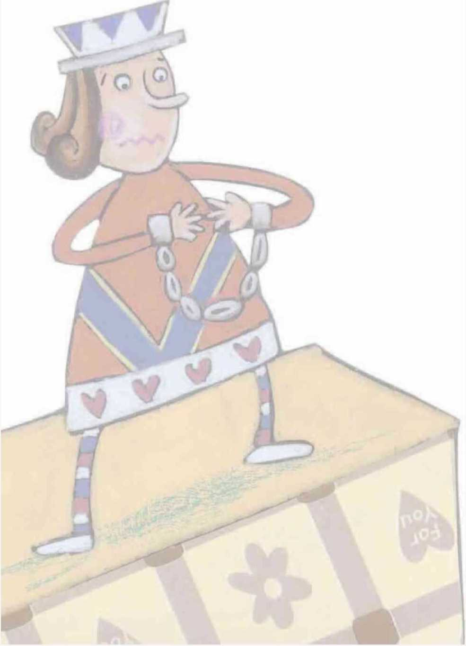
Queen:Maybe the Knave wrote it.
Knave:I didn't. There’s no name signed!King:Didn't you? It only makes the matter worse.You did a bad thing or you'd have signed your name like an honest man.

Slide 11
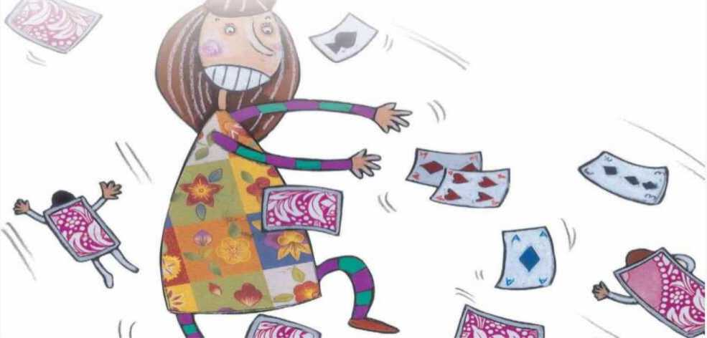
Queen: Read the letter to us, right now!(The White Rabbit reads it, but it is just a poem.)
King: Oh, that's a very important piece of evidence.
(turning to the jury) Now, you must......
Alice(WJR): No, no! (turning to the jury) It doesn't mean anything.(The jury is quite confused.)
King: Now the jury must decide who the thief is.
Queen: No! Off with the Knave's head! The jury can say
what it thinks later.
Alice(WJR): (turning to the Queen) How foolish you are!
The jury must decide first!
Queen: Be quiet! Off with her head!
Alice(WJR): I'm not afraid at all. You're only a pack of cards! (The whole pack of cards rises up. They come flying down upon Alice.) Ahhhhhhh! (Alice wakes up and sees her sister.)
Alice(WJR): Oh, I had a dream. It was strange but exciting.

