Slide 1
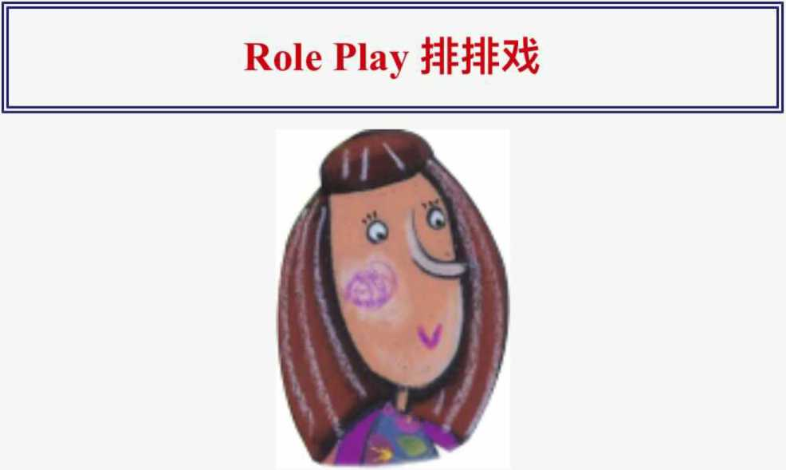
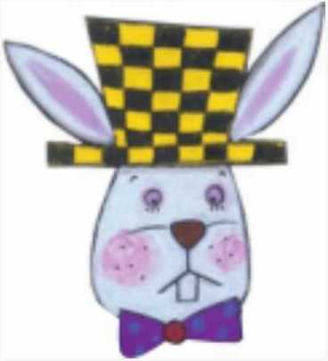
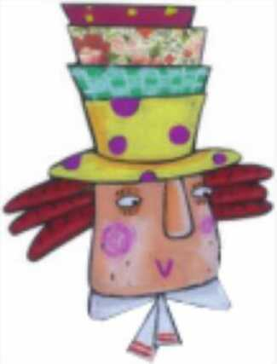
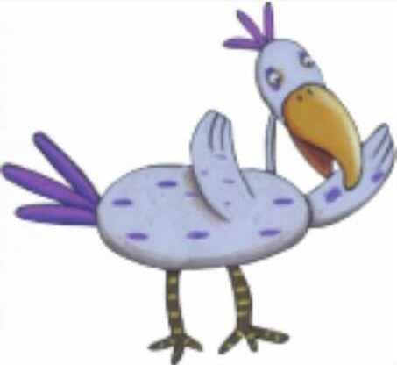
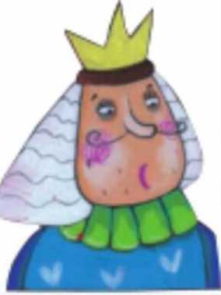
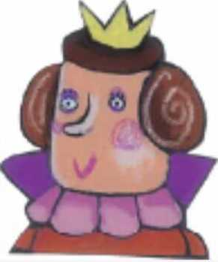
Alice爱丽丝
White Rabbit 白兔
Hatter帽匠
Dodo渡渡鸟
King国王
Queen王后

Slide 2
Knave杰克
Dormouse 腫鼠
March Hare三月兔
Act I Down the Rabbit Hole
(Alice is very bored. At that time, a white rabbit runs by her.)
White Rabbit:Oh! Tin going to be late!
Alice(WJR): (excited) A talking rabbit! I can^{f}t believe it.(The White Rabbit jumps into a hole, and Alice follows him.)(Thump! Alice is in a long hallway with many locked doors.)
Alice(WJR):(curiously) Where am I? Oh, what is this?(Alice picks up a small golden key from a glass table.)(opening a door) The key unlocks this small door.(looking through the doorway) What a beautiful garden!I want to go into the garden, but I am too big.(looking around) Oh, that bottle says "DRINK ME” on it.(drinking from the bottle) Oh, I'm getting smaller and smaller!I'm small enough to fit through the door, but it's locked!(looking around again) That cake box says "EAT ME^{n} on it (eating a piece of cake) Oh, no! I'm getting bigger and bigger!Now I'm too big! I can't go into the garden!

Slide 3
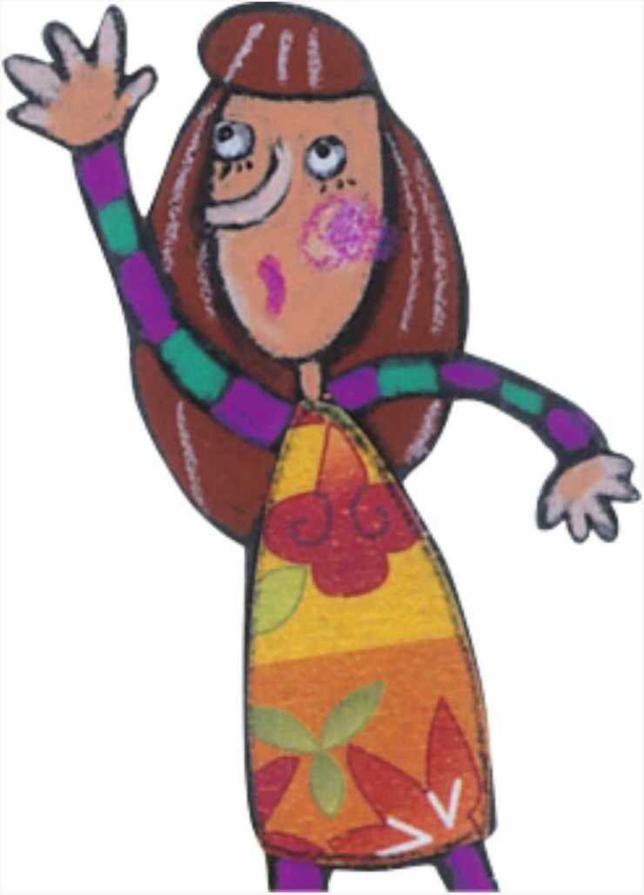
(Alice starts crying. Soon her tears make a big
pool. Suddenly, the White Rabbit runs by Alice.)
(softly) Please, sir Help me. (The White Rabbit is surprised.He drops his gloves and fan and runs away.)
It's very hot!(Alice picks up the gloves and fan and starts to fan herself.)Oh, I'm growing small again!
(Alice runs to get the key, but she slips into the pool of her own tears.) (Alice sees a little mouse splashing in the water.The Mouse and Alice swim to the shore.Many strange birds and animals sit on the shore . Everyone is wet.)
Dodo: Let's have a Caucus Race! That will make us dry. (The animals and birds run in a circle.) Stop! The race is over! Everyone is dry now.
Alice(WJR): (sadly) I miss Dinah.
Dodo: Who is Dinah?
Alice(WJR): Dinah is my cat. She is a great bird hunter 一 Oh,
I am sorry.
(All the birds and animals leave • Alice is alone again.)

Slide 4
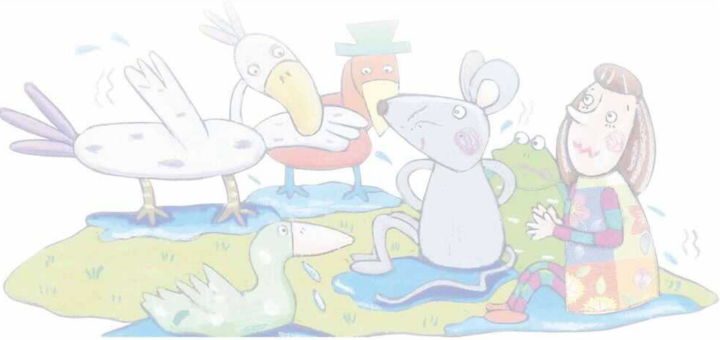
Act II A Mad Tea Party
(The March Hare and Hatter are having tea under a tree.
They are resting their elbows on a sleeping Dormouse.)
Alice(WJR): May I sit down?
March Hare & Hatter: (angrily) No, you may not. There's no room!
Alice(WJR): (sitting down) There's plenty of room!(The Hatter takes his watch and looks at it.)
Hatter: (turning to Alice) What day is it?
Alice(WJR): It is Wednesday.
Hatter: (sadly) Oh, my watch says Monday!
Alice(WJR): That's strange. The watch tells you the day, but it doesn't tell you the time.

Slide 5
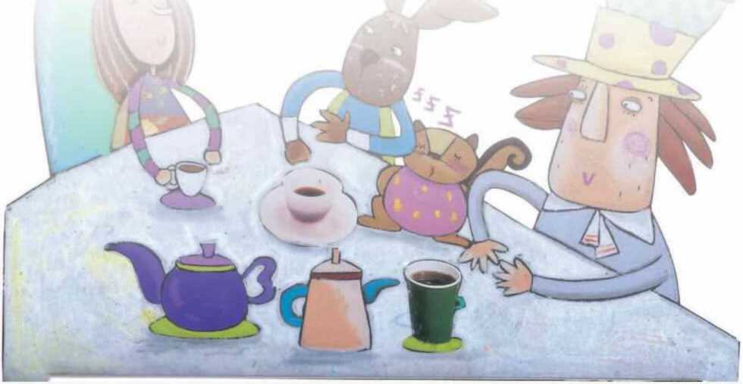
Hatter:
Do you think so? Then does your watch tell you the year?
Alice(WJR): No, but it's the same year for a very long time.
Hatter: And my watch doesn't tell the time because it's always tea-time.
Alice(WJR): (saying to herself) Well, I don't really understand.
March Hare & Hatter：Dormouse, we are bored. Tell us a story!
Dormouse:(sleepily) Once upon a time, there were three sisters.
Their names were Elsie, Lacie, and Tillie.They were learning to draw.
Alice(WJR): What did they draw?

Slide 6
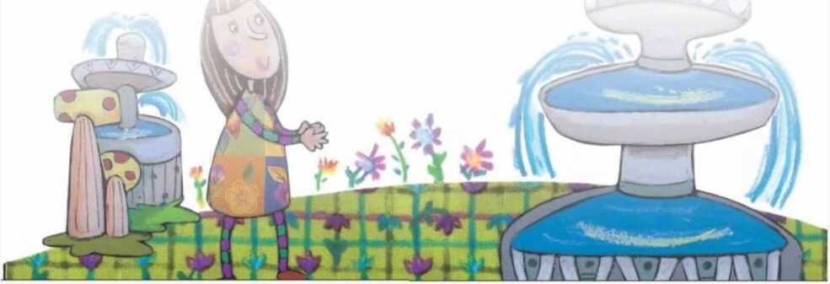
Dormouse: (yawning) They drew things beginning with the letter M.Like mousetraps, the moon, and muchness.(The Dormouse falls asleep.)
Alice(WJR): What is muchness? (Nobody answers.)I've never heard of muchness!This is a stupid tea party! (Alice gets up and walks away.)(Alice sees a big tree with a door in it.)
Alice(WJR): How strange! Anyway, I'll go into the door.
(Alice is back in the long hallway again.)(excitedly) Now I can get the key, unlock the door, and go into the garden!

Slide 7
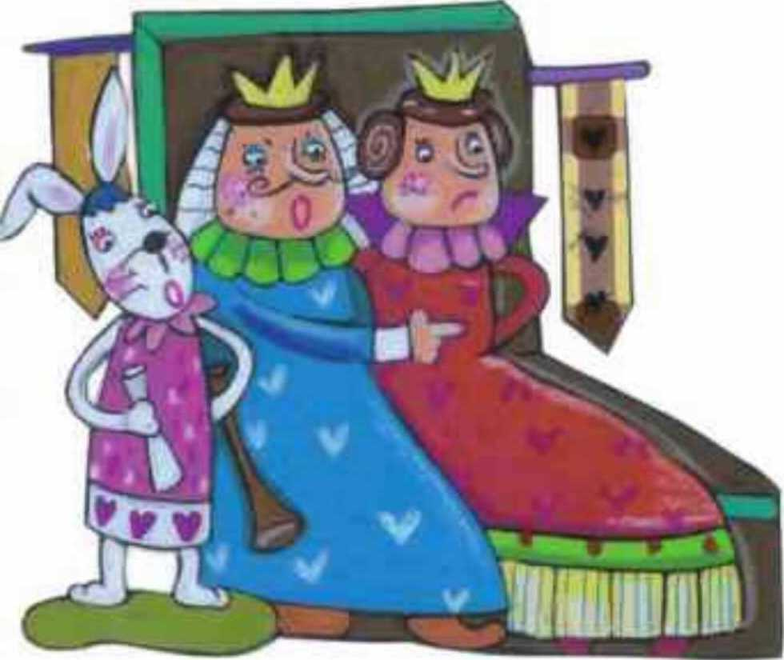
Act III Who Stole the Tarts?
(In the garden, there are the King and Queen of Hearts, many little birds and animals, and a pack of cards.The Knave of Hearts is standing in chains before the King and Queen.The White Rabbit is standing next to the King.In the middle of the room, there is a large dish of tarts.)
Alice(WJR): Ah-ha! This must be a courtroom!Maybe the Knave of Hearts stole some tarts.The King must be the judge and the twelve birds and animals must be the jury.
King: (loudly) Read the paper!
White Rabbit:(blows his trumpet three times)The Queen of Hearts, she made some tarts, all on a summer day;The Knave of Hearts, he stole those tarts, and took them quite away.
Queen:Cut off the Knave of Hearts¹ head!
White Rabbit:Not yet, not yet! We have to call people and ask them questions.

Slide 8
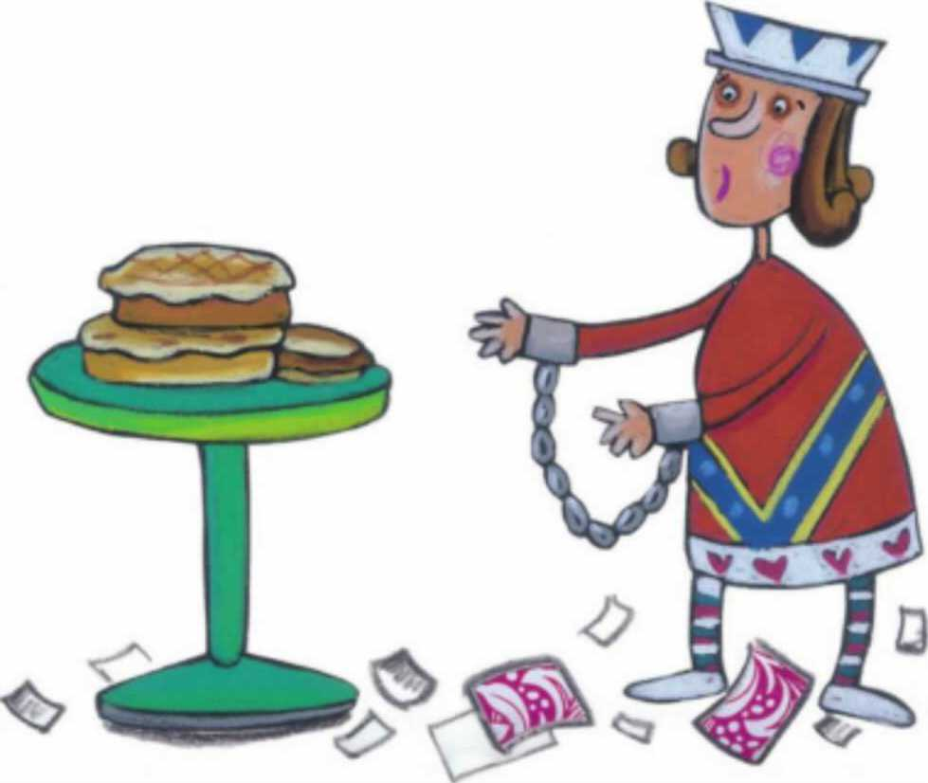
(The White Rabbit blows his trumpet three times and shouts a name.)
The Hatter!
(The Hatter comes in with a teacup and some bread- and-butter.)
King: Take off your hat!
Hatter: (shivering) It's not mine.
King: (angrily) Stolen!
Hatter: (nervously) No, no! I keep hats to sell. I'm a hatter.
King: (angrily) Don't be afraid, or Ill cut off your head!(The Hatter says something, but nobody could understand him.)You can go.
(Alice is getting bigger again.)
Dormouse: Oh, I can't breathe! You're growing too fast.
Alice(WJR): I can't help it! (The Dormouse suddenly falls asleep.)
King: Call the next person!
White Rabbit: Alice!

Slide 9
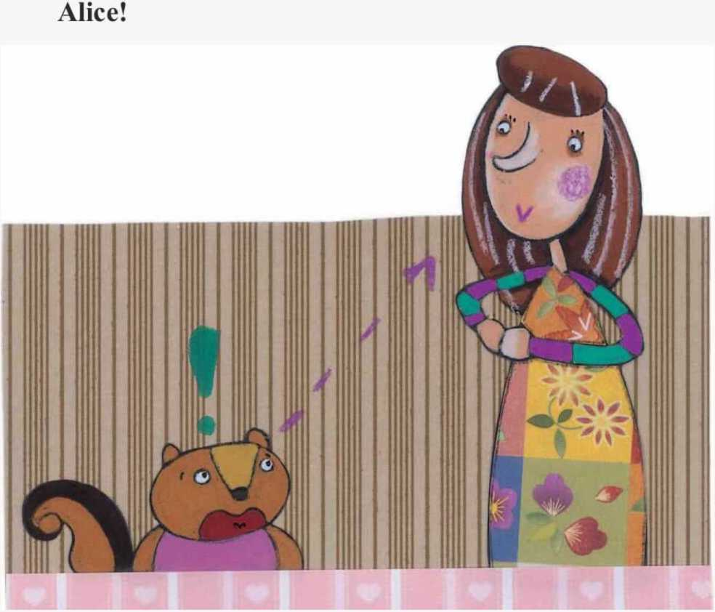
Act IV Alice's Evidence
(Alice is standing in front of the King and Queen.)
King:What do you know about these tarts?
Alice(WJR): Nothing.(The King looks at Alice carefully.)
King:Rule forty-two! All people over a mile high mustleave the court.
Alice(WJR): I'm not a mile high, so I'm not leaving! You made that rule just now.
King:That's the oldest rule in the book.
Alice(WJR): Then it should be Rule Number One! (The King's face goes white, but he says nothing.)
White Rabbit:(waving a piece of paper) Oh, we've just found this letter.

Slide 10
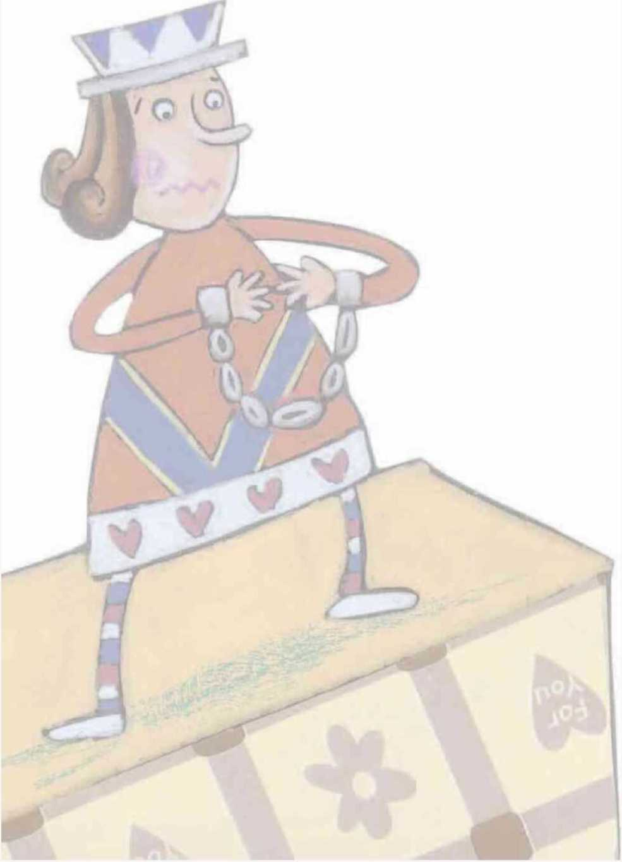
Queen:Maybe the Knave wrote it.
Knave:I didn't. There’s no name signed!King:Didn't you? It only makes the matter worse.You did a bad thing or you'd have signed your name like an honest man.

Slide 11
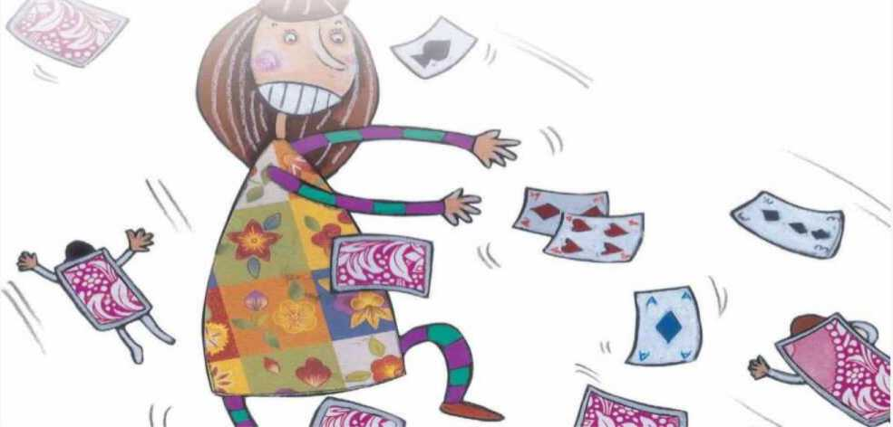
Queen: Read the letter to us, right now!(The White Rabbit reads it, but it is just a poem.)
King: Oh, that's a very important piece of evidence.
(turning to the jury) Now, you must......
Alice(WJR): No, no! (turning to the jury) It doesn't mean anything.(The jury is quite confused.)
King: Now the jury must decide who the thief is.
Queen: No! Off with the Knave's head! The jury can say
what it thinks later.
Alice(WJR): (turning to the Queen) How foolish you are!
The jury must decide first!
Queen: Be quiet! Off with her head!
Alice(WJR): I'm not afraid at all. You're only a pack of cards! (The whole pack of cards rises up. They come flying down upon Alice.) Ahhhhhhh! (Alice wakes up and sees her sister.)
Alice(WJR): Oh, I had a dream. It was strange but exciting.

