Slide 1



Team WwW
Deep-Greedy-Decision
队伍成员：谢国超 郝森跃 莫子恒
指导教师：李钰鹏

Slide 2
Content
First Part
Second Part
Third Part
Algorithm Design and Analysis
Performance Analysis
Future Work

Slide 3

Algorithm Design and Analysis

Slide 4


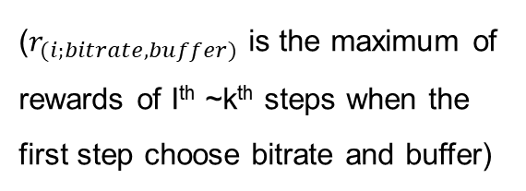
Solution Framework
ABR
model
combination
bitrates
target buffer
$$\sum_{i=1}^{k}{r_{(i;bitrate,buffer)}α^{i}}$$
argmax
bitrate
buffer
The best bitrate and buffer as decision
……..
reward
reward
reward
last state
reward
s_time_interval[-1]
s_buffer_size[-1]
s_end_delay[-1]
Generate
($r_{(i;bitrate,buffer)}$ is the maximum of rewards of Ith ~k^{th} steps when the first step choose bitrate and buffer)
……

Slide 5

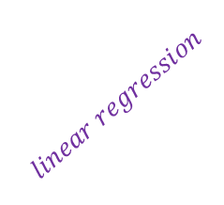
Training Models
Train model
random
bitrates
target buffer
Choose
(i+1)^{th}
environment
decision
s_time_interval[-1]
s_buffer_size[-1]
s_end_delay[-1]
i^{th}
environment
Generate
$$linear regression$$
……
Record input
Record QoE
$$linear regression$$

Slide 6
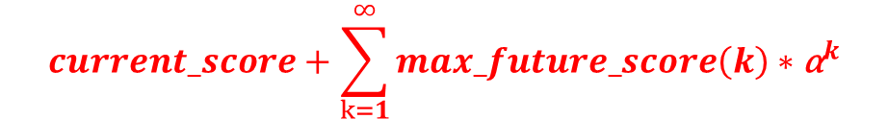

Execution
$$current_score+\sum_{k=1}^{∞}{max_future_score\left(k\right)∗{\text{α}}^{k}}$$
Assume we have:
n bitrates
m target buffer.
……
-0.4
2.1
Total score = 5
1.0
n * m score models
2.9
0.3
2.4
0.7
……
-2.6
2.7
Total score = 3.9
1.9
n * m score models
……..
……..
${\text{(}\text{n}\text{ ∗ }\text{m})}^{k}$ score models
1.2
n * m score models
……
max_future_source(k)
-1.1
Root stage
-0.9
2.4
Total score = 1.2
……
0.3
2.3
n * m score models
-1.2
0.6
Depth 1
0.5
-1.8
current_score
Depth 2
k-2 steps of recursions
Depth k-1
Depth k

Slide 7
Discrete value of target buffer
Training part needs definite bitrates and target buffer
Decision time is limited
The number of target buffer ↑
time to determine. ↑
choices for target buffer were two discrete values in the preliminary
Why discrete value for buffer
lengths?
The value chosen for target buffer
Since during the final, every 0.5s, our algorithm needs to respond, the value over 3 for target buffer is hardly chosen.
First, choose uniformly in [0, 4]
Then, choose in {0.2, 0.3, 0.5, 0.8, 1.5, 3.0}

Slide 8
The value of k —— depth of recursion
when k -> infinite, performance -> optimal
Time efficiency is unacceptable. (×)
How to choose value of k?
decrease value of k
Running time ↓. (√)
Optimize for limited future states. (×)
Increase the switching frequency. (×)

Slide 9
Linear Regression
Converge well and flexibility for training
By our experiments:
NN usually converges to a constant no matter what input is. (×)
Try our best to implement SVR, but still cannot converge after a whole day night training. (×)
Reasons for using linear regression
Avoid overfitting
Instead of NN or SVR, the property of linear regression avoids overfitting.
Fit model well
current score (QoE) | next state (QoE)
0.79 | 0.97
0.86 | 0.98
0.95 | 0.99
0.96 | 0.99
0.97 | 0.99
The rate for fitting are all over about 0.8, which means that linear regression model works.

Slide 10
Performance Analysis

Slide 11
How to determine the number of choices
Conclusion:
10 choices will get higher QoE during our experiments.
Conclusion:
Running time goes exponentially as the number of choices increases.

Slide 12
Future Work

Slide 13
Branch and Bound
Set a upper bound for each model to calculate the maximum QoE under some choice, if it is already smaller than known max value, then dismiss this model.
Parallel Computing
Use parallel computation techniques in practical system to improve the efficiency of the algorithm, e.g., to speed up the computation for different choices in each state.
Future Work
More information helps
(cross layer design)
With more information for the coming video, the model-based solution can perform better. We can try to establish API to acquire such information in practice.

Slide 14
Team WwW
Thank You
队伍成员：谢国超 郝森跃 莫子恒
指导教师：李钰鹏

Slide 15
Team WwW
Q & A

Slide 17
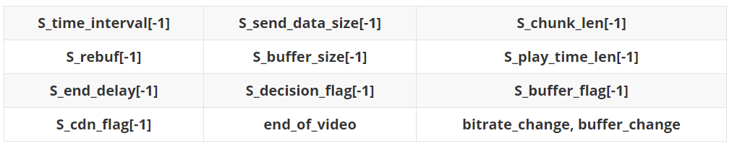
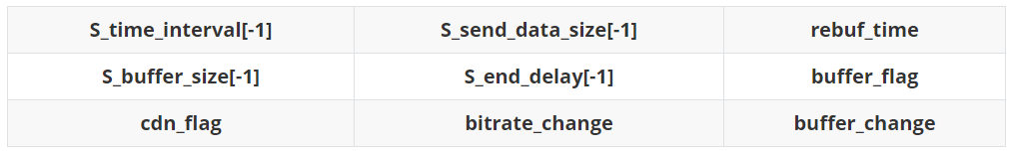
Main Idea
Parameters fed into
ABR

Slide 18
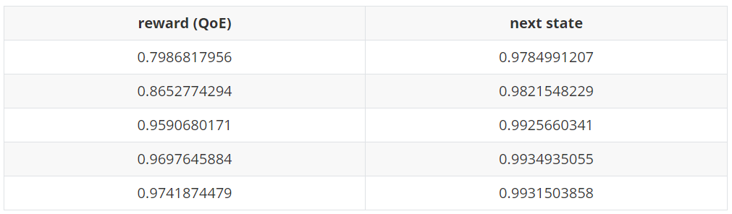
Off-line Training
Repeating randomly decision
Over 10⁸ pieces of data
Advantages
Linear Regression
Never overfitting
Replace independent variables by their average value to decrease their affects.

Slide 19
Branch and Bound
Cut the lower combination decision, when the deviation is over a specific value(experiments and experience).
Parallel Computing
Future Work
Implement parallel computing in reality to help calculate score for each state under different choices.
More information helps
(cross layer design)
With more information for the coming video, the model-based solution can perform better. We try to establish API to acquire such information in practice

