Slide 2
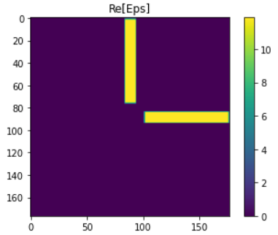
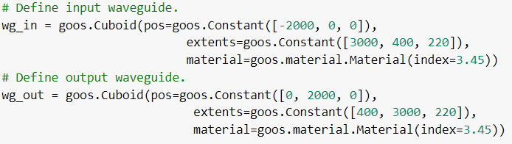
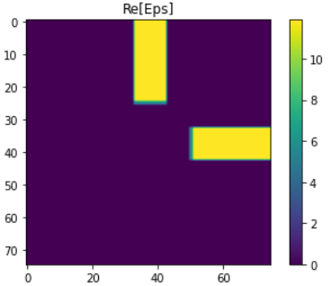
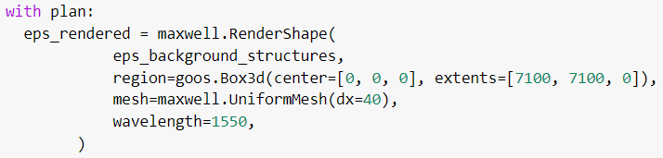
SPINS-B code: structure – 1
+Y
+X
3000
(-2000,0)
Define background structure
(0,0)
center of structure
(x, y, z)
7100
(177.5 pix 7100/40)
width, height, thickness

Slide 3


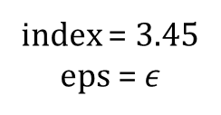
SPINS-B code: structure – 2
Permittivity = 11.9025
Value on the graph
index = 3.45
eps = $ε$
spins\goos\material.py
Half of Permittivity ? = 5.95125

Slide 4
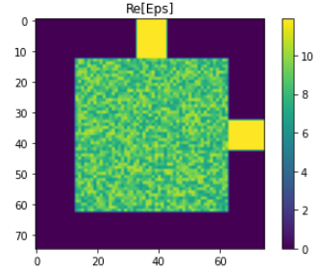
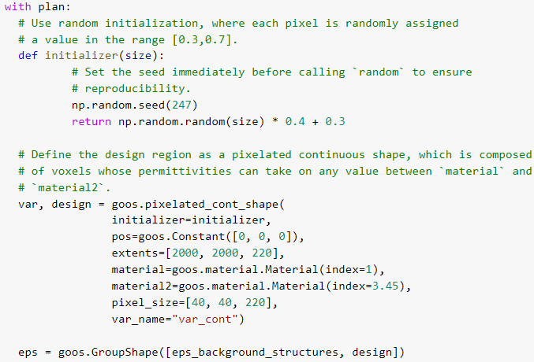

SPINS-B code: structure – 3
Randomly generated initial structure
Random Distributed Permittivity ? =
$$\left(1−t\right)∗index_{1}^{2}+t∗index_{2}^{2}$$

Slide 5
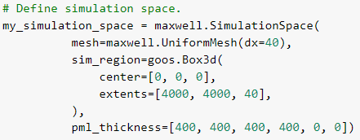
SPINS-B code: EM solver – 1
PML: perfectly matched layer.
PML boundaries are basically implemented as an absorbing material that is also impedance matched to the surrounding materials, to minimize reflections.
--Lumerical

Slide 6
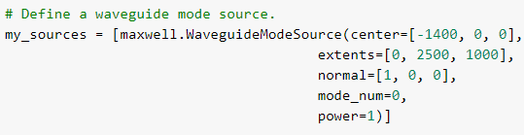
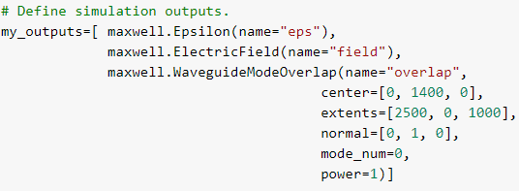
SPINS-B code: EM solver – 2
normal = [0, 1, 0]
?
normal = [1, 0, 0]
extents: Width and height of waveguide mode region.
normal: Normal direction and mode propagation direction of the waveguide.
mode_num: The mode with largest propagation constant is mode 0, the mode with second largest propagation constant is mode 1, etc.
power: The transmission power of the mode.

Slide 7
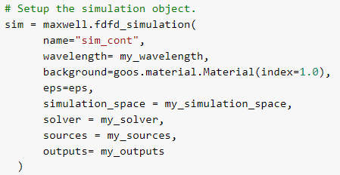
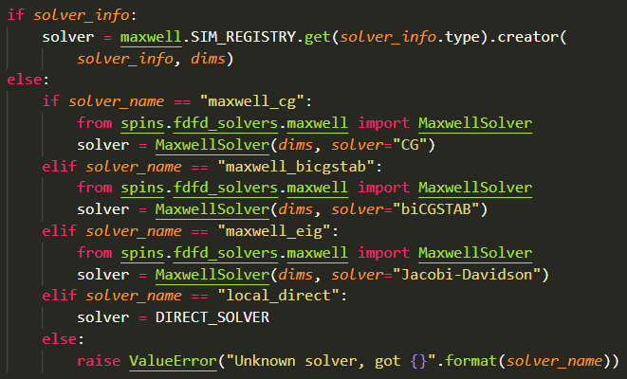
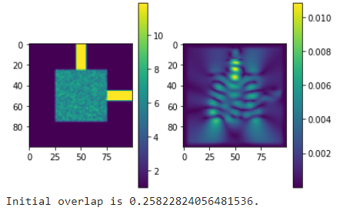


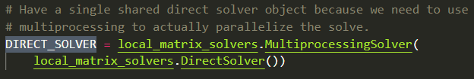
SPINS-B code: EM solver – 3
spins\goos_sim\maxwell\simulate.py
c†E computes the modal overlap of the electric field E with the target mode c at the output port of the device. (unit?)

Slide 8
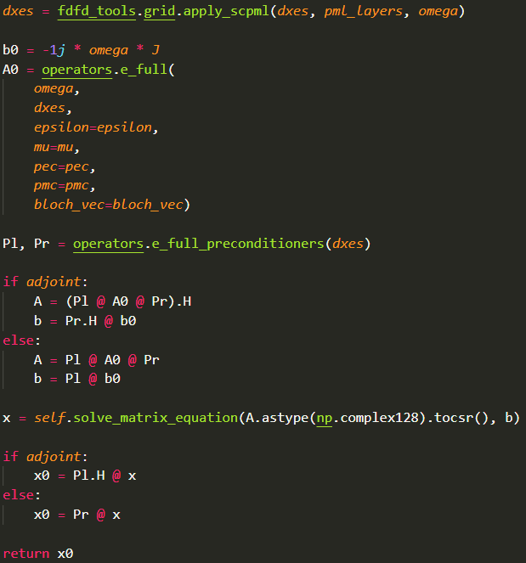
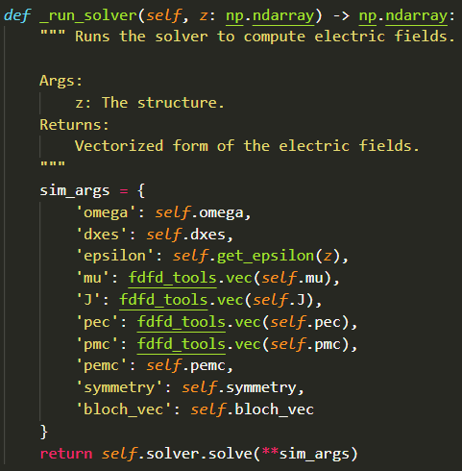
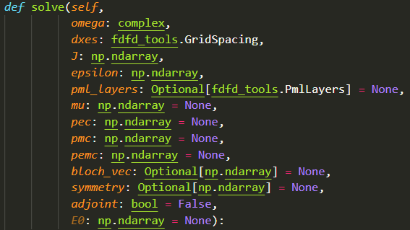
SPINS-B code: EM solver – 4
spins\invdes\problem\simulation.py
spins\fdfd_solvers\local_matrix_solvers.py

Slide 9
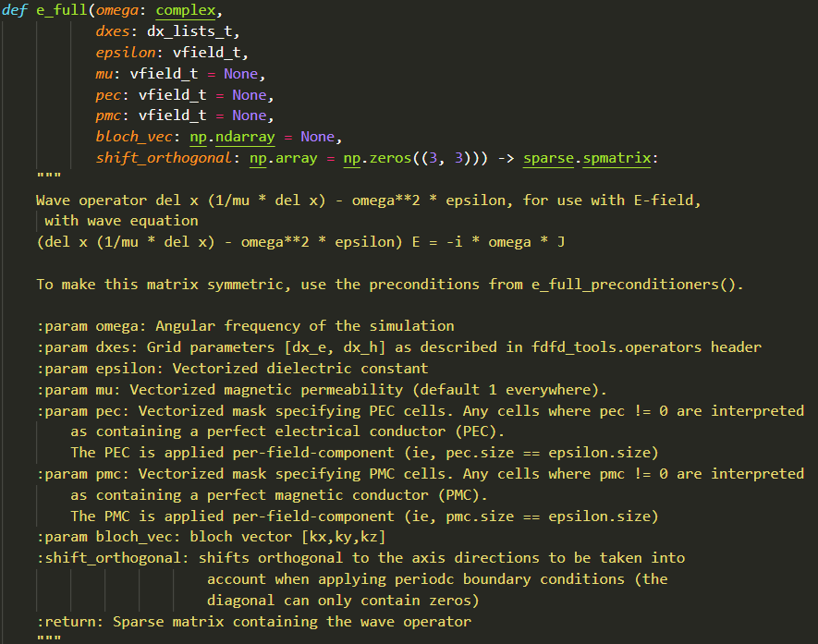
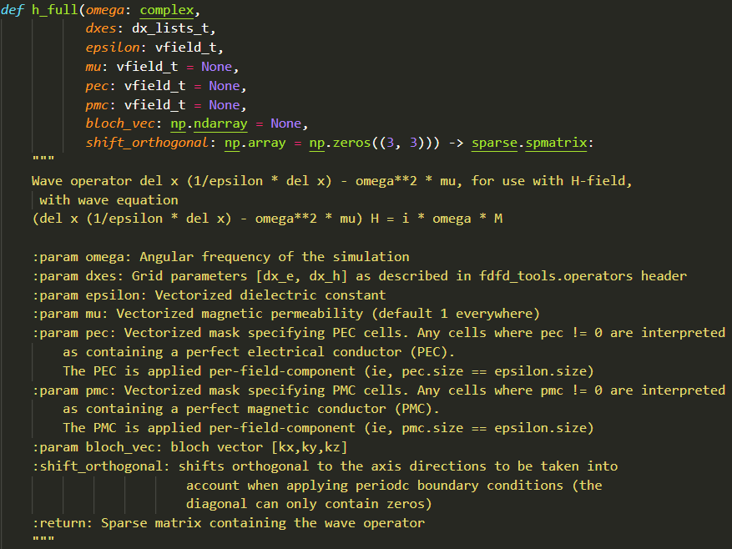
SPINS-B code: EM solver – 5
Electric field/Magnetic field calculation
spins\fdfd_tools\operators.py
…

Slide 10
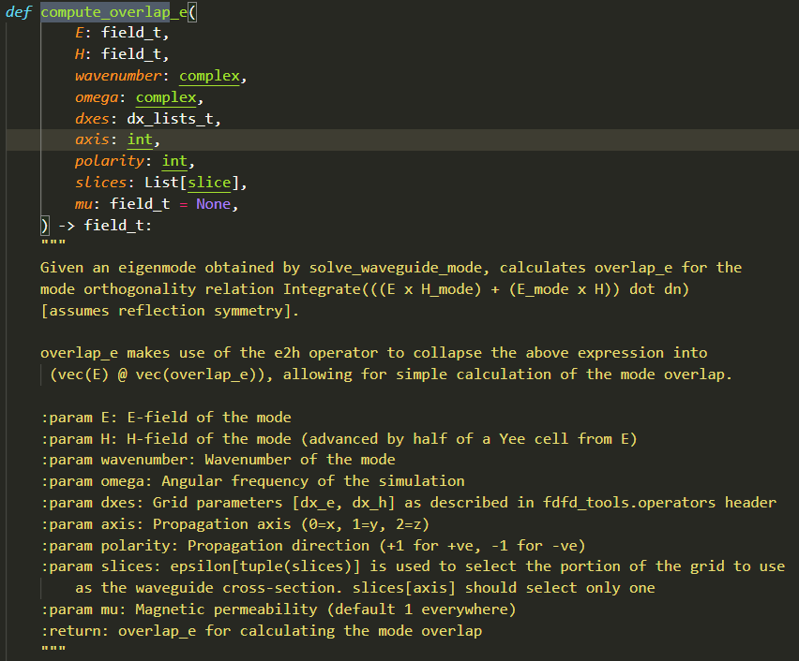
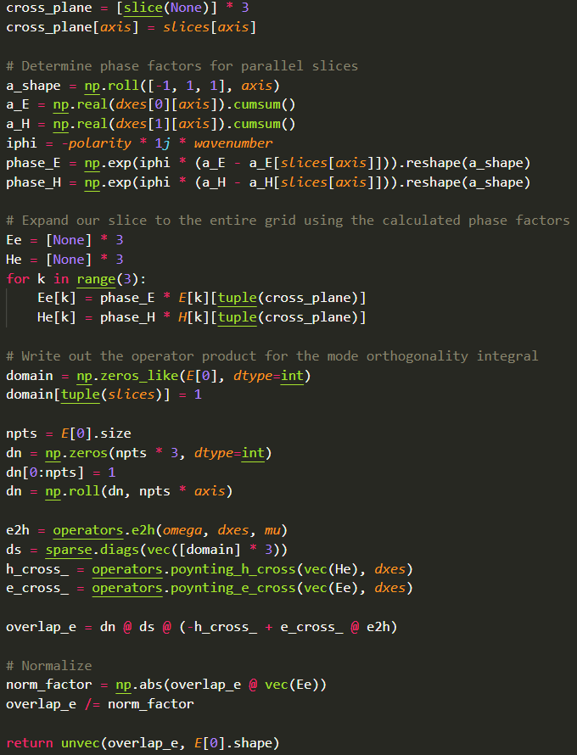
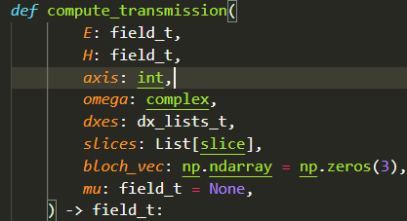
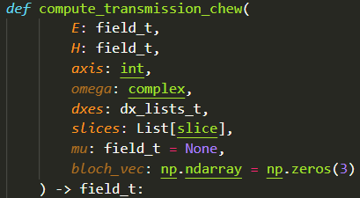
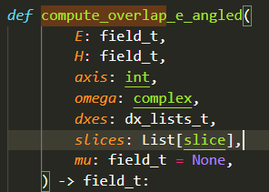
SPINS-B code: EM solver – 5
Overlap & transmission calculation
spins\fdfd_solvers\waveguide_mode.py

Slide 11
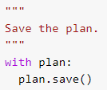

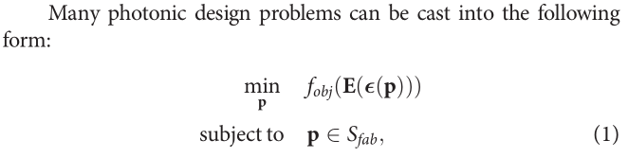

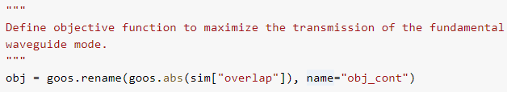

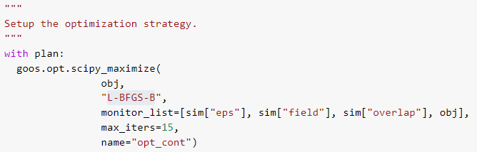
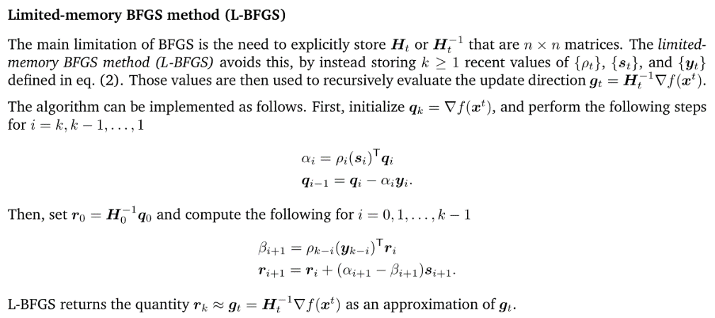
SPINS-B code: Optimization - 1
t: target transmission

Slide 12
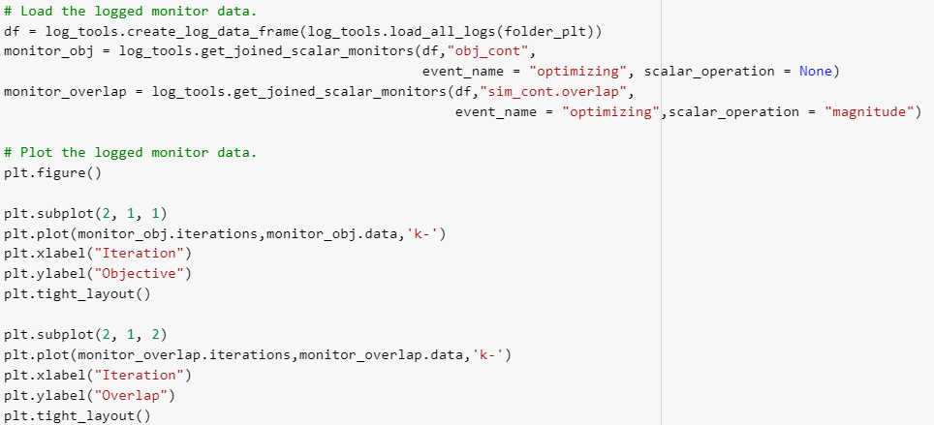
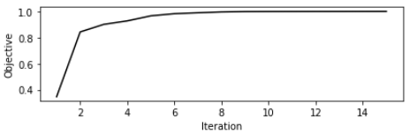
SPINS-B code: Result visualization - 1

Slide 13
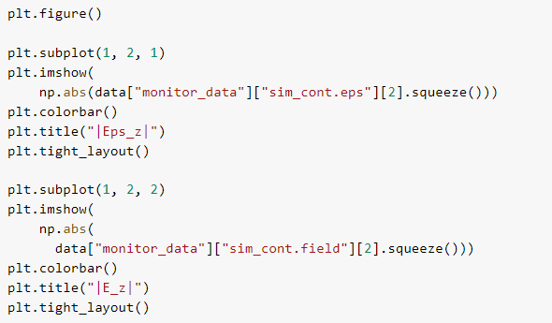
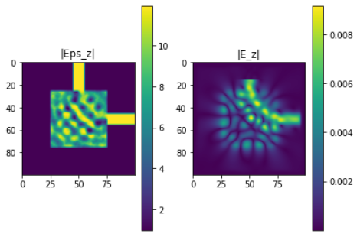
SPINS-B code: Result visualization - 2

