Slide 1
Heineken® Brand
Heineken® 360
Logo Guidelines 2019
Version: August 2019

Slide 2
Content
Heineken® logo guidelines 2019
Content
Contact
Introduction 3
Heineken® logos overview Heineken® brand logo 5 Heineken® brand standard logo overview 7 Heineken® brand vertical logo overview 8 Heineken® brand logo exceptions 9 Heineken® brand logo overview exceptions 10
Heineken® original lager logo 11 Heineken® original lager logo overview 12 Heineken® original lager standard logo overview 13
Heineken® 0.0 logo 14 Heineken® 0.0 legal restrictions 16 Heineken® 0.0 standard logo overview 17 Heineken® 0.0 vertical logo overview 18 Heineken® 0.0 logo overview exceptions 19
Heineken® light logo 21 Heineken® light standard logo overview 23 Heineken® light vertical logo overview 24 Heineken® light logo overview exceptions 25
Logo inspiration 27 Colours 28 Logoset navigation 29
Contact information 30

Slide 3
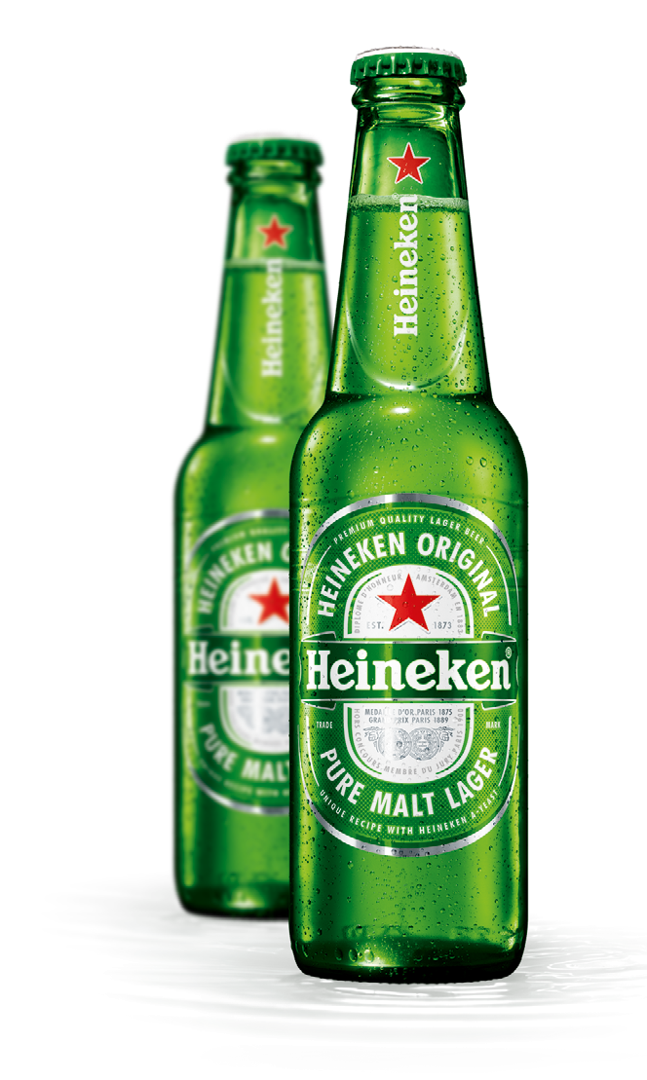
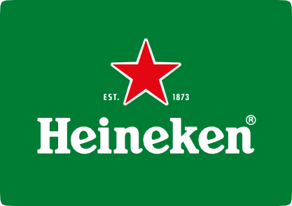
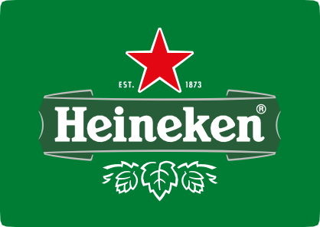
Introduction
Content
Contact
This guideline presents the next subtle step in the evolution of the Heineken® logos. It keeps the brand identity contemporary and progressive, makes Heineken’s most iconic design elements even more powerful, and subtly dials up the authentic roots.
The visual brand identity is rooted in history, and in the iconic green bottle with race-track label. Let’s first zoom in on green.
Around 1900 Gerard Adriaan Heineken wanted his premium quality beer to stand out from all the usual brown beer bottles. To express the clear, bright, fresh and natural character of his lager beer, he choose for a green bottle. Green became the iconic brand colour of Heineken®. And in this design evolution we use green even in the banner, which used to be black.
Secondly the red star.
The star is a medieval brewers symbol. 4 points represent the natural ingredients: malted barley, water,
hops and Heineken’s unique A-Yeast. The 5th was the unknown magic of brewing. Today we don’t rely on magic anymore; we replaced it by craftsmanship. And we still keep the star as our core symbol. In the new logo- and label designs the star became again a bit more prominent. Showing the Heineken® quality symbol with more pride and confidence.
And thirdly, we fine-tuned a lot of details: for example the drawing style of the hops, the outlines around the banner, the text EST. 1873 left and right of the star to show the birth-year of the brand, etc.
The logos are of course derived from, and consistent with, the race-track label on our bottle and can. See the separate packaging design guidelines for more label details.
It is of utmost importance that the Heineken® brand is always represented by the correct logos. It is one of the most valuable assets of our company, and world-famous, anchored in millions, or even billions, consumer minds. Always adhere to these guidelines, and in case of doubt, contact the Global Heineken® brand design team in Amsterdam.
NOTE: Never use logo elements in isolation. For example: never use a smiling ‘e’ in isolation, never use the red star in isolation, never use other coloured stars in isolation. It weakens our trade mark protection significantly.

Slide 4
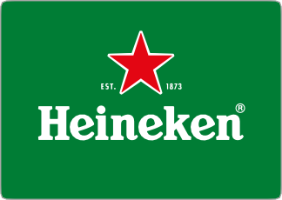
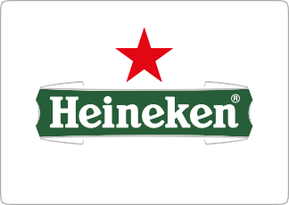
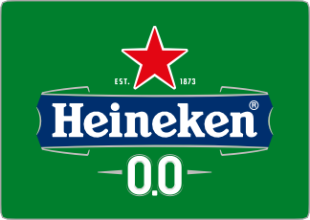
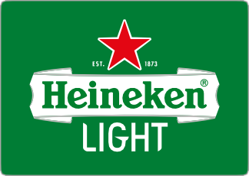
Heineken® logos overview
Content
Contact
BRAND LOGO
PRODUCT LOGOS
Heineken® has in principle 4 logos: Brand logo, Original lager beer product logo,
0.0 product logo and Light product logo.
The basis of these 4 logos is identical: Heineken® word mark with the red star proudly centered above it, and green as brand identifying colour, except for 0.0.
The difference is in the elements around it, which are specific for its usage.
The Heineken® brand logo is the default choice. It provides the most iconic, powerful and universal Heineken® brand recognition. It’s used to express the Heineken® brand and everything it stands for. It’s simple, powerful, draws attention and stands-out from the clutter.
The Heineken® original lager beer logo should be used on items and messages directly related to the beer itself. This logo expresses authenticity, craftsmanship and has a beery look & feel. It’s used for example on glasses, packaging, and to endorse the ‘Stories behind Heineken®’.
The Heineken® 0.0 logo is specifically for items and communication directly related to Heineken® 0.0 lager beer. The logo clearly reads 0.0 and emphasizes the main colour for Heineken® 0.0: blue.
The Heineken® Light logo is specifically for items and communication directly related to Heineken® Light lager beer.
The logo clearly reads LIGHT and emphasizes the main colour for Heineken® Light: white.
Each of the 4 logos has its own varieties as needed for specific applications. There are vertical versions, artworks for different background colours, black and white or small replication. See further in the guideline for details.
NOTE: Never use logo elements in isolation. For example: never use a smiling e in isolation, never use the red star in isolation, never use other coloured stars in isolation. It weakens our trade mark protection significantly.

Slide 5

Heineken® brand logo
Content
Contact
Iconic red star with white outline.
Red points are subtly rounded.
White outline has uniquely shaped points.
EST. 1873 refers to the year the brand was born in Amsterdam.
White Heineken® word mark in the characteristic typeface with smiling e’s, plus registered trade mark ®.
Green background to show the brand’s main visual identifier: Heineken® green.

Slide 6

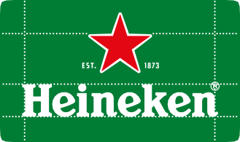
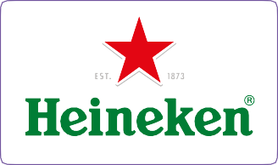
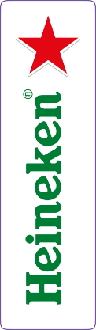



Heineken® brand logo
Content
Contact
The Heineken® brand logo
The Heineken® brand logo is the default choice. It provides the most iconic, powerful and universal Heineken® brand recognition. It’s used to express the Heineken® brand and everything it stands for. It’s simple, powerful, draws attention and stands-out from the clutter.
ALWAYS KEEP THE INDICATED CLEARANCE AREA FROM OTHER ELEMENTS.
¾ H
¾ H
1 H
There are 3 versions:
a horizontal version
a vertical version
and for exceptional cases there is a third option, the horizontal logo
Never use the horizontal logo vertically, and never use the vertical logo horizontally.
H
(height of ‘H’)
¾ H
REVERSED VERSION OF THE BRAND LOGO ON GREEN
There are different versions for specific applications:
reversed out of green (is always preferred), and reversed out of black or grey
positive on white
black on white and white on black
small use in case the logo is less than 35 mm. wide, or is reproduced with a 'rough' printing technique
DO NOT:
use logo elements in isolation; for example do not use the star in isolation, nor the smiling e or the H
use the logos on background colors that are strange for the brand (e.g. blue, red, etc).
Create a Heineken® green area around the logo to isolate the logo from these background colors
change the composition or colors of the logo in any way.
POSITIVE VERSION OF THE BRAND LOGO ON WHITE
HEINEKEN® GREEN
C 85 R 19
M 0 G 103
Y 100 B 11
K 30
HEINEKEN® RED
C 0 R 255
M 100 G 43
Y 100 B 0
K 0
COOL GRAY 4C
C 0 R 187
M 0 G 188
Y 0 B 189
K 35
FOR EXCEPTIONAL USE ONLY
REVERSED VERSION OF THE HORIZONTAL BRAND LOGO
POSITIVE VERSION OF THE HORIZONTAL BRAND LOGO
POSITIVE AND REVERSED VERSION OF THE VERTICAL BRAND LOGO
6

Slide 7



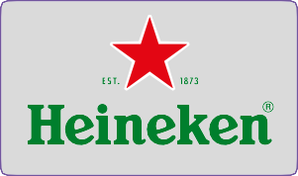
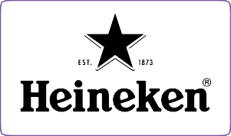
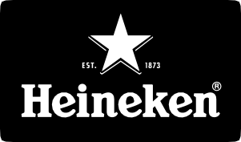



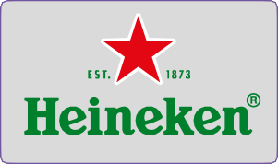
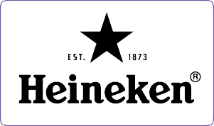
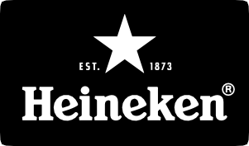


Heineken® brand logo
Content
Contact
Artworks
1: Standard versions
For applications >35mm
Standard Heineken® brand logo, for positive reproduction.
Reference: BRAND_1_A_PMS
Standard Heineken® brand logo, for reversed out reproduction. Reference:
BRAND_1_B_PMS
Standard Heineken® brand logo,
for use on different background colors: green, dark grey or black.
Reference: BRAND_1_C_PMS
Standard Heineken® brand logo, for use on light grey and
alluminium/inox background colors. Reference:
BRAND_1_C1_PMS
Standard mono-colour Heineken® brand logo, for positive reproduction. Reference:
BRAND_1_D_1COLOR
Standard mono-colour Heineken® brand logo, for reversed
out reproduction. Reference: BRAND_1_E_1COLOR
2: Small versions
For small applications, on rough or difficult to print surfaces <35mm
Small use Heineken® brand logo, for positive reproduction.
Reference: BRAND_2_A_PMS
Small use Heineken® brand logo, for reversed out reproduction. Reference:
BRAND_2_B_PMS
Small use Heineken® brand logo,
for use on different background colors: green, dark grey or black.
Reference: BRAND_2_C_PMS
Small use Heineken® brand logo, for use on light grey and alluminium/inox background colors.
Reference: BRAND_2_C1_PMS
Small use mono-colour Heineken® brand logo, for positive reproduction. Reference:
BRAND_2_D_1COLOR
Small use mono-colour Heineken® brand logo, for reversed
out reproduction. Reference: BRAND_2_E_1COLOR
NOTE: Only use these logos horizontally. Use the vertical brand logos on vertical areas/applications.

Slide 8












Heineken® vertical brand logo
Content
Contact
Artworks
3: VERTICAL VERSIONS
For applications >35mm
Heineken® vertical brand
logo, for positive reproduction. Reference:
BRAND_3_A_PMS
Heineken® vertical brand
logo, for reversed out reproduction. Reference:
BRAND_3_B_PMS
Heineken® vertical brand
logo, for use on different background colors: green, grey or black.
Reference: BRAND_3_C_PMS
Mono-colour Heineken® vertical brand logo,
for positive and reversed out reproduction.
Reference: BRAND_3_D_1COLOR BRAND_3_E_1COLOR
4: SMALL VERTICAL VERSIONS
For small applications, on rough or difficult to print surfaces <35mm
Small use Heineken® vertical brand logo, for positive reproduction.
Reference: BRAND_4_A_PMS
Small use Heineken® vertical brand logo, for reversed out reproduction. Reference:
BRAND_4_B_PMS
Small use Heineken® vertical brand logo, for use on different background colors: green, grey or black.
Reference: BRAND_4_C_PMS
Small use mono-colour Heineken® vertical brand logo, for positive and reversed
out reproduction. Reference: BRAND_4_D_1COLOR BRAND_4_E_1COLOR
NOTE: Only use these vertical logos vertically. Use the regular brand logos on horizontal areas/applications.

Slide 9
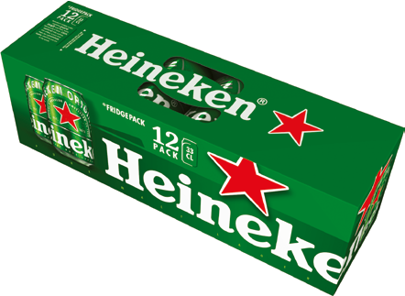


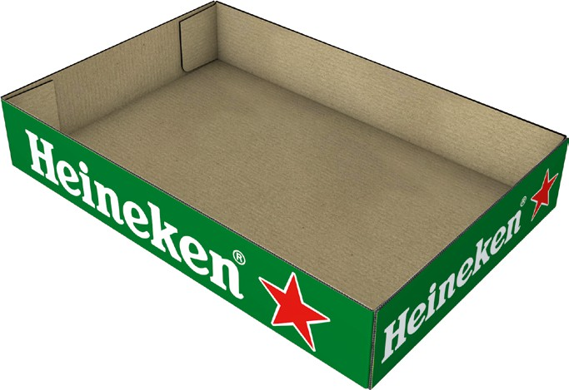
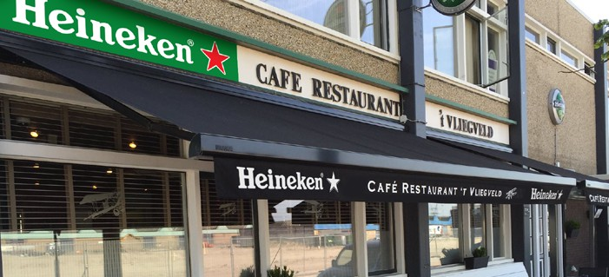
Content
Contact
FOR EXCEPTIONAL ITEMS
Heineken® horizontal brand logo
For exceptional items with a height to width ratio higher than 1:5 a special horizontal logo has been developed. For example 12 Fridgepack cans and can trays.
1:5 Preferred logo proportion

Slide 10















Content
Contact
FOR EXCEPTIONAL ITEMS
Heineken® horizontal brand logo
Artworks
1: Horizontal versions 1:5
For applications >35mm
Standard Heineken® LAGER_HORIZONTAL logo, for positive reproduction.
Reference: BRAND_HORIZONTAL_1_A_PMS
Standard Heineken®LAGER_HORIZONTAL logo, for reversed out reproduction.
Reference: BRAND_HORIZONTAL_1_B_PMS
Standard Heineken® LAGER_HORIZONTAL logo, for use on different background colors: green, grey or black.
Reference: BRAND_HORIZONTAL_1_C_PMS
Standard Heineken® LAGER_HORIZONTAL logo, for use on grey background Reference: BRAND_HORIZONTAL_1_C1_PMS
Standard mono-colour Heineken® LAGER_HORIZONTAL logo, for positive reproduction.
Reference: BRAND_HORIZONTAL_1_D_1COLOR
Standard mono-colour Heineken® LAGER_HORIZONTAL logo, for reversed out reproduction.
Reference: BRAND_HORIZONTAL_1_E_1COLOR
2: SMALL VERSIONS
For small applications, on rough or difficult to print surfaces <35mm
Small use Heineken® LAGER_HORIZONTAL logo, for positive reproduction.
Reference: BRAND_HORIZONTAL_2_A_PMS
Small use Heineken® LAGER_HORIZONTAL logo, for reversed out reproduction.
Reference: BRAND_HORIZONTAL_2_B_PMS
Small use Heineken® LAGER_HORIZONTAL logo, for use on different background colors: green, grey or black.
Reference: BRAND_HORIZONTAL_2_C_PMS
Small use Heineken® LAGER_HORIZONTAL logo, for use on grey background Reference: BRAND_HORIZONTAL_2_C1_PMS
Small use mono-colour Heineken® LAGER_HORIZONTAL logo, for positive reproduction.
Reference: BRAND_HORIZONTAL_2_D_1COLOR
Small use mono-colour Heineken® LAGER_HORIZONTAL logo, for reversed out reproduction.
Reference: BRAND_HORIZONTAL_2_E_1COLOR

Slide 11
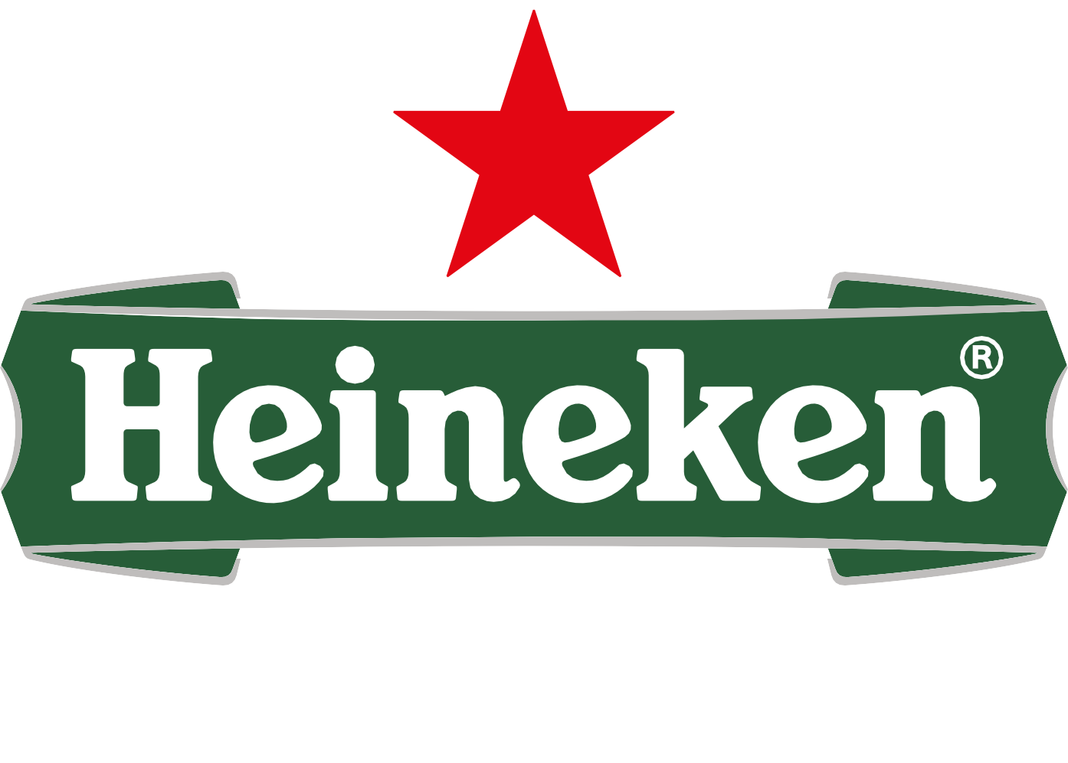
Heineken® original lager logo
Content
Contact
Iconic red star with white outline.
Red points are subtly rounded.
White outline has uniquely shaped points.
EST. 1873 refers to the year the brand was born in Amsterdam.
White Heineken® word mark in the characteristic typeface with smiling e’s, plus registered trade mark ®.
Banner in Heineken® dark green refers to an authentic ribbon.
Silver / aluminium outline, or Cool Grey in regular printing.
Hops line drawing expresses natural ingredients.

Slide 12
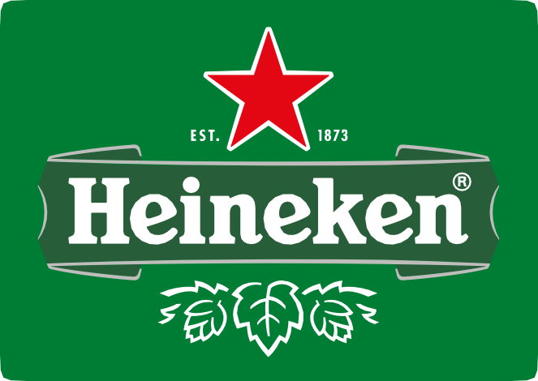
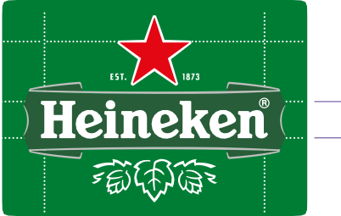
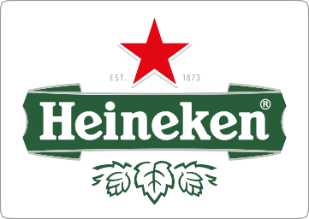
Heineken® original lager logo
Content
Contact
The Heineken® original lager logo
The Heineken® original lager beer logo should be used on items and messages directly related to the beer itself. This logo expresses authenticity, craftsmanship and has a beery look & feel. It’s used a.o. on glasses, packaging, and to endorse the ‘Stories behind Heineken®’.
ALWAYS KEEP THE INDICATED CLEARANCE AREA FROM OTHER ELEMENTS.
1 ¼ H
1 ¼ H
1 ¼ H
There is 1 main version:
- a horizontal version
Never use the horizontal logo vertically.
H
(height of ‘H’
There are different versions for specific applications:
reversed out of green (is always preferred), and reversed out of black or grey
positive on white
black on white and white on black
small use in case the logo is less than 35 mm. wide, or is reproduced with a 'rough' printing technique
2 ¼ H
REVERSED VERSION OF THE ORIGINAL LAGER LOGO ON GREEN
DO NOT:
use logo elements in isolation; for example do not use the star in isolation, nor the smiling e or the H
use the logos on background colors that are strange for the brand (e.g. blue, red, etc). Create a Heineken® green area around the logo to isolate the logo from these background colors
change the composition or colors of the logo in any way.
HEINEKEN® GREEN
C 85 R 19
M 0 G 103
Y 100 B 11
K 30
HEINEKEN® DARK GREEN
C 85 R 0
M 0 G 93
Y 100 B 31
K 55
HEINEKEN® RED
C 0 R 255
M 100 G 43
Y 100 B 0
K 0
COOL GRAY 4C
C 0 R 187
M 0 G 188
Y 0 B 189
K 35
POSITIVE VERSION OF THE ORIGINAL LAGER LOGO ON WHITE

Slide 13
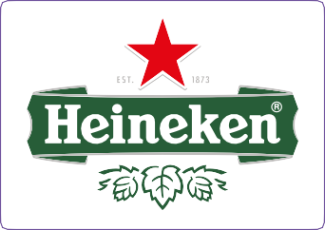
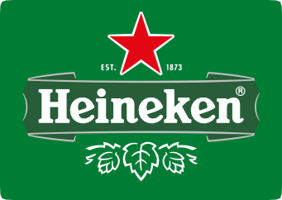

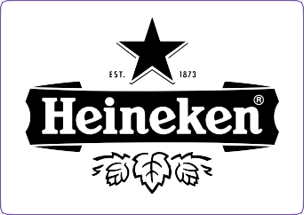
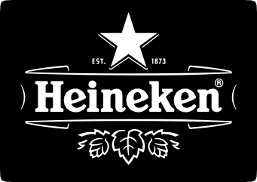

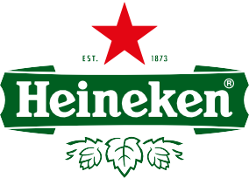
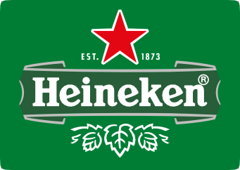

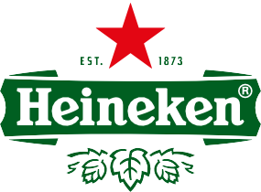
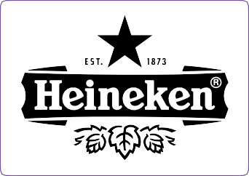
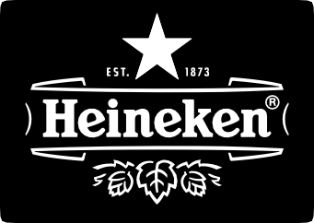
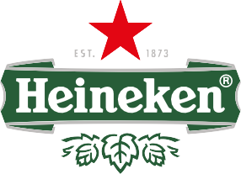
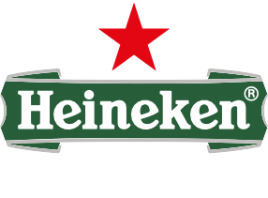
Heineken® original lager logo
Content
Contact
Artworks
1: Standard versions
For applications >35mm
Standard Heineken® original lager logo, for positive reproduction.
Reference: LAGER_1_A_PMS
Standard Heineken® original lager logo, for reversed out reproduction.
Reference: LAGER_1_B_PMS
Standard Heineken® original lager logo, for use on different background colors: green, dark grey or black.
Reference: LAGER_1_C_PMS
Standard Heineken® original lager logo, for use on light grey and alluminium/inox background colors.
Reference: LAGER_1_C1_PMS
Standard mono-colour Heineken® original lager logo, for positive reproduction.
Reference: LAGER_1_D_1COLOR
Standard mono-colour Heineken® original lager logo, for reversed out reproduction.
Reference: LAGER_1_E_1COLOR
2: Small versions
For use on rough to print surfaces or for small applications <35mm
Small use Heineken® original lager logo, for positive reproduction.
Reference: LAGER_2_A_PMS
Small use Heineken® original lager logo, for reversed out reproduction.
Reference: LAGER_2_B_PMS
Small use Heineken® original lager logo, for use on different background colors: green, dark grey or black.
Reference: LAGER_2_C_PMS
Small use Heineken® original lager logo, for use on light grey and alluminium/inox background colors.
Reference: LAGER_2_C1_PMS
Small use mono-colour Heineken® original lager logo, for positive reproduction.
Reference: LAGER_2_D_1COLOR
Small use mono-colour Heineken® original lager logo, for reversed out reproduction.
Reference: LAGER_2_E_1COLOR
NOTE: Only use these logos horizontally.

Slide 14
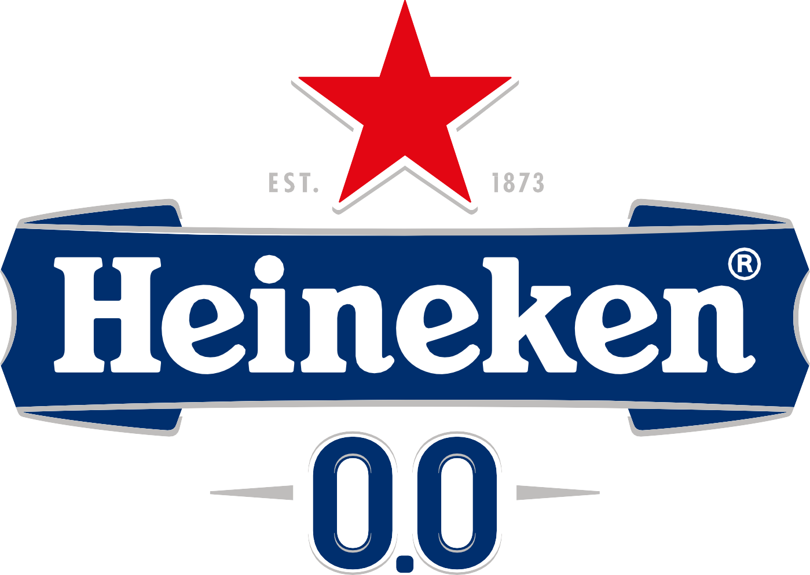
Heineken® 0.0 logo
Content
Contact
Iconic red star with white outline. On a white background the outline is visualized by means of drop-shadow lines in
Cool Gray 4C.
Red points are subtly rounded.
Drop-shadow has uniquely shaped points.
EST. 1873 refers to the year the brand was born in Amsterdam.
White Heineken® word mark in the characteristic typeface with smiling e’s, plus registered trade mark ®.
Banner in Pantone 294C refers to an authentic ribbon.
Silver / aluminium outline, or Cool Grey in regular printing.
The especially designed word 0.0 clearly shows it’s a 0.0 lager beer.
Blue (Pantone 294C) is the primary colour. White is the secondary colour to express the 0.0 character of the alcohol free beer.

Slide 15




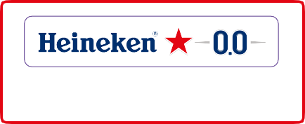
Heineken® 0.0 logo
Content
Contact
The Heineken® 0.0 logo
The Heineken® 0.0 logo is specifically for items and communication directly related to Heineken® 0.0 lager beer. The logo clearly reads 0.0 and emphasizes the main colour for Heineken® 0.0: blue (Pantone 294C).
ALWAYS KEEP THE INDICATED CLEA- RANCE AREA FROM OTHER ELEMENTS.
1 ¼ H |  |  |  | 1 ¼ H
1 ¼ H
There are 3 versions:
a standard version
a vertical version
and for exceptional cases there is a third option, the horizontal logo
Only use the horizontal version in exceptional cases when the standard version really doesn't fit because of very limited height.
Never use the horizontal logo vertically, and never use the vertical logo horizontally.
H
(height of ‘H’)
2 ¼ H
POSITIVE STANDARD VERSION OF THE
0.0 LOGO ON WHITE
There the different versions for specific applications:
positive on white; is preferred for 0.0
reversed out of green, and reversed out of black or grey
positive on white
black on white and white on black
small use in case the logo is less than 35 mm. wide, or is reproduced with a 'rough' printing technique
PANTONE 294C
C 100 R 27
M 69 G 70
Y 7 B 119
K 30
HEINEKEN® RED
C 0 R 255
M 100 G 43
Y 100 B 0
K 0
COOL GRAY 4C
C 0 R 187
M 0 G 188
Y 0 B 189
K 35
DO NOT:
use logo elements in isolation; for example do not use the star in isolation, nor the smiling e or the H
use the logos on background colors that are strange for the brand (e.g. blue, red, etc). Create a white area around the logo to isolate the logo from these background colors
change the composition or colors of the logo in any way
POSITIVE VERTICAL VERSION OF THE 0.0 LOGO ON WHITE
FOR EXCEPTIONAL USE ONLY
POSITIVE HORIZONTAL VERSION OF THE 0.0 LOGO ON WHITE

Slide 16


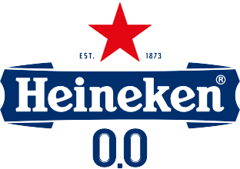
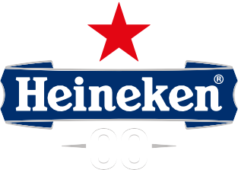

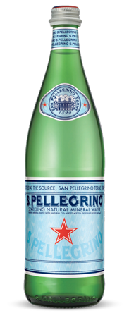
Heineken® 0.0 logo
Content
Contact
Use of Heineken® 0.0 Logo on a blue background
LEGAL RESTRICTION REGARDING PLACEMENT OF THE RED STAR
White area Grey area
Light blue area
(Legaly not allowed to place a logo with Red Star)
PMS: 294 C area
Dark blue area (UCL)
Standard Heineken® 0.0 logo, for positive reproduction.
Reference: 0.0_1_A_PMS
Standard Heineken® 0.0 logo, for use on light grey and alluminium/inox background colors.
Reference: 0.0_1_C1_PMS
Standard Heineken® 0.0 logo, for reversed out reproduction. Reference:
0.0_1_C_PMS
Standard mono-colour Heineken®
0.0 logo, for reversed out reproduction. Reference:
0.0_1_E_1COLOR
THE AGREEMENT WITH SAN PELLEGRINO!
BACKGROUND OF RED STARS
Never use the red star
on a light blue background to avoid violation of the settlement agreement with San Pellegrino.
SAN PELLEGRINO
The background of SP's Red Star is and will not be "Heineken® Green" (Enclosure II), exept for the five products "Dribly, "San Pellegrino menta ghiacciata", "Sanpellegrino Aranciata amara", "Sanpellegrino Limonata", "Sanpellegrino Cedrata" (Enclosure V).
HEINEKEN®
The background of HB's Red Star is and will not be "Sanpellegrino blue" (sparkling water) nor "Limpia/Sanpellegrino pink" (still water) (Enclosure III, IV).
NOTE: Only use these logos horizontally. Use the vertical 0.0 logo on the vertical areas/applications.
16

Slide 17


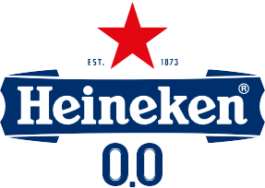
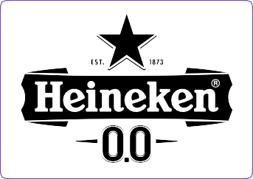
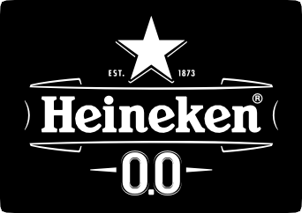


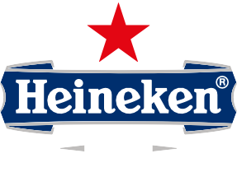

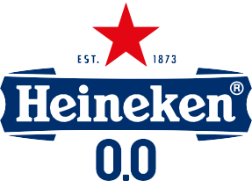
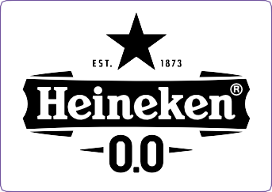
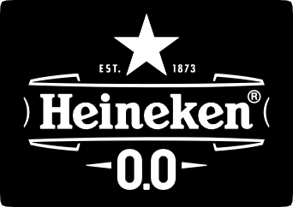
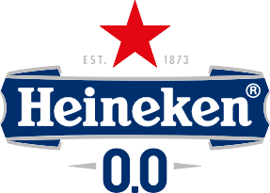

Heineken® 0.0 logo
Content
Contact
Artworks
1: Standard versions
For applications >35mm
Standard Heineken® 0.0 logo, for positive reproduction.
Reference: 0.0_1_A_PMS
Standard Heineken® 0.0 logo, for reversed out reproduction. Reference:
0.0_1_B_PMS
Standard Heineken® 0.0 logo,
for use on different background colors: green, dark blue, dark grey or black.
Reference: 0.0_1_C_PMS
Standard Heineken® 0.0 logo, for use on light grey and alluminium/inox background colors.
Reference: 0.0_1_C1_PMS
Standard mono-colour Heineken® 0.0 logo, for positive reproduction.
Reference: 0.0_1_D_1COLOR
Standard mono-colour Heineken® 0.0 logo, for reversed out reproduction. Reference:
0.0_1_E_1COLOR
2: Small versions
For use on rough to print surfaces or for small applications <35mm
Small use Heineken® 0.0 logo, for positive reproduction.
Reference: 0.0_2_A_PMS
Small use Heineken® 0.0 logo, for reversed out reproduction. Reference:
0.0_2_B_PMS
Small use Heineken® 0.0 logo,
for use on different background colors: green, dark blue, dark grey or black.
Reference: 0.0_2_C_PMS
Small use Heineken® 0.0 logo, for use on light grey and alluminium/inox background colors.
Reference: 0.0_2_C1_PMS
Small use mono-colour Heineken® 0.0 logo, for positive reproduction.
Reference: 0.0_2_D_1COLOR
Small use mono-colour Heineken® 0.0 logo, for reversed out reproduction. Reference:
0.0 _2_E_1COLOR
NOTE: Only use these logos horizontally. Use the vertical 0.0 logo on the vertical areas/applications.

Slide 18



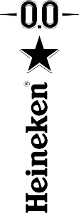



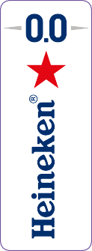

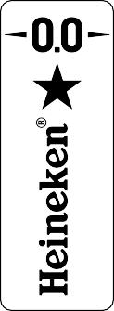


Heineken® 0.0 vertical logo
Content
Contact
Artworks
3: Vertical versions
For applications >66mm
Heineken® 0.0 vertical logo,
for positive reproduction. Reference:
0.0_3_A_PMS
Heineken® 0.0 vertical logo,
for use on dark blue background color.
Reference: 0.0_3_B_PMS
Mono-colour Heineken® 0.0 vertical logo, for positive repro- duction.
Reference: 0.0_3_D_1COLOR
Mono-colour Heineken® 0.0 vertical logo, for reversed out reproduction.
Reference: 0.0_3_E_1COLOR
4: Vertical small versions
For use on rough to print surfaces or for small applications <66mm
Small use Heineken® 0.0 vertical logo,
for positive reproduction. Reference:
0.0_4_A_PMS
Small use Heineken® 0.0 vertical logo, for use on dark blue background color. Reference:
0.0_4_B_PMS
Small use Mono-colour Heineken®
0.0 vertical logo, for positive reproduction.
Reference: 0.0_4_D_1COLOR
Small use Mono-colour Heineken®
0.0 vertical logo, for reversed out reproduction.
Reference: 0.0_4_E_1COLOR
NOTE: Only use these vertical logos vertically. Use the regular 0.0 logo on horizontal areas/applications.

Slide 19





Content
Contact
FOR EXCEPTIONAL ITEMS
Heineken® 0.0 horizontal logo
Artworks
For exceptional items with a hight to width ratio higher than 1:5 a special horizontal logo has been developed. For example 12 Fridgepack cans and can Trays.
Exception for Trays: Logo in white, with the red star on blue background Pantone 294C

Slide 20













Content
Contact
FOR EXCEPTIONAL ITEMS
Heineken® 0.0 horizontal logo
Artworks
1: Horizontal versions 1:5
For applications >35mm
Standard Heineken® 0.0_HORIZONTAL logo, for positive reproduction.
Reference: 0.0_HORIZONTAL_1_A_PMS
Standard Heineken® 0.0_HORIZONTAL logo, for reversed out reproduction.
Reference: 0.0_HORIZONTAL_1_B_PMS
Standard Heineken® 0.0_HORIZONTAL logo, for use on different background colors: green, grey, dark blue or black. Reference: 0.0_HORIZONTAL_1_C_PMS
Standard Heineken® 0.0_HORIZONTAL logo, for use on grey background.
Reference: 0.0_HORIZONTAL_1_C1_PMS
Standard mono-colour Heineken® 0.0_HORIZONTAL logo, for positive reproduction.
Reference: 0.0_HORIZONTAL_1_D_1COLOR
Standard mono-colour Heineken® 0.0_HORIZONTAL logo, for reversed out reproduction.
Reference: 0.0_HORIZONTAL_1_E_1COLOR
2: Small versions
For small applications, on rough or difficult to print surfaces <35mm
Small use Heineken® 0.0_HORIZONTAL logo, for positive reproduction.
Reference: 0.0_HORIZONTAL_2_A_PMS
Small use Heineken® 0.0_HORIZONTAL logo, for reversed out reproduction.
Reference: 0.0_HORIZONTAL_2_B_PMS
Small use Heineken® 0.0_HORIZONTAL logo, for use on different background colors: green, grey, dark blue or black.
Reference: 0.0_HORIZONTAL_2_C_PMS
Small use Heineken® 0.0_HORIZONTAL logo, for use on grey background
Reference: 0.0_HORIZONTAL_2_C1_PMS
Small use mono-colour Heineken® 0.0_HORIZONTAL logo, for positive reproduction.
Reference: 0.0_HORIZONTAL_2_D_1COLOR
Small use mono-colour Heineken® 0.0_HORIZONTAL logo, for reversed out reproduction.
Reference: 0.0_HORIZONTAL_2_E_1COLOR

Slide 21

Heineken® light logo
Content
Contact
Iconic red star with white outline. On a white background the outline is visualized by means of drop-shadow lines in
Cool Gray 4C.
Red points are subtly rounded.
Drop-shadow has uniquely shaped points.
EST. 1873 refers to the year the brand was born in Amsterdam.
Green Heineken® word mark in the characteristic typeface with smiling e’s, plus registered trade mark ®.
Silver / aluminium outline, or Cool Grey in regular printing.
The especially designed word LIGHT clearly shows it’s a Light lager beer.
White is the primary colour to express the light character of the light beer. Heineken® green is the secondary colour, to link it to the Heineken® brand.

Slide 22




Heineken® light logo
Content
Contact
The Heineken® light logo
The Heineken® Light logo is specifically for items and communication directly
related to Heineken® Light lager beer. The logo clearly reads LIGHT and emphasizes the main colour for Heineken® Light: white.
ALWAYS KEEP THE INDICATED CLEARANCE AREA FROM OTHER ELEMENTS.
1 ¼ H 1 ¼ H
1 ¼ H
There are 3 versions:
a standard version
a vertical version
and for exceptional cases there is a third option, the horizontal logo
Only use the horizontal version in exceptional cases when the standard version really doesn't fit because of very limited height.
Never use the horizontal logo vertically, and never use the vertical logo horizontally.
H
(height of ‘H’)
2 ¼ H
POSITIVE STANDARD VERSION OF THE LIGHT LOGO ON WHITE
There the different versions for specific applications:
positive on white; is preferred for Light
reversed out of green, and reversed out of black or grey
positive on white
black on white and white on black
small use in case the logo is less than 35 mm. wide, or is reproduced with a 'rough printing technique
HEINEKEN® GREEN
C 85 R 19
M 0 G 103
Y 100 B 11
K 30
HEINEKEN® RED
C 0 R 255
M 100 G 43
Y 100 B 0
K 0
COOL GRAY 4C
C 0 R 187
M 0 G 188
Y 0 B 189
K 35
DO NOT:
use logo elements in isolation; for example do not use the star in isolation, nor the smiling e or the H
use the logos on background colors that are strange for the brand (e.g. blue, red, etc). Create a white area around the logo to isolate the logo from these background colors
change the composition or colors of the logo in any way.
POSITIVE VERTICAL VERSION OF THE LIGHT LOGO ON WHITE
FOR EXCEPTIONAL USE ONLY
POSITIVE HORIZONTAL VERSION OF THE LIGHT LOGO ON WHITE

Slide 23














Heineken® light logo
Content
Contact
Artworks
1: Standard versions
For applications >35mm
Standard Heineken® Light logo, for positive reproduction.
Reference: LIGHT_1_A_PMS
Standard Heineken® Light logo, for reversed out reproduction. Reference:
LIGHT_1_B_PMS
Standard Heineken® Light logo,
for use on different background colors: green, dark grey or black.
Reference: LIGHT_1_C_PMS
Standard Heineken® light logo, for use on light grey and alluminium/inox background colors.
Reference: LIGHT_1_C1_PMS
Standard mono-colour Heineken® Light logo, for positive reproduction.
Reference: LIGHT_1_D_1COLOR
Standard mono-colour Heineken® Light logo,
for reversed out reproduction. Reference:
LIGHT_1_E_1COLOR
2: Small versions
For use on rough to print surfaces or for small applications <35mm
Small use Heineken® Light logo, for positive reproduction.
Reference: LIGHT_2_A_PMS
Small use Heineken® Light logo, for reversed out reproduction. Reference:
LIGHT_2_B_PMS
Small use Heineken® Light logo,
for use on different background colors: green, dark grey or black.
Reference: LIGHT_2_C_PMS
Small use Heineken® light logo, for use on light grey and alluminium/inox background colors.
Reference: LIGHT_2_C1_PMS
Small use mono-colour Heineken® Light logo, for positive reproduction.
Reference: LIGHT_2_D_1COLOR
Small use mono-colour Heineken® Light logo, for reversed out reproduction.
Reference: LIGHT_2_E_1COLOR
NOTE: Only use these logos horizontally. Use the vertical Light logo on the vertical areas/applications.

Slide 24












Heineken® light vertical logo
Content
Contact
Artworks
3: VERTICAL VERSIONS
For applications >66mm
Heineken® Light vertical logo, for positive reproduction.
Reference: LIGHT_3_A_PMS
Heineken® Light vertical logo, for reversed out reproduction. Reference:
LIGHT_3_B_PMS
Heineken® Light vertical logo,
for use on different background colors: green, grey or black.
Reference: LIGHT_3_C_PMS
Mono-colour Heineken® Light vertical logo, for positive and reversed
out reproduction. Reference: LIGHT_3_D_1COLOR LIGHT_3_E_1COLOR
4: VERTICAL SMALL VERSIONS
For use on rough to print surfaces or for small applications <66mm
Small use Heineken® Light vertical logo, for positive reproduction.
Reference: LIGHT_4_A_PMS
Small use Heineken® Light vertical logo, for reversed out reproduction.
Reference: LIGHT_4_B_PMS
Small use Heineken® Light vertical logo, for use on different background colors: green, grey or black.
Reference: LIGHT_4_C_PMS
Small use mono-colour Heineken® Light vertical logo, for positive and reversed out reproduction.
Reference: LIGHT_4_D_1COLOR LIGHT_4_E_1COLOR
NOTE: Only use these vertical logos vertically. Use the regular Light logo on horizontal areas/applications.

Slide 25




Content
Contact
FOR EXCEPTIONAL ITEMS
Heineken® light horizontal logo
Artworks
For exceptional items with a hight to width ratio higher than 1:5 a special horizontal logo has been developed. For example 12 Fridgepack cans and can Trays.
1:5 Preferred logo proportion

Slide 26












Content
Contact
FOR EXCEPTIONAL ITEMS
Heineken® light horizontal logo
Artworks
1: HORIZONTAL VERSIONS 1:5
For applications >35mm
Standard Heineken® LIGHT_HORIZONTAL logo, for positive reproduction.
Reference: LIGHT_HORIZONTAL_1_A_PMS
Standard Heineken® LIGHT_HORIZONTAL logo, for reversed out reproduction.
Reference: LIGHT_HORIZONTAL_1_B_PMS
Standard Heineken® LIGHT_HORIZONTAL logo, for use on different background colors: green, grey or black.
Reference: LIGHT_HORIZONTAL_1_C_PMS
Standard Heineken® LIGHT_HORIZONTAL logo, for use on grey background Reference: LIGHT_HORIZONTAL_1_C1_PMS
Standard mono-colour Heineken® LIGHT_HORIZONTAL logo, for positive reproduction.
Reference: LIGHT_HORIZONTAL_1_D_1COLOR
Standard mono-colour Heineken® LIGHT_HORIZONTAL logo, for reversed out reproduction.
Reference: LIGHT_HORIZONTAL_1_E_1COLOR
2: SMALL VERSIONS
For small applications, on rough or difficult to print surfaces <35mm
Small use Heineken® LIGHT_HORIZONTAL logo, for positive reproduction.
Reference: LIGHT_HORIZONTAL_2_A_PMS
Small use Heineken® LIGHT_HORIZONTAL logo, for reversed out reproduction.
Reference: LIGHT_HORIZONTAL_2_B_PMS
Small use Heineken® LIGHT_HORIZONTAL logo, for use on different background colors: green, grey or black.
Reference: LIGHT_HORIZONTAL_2_C_PMS
Small use Heineken® LIGHT_HORIZONTAL logo, for use on grey background Reference: LIGHT_HORIZONTAL_2_C1_PMS
Small use mono-colour Heineken® LIGHT_HORIZONTAL logo, for positive reproduction.
Reference: LIGHT_HORIZONTAL_2_D_1COLOR
Small use mono-colour Heineken® LIGHT_HORIZONTAL logo, for reversed out reproduction.
Reference: LIGHT_HORIZONTAL_2_E_1COLOR

Slide 27







logo inspiration
Content
Contact
Inspirational samples for texturized interior applications

Slide 28
Colours
Content
Contact
THE COLOURS OF THE HEINEKEN® LOGOS:
For a worldwide consistant use of the Heineken® logos use the colour palet
provided in this guideline.
All the colours of the Heineken® logos are provided in PMS or Pantone ink recipe,
CMYK (full colour printing) and RGB (screens).
NOTE: Ask the Global Heineken® Design team for physical colour specifications / references in case you don't have them.
PMS | INK RECIPE | CMYK | RGB
HEINEKEN® GREEN (NO PMS) | 63,6% Pantone Green C 27,3% Pantone Yellow C 5,5% Pantone Black C 3,6% Pantone Orange 021 C | C 85 M 0 Y 100 K 30 | R 19 G 103 B 11
HEINEKEN® DARK GREEN (NO PMS) | 54% Pantone Green C 28% Pantone Yellow C 9% Pantone Black C 9% Pantone Orange 021 C | C 85 M 0 Y 100 K 55 | R 0 G 93 B 31
HEINEKEN® RED (NO PMS) | 40,3 Pantone 032 Red C 33% Pantone Yellow C 26,7% Pantone Rubin Red C | C 0 M 100 Y 100 K 0 | R 255 G 43 B 0
COOL GRAY 4C |  | C 0 M 0 Y 0 K 35 | R 187 G 188 B 189
PANTONE 294C |  | C 100 M 69 Y 7 K 30 | R 27 G 70 B 119

Slide 29

Logoset navigation
How to find the correct Heineken® logo files
Content
Contact
Main logoset
The Heineken® logoset consists in the basis of 4 different logos:
MAIN LOGOSET
VERSIONS
POSITIVE VS REVERSED
COLOURS
FILE EXTENSIONS
Heineken® Brand Logo Heineken® Original Lager Logo Heineken® 0.0 Logo
Heineken® Light Logo
Versions
For each logo there is a standard (=1) and small use (=2) version: Standard is the default choice.
If the logo is reproduced with a width < 35 mm the small logo has to be used. The small logo is also best in case the reproduction technology doesn’t allow much detail: e.g. embroidery, brand-mark, embossing.
Exceptional variants: vertical (=3), vertical small (=4), horizontal (=5)
1: STANDARD
BRAND
2: SMALL
LAGER_1_A_FC.ai
3: VERTICAL
LAGER_1_A_FC.eps
4: VERTICAL SMALL
LAGER_1_A_FC
A: POS_on white
LAGER_1_A_PMS
LAGER_1_A_FC.jpg
B: REV_on green
LAGER_1_A_FC.pdf
ORIGINAL LAGER
1: STANDARD
C: REV_on dark grey,green,black
2: SMALL
C1: REV_on light grey,alu/inox
D: POS_1color
Positive vs Reversed
There are positive artworks for on light backgrounds: e.g. white (=A), and reversed artworks for on dark backgrounds: e.g. Heineken® green (=B) or dark grey / black (=C) or light grey and aluminum/inox (=C1).
1 colour versions are available as black on white: positive (=D), and white on black: reversed (=E).
0.0
1: STANDARD
E: REV_1color
2: SMALL
3: VERTICAL
4: VERTICAL SMALL
5: HORIZONTAL
LIGHT
1: STANDARD
Colours
There are different colour versions such as: full colour in CMYK (FC), or Pantone colours (PMS).
2: SMALL
3: VERTICAL
4: VERTICAL SMALL
5: HORIZONTAL
File extensions
For different techniques there are different file types available, recognizable as file-extensions: ai, eps, jpg, pdf.

Slide 30
Contact
Content
Contact
information
Ramses Dingenouts
Senior Packaging & Identity Design Manager Heineken® Global Commerce ramses.dingenouts@heineken.com
Paul Mak
Graphic Quality Manager Heineken® Global Commerce paul.mak@heineken.com
Claudia Vos
Packaging Design Manager Heineken® Global Commerce claudia.vos@heineken.com
In market design development & approval:
The Asset Factory
assetfactory@itg.co.uk
aishamasood@itg.co.uk kimwade@itg.co.uk

