Slide 1
Brand system quick guide
October 2018

Slide 2
Welcome
This document is designed for Uber’s partner and sponsor ecosystem.
When communicating together, in
various partnership environments, we want to safeguard our brand and assist you in:
1. Logo
•
•
Logo and clear space
Lock-ups - partnership & product
2. Color
•
•
Primary brand colours and Safety blue
Secondary colours and Usage proportions
featuring and referencing the Uber brand effectively and correctly
providing access to the correct Uber brand assets
3. Typography
•
•
•
Uber Move Pairings - display
Hierarchy examples and Call to action
•
All partner led creatives must be pre- approved by the Uber brand team.
4. Assets

Slide 3
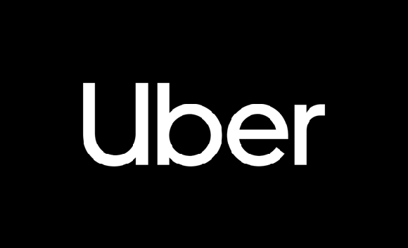



Logo
Logo
Logo should be white on darker backgrounds and black on lighter backgrounds.
Clearspace
Clearspace around the logo is equal to the cap height of the U.

Slide 4
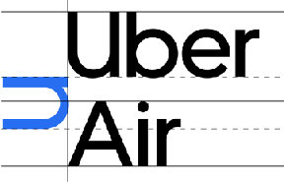
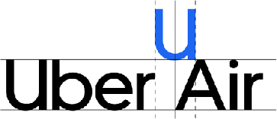

Logo
Vertical lockup
Horizontal lockup
Product lockup
Spacing and alignment guidance for aligning product names with the logo.
Partnership lockup
Aligning partnership logos should follow clear space rules. The separating line between logos can be created either by the vertical line glyph in the Uber Move Display Light at the same size as the logo.
Horizontal Lockup

Slide 5
Color
White
Black
RGB — 255 255 255
CMYK — 0 0 0 0 HEX — FFFFFF
PMS — White
RGB — 0 0 0
CMYK — 70 35 40 100
HEX — 000000
PMS — Black 6 C
Primary brand colors
Our primary brand colors are white and black. They are used to provide accessibility, simplicity, and consistency throughout all brand communications.
Safety Blue
Safety blue is an important color that is unique to Uber and should be used sparingly for moments of support, assurance, and delight
at moments of interaction between a user and the brand.
Safety Blue
RGB — 39 110 241
CMYK — 84 54 0 0 HEX — 276EF1 PMS — 2174 C

Slide 6
Color
Uber Green
Uber Yellow
Uber Red
Uber Brown
Uber Orange
Uber Purple
RGB — 71 179 117
CMYK — 93 0 63 0 HEX — 47B275 PMS — 2416 C
RGB — 255 192 67
CMYK — 0 21 76 0 HEX — FFC043 PMS — 135 C
RGB — 230 76 53
CMYK — 0 82 80 0 HEX — F25138 PMS — 7417 C
RGB — 153 100 77
CMYK — 13 56 61 32 HEX — 99644C PMS — 7525 C
RGB — 255 125 73
CMYK — 79 59 0 0 HEX — FF7D49 PMS — 164 C
RGB — 115 86 191
CMYK — 80 74 0 0 HEX — 7356BF PMS — 2102 C
Secondary colors
Our secondary colors pull from the colors of transportation. They should be used sparingly throughout illustration, photography, and product in order to maintain meaning and potency.
The secondary colors are only used reasonably for illustrations and within product.
Usage proportions
It is important to follow the rules of these proportions when creating any brand communication in order to maintain brand consistency and remain accessible for all people.
White plays a very important role in all brand communications and should provide balance with black.
Safety Blue is only used for critical moments that warrant care between Uber and the user.
Primary colors
Safety color
Secondary colors

Slide 7
Typography
Uber Move Display
Uber Move Text
Light Regular Medium Bold
Light Regular Medium Bold
Uber Move
Uber Move is a key element in our brand. It works to maintain consistency, create clarity, and provide equity to the brand as a global leader in multi-modal transportation.
We have Uber Move Display used for headlines and sub headlines and Uber Move Text used for body copy.
Pairings – Display
It is important to maintain these type pairings. This allows for clarity, consistency, and a strong hierarchy for all communications.
Medium weight should be paired with Light weight, and Bold weight should be paired with Regular weight.
Option 1
Option 2
Medium
Header
Bold
Header
Light
Subhead
Regular
Subhead

Slide 8


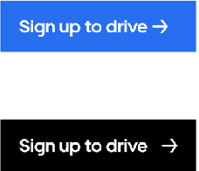

Typography
Headline
Uber Move Display Medium
This headline is two lines set in medium
This subhead is 1/2 the point size of the headline and set to light
6 words or more
1.5x logo point size (minimum)
1.0 leading
0 tracking
Hierarchy example
It is important to organize typography in a hierarchical system according to relative importance or inclusiveness through scale and function depending on communication.
Subhead
Uber Move Display Light
½ headline
1.2 leading
0 tracking
Logo
Logo height = composition margin width
Calls to action
There are 2 ways to create and identify call-to-actions for brand communications. Use Uber Move Text Bold for Action and Uber Move Display Bold for Buttons.
Action
Button
Inactive
Hover/Active

Slide 9
Assets
Logo Assets
https://drive.google.com/drive/u/1/folders/14J25RrgKwMqToxhd9AhlU-bd3V7f64jg
Logo Product Lockups
https://drive.google.com/open?id=1j6kZFsOMZ2WJBBxLT9ia2f0fJJpHIwLR
Logo Partnership Lockups
https://drive.google.com/open?id=1eiIw-EBtCsRZIoBR22BWGWlC8hp5wlQL
Color Assets
https://drive.google.com/open?id=1MAytoi_UW_YX24RgeyZKcLTIeYurCBY4
Typography Assets
https://drive.google.com/open?id=1oKKGpzCmQUyuEVao_Hx4GsZS6TLs94hT

Slide 10
Thank you.

