Slide 1
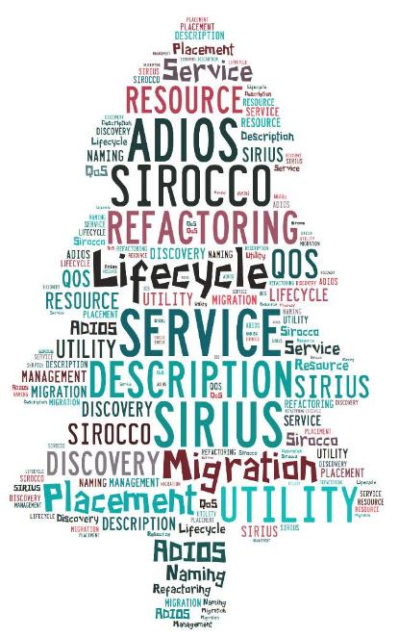
SCIENCE-DRIVEN DATA MANAGEMENT FOR MULTI-TIERED STORAGE
S. Klasky, H. Abbasi, Q. Liu, F. Wang ORNL (klasky@ornl.gov)
J. Lofstead, M. Curry, L. Ward Sandia
M. Parashar Rutgers
C. Maltzahn UCSC
M. Ainsworth Brown, ORNL

Slide 2
Outline
Motivation
SIRIUS Building blocks
Data Description
Auditing
Data Refactoring
Metadata searching
Fuzzy predictable performance

Slide 3
Where do we spend our time in science
Goals
Accelerate this process
Make the process predictable
Make the process adaptable
Make the process scalable as the complexity increases
Make the software easy-to-use
Observation
Most of the time is spent in managing, moving, storing, retrieving , and turning the science data into knowledge
Notes:
----- Meeting Notes (4/30/13 17:08) -----
step 3: rename Analysis to Analytics to connect back to the trendy buzzword

Slide 4
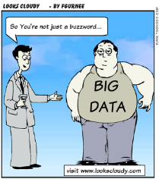
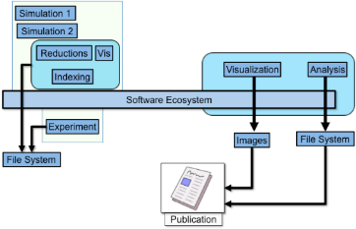
Data Intensive Science
A convergence of “Big Data meets HPC”
Computer technology is changing (Complexity)
Deep memory hierarchy
Accelerators
Scale-in & Scale Out
Experiments, Observations, Simulations are changing (Complexity)
Data (Volume, Velocity, Variety) is increasing
Distributed Data
The Nature of where and how we do science is becoming more complex, users++, physics++
Ultimate goal
Gain enough confidence, fidelity accuracy to accurately predict new science and aid in decision making
Save lives , Save money
Reduce which experiments to run and
Record and understand the best observations

Slide 5
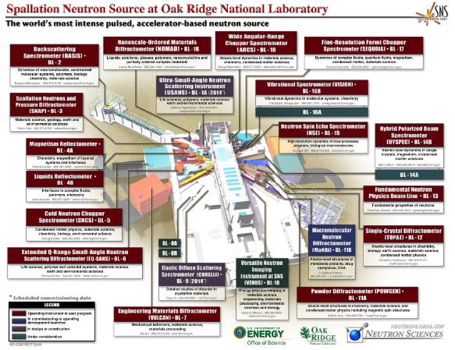
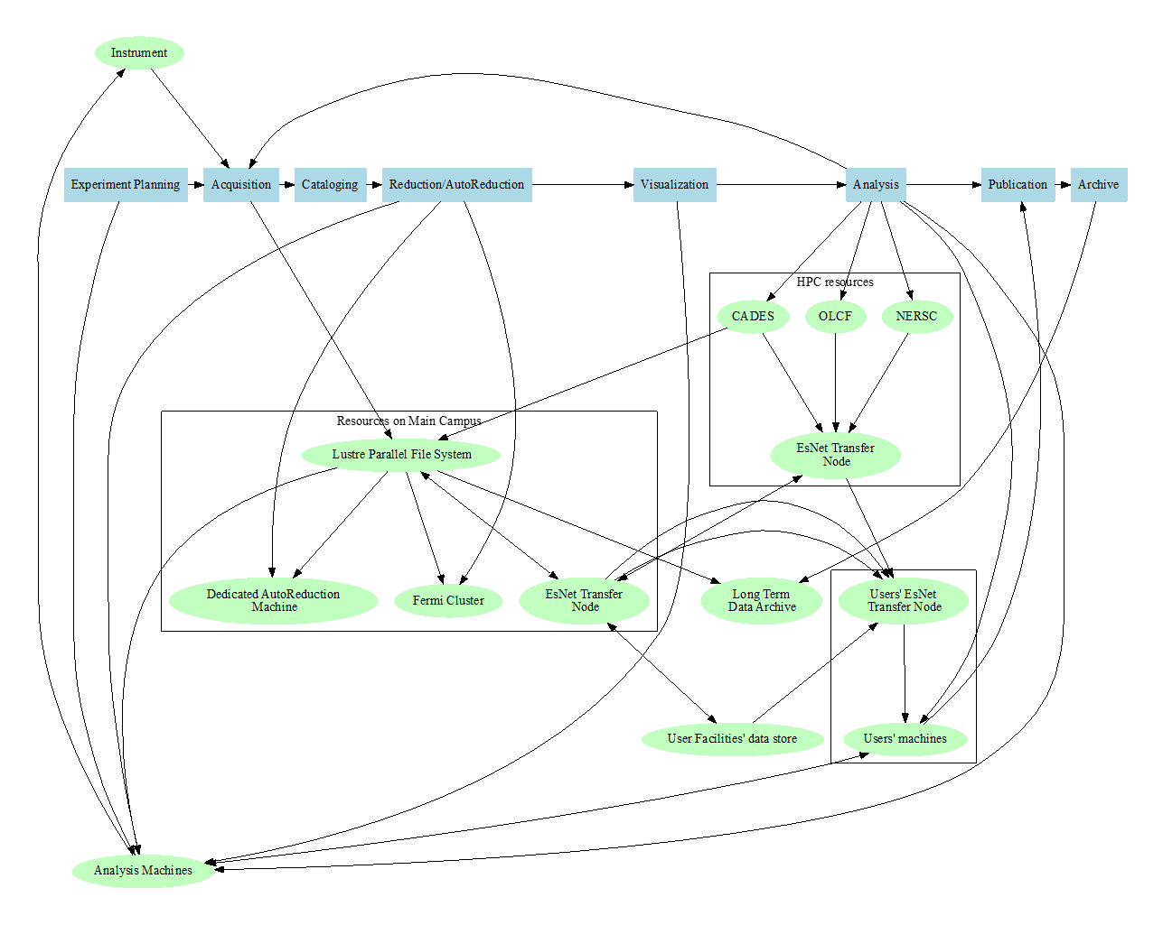
Important points for SIRIUS:
Data is at many places (local file system), Parallel File System, remote file systems, TAPE
Discovering data is very difficult, and the management is ad-hoc
Garrett E. Granroth,
Neutron Data Analysis and Visualization Division, SNS

Slide 6
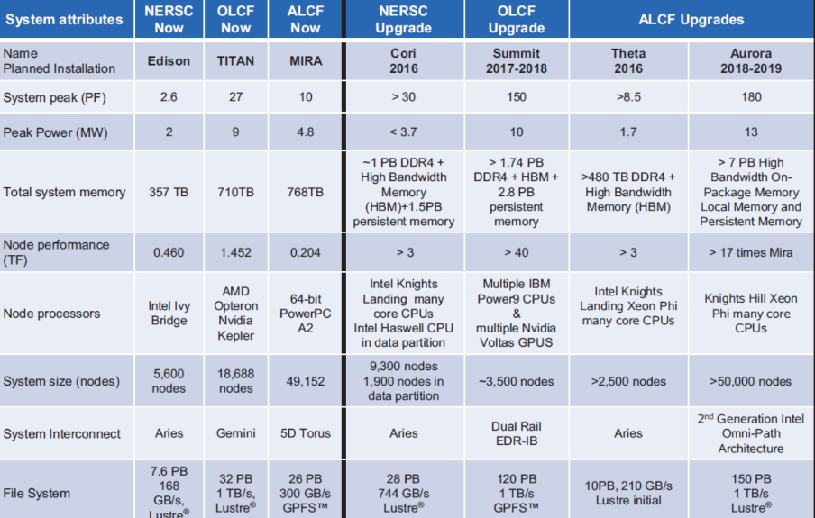
Next Generation doe computing

Slide 7
Most files on the parallel file system are tiny!

Slide 8
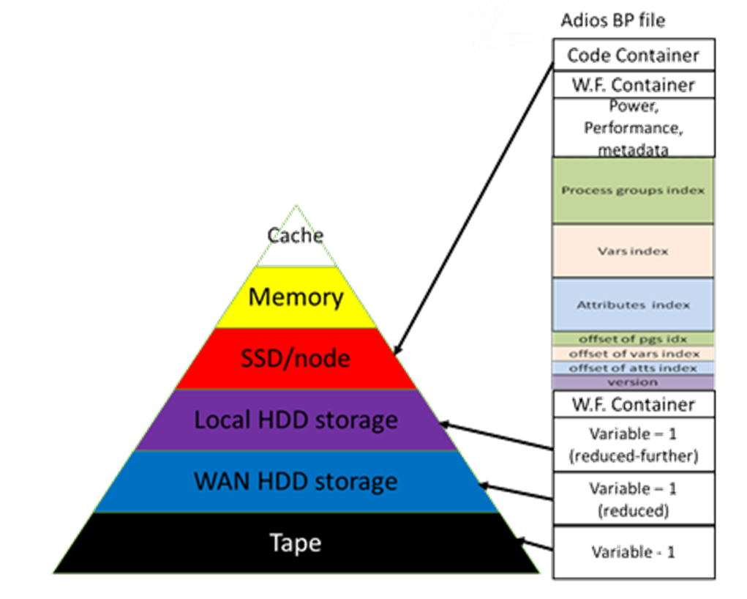
Motivation (SSIO report findings)
http://science.energy.gov/~/media/grants/pdf/lab-announcements/2015/LAB_15-1338.pdf
Standard methods (e.g., parallel file systems, archival storage management systems) of storage organization must dramatically change to provide effective SSIO for future platforms
Scientists need an integrated, coherent view of the storage resources and a common method of managing and accessing data on these resources
Scientists desire increasingly complex and specialized data abstractions that improve their productivity and the quality of their science

Slide 9
What’s broken?
We live in a world of hierarchy yet we flatten large scientific data into a “file”, or a series of files
We often give the file name attributes so we can find the file easier
We move the file by hand, using tools such as scp, gridftp, … but have no knowledge of the users, and we often only want certain information in the file
We issue a series of write/read commands but don’t tell the system any extra information
What happens if it takes 6 months to write/read in the data?
We don’t let users define priorities to data vs. accuracies
We don’t have any semantics that allow data to be placed and migrated and purged at different times

Slide 10
Two Basic principles of Sirius
Principle 1: A knowledge-centric system design that allows user knowledge to define data policies.
Today SSIO layers are written in a stove-pipe fashion, and quite often do not allow optimizations to take place
Re-design the layers in a highly integrated fashion where users place their intentions into the system and actions will statically and dynamically take place to optimize for the system and for individual requests
Principle 2: Predictable performance and quality of data in the SSIO layers needs to be established so science can be done on the exascale systems in a more efficient manner
Without predictable performance, not only can the runs be slowed down because of shared resource contention but also it affects key science decisions

Slide 11
Sirius r&D
Topic | Our work
Data abstractions | Create new APIs and annotations to guide data placement across the storage system
Mapping science data models to hierarchical storage | Enable science-driven mapping, re-organization, reduction and prioritization of data chunks derive from application objects
Mechanisms for data movement across the storage hierarchy | Enable science-driven data placement and migration based on policies
Extend the interaction of middleware with the storage system | Manage data placement and migration between the application, middleware and storage system using an autonomic cross-layer approach
Design and implement of I/O middleware architectures | Create APIs to guide the placement of chunks of data across the SSIO and autonomically move data
Approaches to improve the ability of SSIO software to support C/R | Create utility functions defined for the lifetime of data, and allow C/R data to be automatically placed in the fastest storage and then later purged

Slide 12
Outline
Motivation
SIRIUS Building blocks
Data Description
Auditing
Data Refactoring
Metadata searching
Fuzzy predictable performance

Slide 13

ADIOS
An I/O abstraction framework
Provides portable, fast, scalable, easy-to-use, metadata rich output
Choose the I/O method at runtime
Abstracts the API from the method
http://www.nccs.gov/user-support/center-projects/adios/
Need to provide solutions for “90% of the applications”
Astrophysics
Climate
Combustion
CFD
Environmental Science
Fusion
Geoscience
Materials Science
Medical: Pathology
Neutron Science
Nuclear Science
Quantum Turbulence
Relativity
Seismology
Sub-surface modeling
Weather

Slide 14
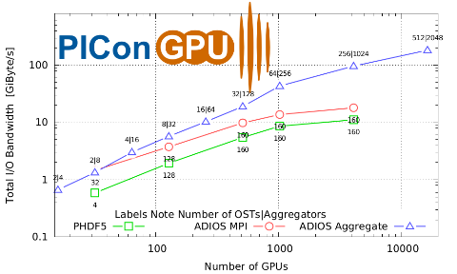
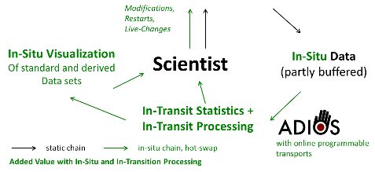


PIConGPU + ADIOS for data intensive accelerator science
M. Bussmann, A. Huebl, R. Widera - HZDR
S. Klasky, Q. Liu, N. Podhorszki, M. Wolf– ORNL
G. Eisenhauer, K. Schwan – GT
M. Parashar – Rutgers
N. Samatova - NCSU
Challenges
Approach
Study laser-driven acceleration of ion beams to make it an affordable alternative to conventional accelerator based radiation therapy and X-ray therapy of cancer
Output data during the entire simulation with as many time steps as possible to study the physical effects; this means 100s of TBs of data are generated per hour
Create a computational laboratory to allow for real-time processing for optimizing parameters of the laser
PIConGPU is a relativistic Particle-in-Cell (PIC) GPGPU code Optimize the target (form, composition, size) and laser parameters (intensity, pulse duration, contrast) to achieve high proton beam energies and good beam quality
Use ADIOS for massive self describing data requirements
Use ADIOS staging for in situ steering of the simulation
Select Results
“ADIOS was able to achieve 184 GB/s on 16,384 nodes on Titan
Research Products/Artifacts
“ADIOS was allowed new physic insights due to the speed and flexibility of the framework”, M. Bussmann, A. Huebl
Notes:
A. Huebl: on ease-of-use
“We are using the bare C-API so ease of use is good since you have a
great manual. I don't count reported bugs / outdated documentation (that were very
quickly fixed) as ease of use.
Ease of use as a user for me is:
- well documented releases (a change log)
- working examples and tests
- useful headers with version numbers, etc.
- good tool support
since ADIOS has all that, I think it is pretty good to use, also keeping
in mind the tremendous complexity that it wraps away.
Specifically transformations are, now they are fixed, fantastic to use
(such as online compression that we value a lot)!”
14

Slide 15
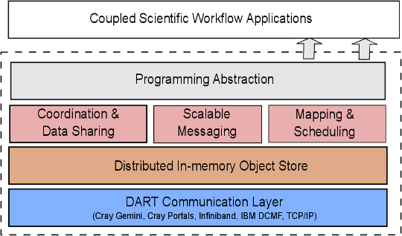
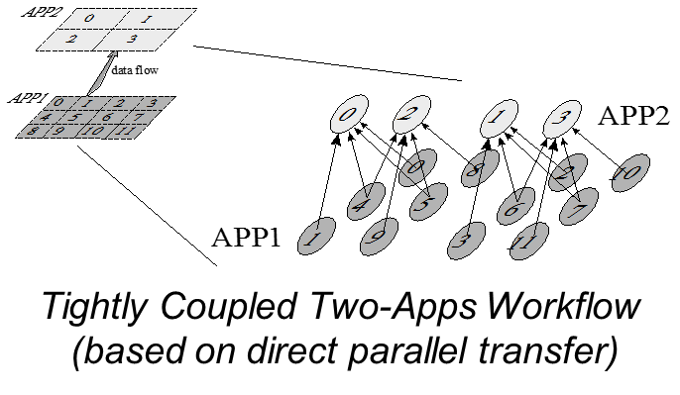
DataSpaces
Virtual shared-space programming abstraction
Simple API for coordination, interaction and messaging
Distributed, associative, in-memory object store
Online data indexing, flexible querying
Adaptive cross-layer runtime management
Hybrid in-situ/in-transit execution
Efficient, high-throughput/low-latency asynchronous

Slide 16
The Sirocco Object Store - SOS
A two-part system:
A low-level, hierarchical fixed-depth object storage system
Smart clients that expose user APIs
Light Weight File System-inspired philosophy
Clients bring/opt-in to services they require
Naming, locking, distributed transactions
Peer-to-peer inspired design
Ephemeral servers and clients
Data and location(s) are decoupled
Greedy optimization of QoS (network, storage, reliability)
Popularity drives copy creation
http://www.cs.sandia.gov/Scalable_IO/sirocco/

Slide 17
Core Design Principles of SIROCCO
No central indices for data location
Data will move continually for integrity
Emphasize scalability, minimality over legacy
Symmetric APIs for all storage
Owner dictates resilience
Servers never couple
Servers cooperate for data safety
Clients cooperate for enhanced semantics
Location choice
Consistency

Slide 18
Outline
Motivation
SIRIUS Building blocks
Data Description
Auditing
Data Refactoring
Metadata searching
Fuzzy predictable performance

Slide 19
Data Descriptions
How do we describe/annotate data generated from applications?
To capture application knowledge and communicate them to middleware/storage
Data utility
Relationships between datasets
Semantics
To specify user requirements
QoS :E.g., bandwidth
Policy: E.g., where and how long should my data stay on a storage layer

Slide 20
Conceptual APIs (for writing)
sirius_init( (in) size)
sirius_open( (in) filename, (out) fh)
sirius_write( (in) fh, (in) buffer, (in) “name”, (in function) refactoring, (in) utility)
sirius_write( (in) fh, (in) buffer, (in) “name2”, (in function) refactoring, (in) utility)
sirius_perform_write( (in) fh, (in) max_time)
sirius_close( (in) fh)
sirius_finalize()

Slide 21
Conceptual APIs (for reading)
sirius_read_open()
sirius_schedule_read(fh, sel, varname, data)
sirius_get_read_time(fh,“deadline=10min”)
sirius_perform_read()
sirius_read_close()
How does the system reassemble the pieces after the data has been refactored?
Re-factoring might mean combing different data chunks together, and this takes time!

Slide 22
Outline
Motivation
SIRIUS Building blocks
Data Description
Auditing
Data Refactoring
Metadata searching
Fuzzy predictable performance

Slide 23
New techniques for “Data Intensive Science”
IDEA: AUDITOR: An additional “simulation” whose purpose is to monitor the fine scale simulation and initiate appropriate actions when anomalies are detected.
Examples
Trigger a checkpoint
Trigger a roll-back
Trigger a local change in a function
…
Not confined to stability issues because it will always reset
Can allow data regeneration cheaply

Slide 24
Basic quantities in Information Theory
Data stream S and for x ∈ S let
P_{r}(X=x) = p_{x} ∈ [0,1]
Shannon Information Content
h(x) = - log₂ p_{x}
Entropy
H(S) = - Σ p_{x} log₂ p_{x}
Noisy/random data has HIGH ENTROPY

Slide 25
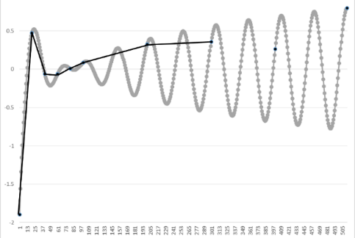
Current practices of today
Linear interpolation
Want to write data every n^{th} timestep
Because of the Storage and I/O requirements users are forced to writing less
Common practice is to write data at every m^{th} timestep, stride = M
If the users reconstruct their data, u(t), at the n^{th} timestep, they need to interpolate between the neighboring timesteps
Φ_{M}(u) = interpolant on coarser grid (stride M), reduce storage my 1/M
Assume (C=constant depending on the complexity of the data)
Original storage cost = 32*N bits (floats)
New storage cost = 32*N/M bits + { 23 – log₂ (C M² Δt²)}N
Ratio = (1/M – 1/16 log₂ M) – 1/16 log₂ Δt + constant
u-ϕ_{M}(u) = O(M² Δt²) : 2nd order interpolation
Cost to store ϕ_{M} + Cost to store mantissa of u- ϕ_{M}(u)
Notes:
8 bits in a byte, 4 bytes per word, N words, M=stride

Slide 26

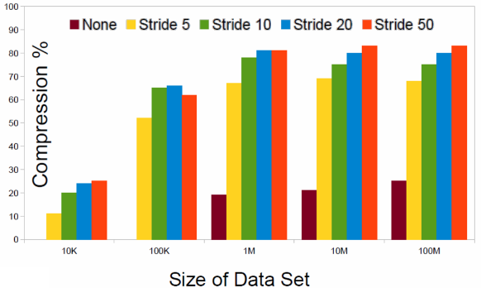
Compression with an interpolation auditor
Linear interpolation is the auditor
If we look at 10MB output then with a stride of 5
Total output = 50MB for 5 steps
10 MB, if we output 1 step
43MB “typical lossless compression”
18MB, using linear auditing but lossless

Slide 27
Other types of auditors
The key to better auditors is to understand what you are simulating/observing
Use a reduce model
Use less resolution
Use a linear equation for short spatial/temporal regions
And other ways to refactor
Precision based re-organization
Store the sign, exponent, and first 3 digits in one bucket for all the values, then the next 5 digits, then the next 6 digits all in separate buckets
Frequency based re-organization
Wavelets
More knowledgeable auditors
Cost of data re-generation vs. data storage/ retrieval

Slide 28
Outline
Motivation
SIRIUS Building blocks
Data Description
Auditing
Data Refactoring
Metadata searching
Fuzzy predictable performance

Slide 29
Computer science challenges in Data Refactoring
To understand the cost associated with refactoring data, e.g., the CPU cycles, extra memory consumed, and communication.
For an auditor-like approach
Where should the auditor run, taking advantage of locality as much as possible?
How much resources to allocate?
How will the auditor and the application communicate?
Most importantly, how do we take both error bound and cost into consideration.
Does the refactoring affect the fidelity of the applications? If so, how much?
After data is refactored, how do we map it to the storage hierarchy? How do we enforce policy?

Slide 30
Memory/Storage arrangement
a. Original memory arrangement
Application
Memory
Particles
Field 1
Field 2
Mesh
b. Refactored and reduced data
Application
Memory
P1
P2
P3
P4
F1
F2
G1
G2
M1
M2
c. Initial storage layout after data movement settled
Parallel FS
P1
P2
F1
G1
M1
Campaign
F2
G2
M2
Long Term
P3
P4
d. Storage layout at a later point in the data life-cycle
Parallel FS
P1
F1
G1
M1
Campaign
F2
G2
M2
Long Term
P3
P4
P2

Slide 31
Data Refactoring and Utility Functions
Need to explore what and where the computation will occur
Flexibility in location based on past work
Flexibility in which operation to perform on which chunk of data
Code generation or code containers are potential study targets
Maintaining relationship between data chunks
Carry attributes from generation to consumption and feedback into a utility computation

Slide 32
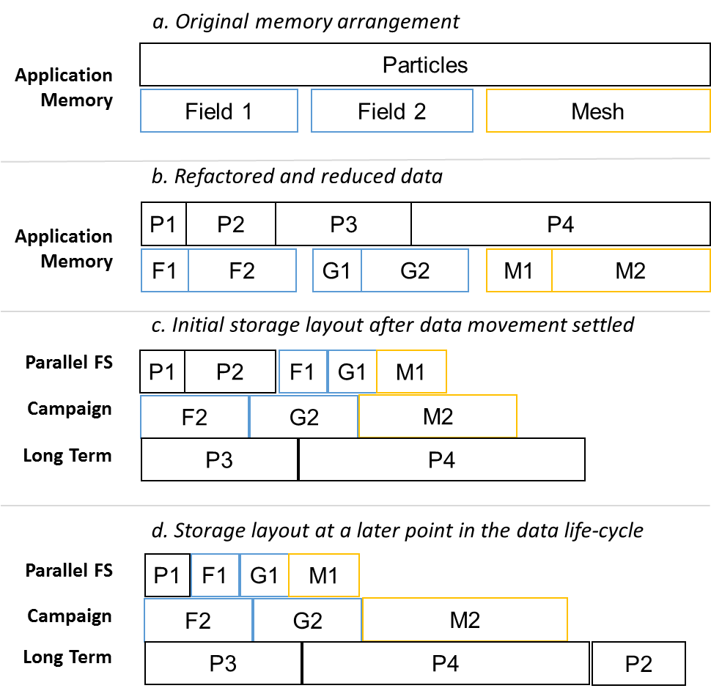
Utility and the User
Describes how long a data chunk will live at a level of the storage hierarchy
Utility is a broad description
Spatial or temporal utility of data
Utility based on in-data features
Utility based on statistical features
Utility has a large component from the user and the use case
Experimental design factors in here
Solving a specific scientific problem => specific data utility function
API for ingesting user preferences and combining with historical provenance
Dynamic utility for online analysis/visualization use cases
e.g. The utility of F1 may be defined more explicitly as, for example, (priority=1, (time-NVRAM=8 hours, time-PFS=30 days, time-CAMPAIGN=100 days, time-TAPE=1000 days),
(priority=2, (time-NVRAM=1 hours, time-PFS=4 days, time-CAMPAIGN=100 days, time-TAPE=300 days).

Slide 33
Relationships between data chunks
Chunked data is best data
Size of chunk
Intra-chunk relationship
Temporal chunking is as valid as spatial chunking
Data oriented design
Inter-chunk relationships
Consistency differences
Precision differences
Delta relationships
E.g. (M1,M2), (F1,F2), (G1,G2) are related: part of the same data structure, but M, F, G are related, so we would want M1 if we read F1 and or G1

Slide 34
Outline
Motivation
SIRIUS Building blocks
Data Description
Auditing
Data Refactoring
Metadata searching
Fuzzy predictable performance

Slide 35
Sirocco Complicates Metadata
Storage devices rather than a file system
No built-in metadata operations as part of IO
Distributed pieces EVERYWHERE
Resilience copies
Storage devices come and go
Performance characteristics can vary considerably

Slide 36
Reading is Hard, But Possible
General case: Search
Use Proxies to enable caching of data and/or location
Cooperative arrangement between clients
Proxies demand exclusive write access

Slide 37
SIRIUS Complicates Metadata
Pick a variety of storage targets based on data “importance”
Different data “compression” on different data pieces
Try to “guarantee” performance
Need to consider decompression/regeneration time if multiple versions exist
Enhance placement decision based on predicted future use
Based on tracking previous use (which needs to be tracked somehow)

Slide 38
Outline
Motivation
SIRIUS Building blocks
Data Description
Auditing
Data Refactoring
Metadata searching
Fuzzy predictable performance

Slide 39
The End-to-End Data Path
Titan Compute Cluster
440 I/O Router
18,688 compute node
and 299,008 cores
Storage Servers (OSS), 288 Dell servers, 64GB RAM each
SION Infiniband Network: 1600 ports, 56 Gbit/sec
Enterprise Storage System: 36 DDN12K-40 controller pairs

Slide 40
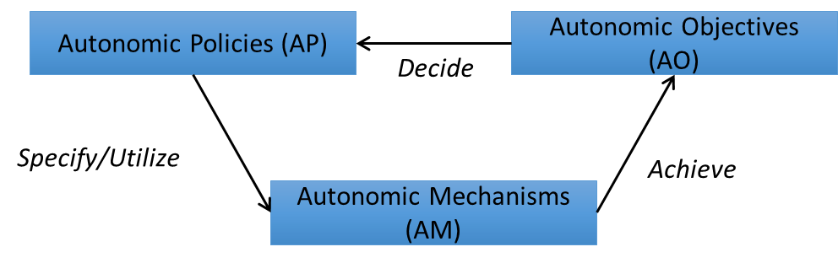
Autonomic Runtime Optimization
Autonomic Objective (AO):
A requirement/objective/goal defined by the user
E.g. least: data movement, end-to-end time, …
Autonomic Policy (AP)
A rule defined to utilize one or more AM(s) to achieve an AO
E.g. data placement adaptation, power consumption adaptation, etc.
Autonomic Mechanism (AM)
An Action that can be used to achieve an AO.
E.g. performing analytic in-situ, change data resolution, change data placement, etc.

Slide 41
Predictable Quality of Service
User: Execute job description J in less than time T at resolution R
System: No, but I can do J in less than T at resolution R’ < R, or can do Job at T’ > T at resolution R.
User: Execute J in less than T at resolution R’.

Slide 42
System Interface
User: Declarative Job Description
Describes workload
Demands latency and resolution guarantees
System: Admission control
Knows about current system utilization and obligations
Discovers possible latency/resolution trade-offs by online sampling
Guarantees or rejects new obligations
Assigns deadlines to workflows

Slide 43
System Mechanisms
Scalable control plane
Tracks data placement and resolution by storage tier (memory/flash/disk/tape)
Monitors resource utilization (CPU, network, memory, storage, …)
Configures schedulers
Schedulers
Allocates resources to workflows: how much
Dispatches resources to workflows: when
Bills workflows for resource utilization
Online Sampling
Probes how quickly particular data can be retrieved

Slide 44
Absolute, Workload-independent Scheduling Metrics
Example: Time utilization
Enables performance isolation
Only need to know once how much I need for my workload
Counter-examples: Priority, Throughput
Dependent on workload
Dependent on everyone else’s workloads
Never any certainty how long things take

Slide 45
Challenges
Scalable admission control
Need scalable control plane (leverage existing work on causal metadata propagation and online sampling for latency/error trade-offs)
Resource-specific schedulers to make performance of resource predictable
Example: read/write sepearation at flash devices
Online sampling to provide quick latency/resolution trade-offs
Without significantly interfering with ongoing workload

Slide 46
Summary
Sirius is attempting to redefine I/O based on key findings
I/O abstractions (Posix) do not give the system enough information to fully optimize
Data is too big to keep in one place and current systems purge data without user intervention
Variability is too large, and users are not in control of their data
Scientific Data is not random data
There is content to the data
Auditing calculations to prioritize, reduce data sizes but keep the information is critical to reduce the time of understanding

Slide 47

Questions

