Slide 1
Lustre at ORNL
Dustin Leverman <leverman@ornl.gov>
10/20/15

Slide 2
Overview:
Lustre file systems in NCCS (National Center for Computational Sciences)
Atlas design (primary scratch)
Atlas routing to clusters
Atlas production issues:
Slow disks
IO harness for validation

Slide 3
Lustre file systems in NCCS
Atlas
30PB broken into two file systems
1TB/sec write throughput (demonstrated)
Primary scratch for OLCF (Titan)
F1
Single 6.3PB file system
~170GB/sec write
Connected to Gaea
OrbFS
Single 70TB File system
Dedicated to Everest
Tuned for reads (requires 10GB/sec) for Everest resolution

Slide 4
Lustre in NCCS Continued
SithFS
Single 92TB file system
~1.5GB/sec write
Scratch area for Sith
SNS (Spallation Neutron source)
~10GB/sec write
Storage for beam-line instruments
Many other misc systems that are non-prod:
ESSCFS
KnotFS
Atlas-TDS
Kronos
Leto
Tick
Sultan
Liberty / Redscare

Slide 5
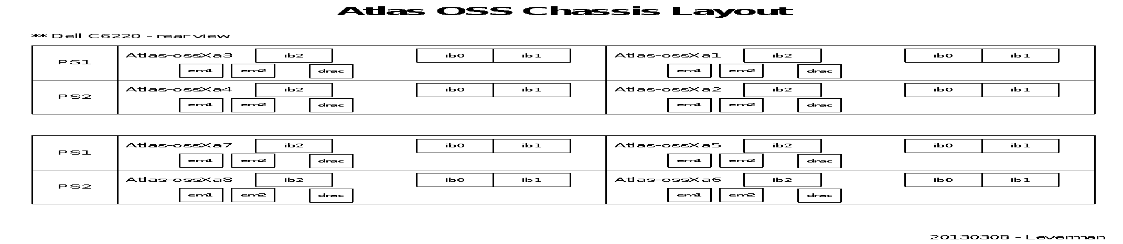
Atlas Design
4 rows (10 cabinets per row)
72 OSSs per row (288 total)
9 SSUs per row (36 total)
each with 1 DDN SFA-12K40X, 8x Dell C6220 nodes
Each OSS has 14 OSTs
7x production (15.3TB each)
7x test (275GB each)
9 FDR TOR IB switches per row (36 total)

Slide 6
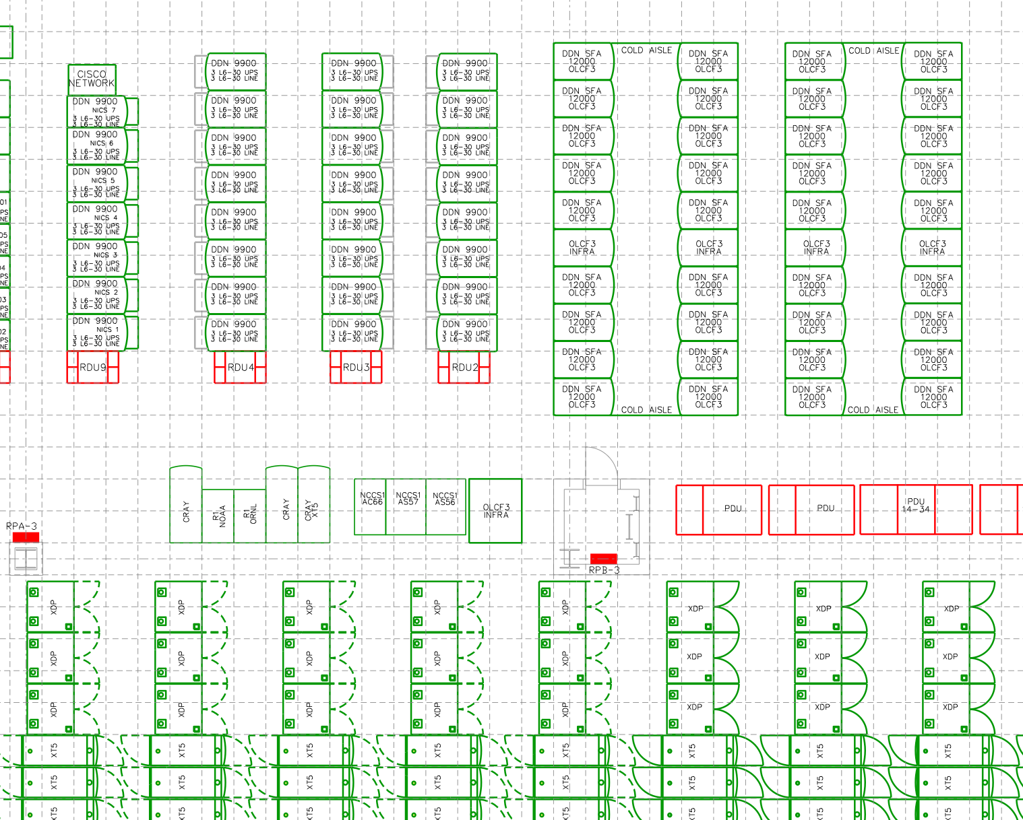

Slide 7
Atlas Management
SION core switches
Atlas prod MDT/MDS
Atlas DNE MDS and MDT
10GE core
Primary IBSM
Linkfarm
Lustre-mgmt
TDS OSS/MDS
Atlas spare nodes

Slide 8
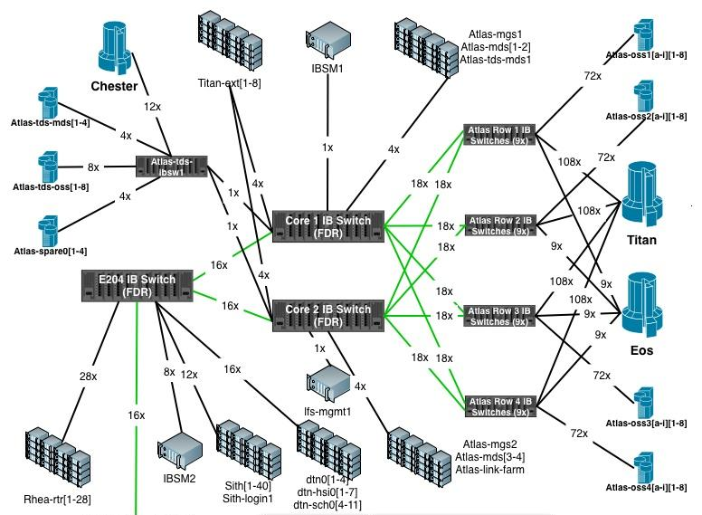

Slide 9
Atlas routing to Clusters and Crays
Many Clusters and Supercomputers in the center:
Titan (~18k clients) – Gemini interconnect (FGR)
Eos (~750 clients) – Aries interconnect (FGR)
Rhea (~500 clients) – FDR Inifniband (FGR – future)
Other small clusters (~200 clients) – FDR Infniniband
Test/Development systems, DTN, login, and mgmt nodes (~300) – FDR Infiniband
LNET routers for all clusters, to break up the fabric
Except for the case of small clusters, DTN, login, etc…
We use FGR on our larger systems and connect them much closer to the OSSs (less latency).

Slide 10
Fine Grained Routing at ORNL
Lustre by default round robins through LNET routers
On large systems a compute node can be several hops away from a random router.
FGR places IO on LNET routers that topologically close on the network.
Unidirectional and bidirectional configurations
Just FGR on the IO server or IO client side?
Tuning for writes, reads, or both.
Observed a 10%-15% improvement in IO performance on JaguarPF/Widow (previous gen)
Titan cannot be run in a non-FGR configuration

Slide 11
Fine Grained Routing at ORNL
Rhea uses unidirectional FGR
36 routers total
Each goes to one of the 36 Atlas leaf switches
Every line card on the Rhea IB switch has a single router
Eos uses unidirectional FGR
38 routers total
36 links to the Atlas leaf switches
2 routers dedicated for MDS traffic
Titan uses bidirectional FGR
440 routers total
12 links per atlas leaf switch for OSS traffic (432 routers)
8 routers dedicated for MDS traffic
36 lustre NIs (one for each leaf switch)

Slide 12
Atlas Production issues: Slow disks
Over time disks can develop slow IO behaviors for certain types of operations.
Observed LUN degradations from 1.2GB/s to 300MB/s from a single disk.
This can severely degrade a job’s performance
Can see degradations in write, read, sequential, and random IO operations.
We have put verbiage in acceptance documents:
“Every LUN in the SSS shall be within +/- 7.5% of the average LUN bandwidth over the SSS for that test”
“Each LUN must meet or exceed 900 MiB/s for sequential writes”
About 1% of the disks in the system were out of spec.

Slide 13
Atlas Production issues: Slow disks
In production slow disks are difficult to find.
Thin LUNs are very important:
Allow you to write to the block device.
Avoid file system caching
Tangent: Test production code changes in identical environment
At-scale environments behave very differently than test systems.
Sometimes upgrades involve on-disk format changes that make it so you can’t (difficult) to roll back…
On Atlas the thin LUNs “use” 1PB of storage; it’s worth it.
Need to take test shots to find slow disks, so workloads that look randomized at the backend do not create IO latency (false positives).
DDN has in interface to help with this if you cannot take outages or do not have thin LUNs.

Slide 14
Atlas Production issues: Slow disks
How to find slow disks:
Run your favorite block level benchmarking software like: fair-lio, fio, or xdd
Need to test different workloads:
100% Sequential Read
100% Sequential Write
100% Random Read
100% Random Write
Be aware that disk’s block refresh algorithms (ATI) could change the performance between runs.
We have observed several hundred MB/s performance drop
Tangent: Be aware that disk firmware can negatively impact mixed workloads; like 80% sequential, 20% random

Slide 15
Lustre IO Harness
Synthetic benchmarks do not expose bugs like real world applications.
IO Harness runs many codes at once to simulate actual behavior in production.
Needs to be updated as user-base and codes change.
Identified many many bugs in testshots that would have significantly impacted production.
LU-4008 – metadata performance
LU-4584 – client evictions
LU-5724/5803 – Recovery issues
LU-7173 – MPIIO jobs cause mds to crash
Many others

Slide 16
Lustre IO Harness
Original codes:
S3D
GTC
MPIIO
Flash
CESM
Updated codes:
S3D
GTC
MPIIO
HACC-IO
ADIOS
ACME
Synthetic Benchmarks
IOR – spot check small scale
IOR – hero run (at-scale)
Mdtest – verify metadata performance
Simul – spot check POSIX semantics

Slide 17
Lustre IO harness
Need a strategy for choosing codes (some examples are very similar to others):
Metadata intensive or object intensive:
Some compile on the lustre file system at run time (very MDS intensive)
File per process vs. single shared file
Many small files vs. small number of large files
Varying IO sizes to Lustre servers
Varying scales of job runs

Slide 18
Questions?

Slide 19
Upcoming Lustre features
DNE
Phase 1
Phase 2 – targeted
Data on meta-data
Declustered Z-Pools?
IME, BB, or accelerated caches?
In kernel lustre client

Slide 20
Tools
LMT – ltop
MDStrace reports
DDNstat
BRW_stats
JobStats
LustreDU
FCP
Parallel Rsync

