Slide 1
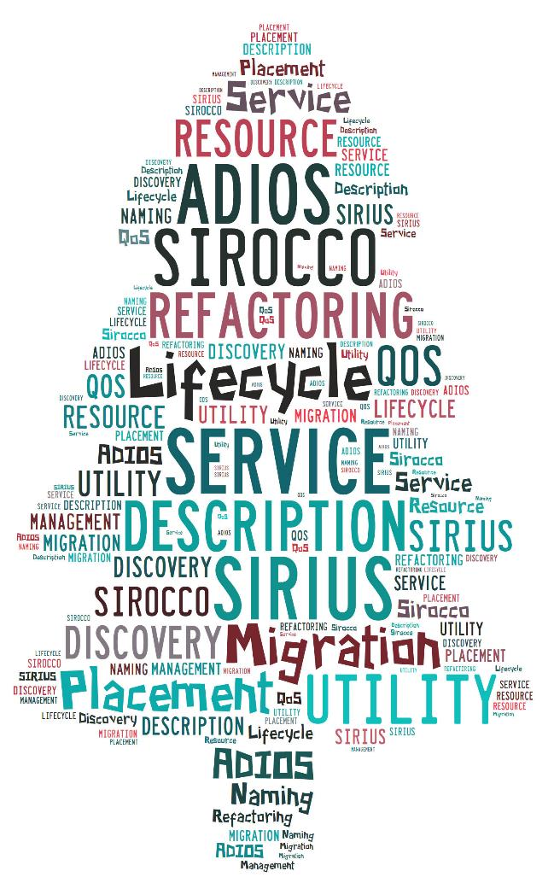
SCIENCE-DRIVEN DATA MANAGEMENT FOR MULTI-TIERED STORAGE
S. Klasky, H. Abbasi, Q. Liu, F. Wang ORNL
J. Lofstead, M. Curry, L. Ward Sandia
M. Parashar Rutgers
C. Maltzahn UCSC

Slide 2
Research Goals
Create new data abstractions to guide placement across the storage system
Enable science-driven mapping, re-organization, reduction and prioritization of data chunks derive from application objects
Manage data placement and migration between the application, middleware and storage system using an autonomic cross-layer approach
Create APIs to guide the placement of chunks of data across the SSIO and autonomically move data

Slide 3
SIRIUS team
ORNL
Scott Klasky
Hasan Abbasi
Mark Ainsworth
Gary Liu
Feiyi Wang
Sandia
Jay Lofstead
Matthew Curry
Lee Ward
Rutgers
Manish Parashar
UCSC
Carlos Maltzahn

Slide 4
Deliverables – Year 1
Develop techniques for data description to describe the data utility based on user expectations. (ORNL)
Evaluate general techniques for refactoring of data that will be embedded in the system . (ORNL)
Explore the use of application hints and utility of data to guide the initial placement of data. (Rutgers)
Investigate the trade-off between “filing” and “piling” data. Demonstrate a time bounded search approach for finding data within the storage system to identify data and the current location. (UCSC)
Demonstrate a metadata service capable of serving both POSIX clients and our clients. (Sandia)

Slide 5
Deliverables – Year 2
Develop a querying system to allow applications to inquire about completion timing information. (ORNL)
Evaluate the effectiveness and overhead to re-organize data and use the multi-layer approach to staging. (ORNL)
Research autonomic data management strategies that can evaluate utility/cost trade-o, and appropriately place/-move data objects at runtime.
Research runtime tracking and estimation. (Rutgers)
Extend Sirocco to enforce data-centric metrics that help guide the QoS decisions. (Sandia)
Prototype time bounded search approach for finding data within the storage system (UCSC)

Slide 6
Deliverables – Year 3
Work with DOE applications to assess the new I/O interface including both APIs and hints. (ORNL, Rutgers)
Prototype new QoS methods for storing & retrieving data in given time bounds. (ORNL, UCSC)
Demonstrate admission control and show scalability for application loads and storage system pressures to maintain quality of service. (Sandia, UCSC)

Slide 7
Memory/Storage arrangement
a. Original memory arrangement
Application
Memory
Particles
Field 1
Field 2
Mesh
b. Refactored and reduced data
Application
Memory
P1
P2
P3
P4
F1
F2
G1
G2
M1
M2
c. Initial storage layout after data movement settled
Parallel FS
P1
P2
F1
G1
M1
Campaign
F2
G2
M2
Long Term
P3
P4
d. Storage layout at a later point in the data life-cycle
Parallel FS
P1
F1
G1
M1
Campaign
F2
G2
M2
Long Term
P3
P4
P2

Slide 8
Goals
I/O needs a new set of APIS to allow users the ability to
Tell the SSIO what is important
Lifetime of the pieces
Time before useless
SSIO needs a new layer to allow “Big Data” to become usable again
Remove the “Art” of doing data management
Predictable Performance vs. accuracy
Our goal is to build a prototype but keep important users as our stakeholders
Talk to our users → try to get funding for our users to work with us
We want to fundamentally change the nature of SSIO for the HPC community

Slide 9
Research Questions are paramount
Focus on questions:
What abstractions can be used to describe data utility and how can they be executed in the SSIO layer?
Can we expedite the time to solution (of analysis) by placing variables in multiple layers of the storage hierarchy? Does this slow down writing, reading? Speed up by X%, reduce storage in higher layers by Y%?
Can we trade accuracy for performance and give “reasonable” bounds?

Slide 10
Simple Study from XGC cyclone case
If we take the first three digits then the error in the spatial derivates are O(10⁻³)
Sorting the values (in chunks) and then compressing can greatly reduce entropy
Open Questions
Going through the Matlab and IDL code from scientist for typical analysis will allow us to further understand the errors
What parts of data go to which parts of the storage?

Slide 11
Suggestion
XGC1 is good test case for a PIC simulation
Look at a Finite Difference or Finite Element Simulation too

Slide 12
Demo(s)
We need to demonstrate our software to Lucy in 1 year from our start date
Want to show several aspects of our software stack
Want everyone to participate

