Slide 1
SIRIUS-related SSIO questions
Data semantics
Mechanisms to let storage and I/O understand data
Can’t store everything and need to prioritize data that are more important.
QoS
No guarantees: performance, capacity
Differentiated storage services, SOSP’11
“an I/O classification architecture to close the widening semantic gap between computer systems and storage systems. By classifying I/O, a computer system can request that different classes of data be handled with different storage system policies.”
No user policies
Storage stack is too complex
Applications->middleware->burst buffer->PFS
No easy way to manipulate the I/O behavior of each layer in the I/O path
IOFlow paper in SOSP’13

Slide 2
SIRIUS Application Drivers
XGC1 large data volume in the ITER-size run
Involving a large number of particles (1PB per day for analysis output)
How to reduce data?
How to prioritize data that more important?
E.g., Particles at high velocity space are more important than others
Blobs
GTC-P wave tracking
Waves can developed in a Tokamak and needs to be tracked and studied.

Slide 3
Data Descriptions
How do we describe/annotate data generated from applications?
To capture application knowledge and communicate them to middleware/storage
Data utility
Relationships between datasets
Semantics
To specify user requirements
QoS
E.g., bandwidth
Policy
E.g., where and how long should my data stay on a storage layer

Slide 4
(Conceptual) SIRIUS APIs
sirius_init(“config.xml”)
I/O configuration: e.g., description of data relationships, policy, # of buckets
<relationship name=“r1” type=“access together”/>
<var name=“primary var” gwrite=“p” type="double" dimensions="1,NX” Priority=“2”, relationship=“r1”/>
<var name=“mesh” gwrite=“m” type="double" dimensions="1,NX” Priority=“2”, relationship=“r1”/>
<var name=“derived var” gwrite=“d" type="double" dimensions="1,NX” Priority=“1”/>
sirius_open()
sirius_write(“primary var”, p, f_{refactoring_p})
f_{refactoring_p} is a callback routine supplied by a user that refactors data and assign utility value to each chunks.
sirius_write(“derived var”, d, f_{refactoring_d})
sirius_close()
sirius_finalize()

Slide 5
(Conceptual) SIRIUS APIs
sirius_read_open()
sirius_schedule_read(fp, sel, varname, “deadline=10mins,location=ssd,duration=1day,err=0.0001”, data)
sirius_perform_read()
sirius_read_close()

Slide 6
Data Refactoring
Potential computer science challenges
To understand the cost associated with refactoring data, e.g., the CPU cycles, extra memory consumed, and communication.
For an auditor-like approach
Where should the auditor run, taking advantage of locality as much as possible?
How much resources to allocate?
How will the auditor and the application communicate?
Most importantly, how do we take both error bound and cost into consideration.
Does the refactoring affect the fidelity of the applications? If so, how much?
After data is refactored, how do we map it to the storage hierarchy? How do we enforce policy?

Slide 7
Quality of Service
Has been talked about a lot in HPC.
Still storage systems don’t provide QoS
Alternative approaches
I/O Re-routing technique. Q. Liu, et. al., USENIX HotStorage'13
CALCioM by M. Dorier, IEEE IPDPS’14
Have been looking at OS-level virtualization using Linux container
Very light-weight and effective in providing QoS.

Slide 8
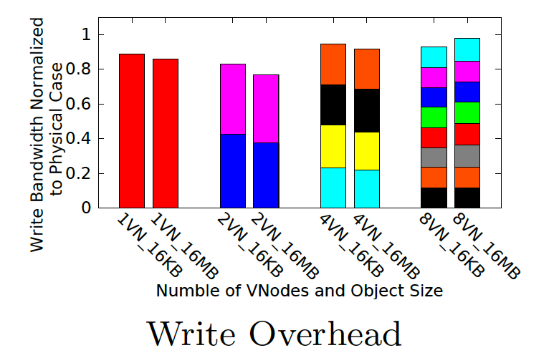
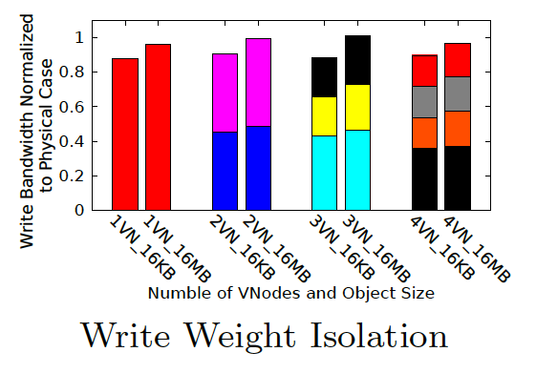
OS-level Virtualization
Low overhead
Good performance isolation

