Slide 1

Bank churn modeling: A solution-based approach
Vincent Techo, PhD
Jul 10, 2023

Slide 2

Contents
Business Problem Overview and Solution Approach
Data Overview
EDA Outcomes
Data Preprocessing
Model Building & Performance
Conclusion

Slide 3
Business Problem Overview
3
The banking industry is high dynamic in recent times.
Many virtual banks are opening up.
Competition is growing

Slide 4
Solution Approach
4
Understand the type of customers
Understand customer behaviors and preferences
Impact of Age, Salary, Credit Score, Account Balance, etc. on on customer churn

Slide 5
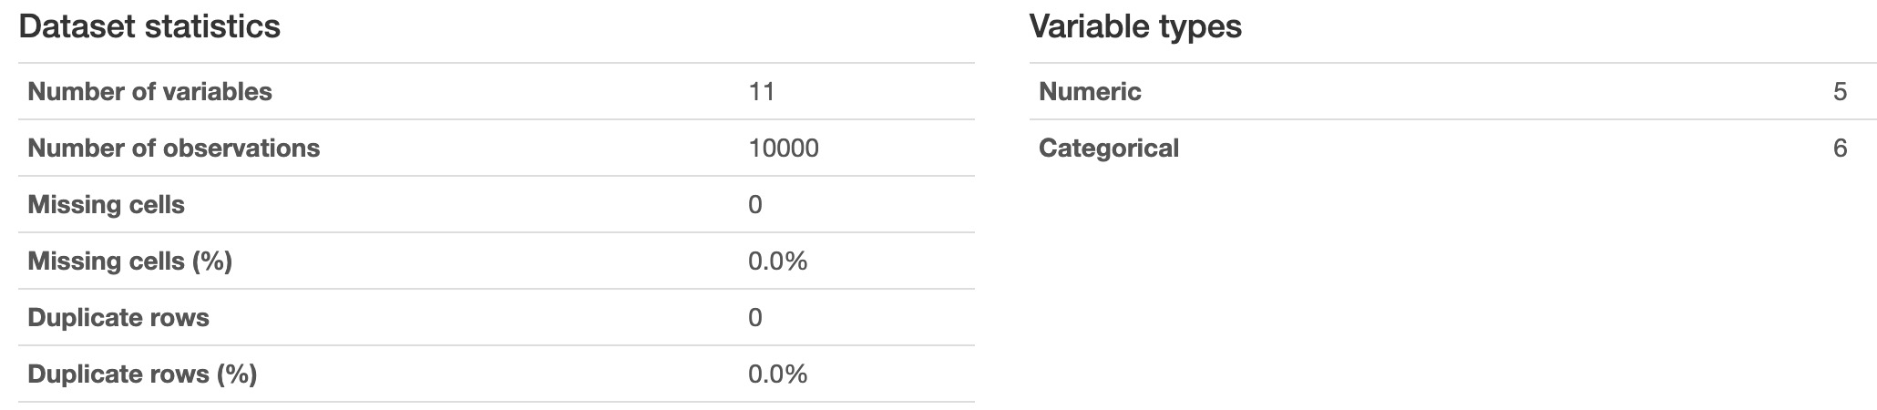
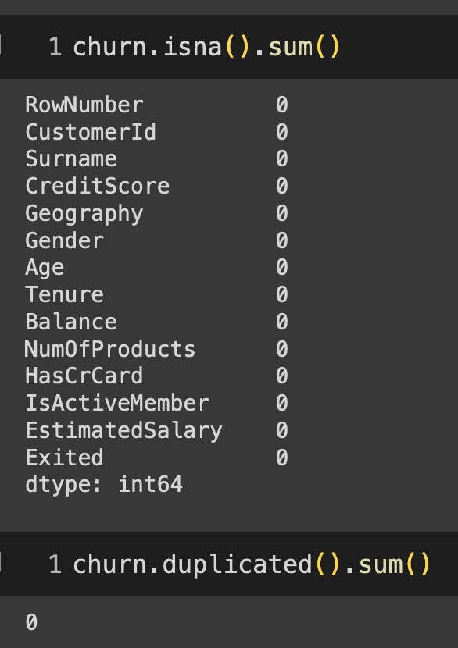
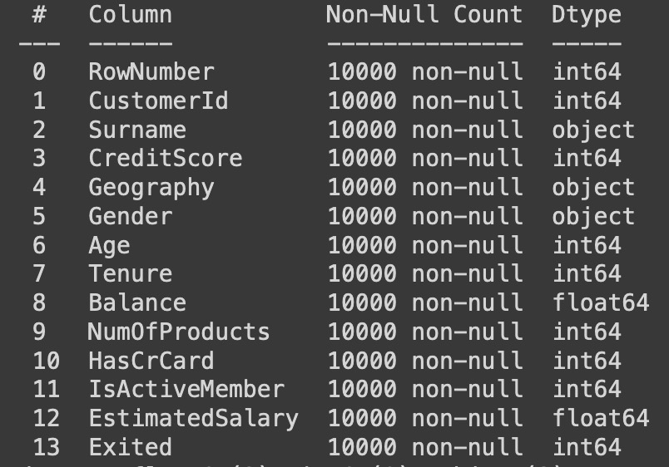
Data Overview
5

Slide 6
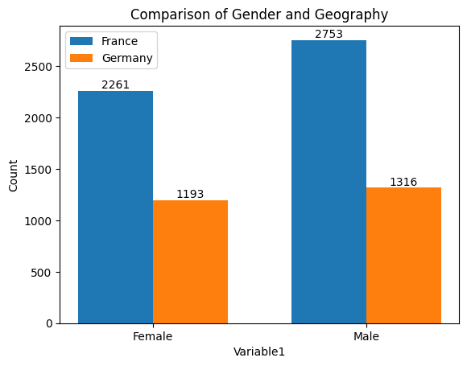
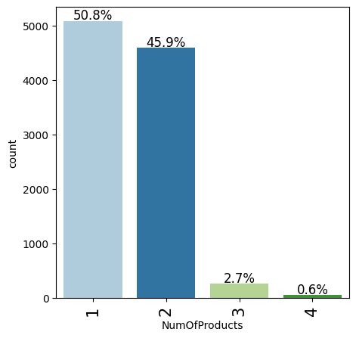
EDA Outcomes
6

Slide 7
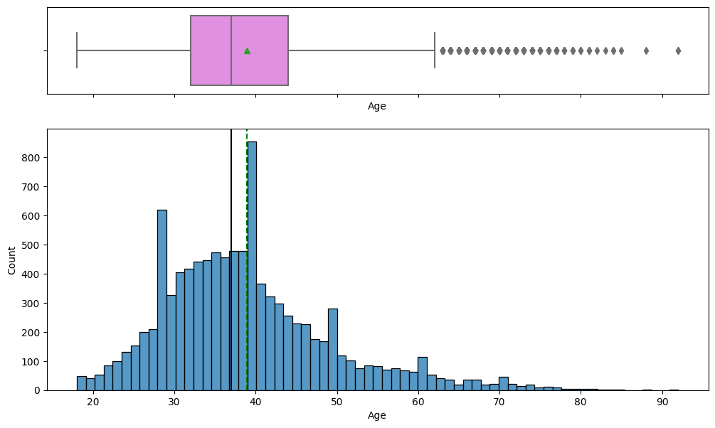
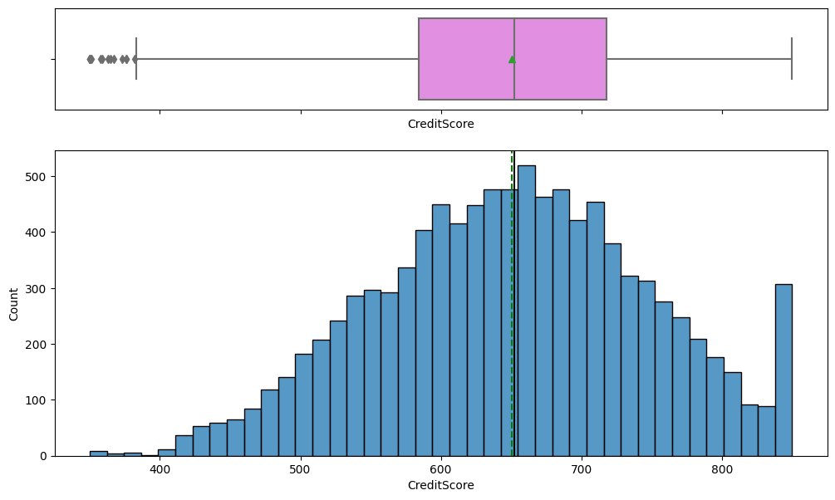
Outlier customers
7

Slide 8
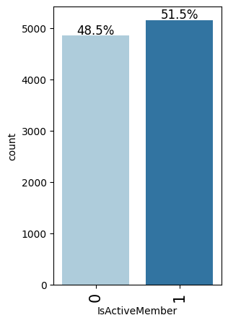
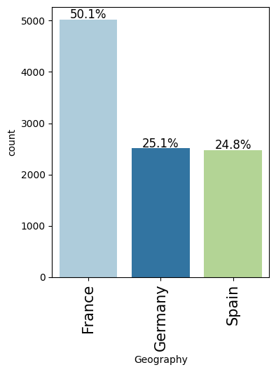
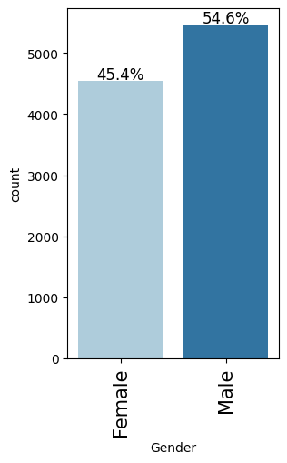
Relative Presence
8

Slide 9
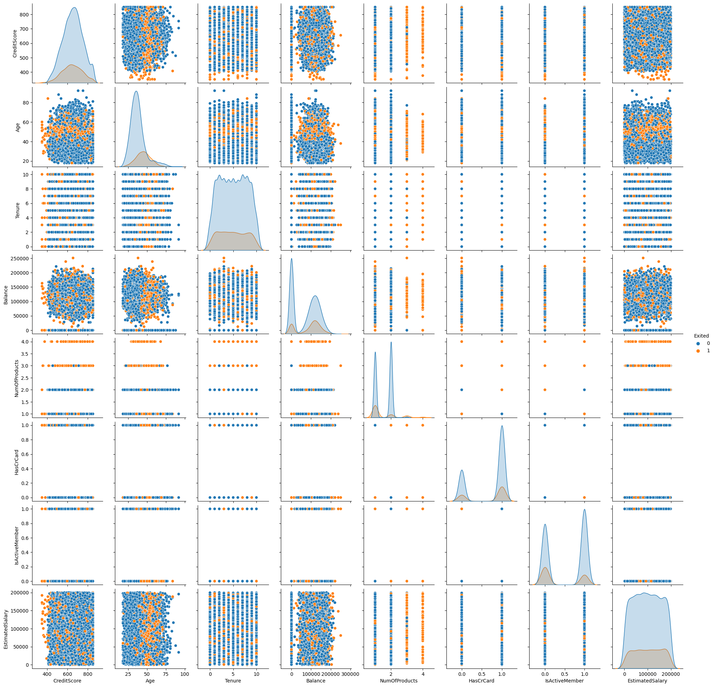
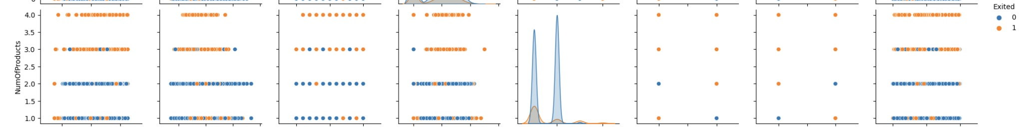
Pairplots

Slide 10
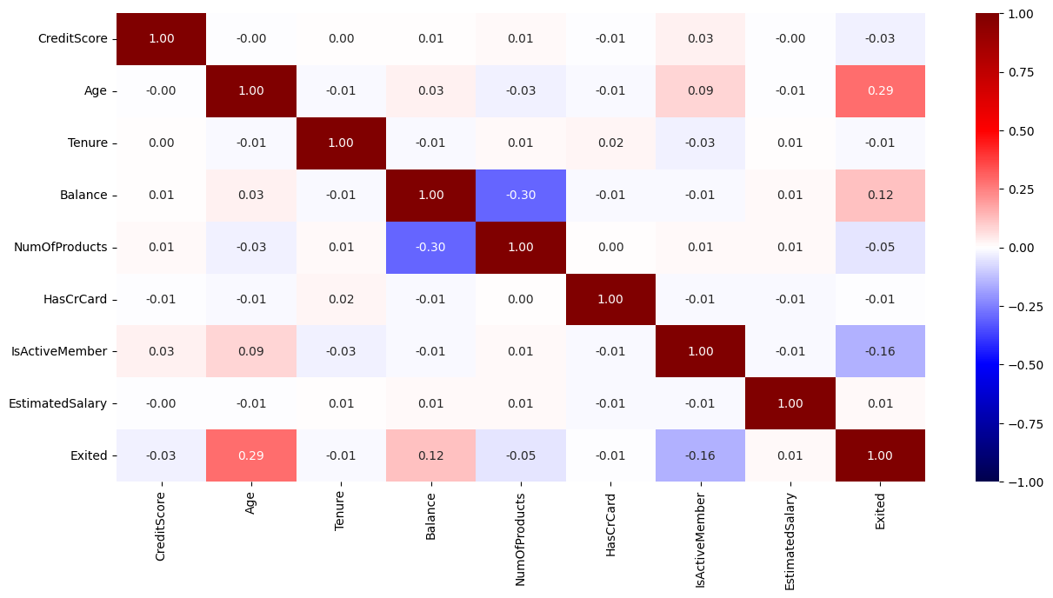
10

Slide 11
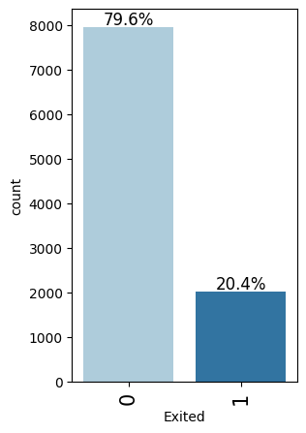
Preprocessing
11
Dropped unique identifier columns
Scaled all features using min-max scaling
Oversampled Train set to reduce imbalance

Slide 12
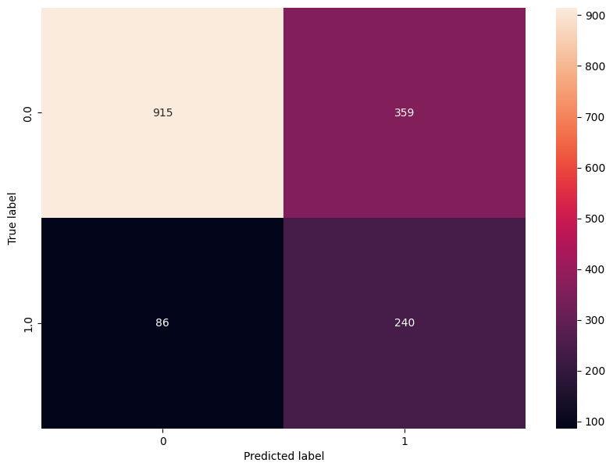
Model Building & Performance
12
Used Simple Logistic Regression Algorithm
Train Accuracy: 72 %
Validation/ Test Accuracy: 71%

Slide 13
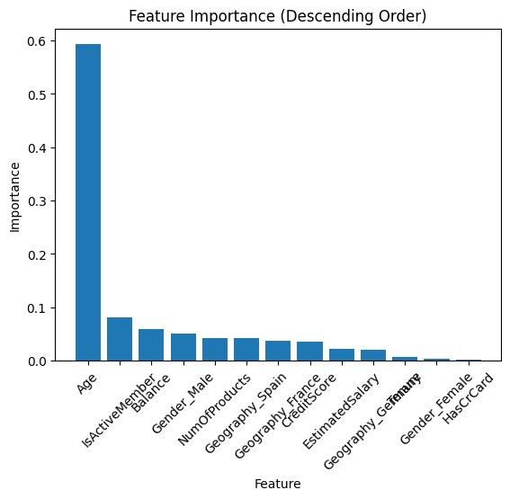
Feature Importance
13

Slide 14
Areas for improvement Conclusion
14
Conclusion
Areas for improvement
Bank customers can be segmented depending on various characteristics.
The churn ratio can be reduced by analyzing the characteristics and building a predictive model.
Age plays a significant role in predicting churn.
Tune model further to get better results.
Use Recall as metric of interest.

Slide 15



