Slide 1

Alpha Green

Slide 2
Contents:
01
02
Our Team
Our goal
03
04
Stages of Realization
Used Technologies

Slide 3
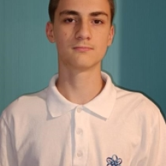
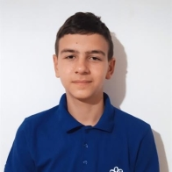
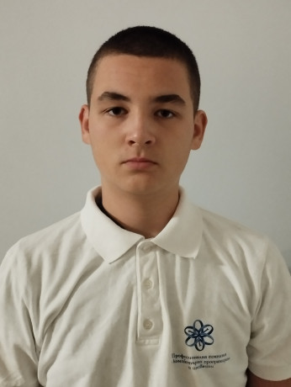
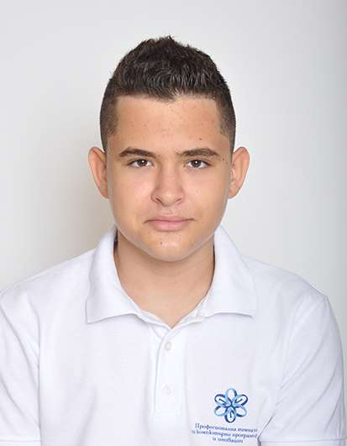
01 The Team
Tsvetan Zhekov
Nikolai Zhelev
Yuan Tomov
Martin Shavov
Scrum Trainer
Front-end developer
Front-end developer
Designer

Slide 4
02 Our Goal
Our goal is to create a better and greener future for future generations to enjoy by developing state-of-the-art technologies and innovation to protect out planet from pollution and global warming.

Slide 5
03 Stages of Realization
Organization
Decide on the idea
Development
Presentation

Slide 6










04 Used Technologies

Slide 7
Thank you for your attention!

