Slide 1

Automatronix
READY TO TRAVEL WITH US?

Slide 2
Table of contents
01
02
03
04
Team
Our goal
The team that made this possible
What we strive for
Stages of Realization
Used Technologies
Each stage we went trough to realize this project
The technologies we used troughout our journey

Slide 3
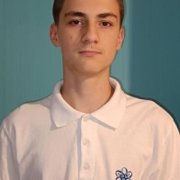



01
The Team
Tsvetan Zhekov
Miroslav Markov
Alexander Ivanov
Anton Kabakov
Scrum Trainer
Designer
Front-end
developer
Front-end
developer

Slide 4

02
Our Goal
Our goal is to make a fully autonomous driving vehicle with at least level 3 driving automation

Slide 5
Stages of Realization
Organization
Decide on the idea
Development
Presentation
03

Slide 6








Used Technologies
04

Slide 7
Thank you for the attention!

