Slide 1
Case Study 2: Workforce Attrition
DDS Analytics
Thomas Pengilly

Slide 2
Objectives
Find trends within the workplace
Determine the top 3 factors that lead to employee turnover
Create attrition predicting models
Determine what factors contribute to an employee’s salary

Slide 3
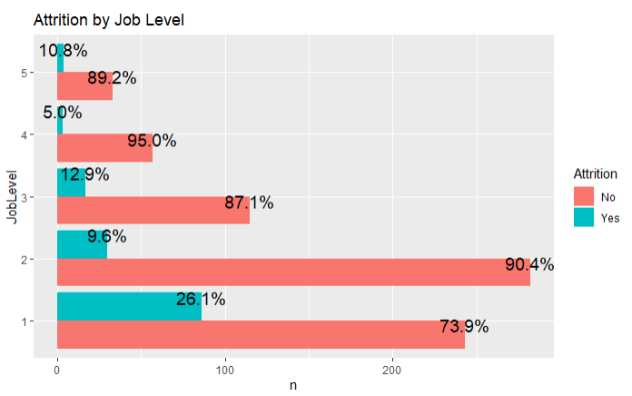
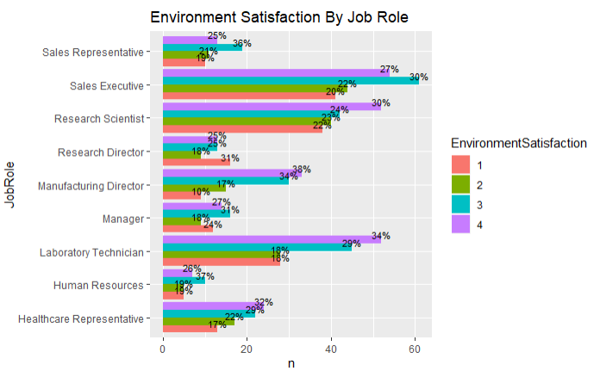
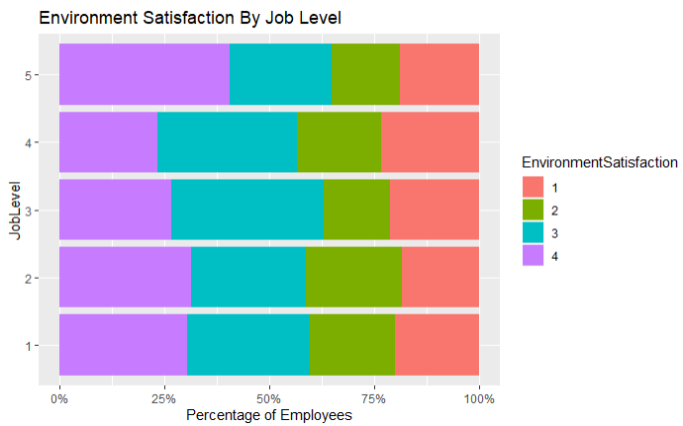
Initial EDA: Workplace Trends
Job Level
Environment Satisfaction
Notes:
Job Level: Indicates need for more workplace training, hard transition for new employees
Decided to look at environment satisfaction
Environment Satisfaction: could indicate a poor work place culture

Slide 4
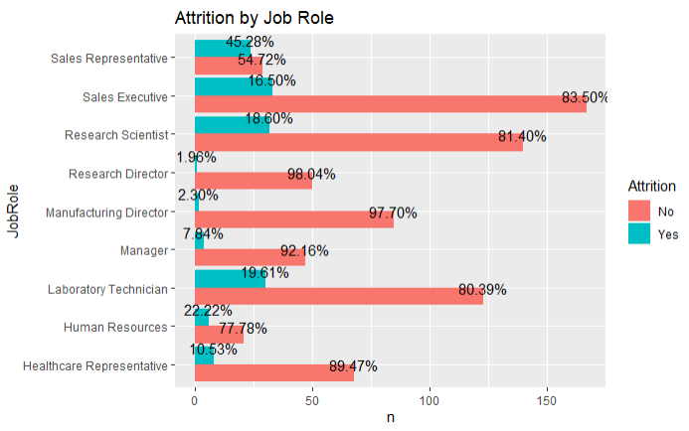
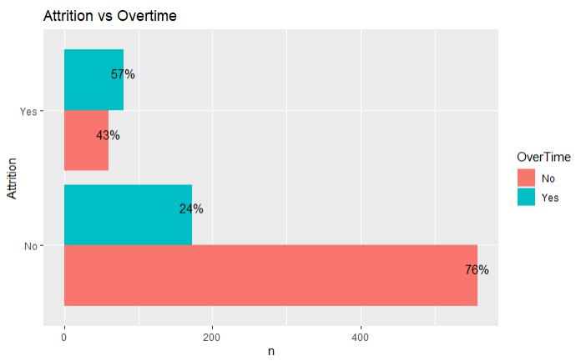
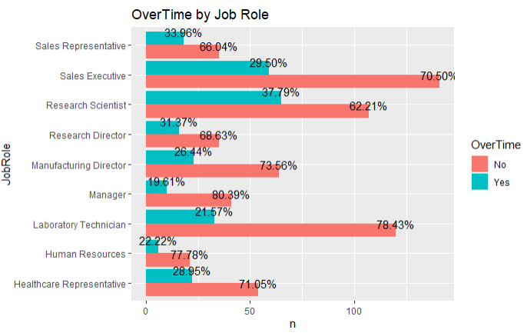
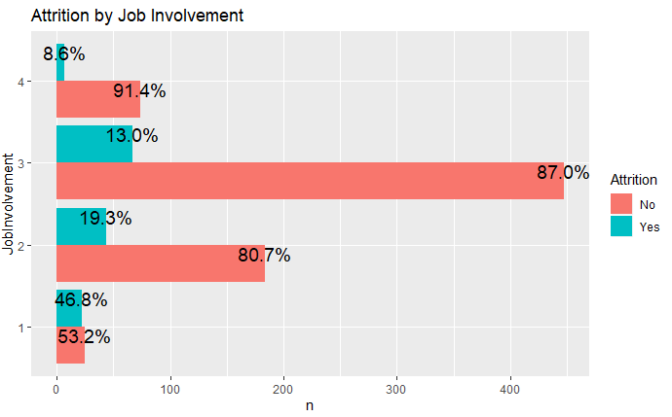
Preventing Attrition
How can you reduce employee turnover?
Job Involvement
Overtime
Job Role

Slide 5
Attrition Modelling
Naïve-Bayes Classifier
Logistic Regression Classifier
Superior performance
Accuracy: 80%
Sensitivity: 83%
Specificity: 61%
Superior interpretability
Can determine significant factors
Accuracy: 88%
Sensitivity: 45%
Specificity: 97%

Slide 6
Fair Salary Determination
Trained 2 models to predict an employee’s salary given the data provided

Slide 7
Fair Salary Model
Multiple Linear Regression
Lasso Regression Model
Easy to interpret— poor performance
Average RMSE of 12,700
Average Residual of 4,600
Highly accurate — not as easy understand
Average RMSE of 1136
Average Residual of 1,000

