Slide 1
Case Study: Brewery Analysis
Thomas Pengilly
Justin Cleveland
Notes:
Youtube Link: https://youtu.be/ZbKUrdkwvT0

Slide 2
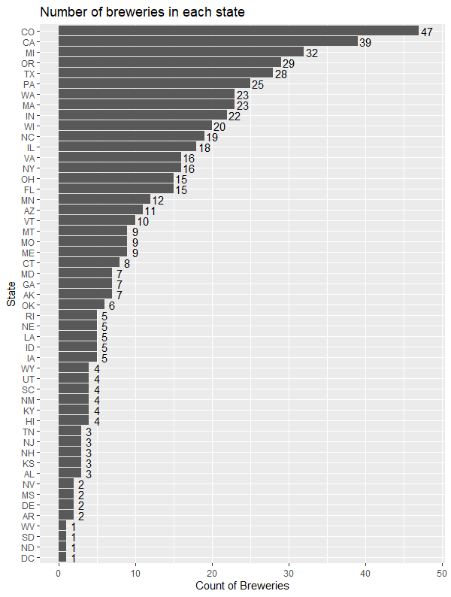
Breweries per State
The Top 10 states account for over 50% of all breweries nationwide
Critical Factors Impacting Brewery Location
Excise taxes
Population over 21
Median Income
Long tradition of brewing
Top 10 States
Notes:
Source: https://vinepair.com/booze-news/best-us-cities-open-brewery/

Slide 3
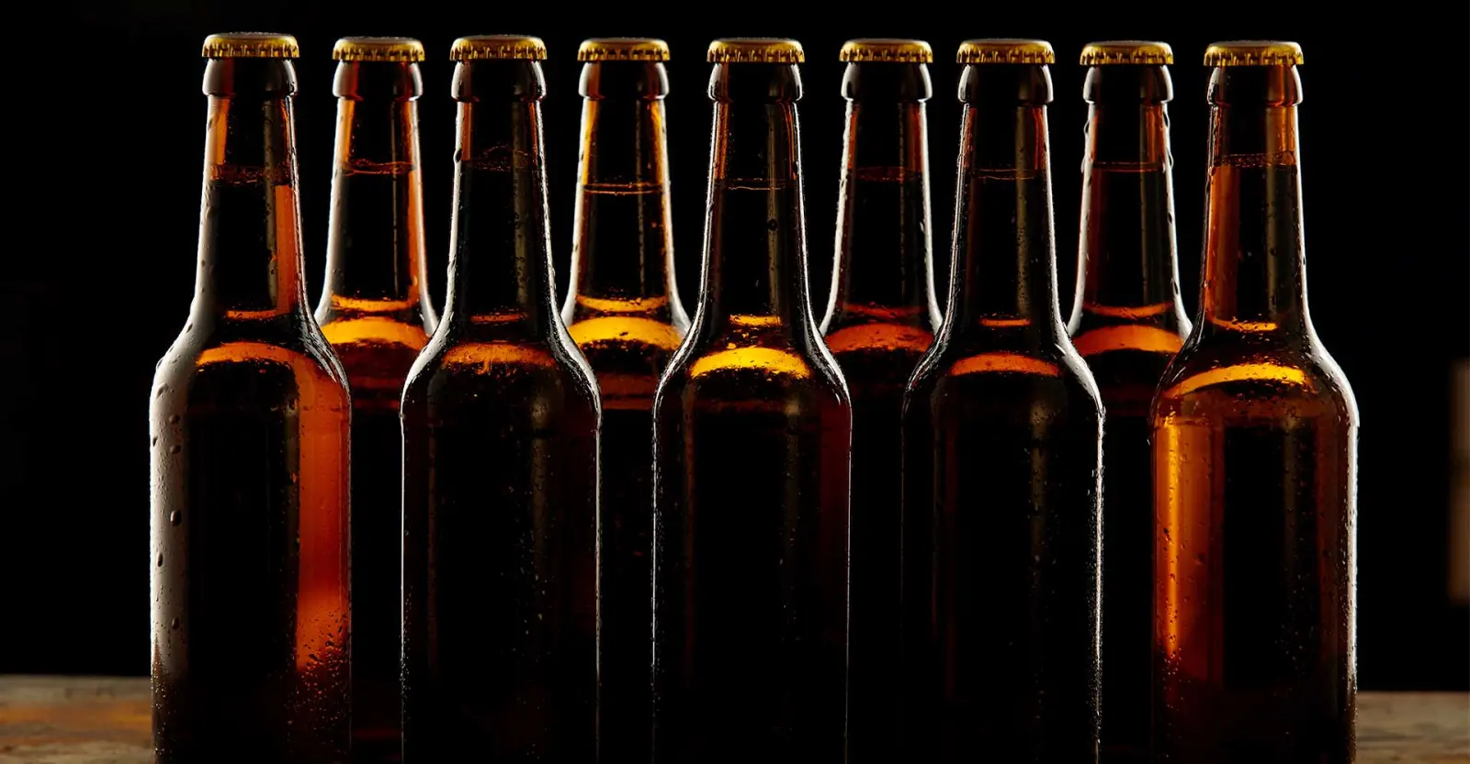
Missing Values
The beer dataset contained over 1000 missing values
That’s almost half of the data!
How do you get meaningful insights with so much missing data?
Replaced missing data with average values by beer style

Slide 4
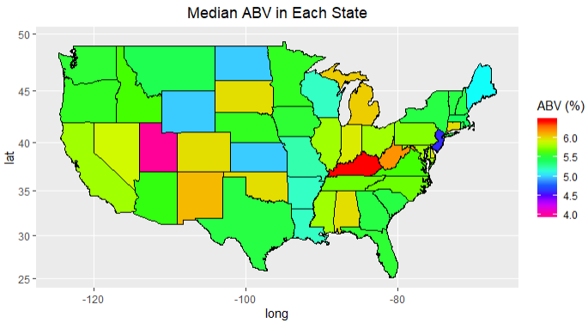
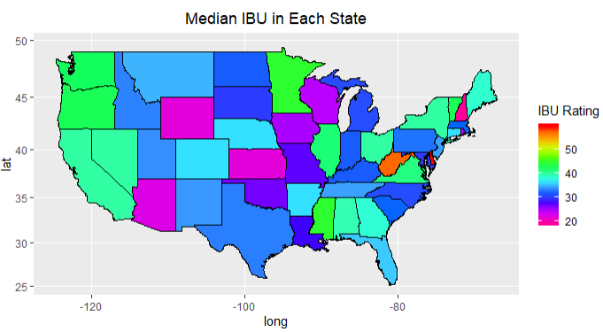
Median ABV by State
Median IBU by State
Kentucky is famous for their Bourbon Whiskey
Kentucky craft beer is commonly aged in whiskey barrels which can drive up the ABV value
DE and WV only produces two beers that have an IBU > 50 90% of all other states produce 8 or more beers
Midwest prefers less bitter beers

Slide 5
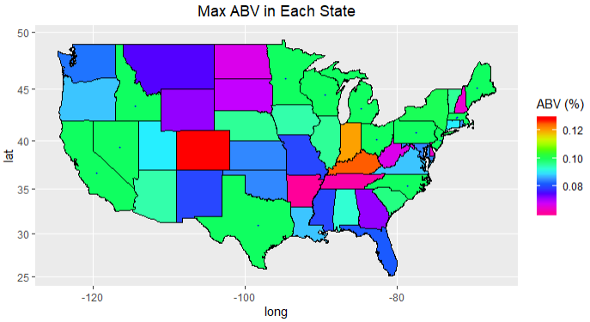
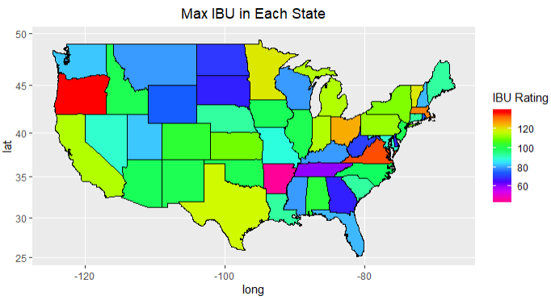
Max ABV by State
Highest IBU by State
State Regulation significantly affects max ABV
CO is home to the Lee Hill Series Vol. 5 - Belgian Style Quadrupel Ale ~ ABV=.128
Midwest prefers less bitter beer
Coasts prefer more bitter beer

Slide 6
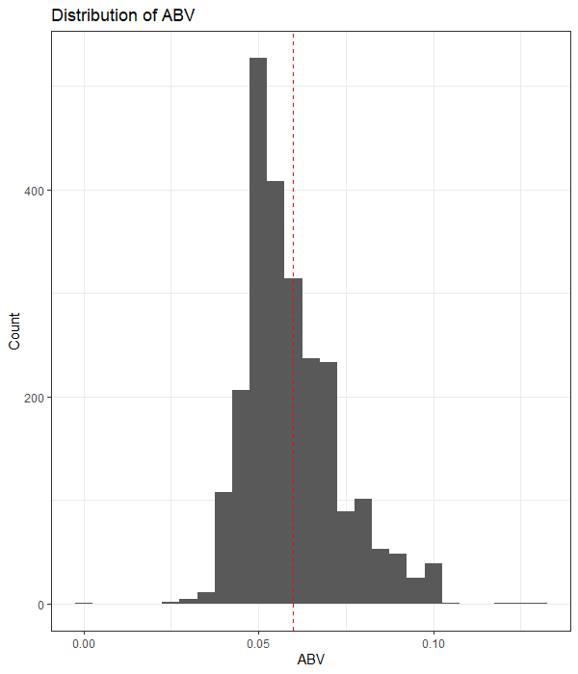
ABV Analysis
Most common alcohol content is 5%
There is a niche market for beers with alcohol content between 7 – 10%
Do people buy beer because it’s strong?
6% avg
Most frequent @ 5%
Niche Market

Slide 7
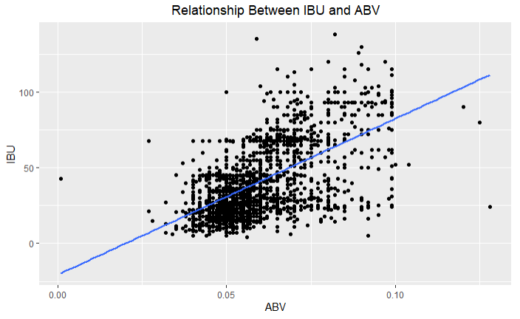
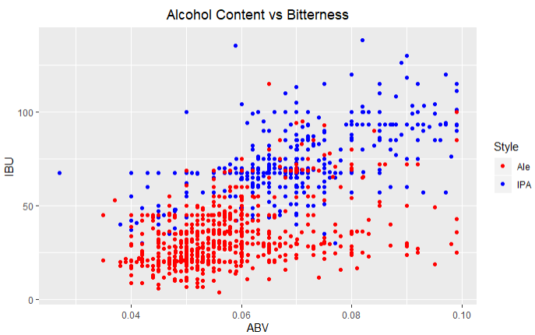
Relationship between bitterness and alcoholic content
There is a general positive relationship between alcohol content and bitterness
There are 2 trends in the data: a positive linear trend and little to no trend

Slide 8
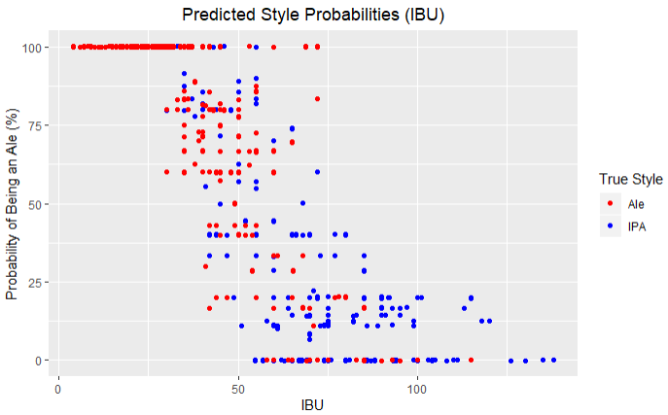
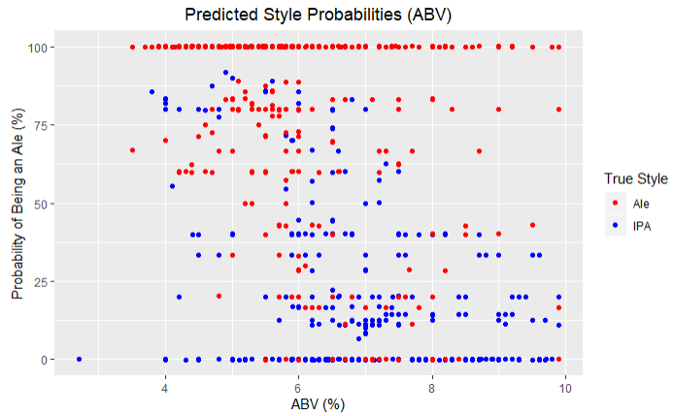

India Pale Ales, Ales: What’s the difference?
How?
Trained two machine learning algorithms to determine the difference:
91% Accuracy
What?
The difference between ales and IPAs are strictly a matter of bitterness

Slide 9
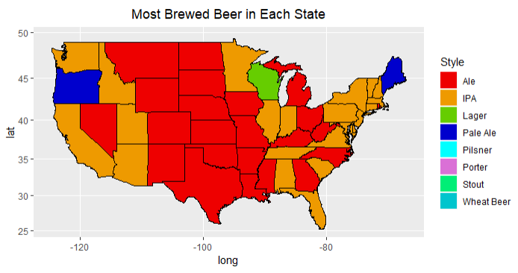
Popular Beer Styles by State
Central States primarily brew Ale
West and East coast state breweries favor IPA’s

Slide 10
Conclusion
Brewery location considerations:
Taxes and demographics
Local beer style preferences
Also useful for targeted marketing

