Slide 1

DriveUp
Bharath Medarametla
Pankaj Hanmant Patil
Manish Hanmantrao Lokhande

Slide 2

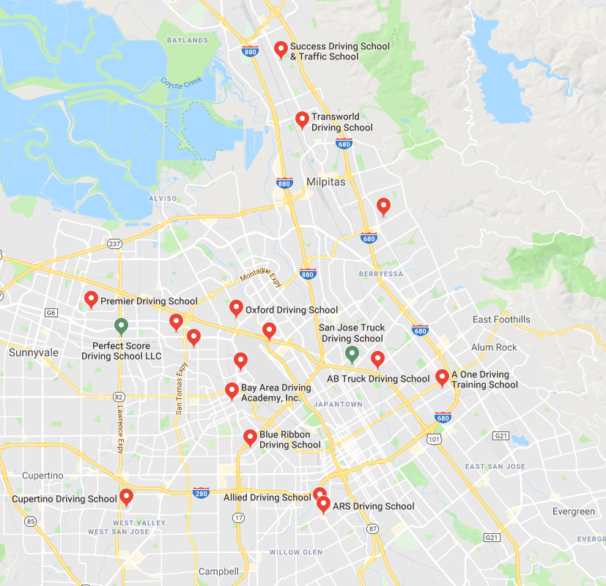
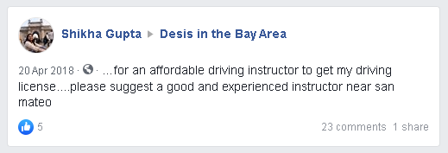



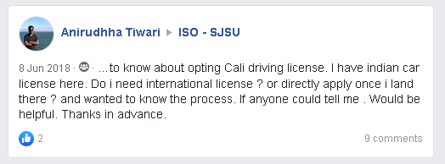

AROUND . . .

Slide 3





Objective
Aggregator App for all stakeholders
Open Market
Surge Price Model
Knockout physical driving schools (middle layer)
Simplify Process
Content & Analytics
Driving School

Slide 4
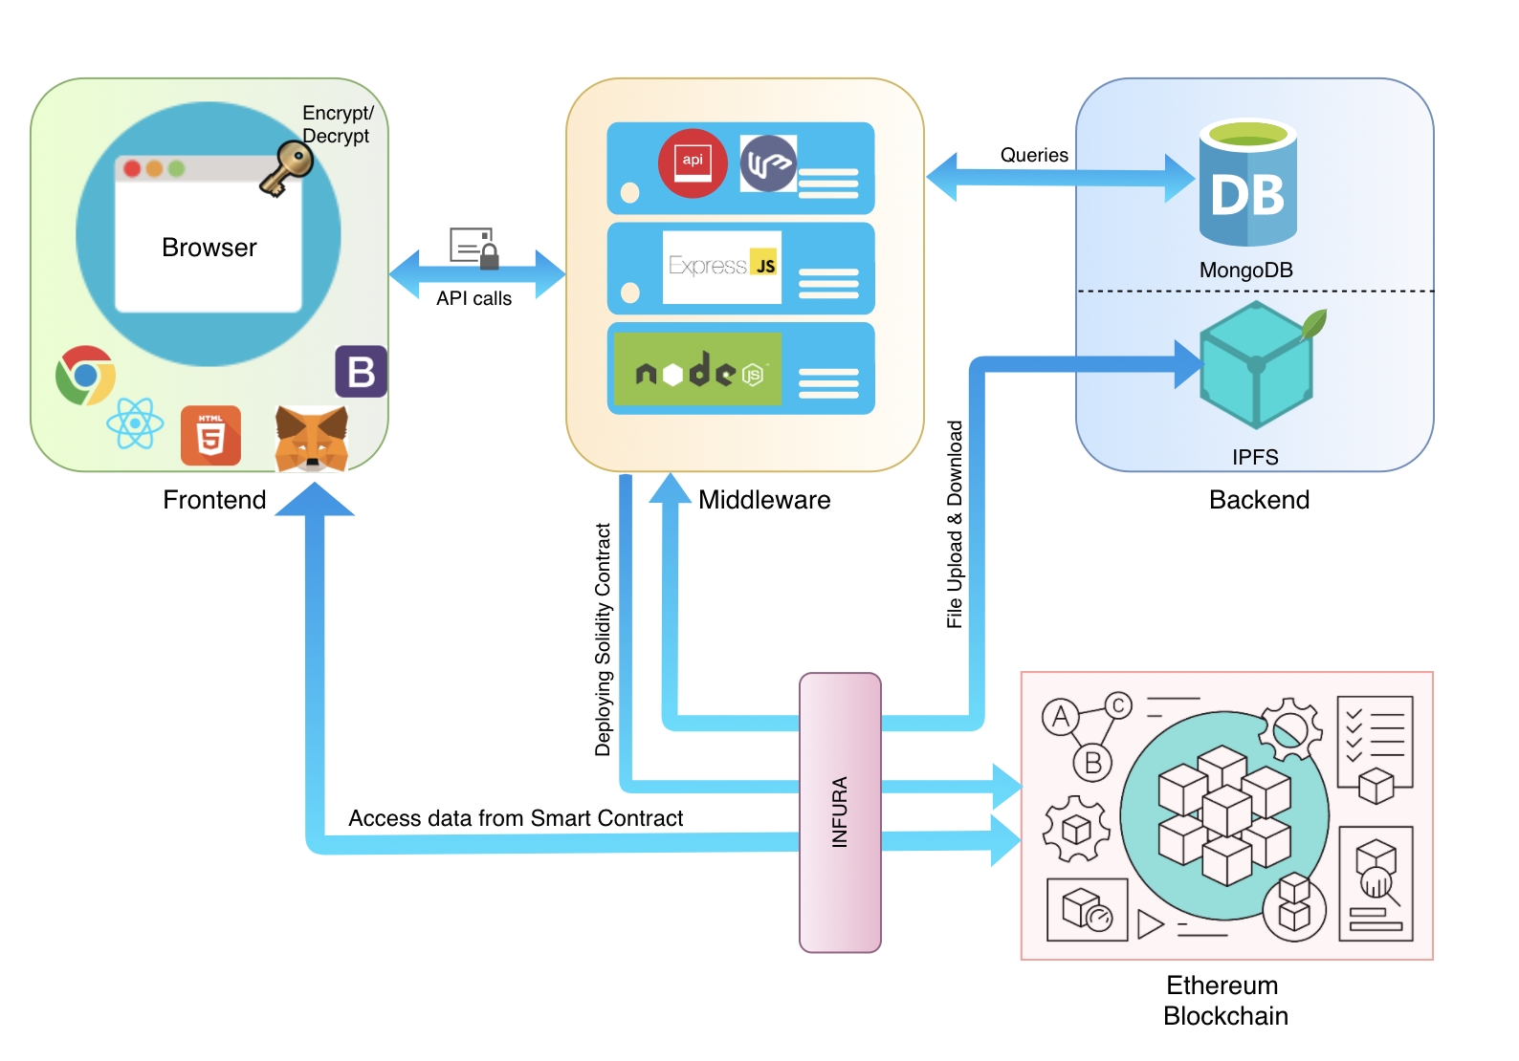
Project Architecture

Slide 5
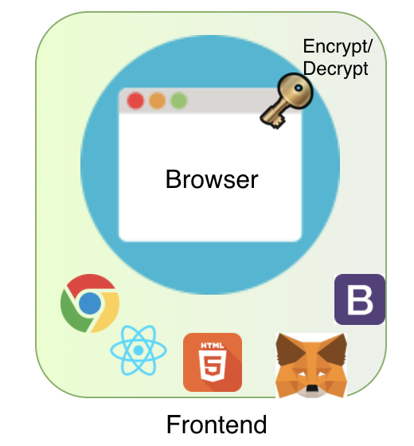
Frontend
We are using React, redux for frontend to create an intuitive UI.
It consists of the following screens:
Register 5. List Files
Login 6. Profile
File Upload 7. Dashboard
File Download
Accessing ethereum blockchain and smart contract to store messages and file metadata
Encrypt and Decrypt files using cryptography key pairs

Slide 6
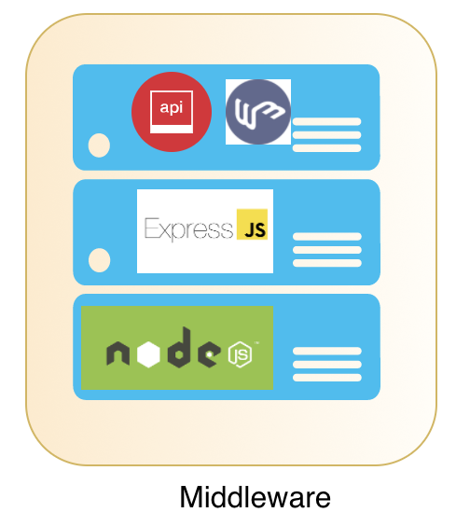
Middleware
The middleware is responsible for the following:
Handling Access Management and session for system users
Uploading and Downloading file from IPFS
Interacting with Frontend and backend to serve requests
Contains Smart contract deployment script
We are using custom loggers to log the server events so that it becomes easier to debug and resolve any issue

Slide 7
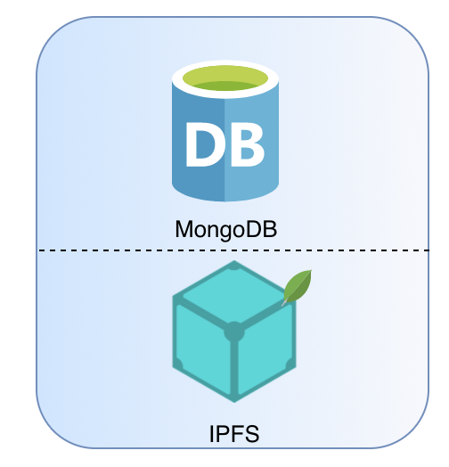
Backend
We are using IPFS in the backend as a distributed file storage system.
Whenever files are stored or uploaded in IPFS in response it gives us the file hash
MongoDB will be used storing User Profile details
We have enabled express to use MongoDB as session store with TTL policy as 30 mins

Slide 8
UI Screenshots

Slide 9
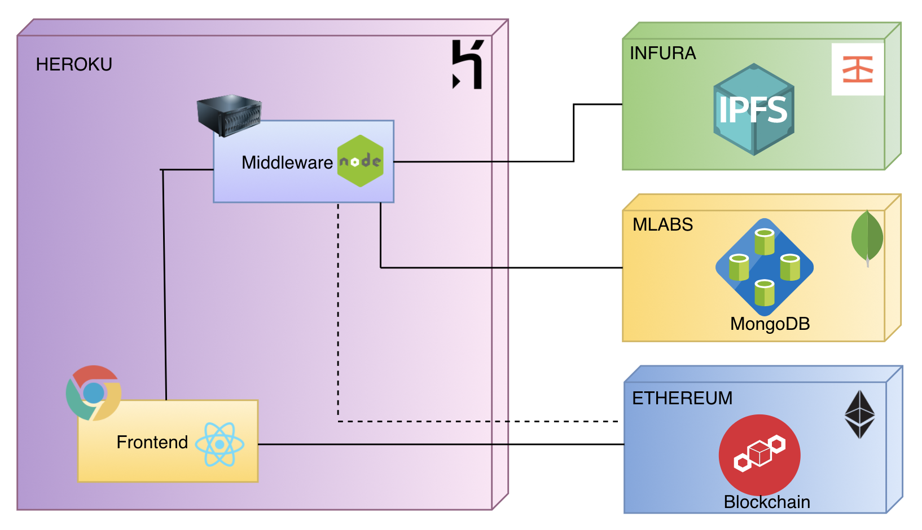
Deployment

Slide 10

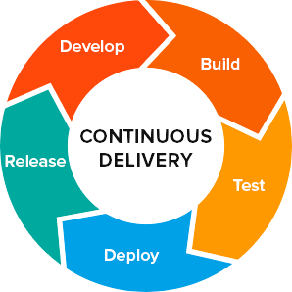





Technologies Used

Slide 11
Future Scope

Slide 12
References

Slide 13
as LEARNER . . .
Search certified Instructors (better choice)
Schedule driving classes (convenient timeslots)
Cost Effective
Tutorials, Practice tests, Quiz
Local rules
Driving pattern analysis (reports)

Slide 14
as INSTRUCTOR . . .
Flexible working hours
Surge pricing
No employer : Be your own boss
Rating & testimonials
Opportunities open up

Slide 15
TRADITIONALLY . . .
New Driver - Learner
Instructor
Driving School
Select Driving School
Location
Cost
Time-Slot Available
Quality Of School
Car model/type
Services offered
Schedule driving classes
Fixed timing
Fixed pay(Hourly)
Employer dependent job security
Not always enough work
Physical Location
Upfront investment
Limited instructors & vehicles
Insurance

Slide 16
as VEHICLE VENDOR . . .
Better Inventory usage
Surge pricing
Booking as per availability
Not dependent on school
Analytics

Slide 17



DRIVING SCHOOL INDUSTRY IN US . . .
•Total Revenue in 2019: $14bn
•Industry Employment: 336,068
•Annual Growth 2014-2019: 2.6%
•Number of Businesses: 169,718
Source : https://www.ibisworld.com/united-states/market-research-reports/tutoring-driving-schools-industry/

Slide 18

















TECHNICAL . . .(WIP)

Slide 19
STATUS . . .
Core Services
Implementation
MVP
Ideation
High level Deign
Integration & Testing
Scope
Infrastructure
& Platform
Value Services

Slide 20
Ideation
High level design
Implementation
Scope
Infrastructure and platform
Integration and testing
Activites

