Slide 1

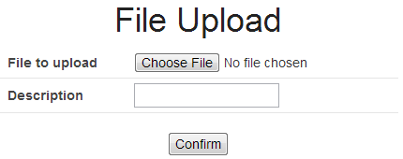
(1)
Upload
File
Temporary directory
for servlet container
<Application Server>
Servlet
Container
Web.xml
Temporary
File
(2)
<Spring MVC>
Dispatcher
Servlet
(3)
<Spring Web>
StandardServlet
MultipartResolver
(9)
(10)
(4)
<Spring Web>
MultipartFile
(6)
<servlet>
Part
(5)
Controller
Upload
File
(7)
(8)
Service
Upload directory
for application
Database

Slide 2
(3)
(7)
Input
Screen
Confirm
Screen
Complete
Screen
Upload
File
(4)
Controller
Controller
(1)
(5)
Service
Move File
Temporary
Upload
Upload Temporary directory
Upload directory
(6)
Upload
File
Upload
File
(2)
or
Database
or
Database

