Slide 1
Decision-Calibrated Belief-to-Action Planning
Our exploration of OpenReview identified several 2026 studies that apply continuous opponent modeling to negotiation tasks. This overlap reduces the novelty of our work.
Explorations on benchmark:
  LLM-Deliberation is a well-known benchmark proposed at NeurIPS 2024 (currently with 154 citations). However, recent studies have shown that the negotiation process in this benchmark is not truly meaningful.
  NegotiationArena can be regarded as a simplified version of SimpleEnv/AmazonHistoryPrice (the environment we tested previously), while still allowing for direct comparisons with existing baselines.
  The ACL benchmark uses the alternating-offers protocol for negotiation. It can serve as a benchmark for evaluating posterior calibration, but it is not ideal as the primary benchmark because it does not involve natural language.

Slide 2
Opponent Simulation
Scaling Inference-Time Computation via Opponent Simulation: Enabling Online
Strategic Adaptation in Repeated Negotiation(ICML2026 Regular): continuous-update belief and belief-usable planner
  Use negotiation trajectories to train an auxiliary LLM.
  Use auxiliary LLM to simulate the actions of the opponent.
  Let the current agent generate several candidate messages.
  For each candidate message, continue the rollout with the simulated opponent.
  Choose the candidate with the best expected value.

Slide 3
Opponent Simulation
This Opponent Simulation used the auxiliary LLM to simulate the opponents through the process and continuous updated it, which overlaps with our work much.
However, this method uses a lot of cost and can only simulate simple fixed model on simple environment(Negotiation Arena with single buyer single seller). Our method can focus on a universal calibrated posterior that can be adaptive to opponents with different characters, irrational behaviors, and how can the planner get decision values from the belief.
I have already done a quick comparison on NegotiationArena, but the experiment still not finished.

Slide 4
Other exists works
MIND(ICLR2026 workshop HCAIR): infer willingness on multi-agent travel planning.
HAR(LLA2026 poster): hierarchical planning on negotiation tasks.
GENEGO(ICML 2026 AgenticUQ Workshop): structured memory and pairwise preference inference on CaSiNo environment. Can be tested as a new baseline

Slide 5
Benchmarks Exploration
From the exploration on openreview, our result on AmazonHistoryPrice(which is called simple env in before slides) and CaSiNo can already be reasonable for a paper, but may require more design for novelty.
Explorations on benchmark:
  LLM-Deliberation is a well-known benchmark proposed at NeurIPS 2024 (currently with 154 citations). However, recent studies have shown that the negotiation process in this benchmark is not truly meaningful.
  NegotiationArena can be regarded as a simplified version of SimpleEnv/AmazonHistoryPrice (the environment we tested previously), while still allowing for direct comparisons with existing baselines.
  The ACL benchmark uses the alternating-offers protocol for negotiation. It can serve as a benchmark for evaluating posterior calibration, but it is not ideal as the primary benchmark because it does not involve natural language.

Slide 6
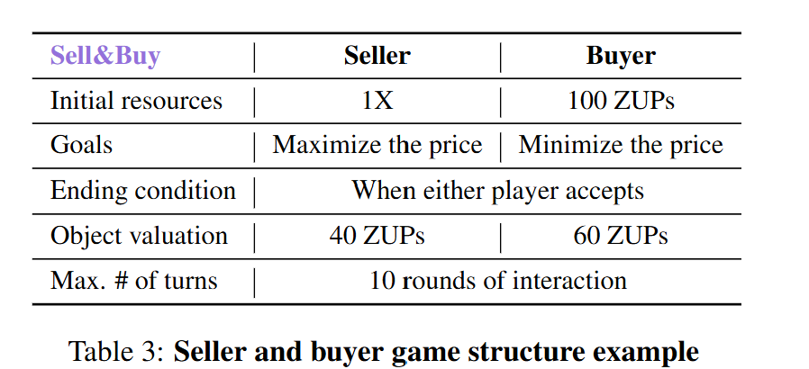
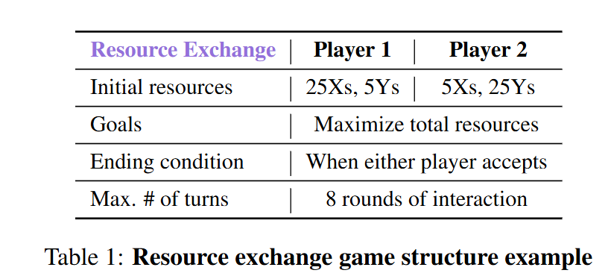
NegotiationArena: simple tasks, essential direct comparison
Its value rises because Opponent Simulation uses a precise repeated-game protocol
05

Slide 7
ANL: a clean mechanism test, not a language benchmark
Can be regard as test for caliberation belief
League | Hidden information / structure | Best diagnostic | Paper role
ANL 2024 | Known utility shape; hidden reservation value | RV posterior, coverage, oracle regret | Calibration sanity
ANL 2025 | Sequential one-to-many, multi-deal dependency | Continuation value and global planning | Planner mechanism
ANL 2026 | Unknown utility + reservation; concealment rewarded | Exploration vs self-information leakage | Information-control stress
06

Slide 8
The research gap becomes a three-link evidence chain
Accuracy alone is insufficient; reward alone does not prove belief
RQ1
RQ2
RQ3
Belief formation
Belief use
Decision value
Is the posterior accurate, calibrated and aware of uncertainty?
Does changing the posterior predictably change candidate ranking and action?
Does the correct posterior beat frozen, shuffled and wrong beliefs?
language evidence → calibrated posterior → counterfactual ranking change → reward / regret improvement
11

Slide 9
METHOD
Proposed framework: Decision-Calibrated Dual-Timescale Belief Planning
Working name: DC-BAP
Evidence builder
Belief updater
Candidate generator
Belief-usable planner
Action-locked generator
Offers • responses • reasons
Posterior + reliability + change
Exploit • probe • safe • fallback
Payoff • risk • IG • leakage
Language realization only
Across episodes
Within an episode
Causal trace
Meta-prior over opponent type, concession dynamics and recurring constraints
Turn-by-turn posterior update from new public evidence; allow abstention and wide intervals
belief before/after → candidates → scores → action → response → reward
Key distinction: the model must know when not to trust its own belief.
12

