Slide 1
Is LLM Negotiation Solved by Prompting?
Preliminary Evidence from Related works and Lightweight Experiments

Slide 2
Negotiation: a Long-Horizon Partially Observable Game
Why Negotiation is Hard
Agents have private information: buyer budget, seller reservation price, preferences.
Success requires opponent modeling, concession scheduling, and utility-aware decisions.
Prompting may look strong, but high deal rate can hide poor buyer utility.
Goal: identify when prompting/RL fails, and which component fixes the bottleneck.
Notes:
[2604.16472] Training Language Models for Bilateral Trade with Private Information
[2503.06416] Advancing AI Negotiations: A Large-Scale Autonomous Negotiation Competition

Slide 3
Existing Benchmark
Existing paper | Benchmark | Method
[1]Deal-or-No-Deal(2017) | multi-issue bargaining | Imitation learning + self-play RL + dialogue rollouts
[2]Cicero(2022) | diplomacy | Planning + dialogue
[3]ASTRA(2025) | multi-issue bargaining | opponent modeling + LP solver
[4]Advancing AI Negotiations(2025) | cross-domain negotiation | Prompt engineering evaluation
[5] Instructing LLMs to Negotiate (2026) | Buyer-seller dialogue | RLVR
[6] Training Language Models for Bilateral Trade (2026) | Tool-called based buyer-seller dialogue | RL+SFT
[7] MERIT (2026) | 9 economical bargaining setting | LLM + human feedback
Multi-issue bargaining remains a challenging testbed for strategic language agents, yet there is still no unified training framework in this setting.
Notes:
[1] [2604.16472] Training Language Models for Bilateral Trade with Private Information
[2] [2002.07788] Multi-Issue Bargaining With Deep Reinforcement Learning
[1] Deal or No Deal? End-to-End Learning for Negotiation Dialogues aclanthology.org/D17-1259.pdf
[4] [2503.06416] Advancing AI Negotiations: A Large-Scale Autonomous Negotiation Competition

Slide 4
Is Negotiation already Solved by Prompting?
Recent frontier LLMs already perform surprisingly well via prompting alone.
Advancing AI Negotiations(2025): hacking-based prompt performed well in AI negotiations.
Instructing LLMs to Negotiate (2026)： small-scale agents can performed better than large-scale agents after training.
MERIT(2026): Baseline LLM policies often deviate from human preferences.
Require a simple first experiment to confirm:
Test different buyer agents against fixed sellers
Multi-issue bargaining across different benchmarks
Direct Prompt/ CoT Prompting/ RL finetuning/ RL + belief model
Metrics: deal rate, utility gained, concession accuracy, language diversity, robostness
Human judge and components.

Slide 5
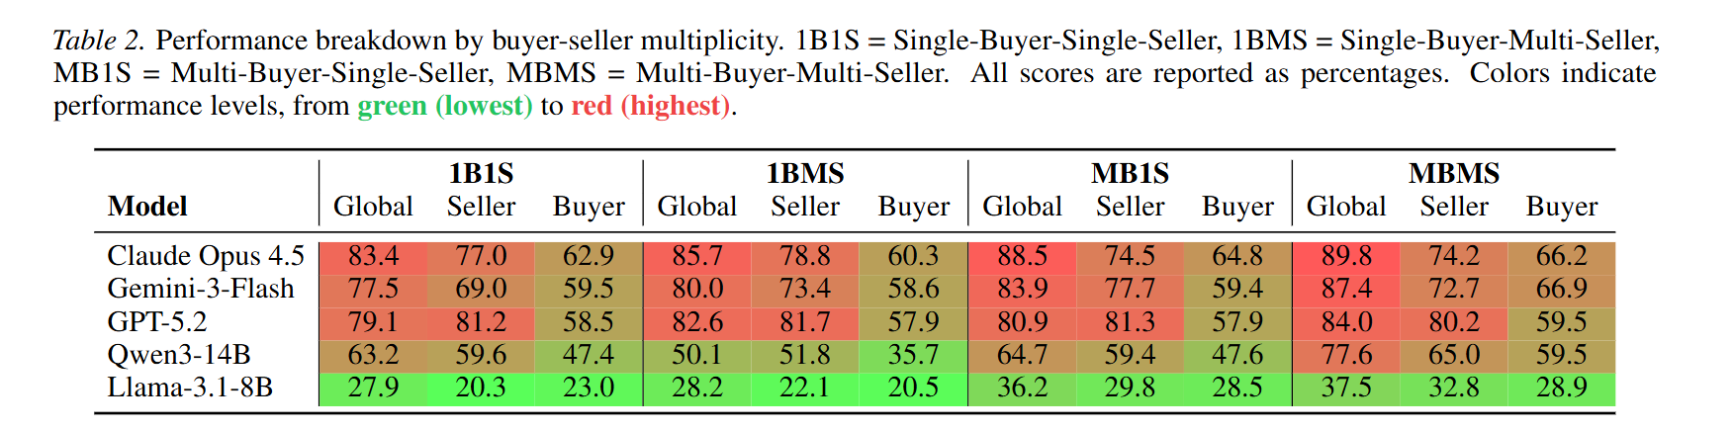
AgenticPay: A verifiable buyer-seller negotiation environment
Episode structure
Buyer has private max price.
Seller has minimum / target price.
Multi-turn natural-language offers.
Ends with agreement or timeout.
Metrics
Deal rate and termination reason.
Agreed price.
Buyer score / seller score / global score.
Quality success and round count.
Notes:
[2604.16472] Training Language Models for Bilateral Trade with Private Information
[2503.06416] Advancing AI Negotiations: A Large-Scale Autonomous Negotiation Competition

Slide 6
Lightweight Experiments
Qwen buyers against fixed AgenticPay sellers
Axis
Values
Models
Qwen3-0.6B, Qwen3-4B
Buyer prompts
Direct Prompt, CoT Prompt
Model pairs
All pairs
Tasks
task1, task2, task3
Seller characters
fair, greedy, patient, impatient, warm, dominant
Seeds
0,1,2,3,4
Num of Trajs
720 trajectories completed

Slide 7
Prompting Achieves Deals, But Deal Rate Is Not Enough
Partial matrix overall result
720
Episodes
0.799
Deal
0.549
Q-success
55.89
Buyer score
3.37
Rounds
Observation
Deal rate is relatively high, but quality success is much lower.
Many agents reach agreements that are not buyer-beneficial.
Negotiation evaluation must include buyer utility, price, robustness, and trajectory behavior.

Slide 8
CoT Looks Strong in Qwen3-0.6B Self-Play
Setting
Episodes
Deal
Q-success
Buyer
Price
Rounds
Direct
90
0.667
0.611
54.04
124.92
4.44
CoT
90
0.944
0.889
88.82
113.94
1.44
Interpretation
CoT improves deal rate, buyer score, and efficiency in homogeneous self-play.

Slide 9
CoT Does Not Robustly Transfer to Stronger Sellers
Qwen06 buyer vs Qwen4 seller
Prompt
Episodes
Deal
Q-success
Buyer
Price
Rounds
Direct
90
0.944
0.444
47.45
141.18
3.39
CoT
90
0.510
0.000
14.30
142.00
4.92
Trajectory pattern
CoT analysis can identify seller prices but fails to enforce buyer-beneficial actions.
Reasoning text is not the same as a stable negotiation policy.
This motivates belief state + typed strategic action.

Slide 10
Prompting Performance Can Be Inflated by Repair
Setting
Raw/Sent Price Mismatch Rate
qwen06->qwen06 Direct
1.000
qwen06->qwen4 Direct
1.000
qwen06->qwen06 CoT
0.056
qwen06->qwen4 CoT
0.490
Raw LLM Output -> Parser / Repair -> Executable BUYER_PRICE -> Reward
Future ablation: strict no-repair evaluation to separate model ability from wrapper ability.

Slide 11
Trajectory-Level Negotiation Problems
1. Deal-quality gap
High deal rate can coexist with low buyer utility.
2. Fixed-price templates
Qwen often repeats prices such as task2 $130 or task3 $170/$175.
3. Weak concession scheduling
Hard sellers cause repeated offers and timeout.
4. Language-action mismatch
CoT reasoning, raw output, repaired action, and reward can disagree.

Slide 12
Seller Character Creates Robustness Gaps
Seller
Deal
Q-success
Buyer
Price
Rounds
fair
0.909
0.727
73.61
124.40
2.45
warm
1.000
0.500
51.79
118.70
1.70
greedy
0.818
0.545
57.25
131.89
3.27
patient
0.727
0.545
49.47
137.75
4.36
impatient
0.741
0.556
60.59
131.12
3.63
dominant
0.600
0.400
41.00
129.50
4.80
Key point
friendly tone is not the same as buyer-beneficial outcome; seller character is a natural belief target.
Building belief model is a problem worth study in this case

Slide 13
Training Motivation
Key concepts in negotiation:
Beliefs for components: require a belief model
  Strategy of components can also be simulated.
Negotiation strategy: should be dynamic in the dialogue
  Attitude: warmth/dominance[1]
  Budget
  Language: natural language realizer
Negotiation can be universally solved by planning under latent beliefs.

Slide 14
Related Work: ASTRA
Opponent modeling + offer optimization
ASTRA components
Partner fairness / stance assessment.
Tool-integrated action with LP solver.
Partner acceptance probability.
Strategy-based final offer selection.
Connection to our direction
Belief model: seller type / reservation / patience.
Typed strategic policy: anchor / hold / concede / accept.
RL selection over strategies and target prices.
Reference: ASTRA, arXiv:2503.07129.

Slide 15
Related Work: MERIT, RLVR, Bilateral Trade
Advancing AI Negotiations(2025): hacking-based prompt performed well in AI negotiations.
Instructing LLMs to Negotiate (2026)： small-scale agents can performed better than large-scale agents after training.
MERIT(2026): Baseline LLM policies often deviate from human preferences.

Slide 16
Preliminary RL Setup
From typed policy to Qwen LoRA
Typed contextual RL
Non-language actor-critic policy.
Learns price/action behavior without generation noise.
Purpose: isolate strategic RL from language realization.
Qwen LoRA lightweight RL
Qwen3-0.6B buyer samples BUYER_PRICE messages.
AgenticPay computes verifiable reward.
LoRA update with sequence-level REINFORCE / group advantage.

Slide 17
Preliminary RL Results
Current RL runs reveal bottlenecks rather than final gains
Method
Episodes
Deal
Q-success
Buyer
Note
Qwen LoRA RL smoke
20
0.500
0.125
11.92
pipeline runs; no eval improvement yet
Typed contextual RL
300
0.500
0.500
13.42
succeeds on easy sellers; fails hard sellers
Group-rollout RL
1 step
-
-
-
distinguishes high-quality vs low-quality offers
Interpretation
Short RL smoke is not evidence that RL fails; it shows the pipeline works and exposes fixed-price / hard-seller bottlenecks.

Slide 18
Why Standard RL Is Hard Here
Sparse and delayed reward at agreement or timeout.
High variance from language sampling and seller response.
Opponent non-stationarity across seller characters.
Credit assignment across multi-turn offers.
Language-action mismatch between reasoning text and executable offer.
Reward hacking risk: maximize deal rate by accepting bad prices.
This motivates group rollouts, typed actions, opponent belief, and naturalizer.

Slide 19
Proposed Direction: RL + Belief + Naturalizer
Dialogue history
Opponent belief
seller type / reservation / patience
Typed strategic policy
anchor / hold / concede / accept
Natural language naturalizer
valid BUYER_PRICE + tone
AgenticPay reward
buyer score + quality success

Slide 20
Future Experiment Plan
1. Complete experiments on larger models and closed-source models.
2. Prompt vs RL comparison on a fixed AgenticPay eval set.
3. Train seller-character / reservation belief model from trajectories.
4. Add naturalizer and evaluate language diversity + action validity.

Slide 21
Questions for Feedback
Is AgenticPay sufficient as the first benchmark, or should ASTRA/MERIT-style multi-issue settings be added earlier?
Should the main contribution focus on RL training or on diagnosing prompting/RL bottlenecks?
Which module should be isolated first: belief model, typed policy, naturalizer, or reward design?
Should Qwen LoRA RL be prioritized, or should we first build stronger structured-policy baselines?
How much human evaluation is needed for preliminary results?

Slide 22
Takeaways
1. Prompting is strong, but negotiation is not solved.
2. High deal rate can hide low buyer utility.
3. Trajectories expose opponent-modeling, concession, and language-action bottlenecks.
4. RL should target these bottlenecks with belief, typed actions, and naturalization.
Thank you

Slide 23
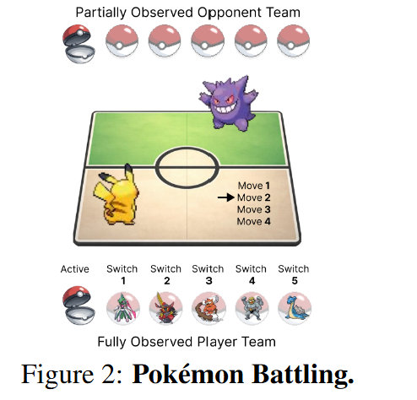
PokeAgent Challenge: Phase-Aware Routing/Meta RL
Pokemon is a long-horizon game
Different phases require different reasoning strategies
Opponent hidden information is critical
Use a LLM router to switch between phases
Preparation: Infer opponent archetype, select opening strategy
Early Game: Information gathering
Mid Game: Resource trading and flexible switching
End Game: Reduced uncertainty, execute deterministic win conditions

Slide 24
PokeAgent Challenge: Phase-Aware Routing/Meta RL
Framework:
Phase-aware LLM router: dynamically selects reasoning mode
Specialist policies: combined with belief inference, planning and
execution
Distillation from 20M+ trajectories
  actions
  latent beliefs
  strategic intentions
RL for router
  reward based on battle outcome and belief accuracy
Lightweight RL finetuning
  limited self-play for stabilization
Meta RL might work, but requires more online learning

Slide 25
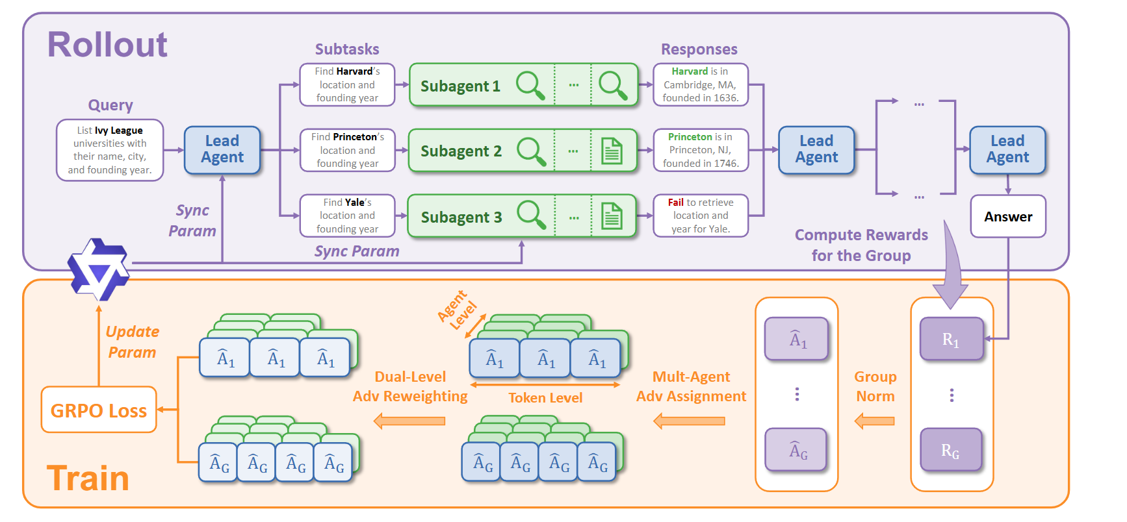
Other Challenges： WideSearch
Further Analyze/improvement on WideSeek framework.
Adaptive agent expansion
  when to spawn / stop subagents
Add a RL-based aggregator
  deduplication
  evidence merging
Hierarchical reward design
  leader vs subagent vs aggregator
Budget-limited reasoning

Slide 26
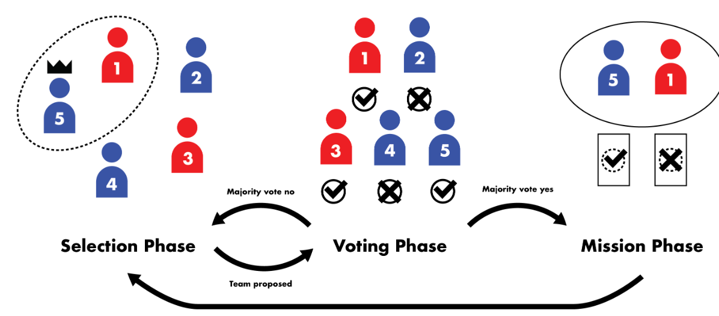
Other Challenges： WereWolf/Avalon Bench
Social reasoning game with:
hidden roles
public dialogue
group voting
team-level rewards
Natural fit for multi-agent self-play RL (e.g. MARS-style)
Possible framework:
shared backbone for all roles
role-conditioned reasoning
RL policy over latent actions
LLM verbalization layer
Main challenges:
sparse rewards
difficult credit assignment
expensive multi-agent rollouts

Slide 27
Other Challenges： Traditional Coordination Challenge Hanabi/Overcooked
Largely explored with traditional MARL
Still useful as controlled environments for:
  Routing / policy selection
  Partner modeling
  Convention reasoning
  Efficient communication: with image?
Possible Research Direction
RL learns low-level coordination skills
LLM performs high-level reasoning:
  partner inference
  convention understanding
  strategy selection
Dynamically route among different executors / policies
Require more exploration

Slide 28
Thank you

