Slide 1
Negotiation Experiment Update
Part I: game-theoretical insights
Part II: validator experiments and trajectory findings
Thesis
Experiment update
Negotiation is planning under latent beliefs: infer opponent type, solve over compact strategic actions, then realize language safely.
Buyer-only validation is not enough; validated seller is the clearest fix for mismatch so far.

Slide 2
Part I
Game-theoretical Insights for Negotiation Agents
Use game-theoretical method to help with belief tracking and strategic action generation.
Belief Model
Planner
Naturalizer
State
reservation range
trait intervals
acceptable range
evidence
strategic act
target price
guardrail
priorities
native BuyerAgent
valid tags
valid contract
product
history
private max
current offers

Slide 3
Idea 1: Calibrated Bayesian Belief State
Replace loose intervals with a scoreable posterior
Current: reservation range; acceptable range patience/flexibility intervals; evidence text.
Update: Factorized posterior over reservation bucket, issue weights, patience, dominance, friendliness, truthfulness. Use Bayesian update.
Source | Useful idea | Metric to add
Preference Estimation | LLM extracts language cues -> Bayesian update | preference accuracy
BOND | posterior belief as auditable output | Brier / ECE
Our framework | belief feeds planner and validator | belief-action consistency

Slide 4
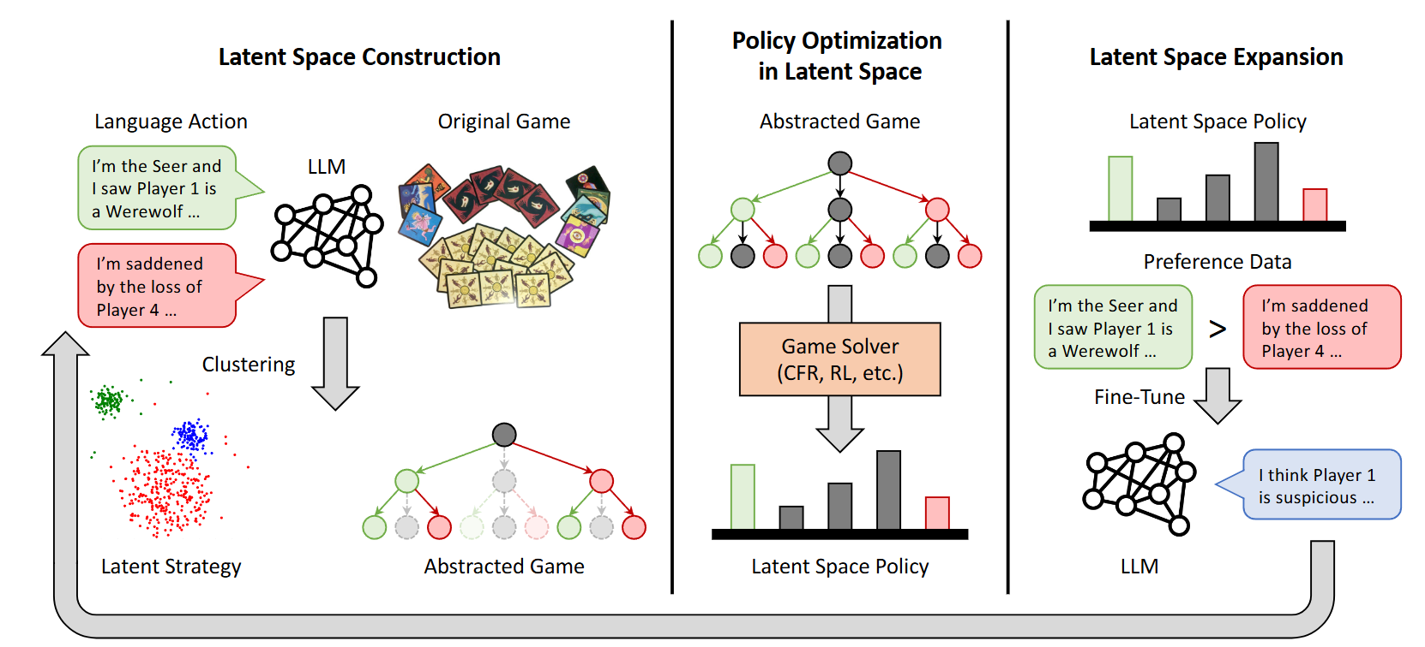
Idea 2: Latent Strategic Actions before Solving
From Zelai’s LSPO work.
LSPO’s lesson: map free-form language to discrete latent strategy space, use CFR to learn the best strategy over latent space and DPO to fine-tune LLM.
Our path: collect trajectories in experiments, use LLM feedback/cluster to rewrite the strategic action set.
Or run CFR?
Citations: LSPO, Xu et al. 2025; Deep CFR, Brown et al. 2018.

Slide 5
Idea 3: Belief-conditioned Best Response / Offer Optimization
Stackelberg view
ASTRA view
Our implementation
Buyer proposes; seller responds. Planner chooses offer a that maximizes U_buyer(a, predicted seller response).
Interpret counterpart behavior, optimize counteroffers via LP, select tactics by acceptance probability.
Add seller-feasible floor and non-price feasibility to planner; optimize within buyer/seller overlap.
This directly targets our mismatch source: seller-side negative utility.
Planner should output structured contract candidates, not only language advice.
Validator becomes a critic that rejects infeasible best responses.
Result:
Use structured contract output.
Change into a value-based RL.
belief -> value network -> Q(action) -> argmax

Slide 6
Idea 4: Separate Binding Actions from Language
Make the economic move explicit, then naturalize it
Method | Core design | What to borrow
Bilateral Trade | tool/event simulator separates binding offers and chat | price/contract as structured action
DAT | small planner steers frozen LM via action token | train planner without degrading language
RLVR | verifiable reward trains negotiation behavior | reward includes surplus, budget, mismatch, timeout
Design implication
A+B should produce a structured action: selected seller, product, price, complete contract, acceptance/walk-away flag. C should only realize it in AgenticPay format.
Training implication
Train planner with verifiable reward terms: BuyerScore, deal, IR, mismatch, timeout, and contract feasibility.
Citations: Bergemann et al. 2026; Li et al. 2024; Liu et al. 2026.

Slide 7
What These Methods Add to Our Framework
A concrete upgrade path
Module | Now | Next | Citation
Belief Model | interval estimates | factorized posterior + calibration | Preference Estimation / BOND
Planner | typed action prompt | latent act + value/LP selector | LSPO / ASTRA / Deep CFR
Naturalizer | native prompt wrapper | structured action realization | DAT / Bilateral Trade
Validator | format + buyer guardrail | two-sided feasibility critic | AgenticPay / mediator pipeline
Training | prompt-only | component-wise RLVR | RLVR negotiation
Short-term: posterior belief + seller-feasibility optimizer + stronger critic.
Medium-term: latent strategic codebook and value planner.
Long-term: train planner under verifiable rewards, keeping naturalizer constrained.
Part I takeaway: game theory provides structure for modules, not a replacement for the LLM.

Slide 8
Part II
Current AgenticPay Experiments
Validator-era comparison, full-framework failure modes, and hard-task trajectory lessons.

Slide 9
Experiment Map
What has been run and what each row means
prompt
A + C
B + C
A + B + C
Repo-native/direct buyer prompt. No explicit belief or planner.
Belief model + low-level generator. Tests whether latent opponent estimates help alone.
Planner + generator. Tests strategy-language decoupling without belief.
Belief → planner → generator. Main framework.
Item | Setting
Benchmark | AgenticPay One Buyer-One Seller-One product subset (28 tasks) covering different domains and several Multi Buyer-Multi Seller-Multi product tasks
Model | Qwen3-14B, same setting with the original paper
Metrics | Deal, Timeout, GlobalScore, BuyerScore, SellerScore, BuyerReward, AvgRounds, Mismatch, Contract feasibility.
All completed core runs use Qwen3-14B, seed 0, max_new_tokens=1024.

Slide 10
Baselines to Add
Inspired by ASTRA, strategy-generation decoupling, and prompt-tactic work
Some recent works:
RLVR Negotiation (Liu et al. 2026): RLVR Qwen3-30B buyers v.s. frontier model buyers.
  Sellers: Qwen3-30B-A3B-Instruct-2507 gpt-5.4-high-reasoning
Trade: SFT/RL - Qwen3-8B and Qwen3-14B negotiate with gpt-4.1/o3-mini. Both buyer and seller roles.
Agentic Pay: Self play/Cross play, use buyer/seller/global score to evaluate models.
ASTRA: full framework negotiate with gpt-4o/gemini-2.0-flash/claude-3.5-sonnet.
Preference Estimation: compare preference prediction accuracy
  Baseline: base-LLM/conventional Bayesian opponent modeling/LLM preference estimation
Main problem now:
update seller
Direct negotiation to compare models
Direct evaluation on belief

Slide 11
Validator-era Four-Variant Comparison
Add validator to avoid wrong price and contract failure
Variant | N | Deal | Timeout | Mismatch | Global | Buyer | Seller
prompt | 28 | 67.9% | 32.1% | 17.9% | 23.02 | 24.63 | 24.07
A+C | 28 | 84.6% | 15.4% | 31% | 23.84 | 25.57 | 25.21
B+C | 28 | 89.3% | 10.7% | 39.3% | 21.36 | 27.54 | 20.63
A+B+C | 28 | 89.3% | 10.7% | 28.6% | 22.71 | 28.99 | 28.15
Result
Failure mode
A+B+C improves over B+C on mismatch and seller score, but it does not yet beat native on global score. A+C looks promising but is only 13/28.
Most framework mismatches are not buyer max violations; they are seller-side negative utility from price and non-price contract terms.

Slide 12
What Validators Changed
Buyer-only guardrail was insufficient; seller validation is promising
Run | N | Deal | Timeout | Mismatch | B-neg | S-neg | IR
A+B+C v2 | 28 | 89.3% | 10.7% | 28.6% | 1 | 7 | 47.1%
A+B+C buyer guardrail | 28 | 82.1% | 17.9% | 32.1% | 1 | 8 | 56.2%
A+B+C + seller validator | 13 | 69.2% | 30.8% | 0.0% | 0 | 0 | 0.0%
B+C buyer guardrail | 28 | 92.9% | 7.1% | 42.9% | 2 | 12 | 77.8%
Buyer guardrail alone did not help: mismatch rose from 28.6% to 32.1% in the complete full-framework run.
Validated seller partial run is the cleanest signal: 0 mismatch and 0 IR violations so far.
Tradeoff: seller validation makes the game stricter and may increase timeout/no-deal risk.
Seller validator row is still partial in local files; present as early evidence, not final result.

Slide 13
Full Framework: Advantage and Remaining Problem
Current strongest claim is control, not final performance dominance
Advantage vs B+C
Advantage vs native
Remaining issue
Belief reduces over-aggressive planner behavior: v2 mismatch 28.6% vs 39.3%, seller score 28.15 vs 20.63.
Higher deal rate and fewer timeouts in v2: 89.3% deal vs 67.9%, 10.7% timeout vs 32.1%.
Score quality and feasibility lag: seller-side infeasible contracts dominate mismatches in taxi/product contract tasks.
The framework can make deals faster, but it sometimes creates deals the scorer rejects.
Non-price terms are the key blind spot: delivery days, route, wait time, utilities, lease months, packaging.
Next fix: plan over a buyer/seller feasible contract region, not only buyer max and target price.
Mismatch is a scientific signal: agreement text is not enough.

Slide 14
Concrete Trajectory: Hard Task4-same model
Full framework + validated seller, three buyers / three sellers / three products
Stage | What happened in the trajectory
Setup | Buyer max = 260 / 270 / 280; seller min = 220 / 230 / 240; products = jacket + shoes + backpack.
Belief | All buyer agents infer seller floor around 240 and likely acceptable range around 250-280.
Plan | All three choose anchor_low, target_price = 250, accept_if_at_or_below = buyer max.
Language | All three produce near-identical messages: offer BUYER_PRICE($250) for the entire set.
Seller | Seller1 counters each path with SELLER_PRICE($230); seller2/3 are not meaningfully explored.
Outcome | Environment selects buyer3 + seller1; final price = 230; rounds = 1; Global = 63.80, Buyer = 85.80, Seller = 33.00.
Good signal
Problem signal
Research insight
The framework immediately finds a feasible agreement in the buyer/seller overlap.
Multi-agent routing collapses to seller1 and language is almost copied across buyers.
Planner should reason over seller competition and diversify exploration, not only optimize one selected path.
Log: runs/.../20260617_105639/logs/003_multi_buyer_multi_products_multi_seller__Task4...log

Slide 15
Hard-task Trajectory Insights
Multi-buyer / multi-seller / multi-product probe
Run | N | Deal | Global | Buyer | Seller
Native probe | 4 | 100.0% | 44.28 | 30.38 | 54.42
Full + seller validator | 4 | 100.0% | 88.72 | 64.62 | 54.17
Full framework + validated seller completes all four structural hard tasks with deal rate 100% and avg rounds 1.0.
The framework optimizes price feasibility well here.

Slide 16
Experimental Conclusions and Todo
1. Add baselines
2. Keep full framework
3. Fix feasibility
Negotiation between different baselines.
Direct, CoT, warm/dominant, rule offer generator, ASTRA-like, validated seller, future RLVR.
A+B+C is still the right structure but may improved through game-theoretic methods.
The next architectural step is joint buyer/seller feasibility planning over all contract terms and preparation for RL.

Slide 17
Next To-do
Experiments blocked now, but the next queue is clear
Finish `full_framework + validated seller` to 28 tasks when experiments are available.
Run new baselines under identical seller-validated setting: direct, CoT, warm, dominant, rule offer generator, ASTRA-like.
Extend hard full-framework testing from structural Task1-4 to contract-heavy Task14-18 and Task25-29.
Add contract-level diagnostics per turn: buyer utility, estimated seller utility, non-price term deltas.
Prepare RL: train belief, planner, and naturalizer separately; use mismatch/IR as verifiable reward signals.
Files: 6.17/agenticpay_experiment_summary.md and this PPT.

