Slide 1
Decision-Calibrated Belief-to-Action Planning
Our exploration of OpenReview identified several 2026 studies that apply continuous opponent modeling to negotiation tasks. This overlap reduces the novelty of our work.
Explorations on benchmark:
  LLM-Deliberation is a well-known benchmark proposed at NeurIPS 2024 (currently with 154 citations). However, recent studies have shown that the negotiation process in this benchmark is not truly meaningful.
  NegotiationArena can be regarded as a simplified version of SimpleEnv/AmazonHistoryPrice (the environment we tested previously), while still allowing for direct comparisons with existing baselines.
  The ACL benchmark uses the alternating-offers protocol for negotiation. It can serve as a benchmark for evaluating posterior calibration, but it is not ideal as the primary benchmark because it does not involve natural language.

Slide 2
Opponent Simulation
Scaling Inference-Time Computation via Opponent Simulation: Enabling Online
Strategic Adaptation in Repeated Negotiation(ICML2026 Regular): continuous-update belief and belief-usable planner
  Use negotiation trajectories to train an auxiliary LLM.
  Use auxiliary LLM to simulate the actions of the opponent.
  Let the current agent generate several candidate messages.
  For each candidate message, continue the rollout with the simulated opponent.
  Choose the candidate with the best expected value.

Slide 3
Opponent Simulation
This Opponent Simulation used the auxiliary LLM to simulate the opponents through the process and continuous updated it, which overlaps with our work much.
However, this method uses a lot of cost and can only simulate simple fixed model on simple environment(Negotiation Arena with single buyer single seller). Our method can focus on a universal calibrated posterior that can be adaptive to opponents with different characters, irrational behaviors, and how can the planner get decision values from the belief.
I have already done a quick comparison on NegotiationArena, but the experiment still not finished.

Slide 4
Other exists works
MIND(ICLR2026 workshop HCAIR): infer willingness on multi-agent travel planning.
HAR(LLA2026 poster): hierarchical planning on negotiation tasks.
GENEGO(ICML 2026 AgenticUQ Workshop): structured memory and pairwise preference inference on CaSiNo environment. Can be tested as a new baseline

Slide 5
Benchmarks Exploration
From the exploration on openreview, our result on AmazonHistoryPrice(which is called simple env in before slides) and CaSiNo can already be reasonable for a paper, but may require more design for novelty.
Explorations on benchmark:
  LLM-Deliberation is a well-known benchmark proposed at NeurIPS 2024 (currently with 154 citations). However, recent studies have shown that the negotiation process in this benchmark is not truly meaningful.
  NegotiationArena can be regarded as a simplified version of SimpleEnv/AmazonHistoryPrice (the environment we tested previously), while still allowing for direct comparisons with existing baselines.
  The ACL benchmark uses the alternating-offers protocol for negotiation. It can serve as a benchmark for evaluating posterior calibration, but it is not ideal as the primary benchmark because it does not involve natural language.

Slide 6
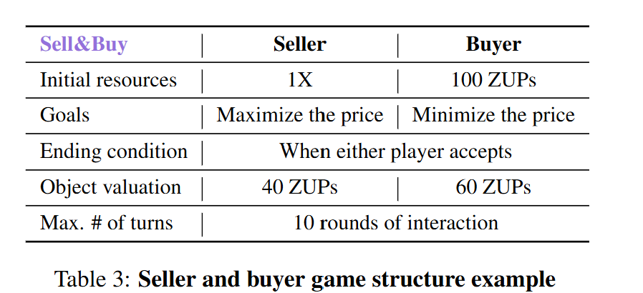
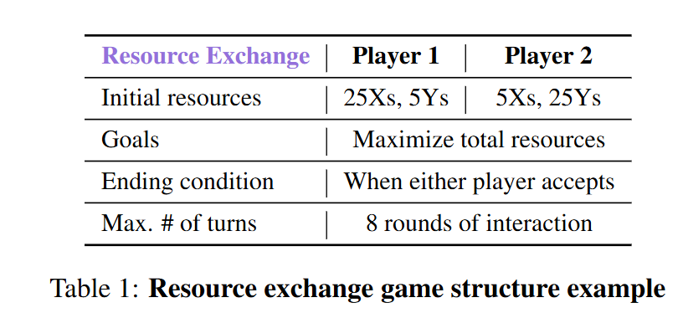
NegotiationArena: simple tasks, essential direct comparison
Its value rises because Opponent Simulation uses a precise repeated-game protocol
05

Slide 7
ANL: a clean mechanism test, not a language benchmark
Can be regard as test for caliberation belief
League | Hidden information / structure | Best diagnostic | Paper role
ANL 2024 | Known utility shape; hidden reservation value | RV posterior, coverage, oracle regret | Calibration sanity
ANL 2025 | Sequential one-to-many, multi-deal dependency | Continuation value and global planning | Planner mechanism
ANL 2026 | Unknown utility + reservation; concealment rewarded | Exploration vs self-information leakage | Information-control stress
06

Slide 8
UPDATED THESIS
The evidence chain is now partially established
We can show an executable belief-to-action channel; learned belief quality remains the bottleneck.
RQ1
RQ1
RQ2
RQ2
RQ3
RQ3
Belief formation
Belief use
Decision value
PARTIAL
Formal actions are reliable evidence. Strategic language and repeated counters do not uniquely reveal reservation utility.
CONFIRMED
Preference interventions cause same-state candidate-ranking and action flips. Policy-only effects remain weak.
CONDITIONAL
Correct belief has oracle headroom and wins in selected roles, but learned continuous belief is not universally better than frozen/shuffled.
Updated research claim
Build a canonical, reliability-gated belief state that an executable planner can causally use across heterogeneous negotiation protocols—and explicitly abstain when the trajectory is not identifiable.
Novelty must be supported by belief accuracy + action causality + decision value—not reward alone.
08

Slide 9
METHOD
Current universal belief–planner architecture
The same core consumes canonical states; only environment adapters know benchmark syntax.
Environment adapter
Public evidence
Factorized belief
Candidate set
Belief-usable planner
Action lock
Canonical state
Exact own utility
Formal action > offer
> bounded semantics
Preference θ
Policy φ • reliability • regime
Exploit • probe
safe • fallback
Payoff • risk • IG
continuation • frontier
Structured decision
Language realization only
Counterparty-scoped state
Reliability-gated update
Auditable decision trace
Beliefs are keyed by session and counterparty; multi-seller evidence cannot leak across agents.
An uncertain posterior is blended with a conservative protocol-local prior rather than trusted blindly.
belief before/after → candidates → scores → locked action → response → reward
Core code: negotiation/framework/ | adapters: Simple Env, AgenticPay, NegotiationArena
09

Slide 10
BELIEF MODEL
What survived trajectory-driven iteration
The key modeling distinction is durable utility versus strategic response behavior.
Evidence hierarchy
Factorized posterior
Iteration outcome
1 Formal ACCEPT / REJECT / COUNTER
2 Repeated formal offers and concessions
3 Contract-term changes
4 Natural-language claims such as ‘below cost’ or ‘final offer’
Preference θ
reservation / issue utilities
Response policy φ
accept / counter / quit / patience
Reliability ρ
evidence strength and calibration
Regime z
old/new mixture and change probability
✓ V5.4 strategic censoring retained
✓ V5.5 behavioral frontier retained
△ V5.9 is the performance candidate
✕ V6.0 response gate rejected
✕ V6.1 fixed weak coupling / probe rejected
Lesson: wide uncertainty is preferable to false precision when utility and aspiration are behaviorally confounded.
A rejection is response-policy evidence; it is not automatically a hard reservation-value lower bound.
10

Slide 11
PLANNER
Belief is executable—not appended as prompt decoration
Adapters enumerate feasible actions; the planner ranks them under exact focal utility and uncertain opponent response.
Score(a) = Pρ(agree | a,b) · Uself(a) + λt IG(a;b) + Vcontinuation(a) − Rquit(a)
Reliability gate
Behavioral frontier
Action-locked realization
Pρ = ρPb + (1−ρ)P0
Low-evidence beliefs cannot dominate the conservative adapter prior.
Do not repeat an unchanged offer inside a formally rejected region when a feasible successor exists.
The LLM verbalizes the selected price / bundle / contract; it cannot change structured fields.
CAUSAL AUDIT
learned • frozen • wrong-confident • shuffled • oracle • no-cross-episode
A useful belief must change the right action—and improve utility relative to wrong or shuffled content.
11

Slide 12
NEGOTIATIONARENA
Strict matched comparison: four focal roles
Qwen3-30B; each cell = 5 runs × 20 episodes. Values are focal reward; utility scales differ by game.
Focal setting | Direct | Opponent Simulation | Our best | Δ vs OS | Reading
Buyer | 7.77 | 12.76 | V3.3 13.11 | +0.35 | Small lead
Seller | 18.08 | 19.13 | V3.3 16.95 | −2.18 | Below OS
Resource-first | 12.34 | 40.57 | V5 18.45 | −22.12 | Opening failure
Resource-second | 9.75 | 11.88 | V3.3 22.47 | +10.59 | Clear lead
Strength
Failure condition
Cost contrast
Observed proposal → belief becomes decision-relevant.
First-mover opening has no current-game evidence.
Opponent Simulation uses up to ~10 LLM calls/action.
No global average is reported: price surplus and resource utility are on different scales.
12

Slide 13
NEGOTIATIONARENA
Causal belief audit: what V8 did—and did not—prove
100 episodes per cell; preference θ and response policy φ are explicitly factorized.
Setting | V8 learned | Frozen | Shuffled | Oracle
Buyer | 7.240 | 7.490 | 7.940 | 12.710
Seller | 11.120 | 13.750 | 11.560 | 17.330
Resource-first | 22.265 | 22.500 | 18.020 | 22.445
Resource-second | 21.675 | 25.125 | 25.665 | 25.655
Confirmed channel
Resource-first: V8 − shuffled = +4.245. Preference content can change useful actions.
Oracle headroom
Buyer +5.47 and Seller +6.21 versus V8: correct reservation information is planner-usable.
Not established
Continuous > frozen and policy φ utility are not consistently supported.
NegotiationArena validates the audit protocol—not a universal payoff-SOTA claim.
13

Slide 14
SIMPLE ENV
AmazonHistoryPrice: reward trend and calibration reality
Development results only. The validation40 and category-shift final64 splits remain untouched.
Dev24 method | Reward | Deal | Comparison
Full framework | 0.3947 | .750 | same-run anchor
Universal V5.4 | 0.4136 | .583 | +0.0189; CI crosses 0
Universal V5.7 | 0.5073 | .750 | +0.1126 descriptive*
Profile300 | Reward | MAE | Coverage
V5.9 | 0.397 | 0.099 | 1.00
V6.0 | 0.381 | 0.120 | 1.00
V6.1 | 0.387 | 0.173 | .88
Frozen | 0.397 | 0.168 | 1.00
Performance signal
Calibration gate
Remaining gap
V5.7 is the best complete dev24 reward, but was not rerun with full framework in the same batch.
V5.9 NL6 MAE 0.212 still trails frozen 0.188. Good reward does not prove a correct belief.
Original trained-Qwen reference reward = 0.7664; current universal method has not matched it.
*Cross-run descriptive comparison; the paired validation experiment is still required.
14

Slide 15
TRAJECTORY AUDIT
The central failure is behavioral non-identifiability
A short counter sequence can be explained by high utility or by low utility plus high strategic aspiration.
V5.9
readiness mixture
mean 0.883
COUNTEREXAMPLE
V5.9
Reward signal; over-attribution
automotive_0004
True seller cost / buyer budget
0.317
V6.0
reservation × aspiration
mean 0.748
V6.0
• Seller rejected profitable offers and publicly claimed ‘below cost’ / ‘final offer’.
• The language claim conflicts with private evaluator truth.
• Terminal acceptance often arrives before another belief-update turn.
Better response Brier; worse reward
V6.1
censored utility + probe
profile MAE 0.173
V6.1
Probe had no net value; stopped
Scientific stop rule: do not tune more constants on the same 6 / 20 trajectories; move to identifiable repeated profiles.
15

Slide 16
NOVELTY
The story after Opponent Simulation
Our differentiation is a calibrated, auditable state abstraction—not more environment-specific rollout search.
Dimension | Opponent Simulation | Our framework
Opponent model | Auxiliary LLM trajectory simulator | Factorized posterior θ, φ, reliability, regime
Planning | Candidate × future rollout search | Executable candidate scoring + bounded IG
Inference cost | Up to ~10 LLM calls / action | Structured planner; ≤1 semantic + 1 realization call
Portability | Prompt / simulator tied to game | Canonical core; environment-specific adapter only
Scientific audit | Payoff-centric | Calibration, action flip, wrong/shuffled/oracle, regret
Known weakness | Expensive; simple opponent simulator | Belief identifiability and first-mover opening
Falsifiable novelty claim: the same reliability-gated belief and planner core transfers across price, multi-issue and multi-party negotiation.
16

Slide 17
EXPERIMENT PLAN
Freeze mechanisms first; earn the universal claim in stages
Development, validation and final tests have distinct roles. Failed variants remain archived.
01
02
03
04
05
01
02
03
04
05
Identifiable suite
Simple validation
AgenticPay transfer
Arena compatibility
Final shift
Repeated hidden profiles
stationary + preference/policy switch
40 unseen scenarios × 3 rollouts
paired, cluster bootstrap
price → contract → 1×2 → 2×2
IR and per-counterparty belief
Direct + Opponent Simulation
matched compute and role strata
64 electronics × 5 rollouts
once after method freeze
Promotion gate
Required baselines
Training order
Calibration + coverage + correct-direction action flip + reward versus frozen/shuffled. No single metric is sufficient.
Direct, CoT, legacy full framework, best executable policy, trained-Qwen reference, Opponent Simulation where applicable.
Evidence extractor → calibrated posterior → canonical candidate ranking → language realization. No environment-token memorization.
Next milestone: demonstrate behavioral identifiability and change tracking before any calibration SFT.
17

