Slide 1
Decision-Calibrated Belief-to-Action Planning
Our exploration of OpenReview identified several 2026 studies that apply continuous opponent modeling to negotiation tasks. This overlap reduces the novelty of our work.
Explorations on benchmark:
  LLM-Deliberation is a well-known benchmark proposed at NeurIPS 2024 (currently with 154 citations). However, recent studies have shown that the negotiation process in this benchmark is not truly meaningful.
  NegotiationArena can be regarded as a simplified version of SimpleEnv/AmazonHistoryPrice (the environment we tested previously), while still allowing for direct comparisons with existing baselines.
  The ACL benchmark uses the alternating-offers protocol for negotiation. It can serve as a benchmark for evaluating posterior calibration, but it is not ideal as the primary benchmark because it does not involve natural language.

Slide 2
Opponent Simulation
Scaling Inference-Time Computation via Opponent Simulation: Enabling Online
Strategic Adaptation in Repeated Negotiation(ICML2026 Regular): continuous-update belief and belief-usable planner
  Use negotiation trajectories to train an auxiliary LLM.
  Use auxiliary LLM to simulate the actions of the opponent.
  Let the current agent generate several candidate messages.
  For each candidate message, continue the rollout with the simulated opponent.
  Choose the candidate with the best expected value.

Slide 3
Opponent Simulation
This Opponent Simulation used the auxiliary LLM to simulate the opponents through the process and continuous updated it, which overlaps with our work much.
However, this method uses a lot of cost and can only simulate simple fixed model on simple environment(Negotiation Arena with single buyer single seller). Our method can focus on a universal calibrated posterior that can be adaptive to opponents with different characters, irrational behaviors, and how can the planner get decision values from the belief.
I have already done a quick comparison on NegotiationArena, but the experiment still not finished.

Slide 4
Other exists works
MIND(ICLR2026 workshop HCAIR): infer willingness on multi-agent travel planning.
HAR(LLA2026 poster): hierarchical planning on negotiation tasks.
GENEGO(ICML 2026 AgenticUQ Workshop): structured memory and pairwise preference inference on CaSiNo environment. Can be tested as a new baseline

Slide 5
Benchmarks Exploration
From the exploration on openreview, our result on AmazonHistoryPrice(which is called simple env in before slides) and CaSiNo can already be reasonable for a paper, but may require more design for novelty.
Explorations on benchmark:
  LLM-Deliberation is a well-known benchmark proposed at NeurIPS 2024 (currently with 154 citations). However, recent studies have shown that the negotiation process in this benchmark is not truly meaningful.
  NegotiationArena can be regarded as a simplified version of SimpleEnv/AmazonHistoryPrice (the environment we tested previously), while still allowing for direct comparisons with existing baselines.
  The ACL benchmark uses the alternating-offers protocol for negotiation. It can serve as a benchmark for evaluating posterior calibration, but it is not ideal as the primary benchmark because it does not involve natural language.

Slide 6
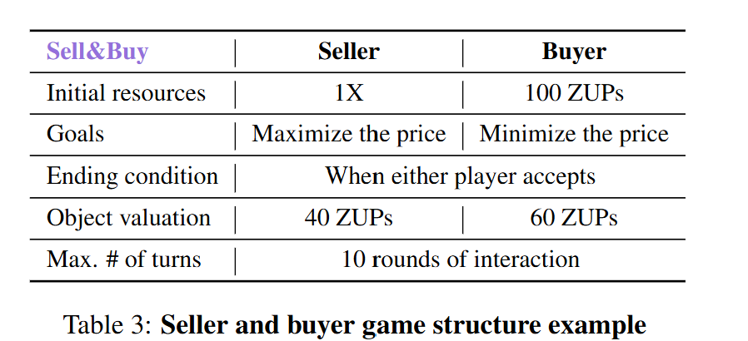
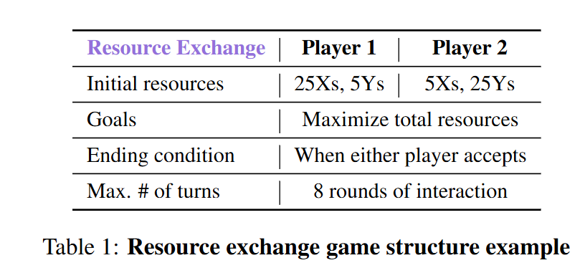
NegotiationArena: simple tasks, essential direct comparison
Its value rises because Opponent Simulation uses a precise repeated-game protocol
05

Slide 7
ANL: a clean mechanism test, not a language benchmark
Can be regard as test for caliberation belief
League | Hidden information / structure | Best diagnostic | Paper role
ANL 2024 | Known utility shape; hidden reservation value | RV posterior, coverage, oracle regret | Calibration sanity
ANL 2025 | Sequential one-to-many, multi-deal dependency | Continuation value and global planning | Planner mechanism
ANL 2026 | Unknown utility + reservation; concealment rewarded | Exploration vs self-information leakage | Information-control stress
06

Slide 8
UPDATED THESIS
A reward-first universal buyer framework
Only Simple reward and AgenticPay buyer score decide promotion; belief metrics explain why.
CONTROL
CONTROL
PRIMARY
PRIMARY
STATUS
STATUS
What is frozen
What is optimized
Current verdict
Buyer-only modification
Fixed native seller
Native benchmark scorer
Task/scenario clustered evaluation
Simple: native reward
AgenticPay: buyer score
Deal failure and calibration are diagnostics—not surrogate objectives.
Simple has a credible positive anchor.
AgenticPay remains below direct / CoT.
The main gap is accept / continue and multi-issue adaptation.
Falsifiable claim
A canonical, calibrated opponent state improves buyer utility only when an executable planner changes probe, concession and accept boundaries—across price and contract negotiation.
No reward gain → no method promotion, even if belief accuracy or action-flip improves.
08

Slide 9
METHOD
Current executable framework: six explicit interfaces
The core is protocol-free; adapters own syntax, legal actions and exact focal utility.
1 Adapter
2 Belief
3 Candidates
4 Planner
5 Renderer
6 Validator
history →
CanonicalState
θ utility
φ response policy
legal offers
accept / quit
reward EV
probe / frontier
locked action
action-aware text
IR + contract
semantic lock
Persistent state
Auditable action
No hidden evaluator truth
(session, counterparty) posterior; rejection frontier; old/new regime mixture.
belief → ranked candidates → selected ID → validation → public response → reward.
Production variants never receive seller cost, utility weights or benchmark labels.
Core: negotiation/framework/ | adapters: Simple_Env/buyer/ and AgenticPay_Env/buyer/
09

Slide 10
BELIEF STATE
What the framework maintains—and what it does not assume
Durable preference is separated from strategic response behavior and confidence.
State block | Maintained variables | Evidence / update
Preference θ | reservation interval; issue-option scores | formal offers + bounded semantic extraction
Response φ | accept/counter/quit; patience; rejected frontier | observed formal responses
Reliability ρ | preference and policy confidence | evidence count + source strength
Regime z | old/new mixture; change probability | opponent switch / behavioral shift
Structured first
Reliability gated
Causal controls
ACCEPT / REJECT / COUNTER dominate language claims.
Weak posteriors blend toward a broad safe prior.
frozen / wrong / shuffled / oracle remain diagnostics.
Belief calibration is explanatory; native buyer utility remains the optimization target.
10

Slide 11
PLANNER V2
Decision boundaries that can change reward
The planner controls probe, concession frontier and accept / continue—not just prompt wording.
Q(a) = P(agreement | a, b) · Ubuyer(a) + information value − quit / timeout risk
Probe boundary
Concession frontier
Terminal accept guard
Probe only when uncertainty is decision-relevant, buyer utility stays safe, and enough horizon remains.
Do not repeat a formally rejected region when a feasible successor has better response value.
Compare guaranteed IR seller proposal with conservative counter EV after repeated failure / near deadline.
Renderer invariant
OFFER says propose • ACCEPT matches the exact outstanding package • validator repairs mismatch
Training is deferred until real reward-backed labels exist; synthetic oracle gain is not enough.
11

Slide 12
EVALUATION
Frozen buyer-only protocol and primary outcomes
All formal comparisons use fixed sellers and matched scenario/task clusters.
Environment | Formal coverage | Primary metric | Cluster unit
Simple / AmazonHistoryPrice | 128 scenarios × 3 rollouts | native reward | scenario
AgenticPay single28 | 28 tasks × 3 seeds | buyer score | task
Promotion statistics
Explanatory audit
Resource control
Paired bootstrap 95% CI after averaging rollouts/seeds inside each cluster.
deal, timeout, IR, action mismatch, accept availability, calibration and action flip.
Local Qwen3-30B services on GPU1 / GPU2 only; seller and scorer unchanged.
Every iteration stores hypothesis, before/after source, exact commands, raw trajectories and result report.
12

Slide 13
SIMPLE ENV
Formal full evaluation: a credible positive anchor
128 scenarios × 3 rollouts; native reward; fixed seller; task changes only the buyer.
Buyer variant | Mean reward | Reading
Direct prompt | 0.0961 | 70.1% zero reward
CoT prompt | 0.4065 | strong prompt baseline
Legacy full framework | 0.4464 | same-run anchor
Universal V5.9 | 0.4981 | best frozen mechanism
Universal V6.3 AWR | 0.5130 | best point estimate
Paired contrast | Δ reward [95% CI]
V6.3 − CoT | +0.1066 [+0.0581,+0.1560]
V6.3 − Full | +0.0666 [+0.0203,+0.1118]
V6.3 − V5.9 | +0.0149 [−0.0296,+0.0589]
V6.3 − oracle envelope* | +0.0060 [−0.0390,+0.0501]
Conclusion: V6.3 beats each single CoT/full baseline, but not V5.9 or the per-scenario best envelope significantly.
13

Slide 14
AGENTICPAY
Formal initial evaluation: the universal variants fail
28 tasks × 3 seeds; official buyer score; native fixed seller.
Buyer variant | BuyerScore | Deal Rate | Timeout Rate
Direct prompt | 32.953 | 90.5% | 9.5%
CoT prompt | 31.720 | 90.5% | 9.5%
Legacy full | 21.311 | 90.5% | 9.5%
Universal V1 | 15.731 | 81.0% | 19.0%
Universal V2 AWR | 18.177 | 94.0% | 6.0%
Verified diagnostic | Observed
V1 OFFER says ACCEPT | 865 / 977 turns
V2 OFFER says ACCEPT | 502 / 591 turns
V2 − CoT | −13.542 CI [−25.867,−1.782]
V2 − V1 | +2.447 CI [−6.435,+10.621]
Metric meanings / formulas
• BuyerScore: discounted buyer utility, ≈ γ^(t−1)[10 + 80r_b + 10]; r_b=(B−P)/(B−C) for price-only or U_b/Z_max for contracts; infeasible/no-deal = −15[1−γ^(t−1)].
• Deal Rate: valid agreements / all episodes.
• Timeout Rate: episodes reaching max rounds without a valid agreement / all episodes.
14

Slide 15
ITERATION 001
Protocol correctness helps—but does not beat strong prompts
V3 changes only action-aware rendering and semantic validation; belief and planner remain V1.
Same 8-task × 3-seed subset | Buyer score
Direct prompt | 50.079
CoT prompt | 45.963
Legacy full | 34.689
V1 | 19.759
V3 action-consistent | 33.132
Action mismatch
Agreement gap
V1 158 / 177
V3 0 / 329
Deal 62.5%
Timeout 37.5%
V3 − V1
V3 − direct
+13.37
CI [−7.92,+39.92]
−16.95
CI [−53.54,+22.28]
236 acceptable seller proposals appeared; only 12 were selected, with 53 late deferrals → planner boundary is the next target.
15

Slide 16
ITERATION 002
Proposal-backed terminal guard: first causal smoke
Only the accept / continue ranking changes; belief, candidates, renderer, seller and scorer stay frozen.
Task4 / seed 20260817 | V3 | V4 terminal guard
Buyer score | −2.731 | 52.263
Agreement | No | Yes
Rounds | 21 | 14
Contract IR violation | — | 0
Selected event | repeat counter | accept exact seller package
Guard evidence
Turn 13 • repeated formal failures • complete public proposal • buyer IR positive
Formal status
Smoke only. Dev has 6 / 24 records saved; no aggregate claim until completion.
The guard is environment-independent: guaranteed accept value is compared with conservative counter expected value.
16

Slide 17
NOVELTY
A coherent story after Opponent Simulation
Our claim is cross-environment state abstraction plus auditable action use—not more rollouts.
Dimension | Opponent Simulation | Our framework
Opponent state | auxiliary LLM simulator | θ utility + φ policy + ρ + regime
Decision | candidate rollout search | legal candidate EV + probe/frontier/accept
Cost | many LLM calls per action | structured core; bounded semantic calls
Transfer unit | game-specific simulator/prompt | canonical state + thin adapter
Audit | mostly payoff | reward + calibration + wrong/shuffled/oracle
Novelty is earned only if one frozen core improves buyer utility in Simple, AgenticPay and compatibility tests—not by environment-specific tuning.
17

Slide 18
PLAN
Reward-first iteration and final evidence package
Each iteration changes one mechanism, preserves trajectories and returns to both full environments.
01
01
02
02
03
03
04
04
05
05
Finish V4 dev
Core alignment
Simple transfer
AgenticPay breadth
Final freeze
8 tasks × 3 seeds
paired buyer score
behavioral frontier
issue tradeoff posterior
validation40 × 3
no seller change
single28 → 1×2 / 2×2
contract IR
Simple128 × 3
AgenticPay28 × 3
Promotion gate
Training trigger
Final baselines
Mean > legacy full; paired CI and task coverage reported; no IR regression.
Only after real trajectory reward labels: conservative offline RL / AWR with base fallback.
Direct, CoT, legacy full, best universal, wrong/shuffled belief; OS where applicable.
Target result: positive buyer-utility delta in both Simple and AgenticPay with one frozen planner/belief design.
18

