Slide 1
IBM Good Tech Scholars Program 2021, 22nd November to November 25th
FUTURE FARM
THEME: Digital Transformation For Social Change

Slide 2
OUTLINE
Team Introduction
Problem Statement
Solution
Summary

Slide 3
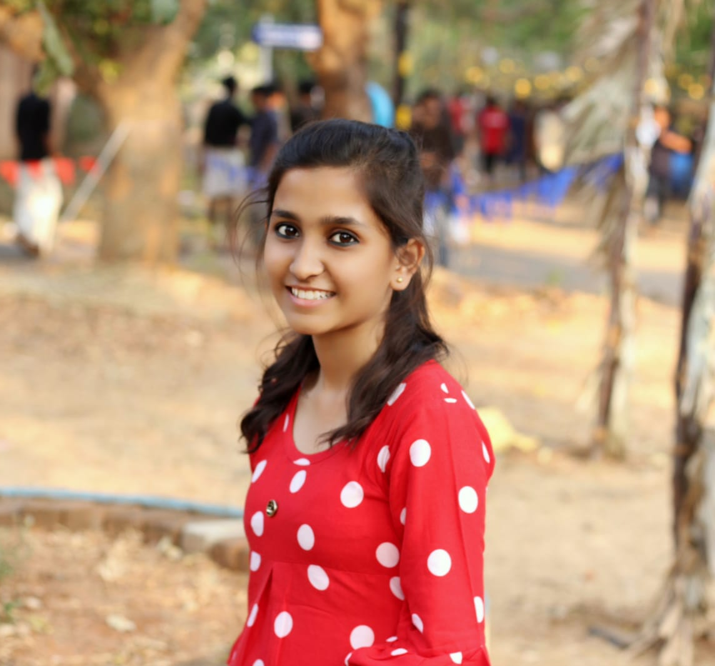
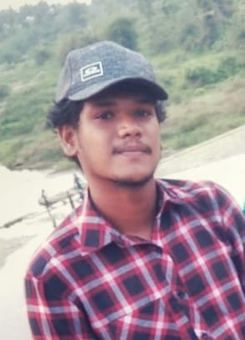
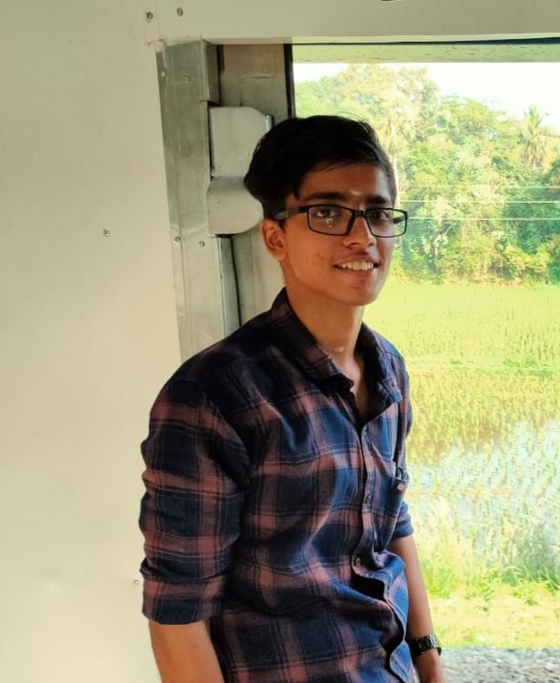
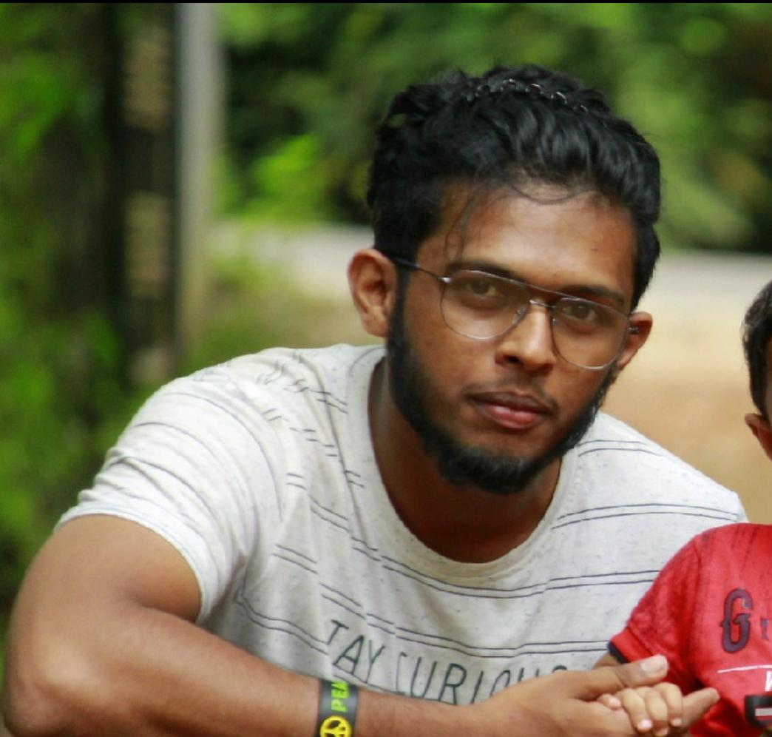
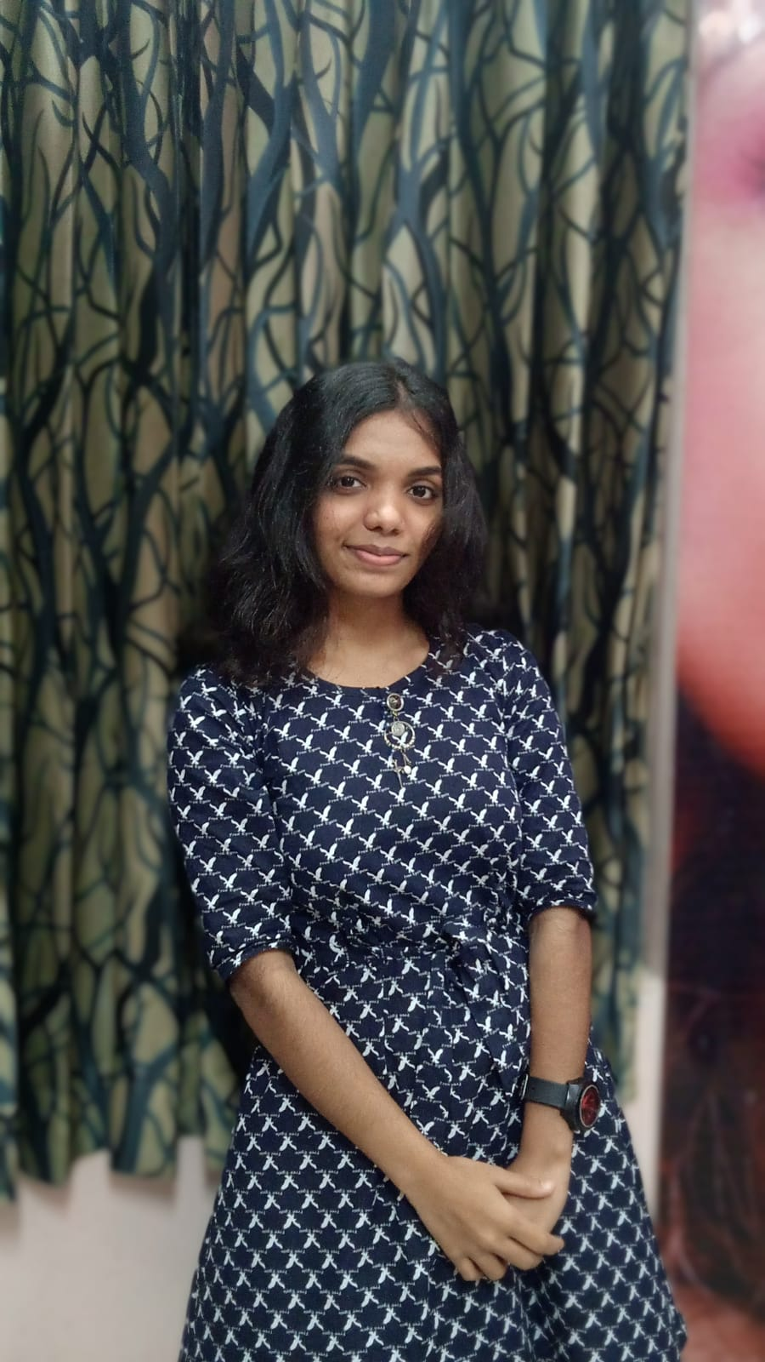
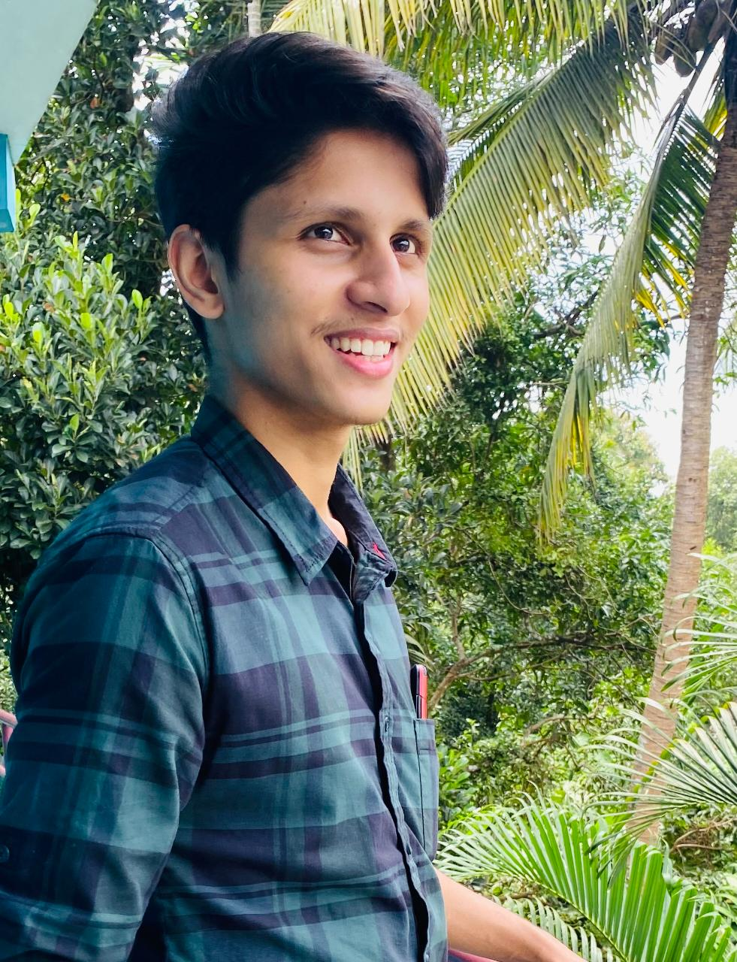
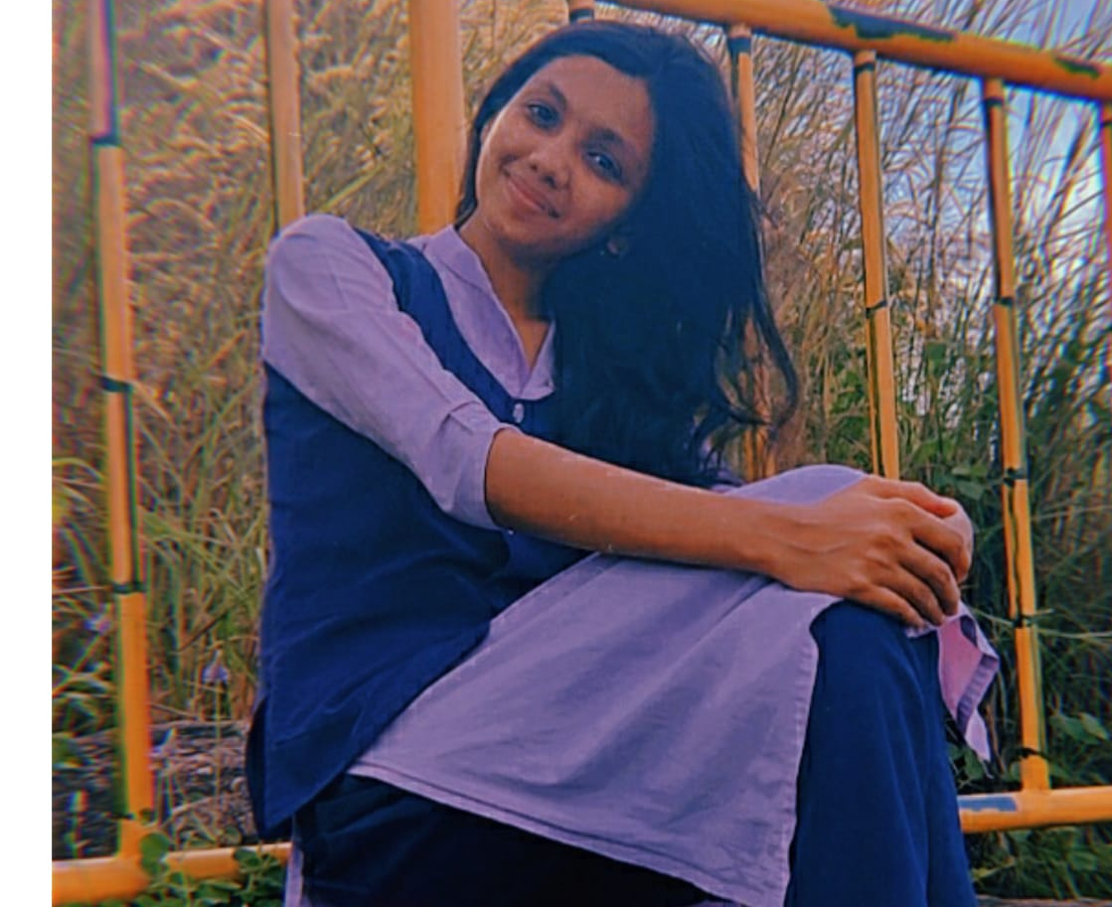
TEAM TITANS
Anumol S
Aravind K S
Aravind H
Sreehari R Chandran
Sneha Mani
Amritha S

Slide 4
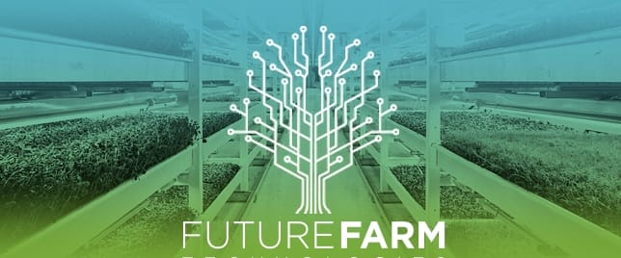

Slide 5
Problem Statement
Can we help farmers to cultivate better ?

Slide 6
SOLUTION
Developing a farmer assisting web application ‘FUTURE FARM’ for:
Predicting the suitable crop for the particular land.
Suggesting fertilizers for better harvesting

Slide 7
TECHNOLOGY USED
Language Python, CSS, HTML.
Bootstrap
Heroku for Deployment
Dash for web application framework
ML Algorithm : K Nearest Neighbours Algorithm for crop suggestion.
Random Forest Algorithm for Fertilizer Recommendation.

Slide 8
WORKFLOW
ML algorithm
Crop Suggestion
Fertilizer recommendation
Plant Disease Diagnosis
(UI)Website
Output in to website
Python code(app. Py)
Prediction
PKL

Slide 9
FUTURE FARM REFERENCE
website link:
https://ibmnm.000webhostapp.com/index.html
github link:
https://github.com/TRAMPTIX/ibmfinal
Data set link:
https://www.kaggle.com/atharvaingle/crop-recommendation-dataset

Slide 10
THANK YOU

