Slide 1




WASTE CLASSIFICATION USING
CNN MODEL

Slide 2

Learning Objectives
CNN is supervised learning technique for finding patterns in images to classify and recognize objects, classes and categories.
CNN architecture has three layers Convolution layers, Rectified linear unit, and Pooling layers. CNN also use to classify audio, time series and signal data.
By using CNN model to identify whether it is plastic waste or not
In this CNN we use the AI power model to classify the waste materials based on the Visualization of the data image of the product like( plastic water bottle ,apple ,etc )
So, from this CNN method we can identify whether it is Organic or recyclable of that considered product
First we will train the model after that testing process ,then finally deployment.
GOAL
Source :
www.freepik.com/

Slide 3
CNN is supervised learning technique for finding patterns in images to classify and recognize objects, classes and categories. CNN architecture has three layers Convolution layers, Rectified linear unit, and Pooling layers. CNN also use to classify audio, time series and signal data
convolutional neural network (CNN) is a type of artificial neural network used primarily for image recognition and processing, due to its ability to recognize patterns in images.
Here the tools are used in ths CNN model and development environments are
Keras 1)Jupter notebook
Open CV - Python 2) Google colab
Numpy
Pandas
Matplotlib
Tools and Technology used

Slide 4
Methodology
The methodology for a Convolutional Neural Network (CNN) model for image classification involves breaking down images into smaller pieces to identify patterns. These patterns help the CNN recognize objects, such as shapes and edges.
Steps in the CNN model methodology
Import libraries: Import libraries like TensorFlow
Set up directory structure: Create a directory structure for the image data
Create image data generators: Create generators to flow data from directories
Train the CNN model: Train the CNN model using the image data
Evaluate the model: Evaluate the performance of the CNN model
CNN model architecture
Convolutional layer: Applies filters to the input image to capture local patterns
Activation layer: Introduces non-linearity using activation functions like ReLU
Pooling layer: Reduces spatial dimensions while retaining important information
Dense layer: Also known as a fully connected layer
CNN model advantages
CNNs are inspired by how animals process visual information to recognize objects
CNNs are efficient because they use the same filters across different parts of an image
CNNs are a popular method for image classification

Slide 5
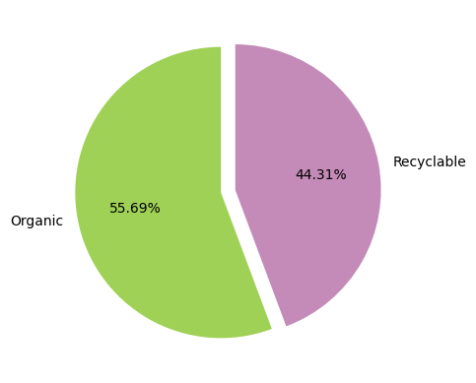
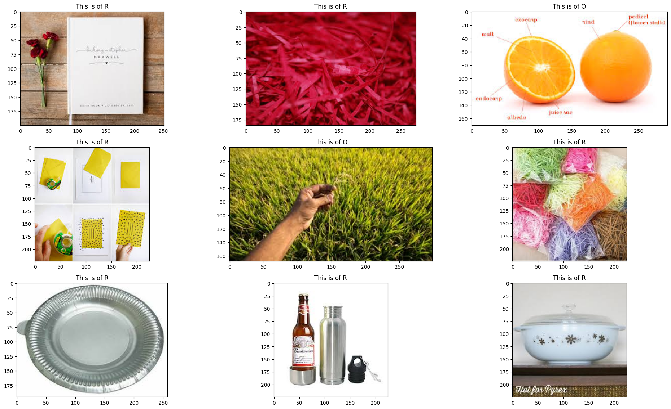
The problem statement for a CNN model for image classification is to build a model that can classify images based on their content

Slide 6
Solution:
CNN methods in image processing involve using convolutional layers to detect features, pooling layers to downsample data, and fully connected layers for classification. Activation functions add non-linearity, optimization algorithms adjust parameters, and regularization techniques prevent overfitting

Slide 7
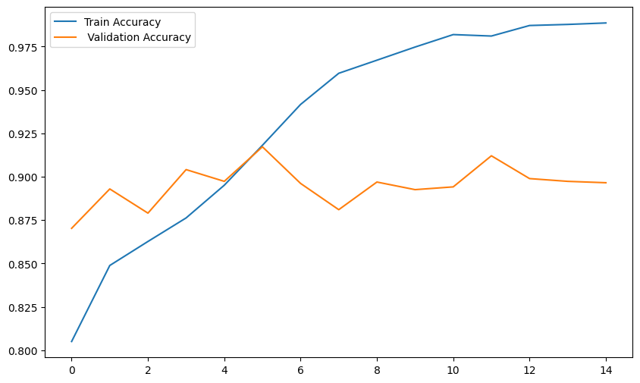
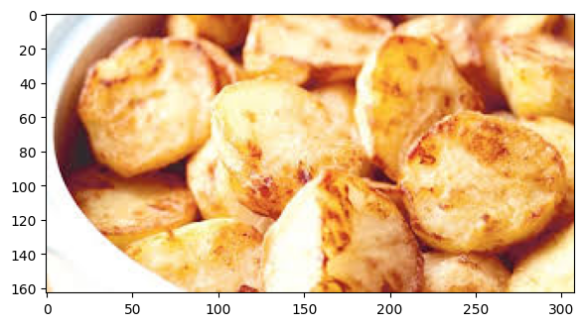
Screenshots and outputs
These are the models we train the based on the material which is organic waste and training model values shown in Train Model Accuracy and their validation Accuracy

Slide 8
Conclusion:
Convolutional neural networks (CNNs) are a powerful tool for image classification that can accurately identify objects in images. CNNs can automatically learn and extract complex features, and are used in many applications.
Conclusion
CNNs have revolutionized computer vision and can be used in many applications.
CNNs can be used for object recognition, medical image analysis, facial recognition, and art generation.
CNNs can be improved by balancing complexity with regularization techniques to avoid overfitting.
CNNs can be improved by adding more input layers and hidden neurons.
CNNs can be improved by using attention mechanisms, architectural innovations, and self-supervised learning

