Slide 1
OpenMP Tutorial Guided Demo (ECP Annual Meeting 2022)
Colleen Bertoni (bertoni@anl.gov)
Dossay Oryspayev (doryspaye@bnl.gov)
JaeHyuk Kwack (jkwack@anl.gov)
May 2nd, 2022

Slide 2
Agenda
Two examples of porting CPU OpenMP to OpenMP offload
Vector addition (DAXPY) in C
GAMESS RI-MP2 miniapp in Fortran
Go through compiling and running CPU version
Port to OpenMP offload
Compare results from CPU to GPU

Slide 3
Vector addition in C/C++
CPU version: Get the code and build it (on Ascent)
# get the examples
$ git clone https://github.com/vlkale/OpenMP-tutorial
# submit an interactive job
$ bsub -W 2:00 -nnodes 1 -P GEN180 -Is $SHELL
$ cd OpenMP-tutorial/vector-add

Slide 4
Vector addition in C/C++
CPU version
Multiplies one vector by a scalar and then adds it to another.
On the CPU, just use “#pragma omp parallel for” to run it in parallel.
#pragma omp parallel for
for (size_t j=0; j<ARRAY_SIZE; j++) {
a[j] = a[j]+scalar*b[j];
}

Slide 5
Vector addition in C/C++
CPU version
Multiplies one vector by a scalar and then adds it to another.
On the CPU, just use “#pragma omp parallel for” to run it in parallel.
start_time = omp_get_wtime();
for(size_t i=0;i<iters;i++)
{
iteration_time[i] = omp_get_wtime();
#pragma omp parallel for
for (size_t j=0; j<ARRAY_SIZE; j++) {
a[j] = a[j]+scalar*b[j];
}
iteration_time[i] = omp_get_wtime() - iteration_time[i];
}
time = omp_get_wtime()-start_time;
printf("Time: %lf\n", time);

Slide 6
Vector addition in C/C++
CPU version: Run it with 42 threads on the 2 P9s
$ make vector_add_cpu
xlc++ -O2 -qsmp=omp vector_add_cpu.cpp -o vector_add_cpu
$ ./run_vector_add_cpu.sh
+ OMP_PROC_BIND=spread
+ OMP_NUM_THREADS=42
+ jsrun -n 1 -a 1 -c 42 -r 1 --bind packed:42 ./vector_add_cpu
The total memory allocated is 8192.000 MB.
Time (s): 17.649502
Success!

Slide 7
Vector addition in C/C++
How to port from CPU to GPU?
What pragmas to offload the compute?
What about data movement?

Slide 8
Vector addition in C/C++
CPU version
1. What pragmas to to offload the compute?
2. What about data movement?
#pragma omp parallel for
for (size_t j=0; j<ARRAY_SIZE; j++) {
a[j] = a[j]+scalar*b[j];
}

Slide 9
Vector addition in C/C++
CPU version
1. What pragmas to to offload the compute?
2. What about data movement?
#pragma
for (size_t j=0; j<ARRAY_SIZE; j++) {
a[j] = a[j]+scalar*b[j];
}

Slide 10
Vector addition in C/C++
GPU version
1. What pragmas to to offload the compute?
2. What about data movement?
#pragma omp target teams distribute parallel for simd
for (size_t j=0; j<ARRAY_SIZE; j++) {
a[j] = a[j]+scalar*b[j];
}

Slide 11
Vector addition in C/C++
GPU version
1. What pragmas to to offload the compute?
2. What about data movement?
#pragma omp target teams distribute parallel for simd
for (size_t j=0; j<ARRAY_SIZE; j++) {
a[j] = a[j]+scalar*b[j];
}

Slide 12
Vector addition in C/C++
GPU version
#pragma omp target enter data map(to:a[0:ARRAY_SIZE])
#pragma omp target enter data map(to:b[0:ARRAY_SIZE])
#pragma omp target teams distribute parallel for simd
for (size_t j=0; j<ARRAY_SIZE; j++) {
a[j] = a[j]+scalar*b[j];
}
#pragma omp target update from(a[0:ARRAY_SIZE])
Transferring data

Slide 13
Vector addition in C/C++
GPU version
#pragma omp target enter data map(to:a[0:ARRAY_SIZE])
#pragma omp target enter data map(to:b[0:ARRAY_SIZE])
start_time = omp_get_wtime();
for(size_t i=0;i<iters;i++)
{
iteration_time[i] = omp_get_wtime();
#pragma omp target teams distribute parallel for
for (size_t j=0; j<ARRAY_SIZE; j++) {
a[j] = a[j]+scalar*b[j];
}
iteration_time[i] = omp_get_wtime() - iteration_time[i];
}
time = omp_get_wtime()-start_time;
#pragma omp target update from(a[0:ARRAY_SIZE])
printf("Time: %lf\n", time);

Slide 14
Vector addition in C/C++
GPU version
$ make vector_add_gpu
xlc++ -O2 -qsmp=omp -qoffload vector_add_gpu.cpp -o vector_add_gpu
$ ./run_vector_add_gpu.sh
+ jsrun -n 1 -a 1 -c 1 -g 1 ./vector_add_gpu
The total memory allocated is 8192.000 MB.
Time (s): ???
Success!

Slide 15
Vector addition in C/C++
GPU version
$ make vector_add_gpu
xlc++ -O2 -qsmp=omp -qoffload vector_add_gpu.cpp -o vector_add_gpu
$ ./run_vector_add_gpu.sh
+ jsrun -n 1 -a 1 -c 1 -g 1 ./vector_add_gpu
The total memory allocated is 8192.000 MB.
Time (s): 5.333160
Success!
CPU time was 17.649502 s,
The ratio is 3.3x (17.649502 / 5.333160), which is close to the ratio of the memory BWs

Slide 16
Vector addition in C/C++
GPU version: including data transfer overhead
start_time = omp_get_wtime();
#pragma omp target enter data map(to:a[0:ARRAY_SIZE])
#pragma omp target enter data map(to:b[0:ARRAY_SIZE])
for(size_t i=0;i<iters;i++)
{
iteration_time[i] = omp_get_wtime();
#pragma omp target teams distribute parallel for
for (size_t j=0; j<ARRAY_SIZE; j++) {
a[j] = a[j]+scalar*b[j];
}
iteration_time[i] = omp_get_wtime() - iteration_time[i];
}
#pragma omp target update from(a[0:ARRAY_SIZE])
time = omp_get_wtime()-start_time;
printf("Time: %lf\n", time);
Now we move the timers to include the data transfer

Slide 17
Vector addition in C/C++
GPU version: including data transfer overhead
$ make vector_add_gpu
xlc++ -O2 -qsmp=omp -qoffload vector_add_gpu.cpp -o vector_add_gpu
$ ./run_vector_add_gpu.sh
+ jsrun -n 1 -a 1 -c 1 -g 1 ./vector_add_gpu
The total memory allocated is 8192.000 MB.
Time (s): ???
Success!

Slide 18
Vector addition in C/C++
GPU version: including data transfer overhead
$ make vector_add_gpu
xlc++ -O2 -qsmp=omp -qoffload vector_add_gpu.cpp -o vector_add_gpu
$ ./run_vector_add_gpu.sh
+ jsrun -n 1 -a 1 -c 1 -g 1 ./vector_add_gpu
The total memory allocated is 8192.000 MB.
Time (s): 7.875810
Success!
CPU time was 17.649502 s,
The ratio is 2.2x (17.649502 / 7.875810), which is less than before, since we include data transfer in the timing.

Slide 19
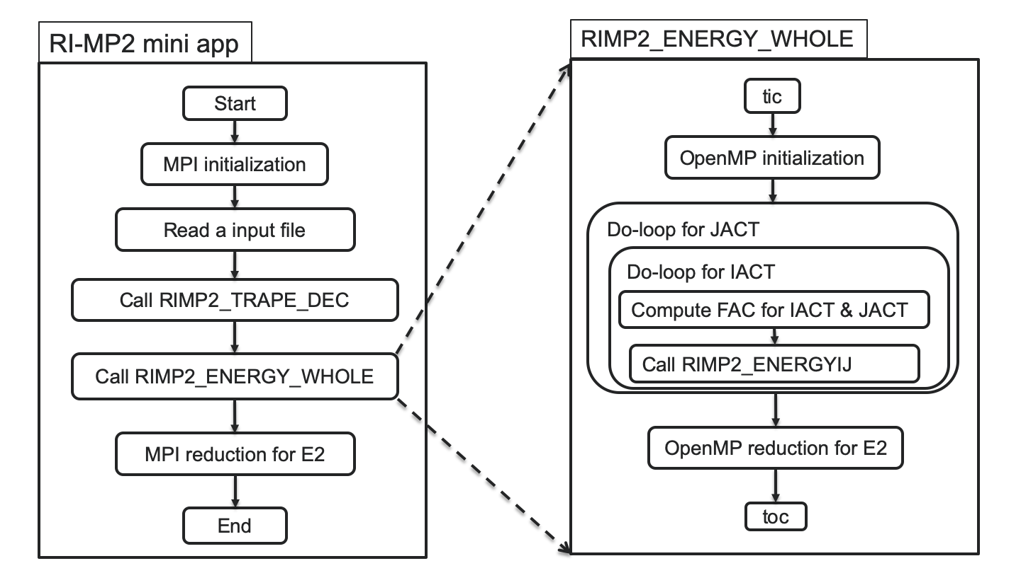
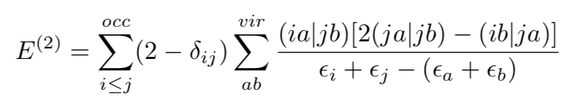
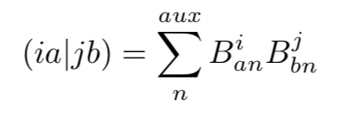
Introduction of GAMESS RI-MP2 miniapp in Fortran
GAMESS and RI-MP2 kernel
GAMESS is a quantum chemistry software package designed for molecular simulations.
(E)FMO/RI-MP2 is one of the quantum chemistry algorithms of interest
Algorithm of interest in GAMESS ECP problem
RI-MP2 equations:
During this tutorial, arbitrarily generated inputs will be used;
Therefore, the computed energy is not realistic.

Slide 20
Introduction of GAMESS RI-MP2 miniapp in Fortran
CPU version: Get the code and build it (on Ascent)
# get the examples
$ git clone https://github.com/jkwack/GAMESS_RI-MP2_MiniApp.git --branch ECP2021
# submit an interactive job
$ bsub -W 2:00 -nnodes 1 -P GEN180 -Is $SHELL
$ cd GAMESS_RI-MP2_MiniApp
# set the environment
$ source source_me_OLCF_ASCENT

Slide 21
Introduction of GAMESS RI-MP2 miniapp in Fortran
GAMESS and RI-MP2 kernel
Restructured RI-MP2 kernels
for fewer DGEMM calls with larger matrices
subroutine RIMP2_ENERGY_WHOLE ( ... )
...
do-loop for JACT ! From 1 to NACT
call RIMP2_ENERGYIJ (B32(:,:,1:JACT), B32(:,:,JACT), E2, ...)
enddo
...
end !subroutine RIMP2_ENERGY_WHOLE ( ... )
subroutine RIMP2_ENERGYIJ( ... )
...
call DGEMM for BI(:,:,1:JACT), BJ(:,:), QVV(:,:,1:JACT)
...
do-loop for IC ! From 1 to JACT
Set FAC
do-loop for IB ! From 1 to NVIR
do-loop for IA ! From 1 to NVIR
compute E2_t with QVV(:,:,IC), eij(:,:), eab(:,:)
enddo
enddo
E2 = E2 + FAC*E2_t
enddo
...
end !subroutine RIMP2_ENERGYIJ( ... )
Math Library call
Additional computation with
the results from Math Library

Slide 22
Introduction of GAMESS RI-MP2 miniapp in Fortran
Build the CPU version with ESSL on a compute node
$ cd GAMESS_RI-MP2_MiniApp/
$ source source_me_OLCF_ASCENT
$ make my_rimp2_cpu
xlf90_r -qsmp=omp GAMESS-RIMP2-CorrEng-Tutorial-cpu.f90 -o my_rimp2_cpu -L/sw/ascent/essl/6.1.0-2/essl/6.1/lib64 -lessl
** rimp2_shared === End of Compilation 1 ===
** mp2correng === End of Compilation 2 ===
** rimp2_energy_whole === End of Compilation 3 ===
** rimp2_energyij === End of Compilation 4 ===
** initialization === End of Compilation 5 ===
1501-510 Compilation successful for file GAMESS-RIMP2-CorrEng-Tutorial-cpu.f90.

Slide 23
Introduction of GAMESS RI-MP2 miniapp in Fortran
Run it with 42 threads on 2 P9s with ESSL
$ OMP_PROC_BIND=spread OMP_NUM_THREADS=42 jsrun -n 1 -c 42 -a 1 -b packed:42 -g 0 ./my_rimp2_cpu w30
Using the structure of w30.kern
NAUXBASD,NCOR,NACT,NVIR,NBF = 2520 30 120 570 750
Memory Footprint:
B32(1436400, 120) = 1378.9440 MB
eij( 120, 120) = 0.1152 MB
eab( 570, 570) = 2.5992 MB
QVV( 570,120, 570) = 311.9040 MB
Number of OMP threads: 42
Computed mp2 corr energy: 0.34722E+00
Ref. mp2 corr energy: 0.34722E+00
Wall time: 19.158 sec
Passed :-)

Slide 24
Introduction of GAMESS RI-MP2 miniapp in Fortran
GAMESS and RI-MP2 kernel
subroutine RIMP2_ENERGY_WHOLE ( ... )
...
do-loop for JACT ! From 1 to NACT
call RIMP2_ENERGYIJ (B32(:,:,1:JACT), B32(:,:,JACT), E2, ...)
enddo
...
end !subroutine RIMP2_ENERGY_WHOLE ( ... )
subroutine RIMP2_ENERGYIJ( ... )
...
call DGEMM for BI(:,:,1:JACT), BJ(:,:), QVV(:,:,1:JACT)
...
do-loop for IC ! From 1 to JACT
Set FAC
do-loop for IB ! From 1 to NVIR
do-loop for IA ! From 1 to NVIR
compute E2_t with QVV(:,:,IC), eij(:,:), eab(:,:)
enddo
enddo
E2 = E2 + FAC*E2_t
enddo
...
end !subroutine RIMP2_ENERGYIJ( ... )
Math Library call
Additional computation with
the results from Math Library

Slide 25
Introduction of GAMESS RI-MP2 miniapp in Fortran
Build the CPU version with NVBLAS and ESSL on a compute node
$ make my_rimp2
xlf90_r -qsmp=omp -qoffload GAMESS-RIMP2-CorrEng-Tutorial.f90 -o my_rimp2 -lnvblas -L/sw/ascent/essl/6.1.0-2/essl/6.1/lib64 -lessl
** rimp2_shared === End of Compilation 1 ===
** mp2correng === End of Compilation 2 ===
** rimp2_energy_whole === End of Compilation 3 ===
** rimp2_energyij === End of Compilation 4 ===
** initialization === End of Compilation 5 ===
1501-510 Compilation successful for file GAMESS-RIMP2-CorrEng-Tutorial.f90.

Slide 26
Introduction of GAMESS RI-MP2 miniapp in Fortran
Run it with a V100 GPU with NVBLAS
$ OMP_NUM_THREADS=1 jsrun -n 1 -c 1 -g 1 ./my_rimp2 w30
...
Using the structure of w30.kern
NAUXBASD,NCOR,NACT,NVIR,NBF = 2520 30 120 570 750
Memory Footprint:
B32(1436400, 120) = 1378.9440 MB
eij( 120, 120) = 0.1152 MB
eab( 570, 570) = 2.5992 MB
QVV( 570,120, 570) = 311.9040 MB
Number of OMP threads: 1
Computed mp2 corr energy: 0.34722E+00
Ref. mp2 corr energy: 0.34722E+00
Wall time: 18.579 sec
Passed :-)
Basically the same
time as running 42 threads
on the CPU

Slide 27
Introduction of GAMESS RI-MP2 miniapp in Fortran
Run it with NSYS NVPROF on a V100 GPU with NVBLAS
$ module load nsight-systems
$ OMP_NUM_THREADS=1 jsrun -n 1 -c 1 -g 1 nsys nvprof ./my_rimp2 w30
…
CUDA Kernel Statistics:
Time(%) Total Time (ns) Instances Name
------- --------------- --------- --------------------------------------
99.8 4667566827 8270 volta_dgemm_64x64_tn
0.2 9515044 54 void gemm_kernel2x2_core<...>(...)
CUDA Memory Operation Statistics (by time):
Time(%) Total Time (ns) Operations Operation
------- --------------- ---------- ------------------
78.4 4936599702 16649 [CUDA memcpy HtoD]
21.5 1351186959 4162 [CUDA memcpy DtoH]
0.2 10934270 4162 [CUDA memset]
more time used by data transfer
than compute

Slide 28
Introduction of GAMESS RI-MP2 miniapp in Fortran
GAMESS and RI-MP2 kernel
subroutine RIMP2_ENERGY_WHOLE ( ... )
...
do-loop for JACT ! From 1 to NACT
call RIMP2_ENERGYIJ (B32(:,:,1:JACT), B32(:,:,JACT), E2, ...)
enddo
...
end !subroutine RIMP2_ENERGY_WHOLE ( ... )
subroutine RIMP2_ENERGYIJ( ... )
...
call DGEMM for BI(:,:,1:JACT), BJ(:,:), QVV(:,:,1:JACT)
...
do-loop for IC ! From 1 to JACT
Set FAC
do-loop for IB ! From 1 to NVIR
do-loop for IA ! From 1 to NVIR
compute E2_t with QVV(:,:,IC), eij(:,:), eab(:,:)
enddo
enddo
E2 = E2 + FAC*E2_t
enddo
...
end !subroutine RIMP2_ENERGYIJ( ... )
Math Library call
Additional computation with
the results from Math Library

Slide 29
Introduction of GAMESS RI-MP2 miniapp in Fortran
GAMESS and RI-MP2 kernel
subroutine RIMP2_ENERGY_WHOLE ( ... )
...
!$omp target enter data map(alloc: QVV) map(to: eij,eab,B32)
do-loop for JACT ! From 1 to NACT
call RIMP2_ENERGYIJ (B32(:,:,1:JACT), B32(:,:,JACT), E2, ...)
enddo
!$omp target exit data map(release: QVV,eij,eab,B32)
...
end !subroutine RIMP2_ENERGY_WHOLE ( ... )
subroutine RIMP2_ENERGYIJ( BI, BJ, ... )
...
call DGEMM for BI(:,:,1:JACT), BJ(:,:), QVV(:,:,1:JACT)
...
do-loop for IC ! From 1 to JACT
Set FAC
do-loop for IB ! From 1 to NVIR
do-loop for IA ! From 1 to NVIR
compute E2_t with QVV(:,:,IC), eij(:,:), eab(:,:)
enddo
enddo
E2 = E2 + FAC*E2_t
enddo
...
end !subroutine RIMP2_ENERGYIJ( ... )

Slide 30
Introduction of GAMESS RI-MP2 miniapp in Fortran
GAMESS and RI-MP2 kernel
subroutine RIMP2_ENERGY_WHOLE ( ... )
...
!$omp target enter data map(alloc: QVV) map(to: eij,eab,B32)
do-loop for JACT ! From 1 to NACT
call RIMP2_ENERGYIJ (B32(:,:,1:JACT), B32(:,:,JACT), E2, ...)
enddo
!$omp target exit data map(release: QVV,eij,eab,B32)
...
end !subroutine RIMP2_ENERGY_WHOLE ( ... )
subroutine RIMP2_ENERGYIJ( BI, BJ, ... )
!$omp target data use_device_ptr(BI,BJ,QVV)
call DGEMM for BI(:,:,1:JACT), BJ(:,:), QVV(:,:,1:JACT)
!$omp end target data
do-loop for IC ! From 1 to JACT
Set FAC
do-loop for IB ! From 1 to NVIR
do-loop for IA ! From 1 to NVIR
compute E2_t with QVV(:,:,IC), eij(:,:), eab(:,:)
enddo
enddo
E2 = E2 + FAC*E2_t
enddo
...
end !subroutine RIMP2_ENERGYIJ( ... )

Slide 31
Porting to OpenMP offload for GAMESS RI-MP2 miniapp
Adding ‘teams distribute’ and ‘parallel do’ for the additional comp.
subroutine RIMP2_ENERGYIJ( ... )
...
!$omp target map(tofrom:E2)
!$omp teams distribute reduction(+:E2)
DO IC=1,JACT
E2_t = 0.0D00
!$omp parallel do reduction(+:E2_t) collapse(2)
DO IB=1,NVIR
DO IA=1,NVIR
Tijab=QVV(IA,IC,IB)/(eij(IACT+IC-1,JACT)-eab(IA,IB))
Q_t=QVV(IA,IC,IB)+QVV(IA,IC,IB)
E2_t=E2_t + Tijab*(Q_t-QVV(IB,IC,IA))
ENDDO
ENDDO
!$omp end parallel do
FAC=2.0D00
IF(IACT+IC-1.EQ.JACT) FAC=1.0D00
E2 = E2 + FAC*E2_t
ENDDO
!$omp end teams distribute
!$omp end target
end !subroutine RIMP2_ENERGYIJ( ... )

Slide 32
Introduction of GAMESS RI-MP2 miniapp in Fortran
Build the updated GPU version with NVBLAS and ESSL on a compute node
$ make my_rimp2_v2
xlf90_r -qsmp=omp -qoffload GAMESS-RIMP2-CorrEng-Tutorial-V2.f90 -o my_rimp2_v2 -lnvblas -L/sw/ascent/essl/6.1.0-2/essl/6.1/lib64 -lessl
** rimp2_shared === End of Compilation 1 ===
** mp2correng === End of Compilation 2 ===
** rimp2_energy_whole === End of Compilation 3 ===
** rimp2_energyij === End of Compilation 4 ===
** initialization === End of Compilation 5 ===
1501-510 Compilation successful for file GAMESS-RIMP2-CorrEng-Tutorial.f90.

Slide 33
Porting to OpenMP offload for GAMESS RI-MP2 miniapp
Run the update version on a V100 GPU with NVBLAS
$ OMP_NUM_THREADS=1 jsrun -n 1 -c 1 -g 1 ./my_rimp2_v2 w30
...
Using the structure of w30.kern
NAUXBASD,NCOR,NACT,NVIR,NBF = 2520 30 120 570 750
Memory Footprint:
B32(1436400, 120) = 1378.9440 MB
eij( 120, 120) = 0.1152 MB
eab( 570, 570) = 2.5992 MB
QVV( 570,120, 570) = 311.9040 MB
Number of OMP threads: 1
Computed mp2 corr energy: 0.34722E+00
Ref. mp2 corr energy: 0.34722E+00
Wall time: 2.385 sec
Passed :-)
8.0X faster than
42 threads on 2 P9!

Slide 34
Porting to OpenMP offload for GAMESS RI-MP2 miniapp
What about with a different input size?
$ OMP_NUM_THREADS=1 jsrun -n 1 -c 1 -g 1 ./my_rimp2_v2 benz
...
Computed mp2 corr energy: 0.22222E+02
Ref. mp2 corr energy: 0.22222E+02
Wall time: 0.006 sec
Passed :-)
$ OMP_PROC_BIND=spread OMP_NUM_THREADS=42 jsrun -n 1 -c 42 -a 1 -b packed:42 -g 0 ./my_rimp2_cpu benz
Computed mp2 corr energy: 0.22222E+02
Ref. mp2 corr energy: 0.22222E+02
Wall time: 0.006 sec
Passed :-)
No speed-up, what happened?

Slide 35
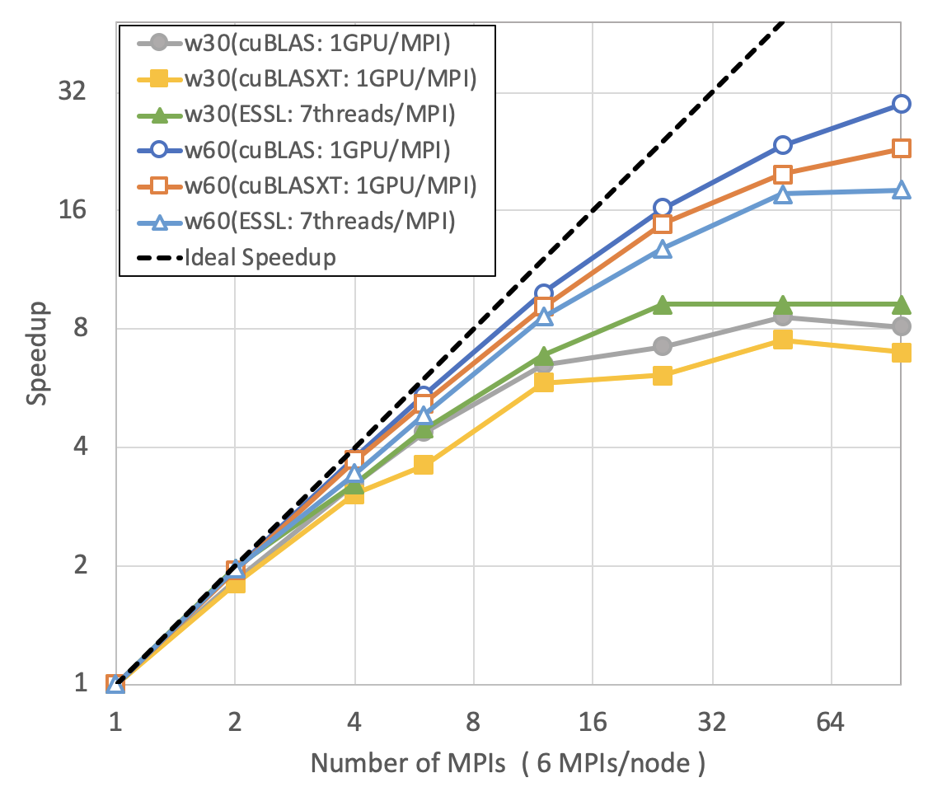
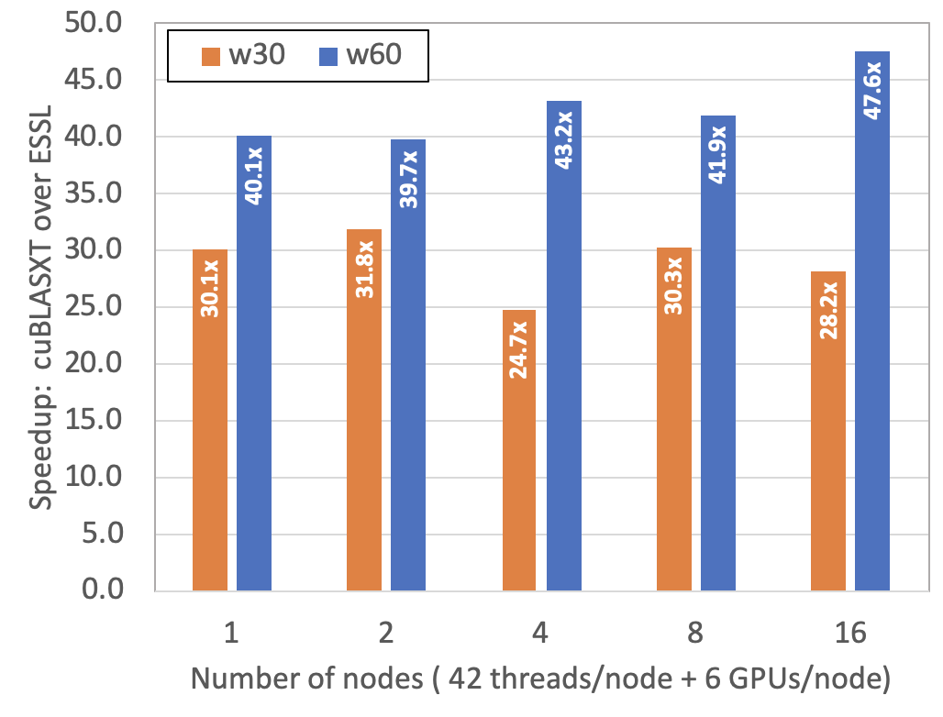
Porting to OpenMP offload for GAMESS RI-MP2 miniapp
MPI+OpenMP offloading scale-out results (presented at WACCPD-19)
The peak ratio of
six V100 GPUs over two IBM P9
(i.e., 43.33x)

