Slide 1
OpenMP 5+ Tutorial
Presenters
Colleen Bertoni (ANL)
Dossay Oryspayev (BNL)
Johannes Doerfert (ANL)
Tom Scogland (LLNL)
Vivek Kale (BNL)
2022 Exascale Computing Project
Virtual Annual Meeting
May 2nd, 2022
2:30 PM ET – 6:00 PM ET
Acknowledgements: Thanks to Helen He, Tim Mattson,
Barbara Chapman, Michael Klemm and many others for
for some slides used in this presentation.
Notes:
Add Swaroop as contributor? Or, make tutorial with contributors

Slide 2
Agenda (Eastern)
2:30 - 3:15pm Introduction and Demo
3:15 - 3:25pm Break
3:25 - 3:45pm Tips from an LLVM OpenMP developer and Q&A
3:45 - 4:00pm Break
4:00 - 4:45pm Guided Demo/ Hands-on Session
4:45 - 5:00pm Break
5:00 - 6:00pm Advance Topics and Q&A
Q&A Throughout the tutorial – feel free to ask questions

Slide 3
Overall Acknowledgements
For ECP:
This research was supported by the Exascale Computing Project (17-SC-20-SC), a joint project of the U.S. Department of Energy’s Office of Science and National Nuclear Security Administration, responsible for delivering a capable exascale ecosystem, including software, applications, and hardware technology, to support the nation’s exascale computing imperative.
For ALCF:
This research used resources of the Argonne Leadership Computing Facility, which is a DOE Office of Science User Facility supported under Contract DE-AC02-06CH11357.

Slide 4
Evolution of DOE Leadership Class Systems
Accelerated node
Name | Cori | Theta | Summit | Sierra | Perlmutter | Frontier | Aurora
System peak (PF) | Haswell: 2.81 KNL: 29.5 | 11.69 | 200 | 125 | > 120 | >1500 (1.5 Exaflops) | ≥ 2000 (2 Exaflops)
Peak Power (MW) | 4.2 | 1.7 | 13.3 |  | 6
Total system memory | Haswell: 298.5 TB DDR4 KNL: 1.06 PB DDR4 + High Bandwidth Memory | 1475 TB: 843 DDR4 + 70 MCDRAM + 562 SSD | 2.8 PB: DDR4, HBM2, PB persistent, memory | 1.4 PB DDR4, HBM2, PB persistent, memory | 1.92 PB DDR4 + 240 TB HBM |  | > 10 PB
Node performance (TF) | Haswell: 1.178 KNL: 3.046 | 2.66 | >40 |  | > 70 (GPU) > 4 (CPU) |  | > 130
Node Processors | Intel Haswell Intel KNL | Intel KNL | 2 POWER9 6 NVIDIA Volta GPUs | 2 POWER9 4 NVIDIA Volta GPUs | CPU-GPU nodes: AMD EPYC (Milan) 4x NVIDIA A100 GPU | 1 AMD EPYC CPU 4 AMD Radeon Instinct GPU | 2 Intel Xeon ”Sapphire Rapids” scalable CPU, 6 Intel “Ponte Vecchio” GPU
System Size (nodes) | Haswell; 2,388 nodes KNL: 9,688 nodes | 4,392 nodes | ~4600 nodes | 4320 | > 1500 (GPU) > 3000 (CPU) |  | > 9000
System Interconnect | Aries | Aries | Dual Rail EDR-IB | Dual Rail EDR-IB | HPE Slingshot | HPE Slingshot | HPE Slingshot
File System | 28 PB >700 GB/s Lustre | 10 PB 744 GB/s Lustre | 120 PB 1 TB/s GPFS |  | 35 PB All Flash, Lustre | 2-4x performance / capacity of Summit | ≥230 PB, ≥25 TB/s (DAOS)
Approximate year | 2016 | 2016 | 2018 | 2018 | 2021 | 2021-2022 | 2022-2023

Slide 5
Evolution of DOE Leadership Class Systems
Accelerated node
Name | Cori | Theta | Summit | Sierra | Perlmutter | Frontier | Aurora
System peak (PF) | Haswell: 2.81 KNL: 29.5 | 11.69 | 200 | 125 | > 120 | >1500 (1.5 Exaflops) | ≥ 2000 (2 Exaflops)
Peak Power (MW) | 4.2 | 1.7 | 13.3 |  | 6
Total system memory | Haswell: 298.5 TB DDR4 KNL: 1.06 PB DDR4 + High Bandwidth Memory | 1475 TB: 843 DDR4 + 70 MCDRAM + 562 SSD | 2.8 PB: DDR4, HBM2, PB persistent, memory | 1.4 PB DDR4, HBM2, PB persistent, memory | 1.92 PB DDR4 + 240 TB HBM |  | > 10 PB
Node performance (TF) | Haswell: 1.178 KNL: 3.046 | 2.66 | >40 |  | > 70 (GPU) > 4 (CPU) |  | > 130
Node Processors | Intel Haswell Intel KNL | Intel KNL | 2 POWER9 6 NVIDIA Volta GPUs | 2 POWER9 4 NVIDIA Volta GPUs | CPU-GPU nodes: AMD EPYC (Milan) 4x NVIDIA A100 GPU | 1 AMD EPYC CPU 4 AMD Radeon Instinct GPU | 2 Intel Xeon ”Sapphire Rapids” scalable CPU, 6 Intel “Ponte Vecchio” GPU
System Size (nodes) | Haswell; 2,388 nodes KNL: 9,688 nodes | 4,392 nodes | ~4600 nodes | 4320 | > 1500 (GPU) > 3000 (CPU) |  | > 9000
System Interconnect | Aries | Aries | Dual Rail EDR-IB | Dual Rail EDR-IB | HPE Slingshot | HPE Slingshot | HPE Slingshot
File System | 28 PB >700 GB/s Lustre | 10 PB 744 GB/s Lustre | 120 PB 1 TB/s GPFS |  | 35 PB All Flash, Lustre | 2-4x performance / capacity of Summit | ≥230 PB, ≥25 TB/s (DAOS)
Approximate year | 2016 | 2016 | 2018 | 2018 | 2021 | 2021-2022 | 2022-2023

Slide 6


OpenMP and the OpenMP Architecture Review Board
The mission of the OpenMP ARB (Architecture Review Board) is to standardize directive-based multi-language high-level parallelism that is performant, productive and portable.

Slide 7

History of OpenMP: 1997 - 2022
In spring, 7 vendors and the DOE agree on the spelling of parallel loops and form the OpenMP ARB. By October, version 1.0 of the OpenMP specification for Fortran is released.
OpenMP supports taskloops, task priorities, doacross loops, and hints for locks. Offloading now supports asynchronous execution and dependencies to host execution.
Supports offloading execution to accelerator and coprocessor devices, SIMD parallelism, and more. Expands OpenMP beyond traditional boundaries.
Supports: Memory Management API, Reverse Offload, Loop construct, Detached tasks, Custom Mappers,
Tools API
loop transformation (tiling, ...),
Improved `omp loop`*, variant overloading, runtime variant selection*, compiler agnostic "built-in assume"
Unified Fortran and C/C++: Bigger than both individual specifications combined.
Incorporates task parallelism. The OpenMP memory model is defined and codified.
cOMPunity, the group of OpenMP users, is formed to enable researcher participation.and organize workshops
Minor modifications
Support min/max reductions in C/C++.
Locality, loop transformations, clarifications
1.1
Specification clarifications
1.0
2.0
3.0
3.1
4.0
2.5
5.0
5.2
6.0
C/C++ v 1.0. First hybrid applications with MPI* and OpenMP appear.
4.5
5.0
5.1
The merge of Fortran and C/C+ specifications begins.
1.0
2.0
1997
1998
1999
2000
2001
2002
2003
2004
2005
2006
2007
2008
2009
2010
2011
2012
2013
2014
2015
2016
2017
2018
2019
2020
2021
2022
Permanent ARB
Auxiliary ARB

Slide 8
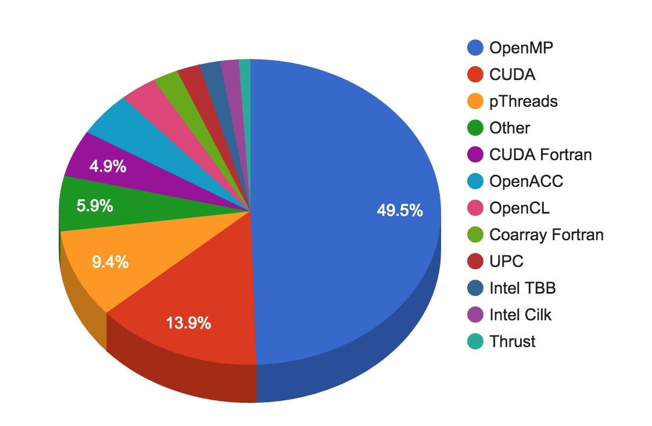


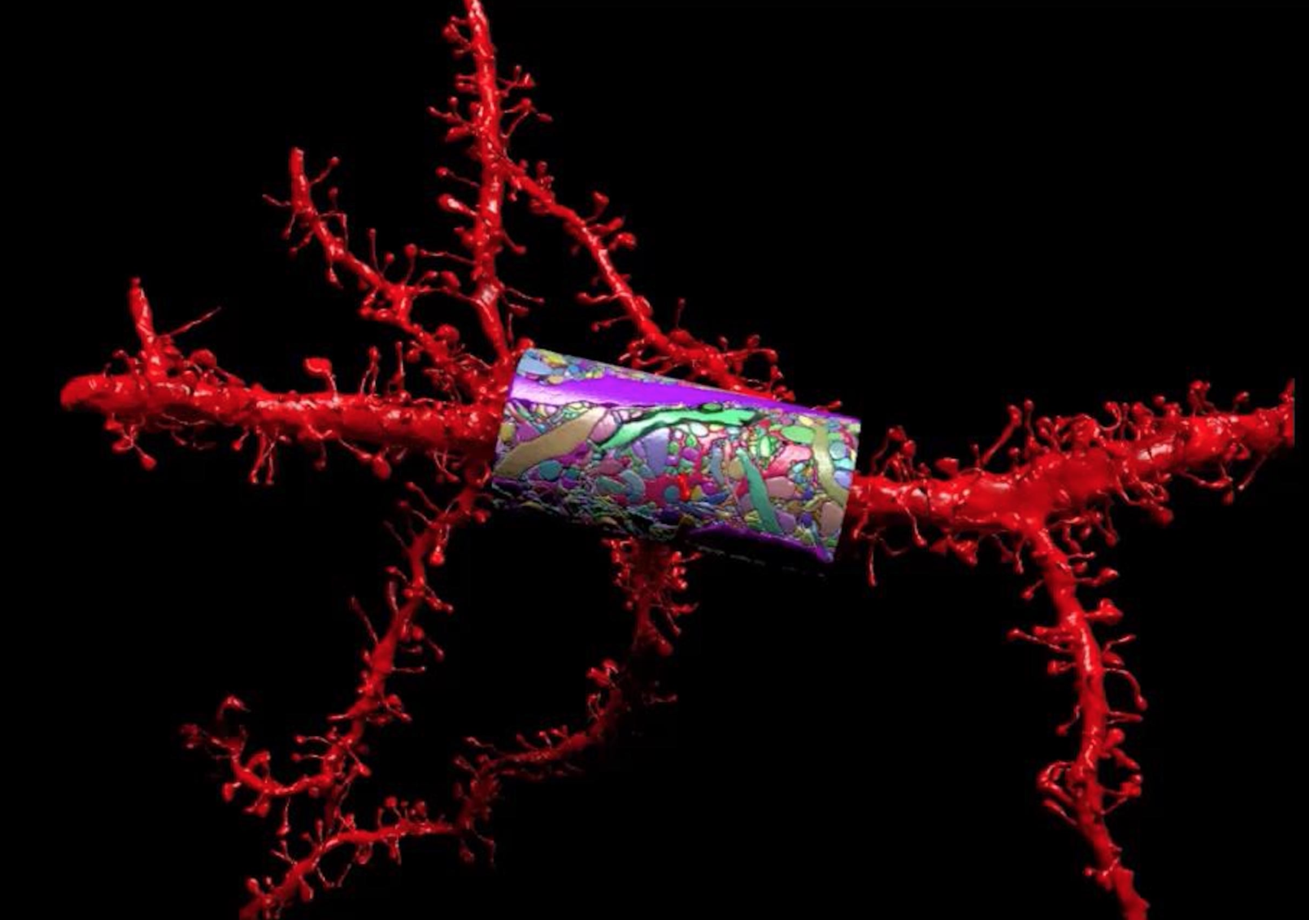
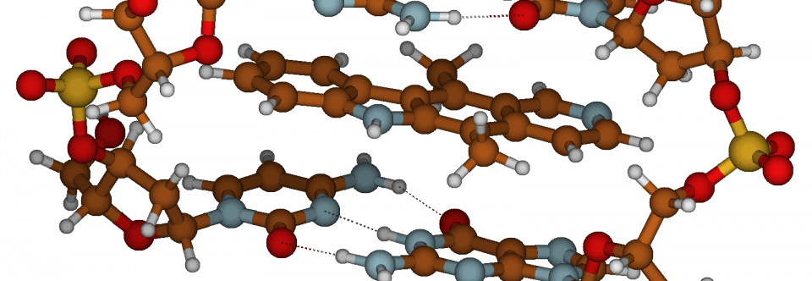
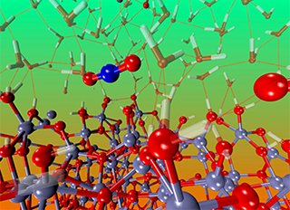

Relevance of OpenMP in ECP
Target directives (to support accelerators): target regions (structured and unstructured), nested target regions, pipelined parallelism, loop transformations, data mapping APIs
Programming memories (High Bandwidth, Low Latency, Accelerator memories) with traits (pinned memory, etc)
Optimization of complex data structure motion (e.g., deep copy)
Improved C++/object-oriented programming support
Improved tasking support: data-locality-aware scheduling, futures, Taskloops, groups, dependences, priorities, cancellation, do across (wavefront parallelism), Ordered (do across), Thread affinity (better control of thread bindings) per parallel region (including nested parallelism)
Asynchronous execution (nowait) and data dependences (depend)
SIMD directives (to support SIMD parallelism)
Focus on continuity of technology and early access to ECP users
OpenMP is about 50%, out of all choices of X
Update late 2016: 75% of codes use OpenMP
E3SM
LQCD
CANDLE
NWCHEM

Slide 9
OpenMP (Offload) Compilers
GPU | Vendor | Compiler | flags
Nvidia | LLVM​ | clang++ | -fopenmp -fopenmp-targets=nvptx64-nvidia-cuda
 | HPE | CC/ftn | -fopenmp -fopenmp-targets=nvptx64/-h omp
 | Nvidia​ | nvc++/ nvfortran | -mp=gpu
 | IBM​ | xlC_r/xlf90_r | -qsmp=omp -qoffload
 | GNU | g++/gfortran | -fopenmp -foffload=-lm
Intel | Intel | icpx/ifx | -fiopenmp -fopenmp-targets=spir64
AMD | AMD | clang++/flang | -fopenmp -fopenmp-targets=amdgcn-amd-amdhsa -Xopenmp-target=amdgcn-amd-amdhsa
 | LLVM | clang++/flang | -fopenmp -fopenmp-targets=amdgcn-amd-amdhsa -Xopenmp-target=amdgcn-amd-amdhsa
 | HPE | CC/ftn | -fopenmp -fopenmp-targets=amdgcn-amd-amdhsa -Xopenmp-target=amdgcn-amd-amdhsa/-h omp
 | GNU | g++/gfortran | -fopenmp -foffload=-lm
Generally about CPU and GPU compilers:
https://www.openmp.org/resources/openmp-compilers-tools/

Slide 10
Other OpenMP-relevant Sessions at the ECP Annual Meeting
Early Experience of Application Developers with OpenMP Offloading
Wed. May 4, 2022
4:00 PM - 6:00 PM ET / 3:00 PM - 5:00 PM CT / 1:00 PM - 4:00 PM PT
At ECP Annual Meeting Community BoF Days:
OpenMP Roadmap for Accelerators Across DOE Pre-Exascale/Exascale Machines
Wed. May 11, 2022
11:00 AM - 12:30 PM ET / 10:00 AM - 11:30 AM CT / 8:00 AM - 9:30 AM PT
LLVM in ECP - State of the Union
Thurs. May 12, 2022
1:00 PM - 2:30 PM ET / 12:00 PM - 1:30 PM CT / 10:00 AM - 11:30 AM PT

Slide 11
Important Features in OpenMP
Target directives (support for accelerators)
structured and unstructured target data regions
Asynchronous execution (nowait) and data dependences (depend)
Tasking directives (support asynchronous programming)
Load balancing computation
Orchestrate work between multicores and accelerators
Multi-level parallelism
Taskloops
Loop directives for worksharing (to support multi-cores and accelerators)
SIMD directives (to support SIMD parallelism)
Thread affinity (better control of thread/core bindings)
Per parallel region (including nested parallelism)
Extended runtime APIs
Device Memory Routines

Slide 12
OpenMP – Simple and Modern
Basic Offloading topics
Offloading code to the device
Expressing parallelism
Mapping data

Slide 13
How to use modern OpenMP – Execution Mapping
CPU (host)
move data & issue execution
The target construct offloads the enclosed code to the accelerator: single thread on a device (GPU)
GPU
(device)

Slide 14
How to use modern OpenMP – Execution Mapping
CPU (host)
The target construct offloads the enclosed code to the accelerator: single thread on a device (GPU)
GPU
GPU
SM

Slide 15
How to use modern OpenMP – Execution Mapping
CPU (host)
The target construct offloads the enclosed code to the accelerator: single thread on a device (GPU)
The teams construct creates a league of teams: one thread each, concurrent (not parallel) execution (on SMs)
GPU
GPU
SM

Slide 16
How to use modern OpenMP – Execution Mapping
CPU (host)
The target construct offloads the enclosed code to the accelerator: single thread on a device (GPU)
The teams construct creates a league of teams: one thread each, concurrent (not parallel) execution (on SMs)
The parallel construct creates a new team of threads: parallel execution (by hardware threads)
GPU
GPU
SM
threads (aka. work items or SIMD lanes)

Slide 17
How to use modern OpenMP – Execution Mapping
CPU (host)
The target construct offloads the enclosed code to the accelerator: single thread on a device (GPU)
The teams construct creates a league of teams: one thread each, concurrent (not parallel) execution (on SMs)
The parallel construct creates a new team of threads: parallel execution (by hardware threads)
The simd construct indicates SIMD execution is allowed
GPU
GPU
SM
threads (aka. work items or SIMD lanes)

Slide 18
How to use modern OpenMP – Execution Mapping
Coarse-grained parallelism
Teams
GPU SMs* (not 1-1 mapping)
Fine-grained parallelism
Parallel [+SIMD]
Cuda cores in an SM*
* For NVIDIA GPUs

Slide 19
How to use OpenMP – Execution Example
#pragma omp target
#pragma omp teams distribute
for (i=0; i<N; ++i) {
#pragma omp parallel for
for (j=0; j<N; ++j) {
x[j+N*i] *= 2.0;
}
}
The target construct offloads the enclosed code to the accelerator
The teams construct creates a league of teams
The distribute construct distributes the outer loop iterations between the league of teams
The parallel for combined construct creates a thread team for each team and distributes the inner loop iterations to threads

Slide 20
How to use OpenMP – Data Mapping Example
#pragma omp target map(tofrom:x[0:M])
#pragma omp teams distribute
for (i=0; i<N; ++i) {
#pragma omp parallel for
for (j=0; j<N; ++j) {
x[j+N*i] *= 2.0;
}
}
The target construct offloads the enclosed code to the accelerator
The teams construct creates a league of teams
The distribute construct distributes the outer loop iterations between the league of teams
The parallel for combined construct creates a thread team for each team and distributes the inner loop iterations to threads
The map construct maps data for a single target region

Slide 21
How to use OpenMP – Data Mapping Example
#pragma omp target enter data map(tofrom: x[0:M])
#pragma omp target
#pragma omp teams distribute
for (i=0; i<N; ++i) {
#pragma omp parallel for
for (j=0; j<N; ++j) {
x[j+N*i] *= 2.0;
}
}
The target construct offloads the enclosed code to the accelerator
The teams construct creates a league of teams
The distribute construct distributes the outer loop iterations between the league of teams
The parallel for combined construct creates a thread team for each team and distributes the inner loop iterations to threads
The map construct on a target region maps data for that target region
#pragma omp target exit data \
map(from:x[0:M])

Slide 22
OpenMP Device Constructs – core functionality
Execute code on a target device
omp target [clause[[,] clause],…]
structured-block
omp declare target
[function-definitions-or-declarations]
Manage the device data environment
map ([map-type:] list)
map-type := alloc | tofrom | to | from | release | delete
omp target data [clause[[,] clause], …]
structured-block
omp target enter/exit data [clause[[,] clause], …]
omp target update [clause[[,] clause],…]
omp declare target
[variable-definitions-or-declarations]
Parallelism & Workshare for devices
omp teams [clause[[,] clause],…]
structured-block
omp distribute [clause[[,] clause],…]
for-loops
Device Runtime Routines
void omp_set_default_device(int dev_num)
int omp_get_default_device(void)
int omp_get _num_devices(void)
int omp_get_team_num(void)
int omp_is_initial_device(void)
…
Environment variables
OMP_DEFAULT_DEVICE
OMP_THREAD_LIMIT

Slide 23
Demo
OpenMP Offload 101
Offloading code to the device and getting device info
Expressing parallelism
Mapping data
Details and slides: https://anl.box.com/v/openmp-tutorial-2022
# pull from github
$ git clone https://github.com/vlkale/OpenMP-tutorial
$ cd OpenMP-tutorial/offload-101

Slide 24
Resources for OpenMP
OpenMP Specifications and OpenMP Examples (ratified by OpenMP Language Committee) can be found at: https://www.openmp.org/specifications/
Compilers that support OpenMP:
https://www.openmp.org/resources/openmp-compilers-tools/#compilers
Test-suites:
SOLLVE V&V: Test-suite for all the new features introduced in OpenMP 4.5+ with focus on features important for ECP applications [ https://github.com/SOLLVE/sollve_vv ]
OvO: It is a collection of OpenMP Offloading test functions for C++ and Fortran [ https://github.com/TApplencourt/OvO ]
OpenMP IBM Tests: OpenMP Volta GPU tests [ https://github.com/clang-ykt/omptests ]

