Slide 1

GEM assembly
Álvaro Ezquerro
July 2025
DM

Slide 2
GEM generator module
The assembly is generated by the function:
generate_gem_assembly(name="gem_assembly", registry=None, is_right_side=True):
It can generate the assembly for the right or left side. These are mirror assemblies of each other. By 180º rotation over the X axis it could also be achieved (thanks to its symmetry) except for the gem top & bottom feedthrough, which would be switched.
In this document, the right side assembly is shown.

Slide 3
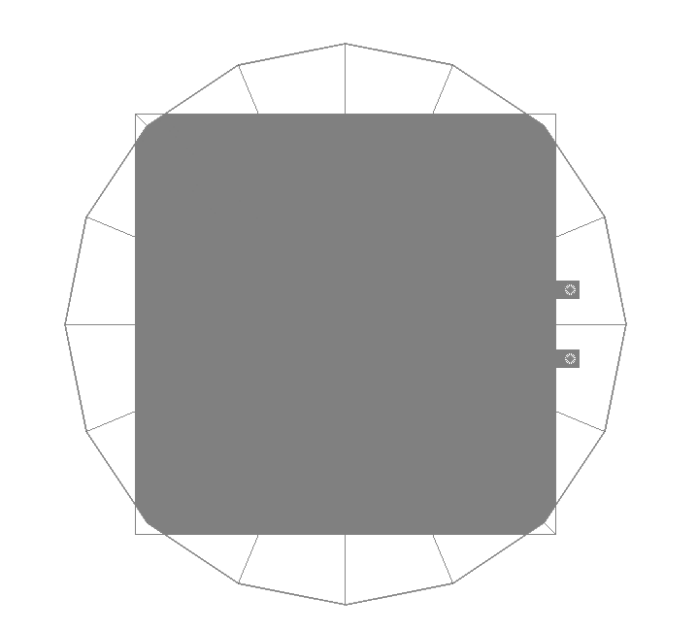
gemKaptonFoil
gemKaptonFoilLength
This solid is placed in the center of the assembly.
mmBaseCornerRadius
gemKaptonFeedthroughLength
gemKaptonFeedthroughWidth
gemCopperFeedthroughInnerRadius
gemKaptonFoilThickness

Slide 4
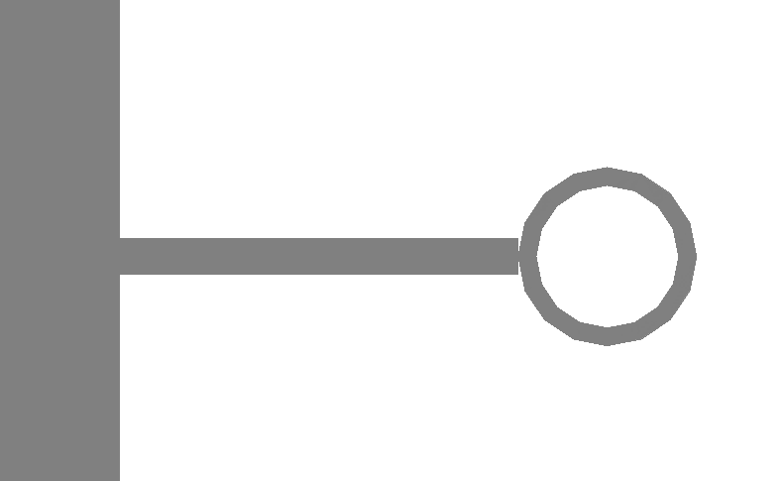

gemTop
gemCopperFeedthroughLength
gemCopperFeedthroughInnerRadius
gemCopperFeedthroughWidth
gemCopperFeedthroughOuterRadius
gemCopperFoilLength
gemCopperFoilThickness

Slide 5
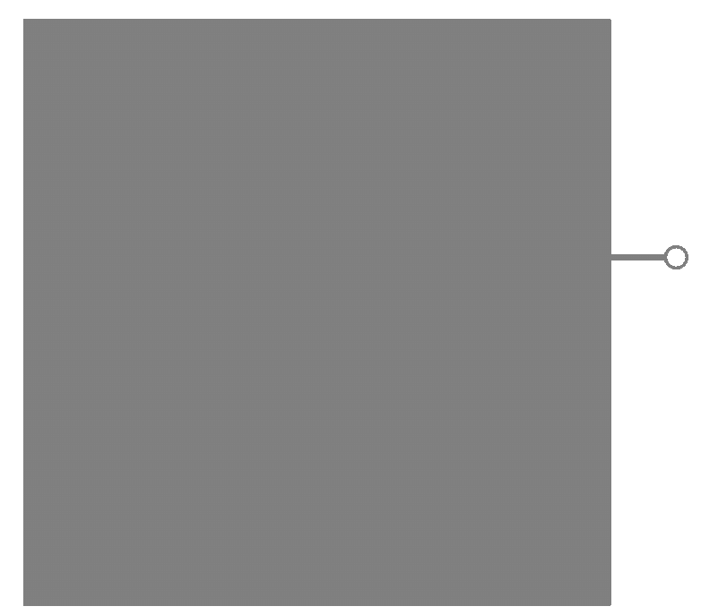
gemBottom
gemCopperFeedthroughLength
gemCopperFeedthroughInnerRadius
gemCopperFeedthroughWidth
gemCopperFeedthroughOuterRadius
gemCopperFoilLength
gemCopperFoilLength/2
gemDistanceBetweenFeedThroughs/2
gemCopperFoilThickness

Slide 6
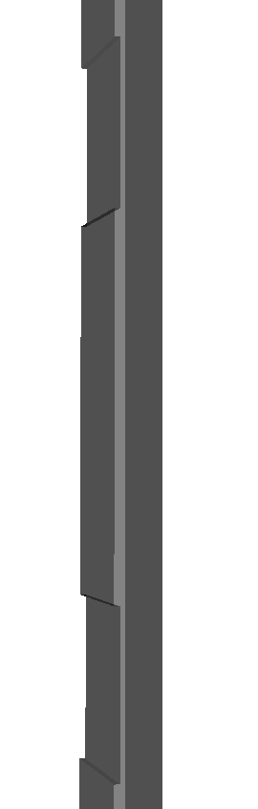
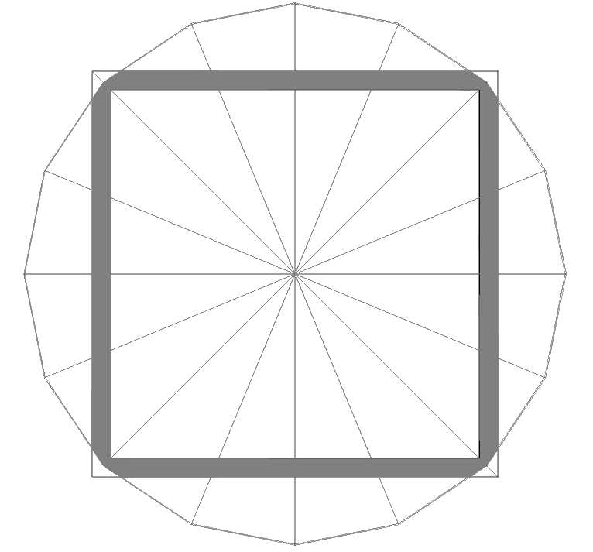
gemFrame
gemFrameIndentationDepth
gemFrameLength
gemFrameIndentationLength
gemFrameWidth
gemFrameWidth
mmBaseCornerRadius
gemFrameLength - 2*gemFrameWidth
gemFrameThickness
*Indentation is needed to avoid overlap with the feedthroughs

Slide 7
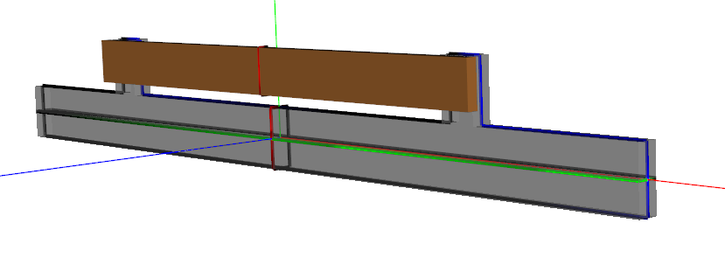
gemmMSeparator & gemmMSeparatorFixer
gemmMSeparatorFixerLength
gemmMSeparatorFixerThickness
gemmMSeparatorFixerWidth
gemmMSeparatorExtensionLength
gemmMSeparatorWidth
gemmMSeparatorFixerToSeparatorDistance
gemmMSeparatorExtensionDistance
gemmMSeparatorExtensionWidth
gemmMSeparatorLength
gemmMSeparatorThickness

Slide 8
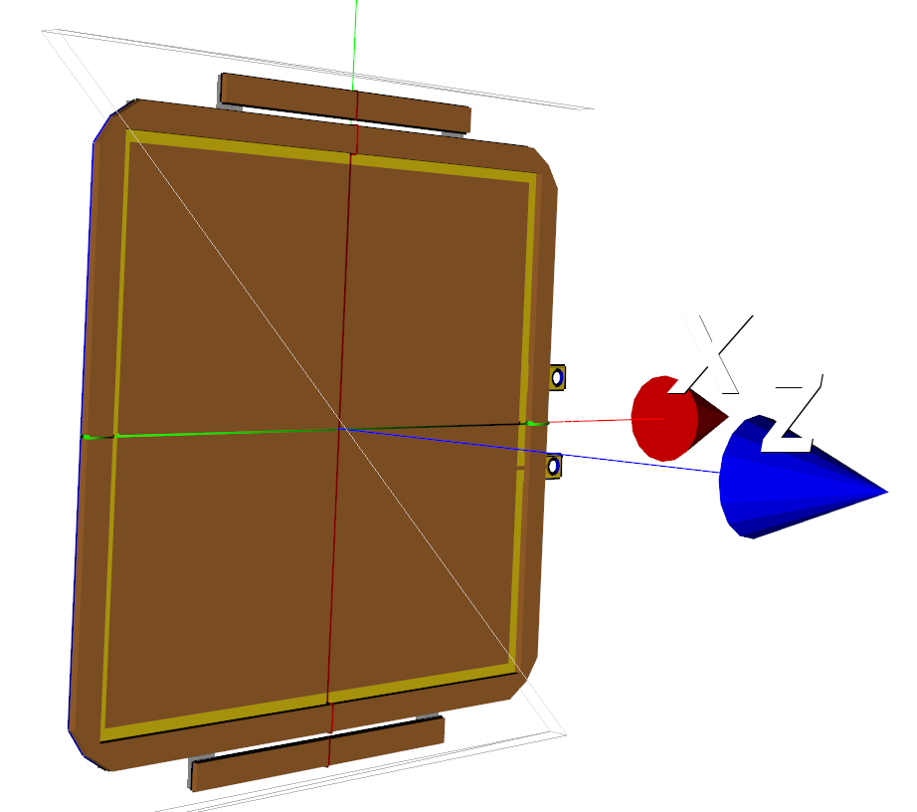
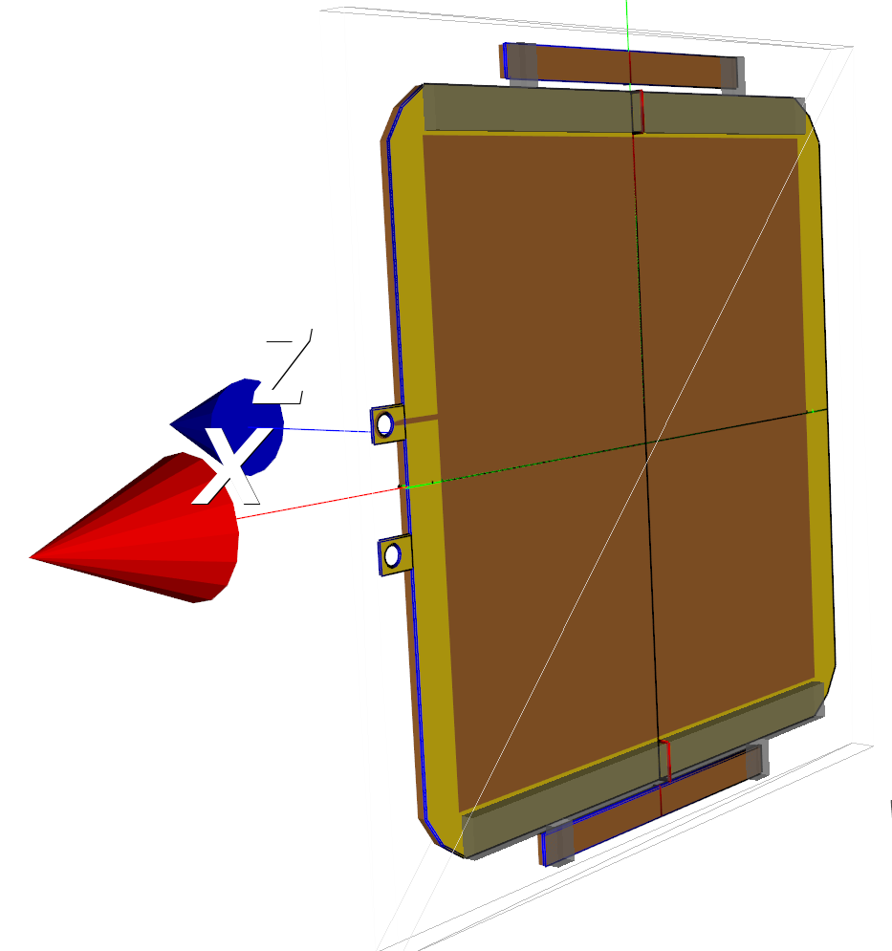
Final assembly

