Slide 1

Micromegas assembly
Álvaro Ezquerro
July 2025
DM

Slide 2
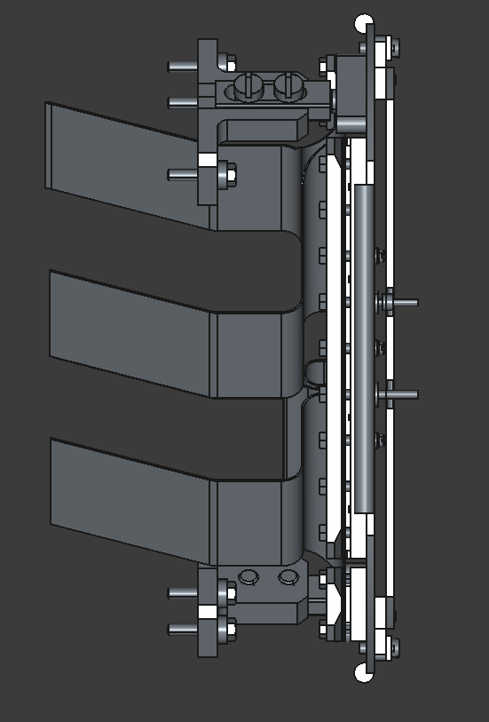
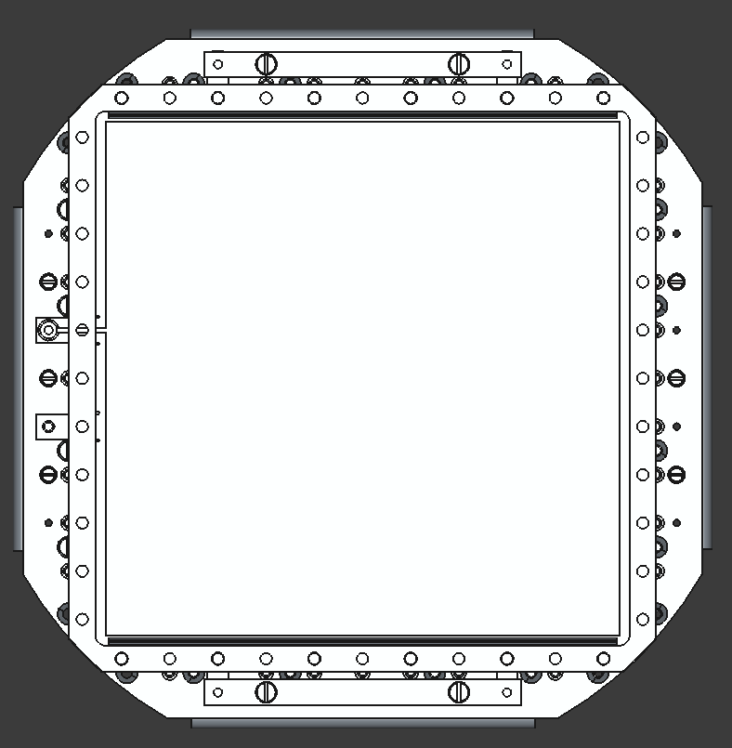
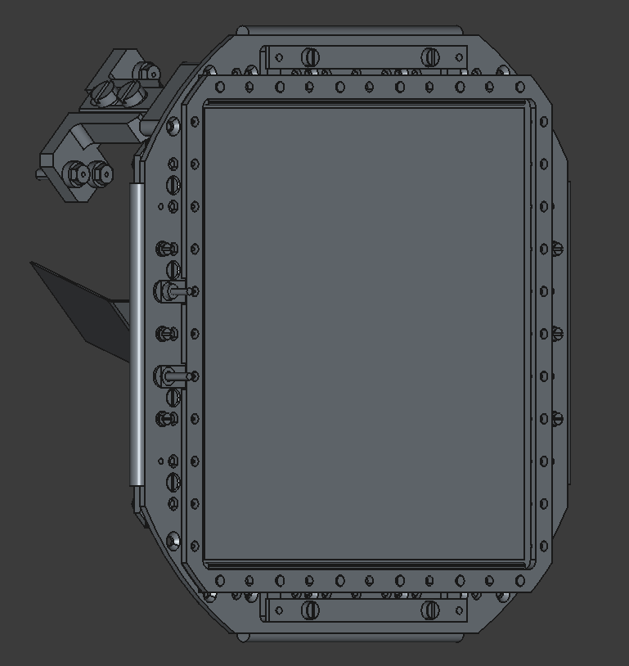
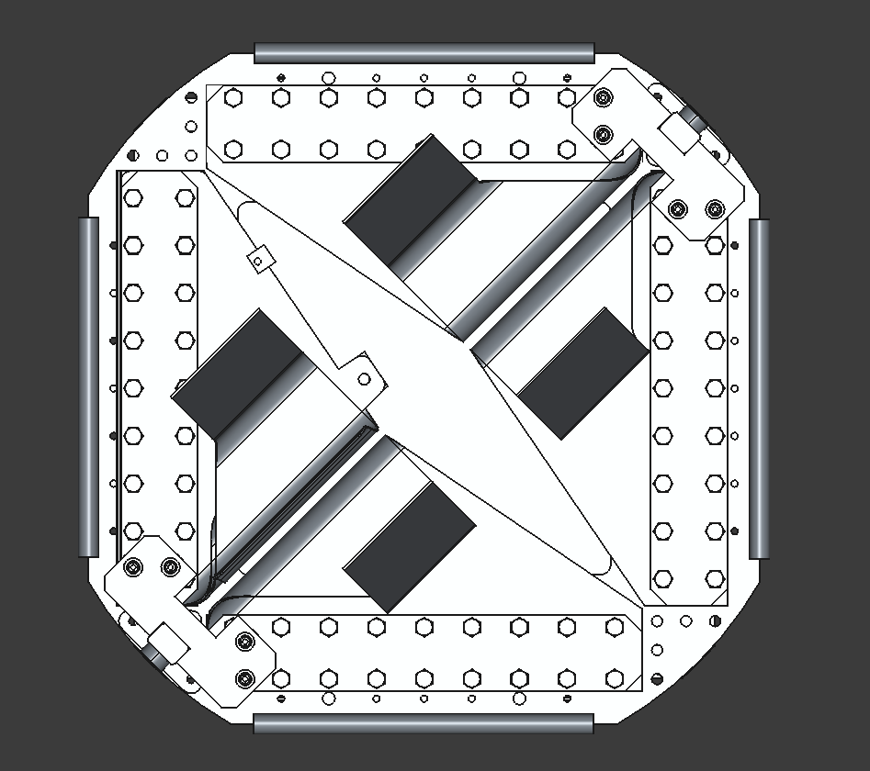
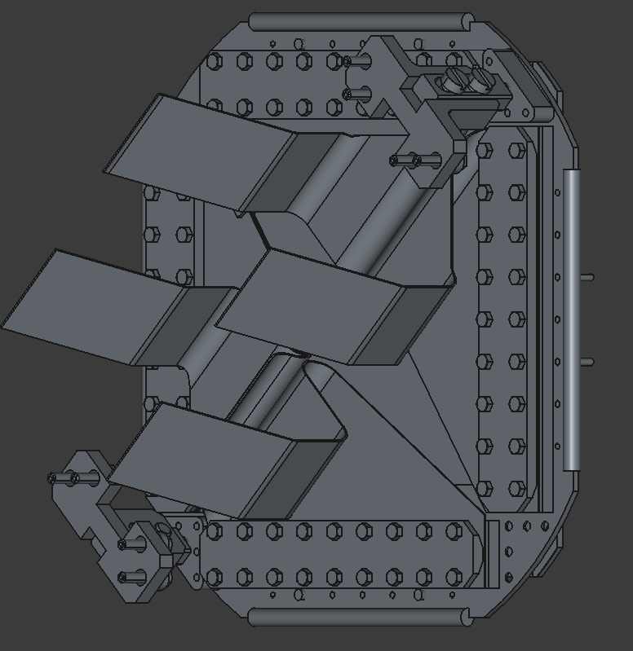
CAD design which is based on
And photos of the real setup:
June 2022 intervention

Slide 3
Micromegas generator module
The assembly is generated by the function: generate_micromegas_assembly(name="micromegas_assembly", registry=None, is_right_side=True):
It can generate the assembly for the right or left side. These are mirror assemblies of each other, which cannot be done by rotation of one of the assemblies.
In this document, the right side assembly is shown.

Slide 4
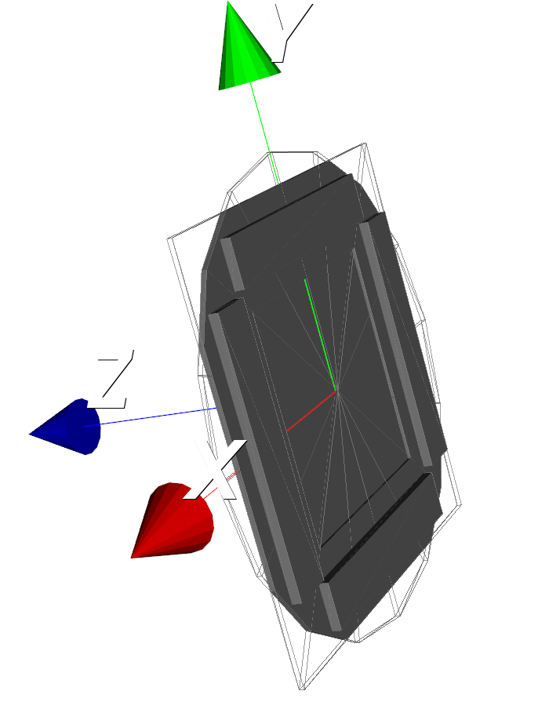
mMBase
mmBaseLength
mmBaseRecessLength
mmBaseThickness
mmBaseRadius
mmBaseRecessThickness

Slide 5
mMBaseBracket
mmBaseEndToBracketDistance
mmBaseBracketWidth
mmBaseBracketLength
mmBaseBracketThickness

Slide 6
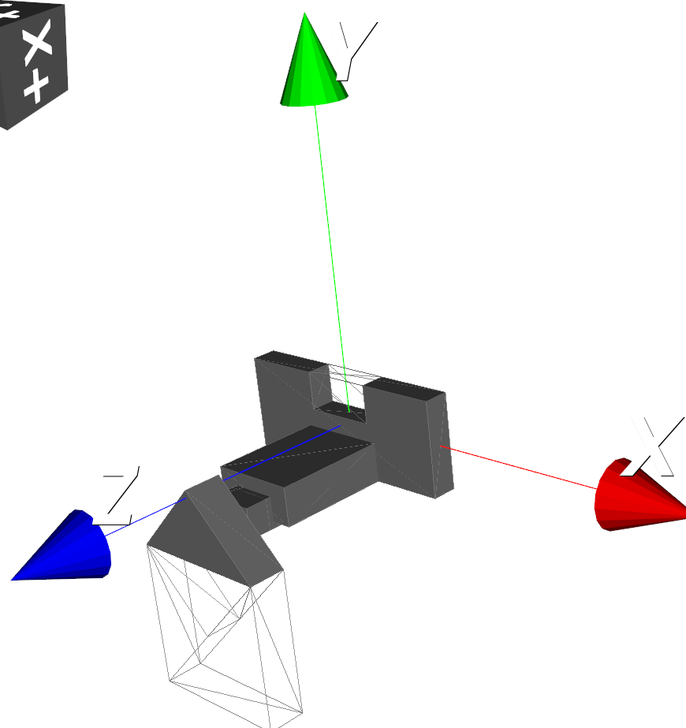
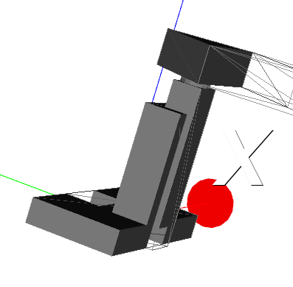
mMSupport
mMTriangularSupport
Column C
cupSupportBaseCut
Column B
mMTriangularSupportThickness
Column A
HeightC
capSupportBase
HeightA
HeightB
capSupportFinalHeight
capSupportColumnProtrusionAtoB
capBaseSupportThickness
capSupportColumnBtoBase
mMTriangularSupportSquareCut

Slide 7
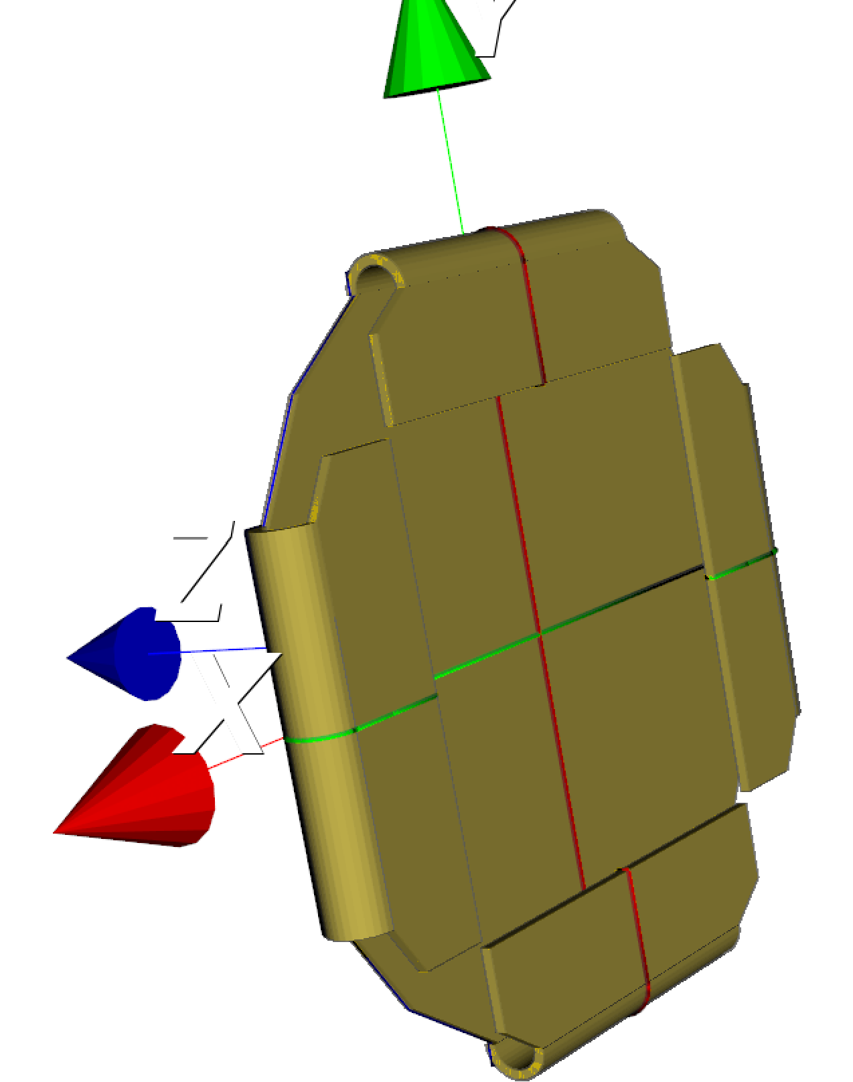
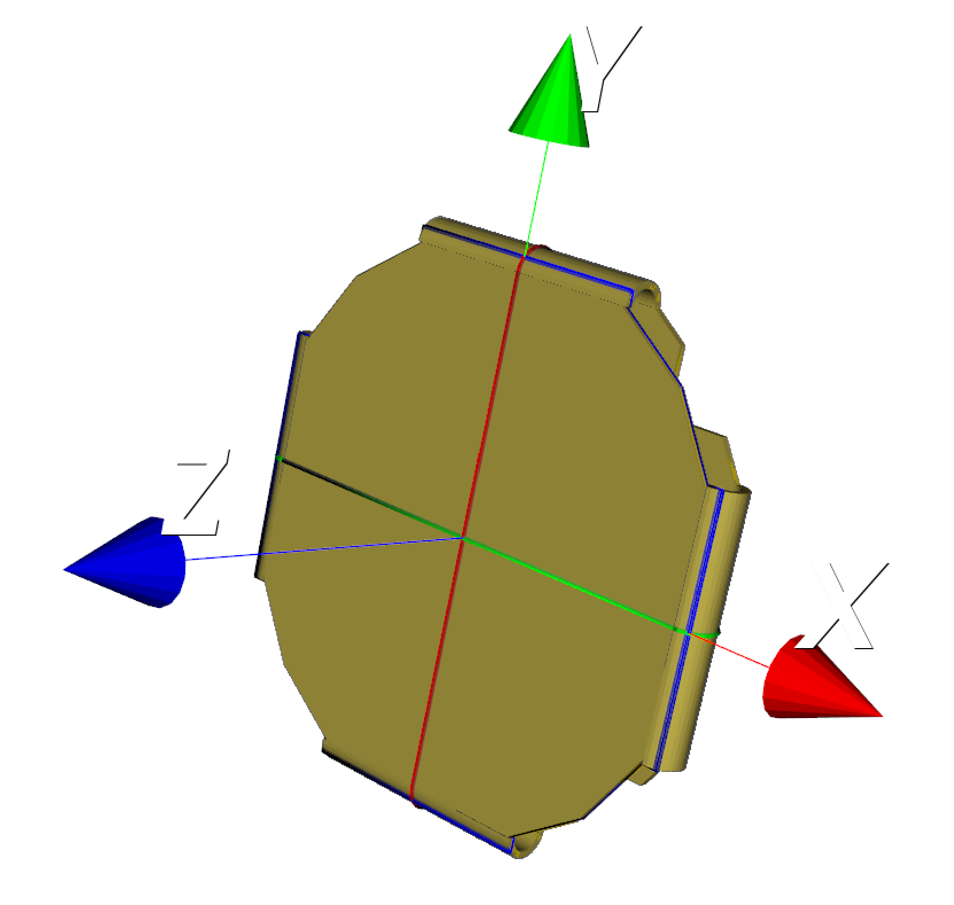
mMBoard
rollerCylinderLength
mMBaseEndToBracketDistance
mmBaseBracketWidth
mMBaseBracketLength
mMBoardRadius
mMBoardLength

Slide 8
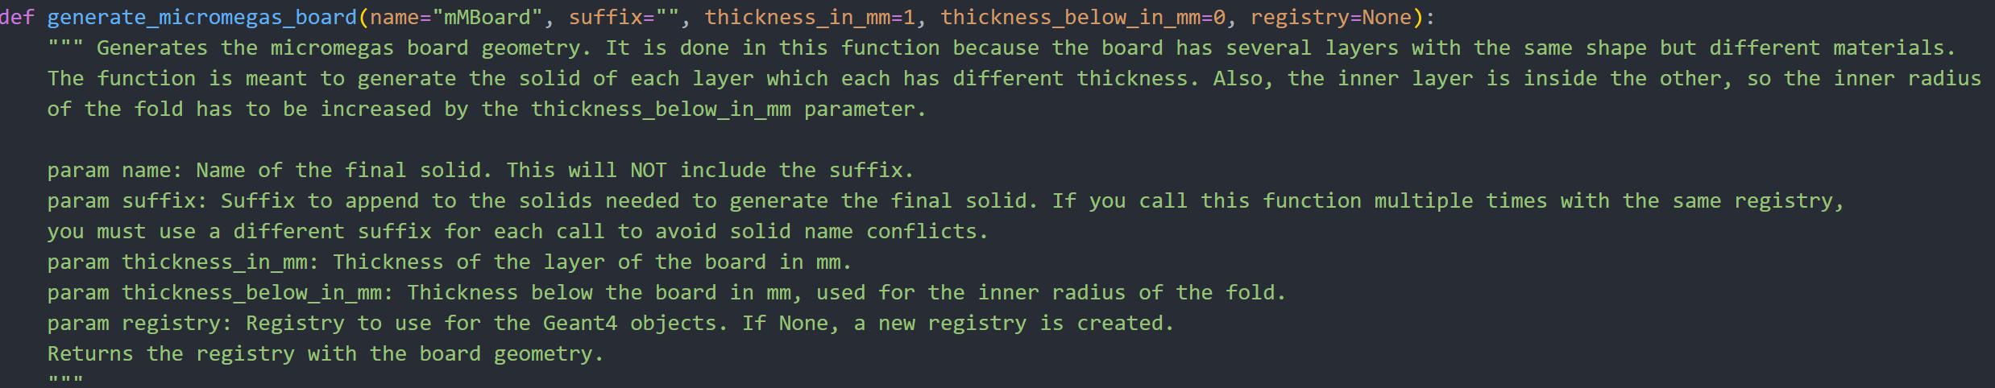
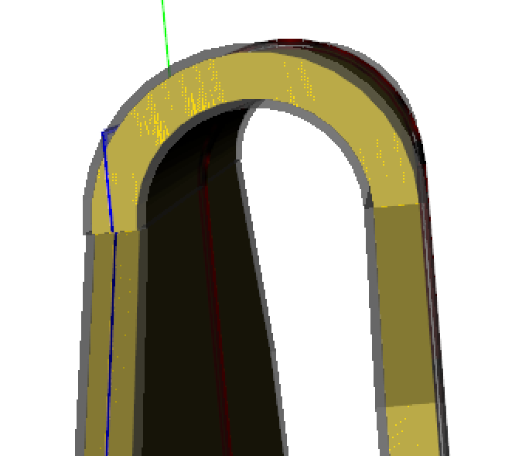
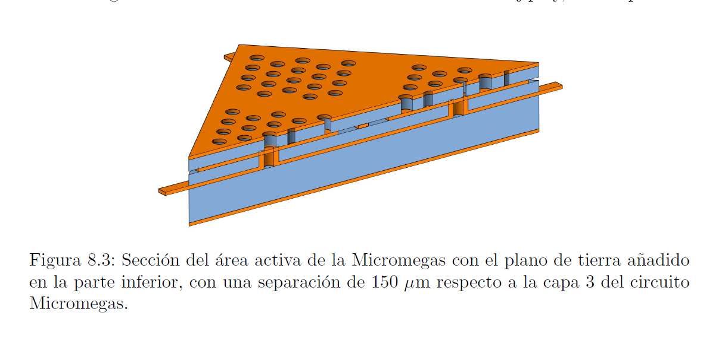
mMBoard – thickness
The micromegas has 4 copper layers (mesh, X strips, Y strips, grounding) of 17um thickness separated by 2 kapton layers of 50um (amplification gap) and another one of 150um thickness. See Hector Mirallas thesis.
For simplicity, we model the mM board as a sandwich of copper-kapton-copper, omiting the internal 2 layers of copper. But, for the micromegas active area (25cmx25cm), we do include this 2 layers of copper (mMCopperFoilLayer2,3_PV).
thickness_below_in_mm
mMBoardFoldInnerRadius
mMCopperFoilThickness
mMBoardThickness
*thickness is increased for visualization purposes

Slide 9
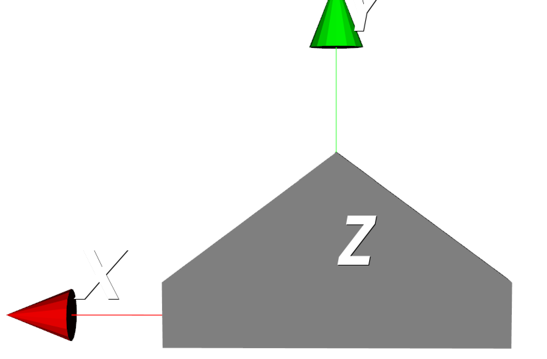
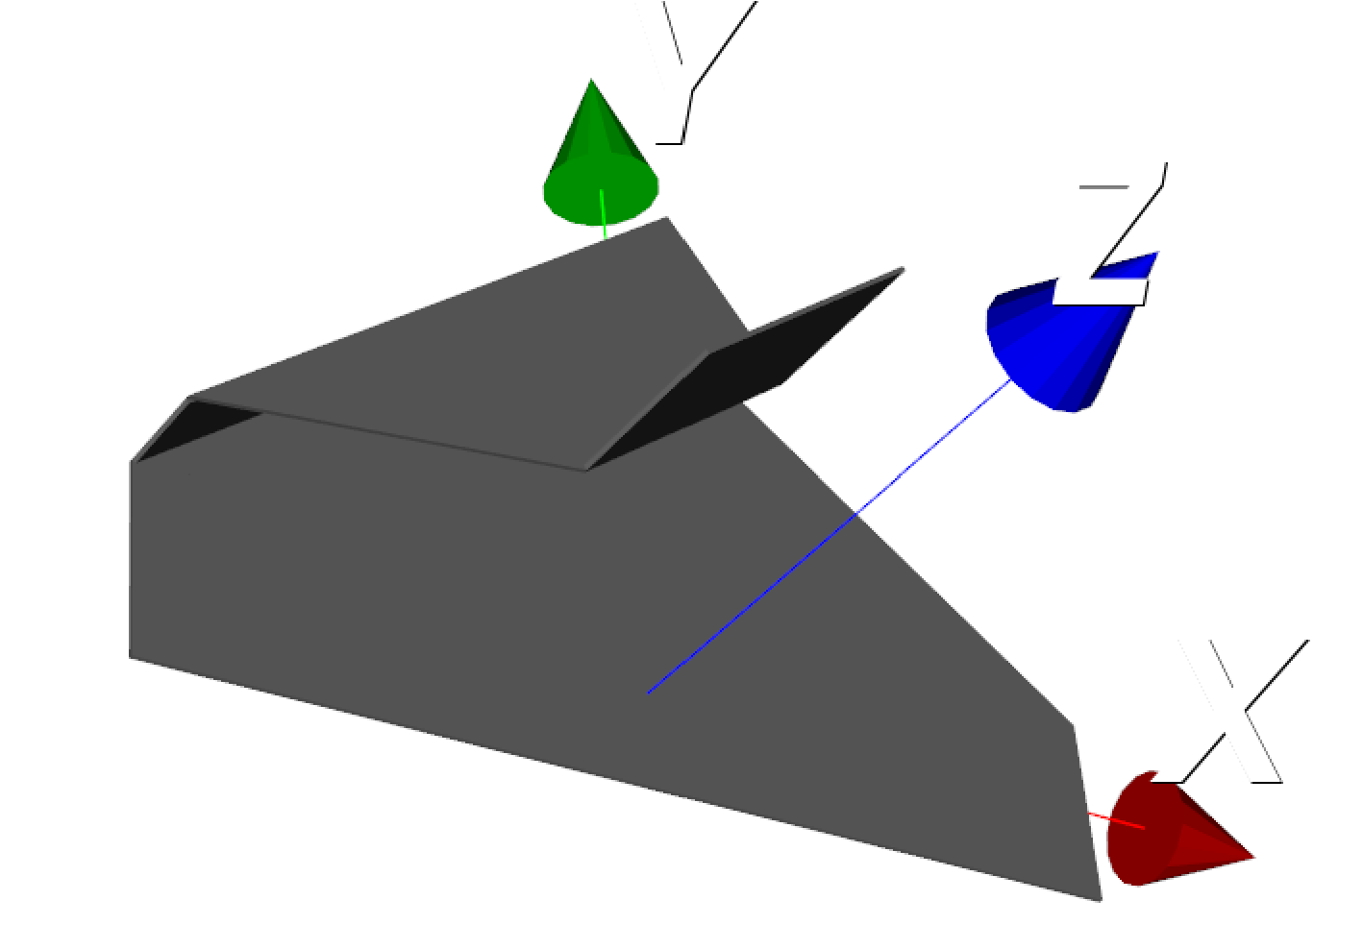
Limande A
* Limande B is the same but with the top layer above the right hipotenuse instead of the left one (mirror respect to YZ plane)
limandeTrapezoidLength
limandeHipotenuse
limandeHalfTriangleHeight
limandeHipotenuse
limandeStraightHeight
limandeFoldDistance
limandeBracketSideLength
limandeBracketSideWidth
limandeWidth

Slide 10
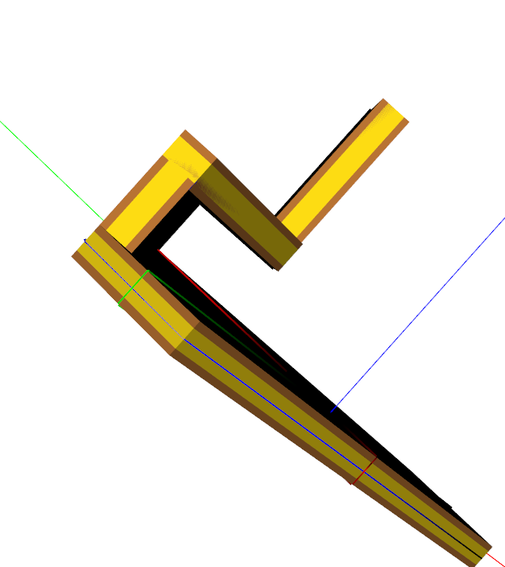
Limande – thickness
The flat cables (limandes) have 4 copper layers (mesh, X strips, Y strips, grounding) of ¿17um thickness?(I asume its the same as the mM layers) separated by 2 kapton layers of 50um (amplification gap) and another one of 350um thickness. See Hector Mirallas thesis.
For simplicity, we model the limandes as a sandwich of copper-kapton-copper, omiting the internal 2 layers of copper.
thickness_below_in_mm
limandeCopperThickness
limandeThickness
*thickness is increased for visualization purposes

Slide 11
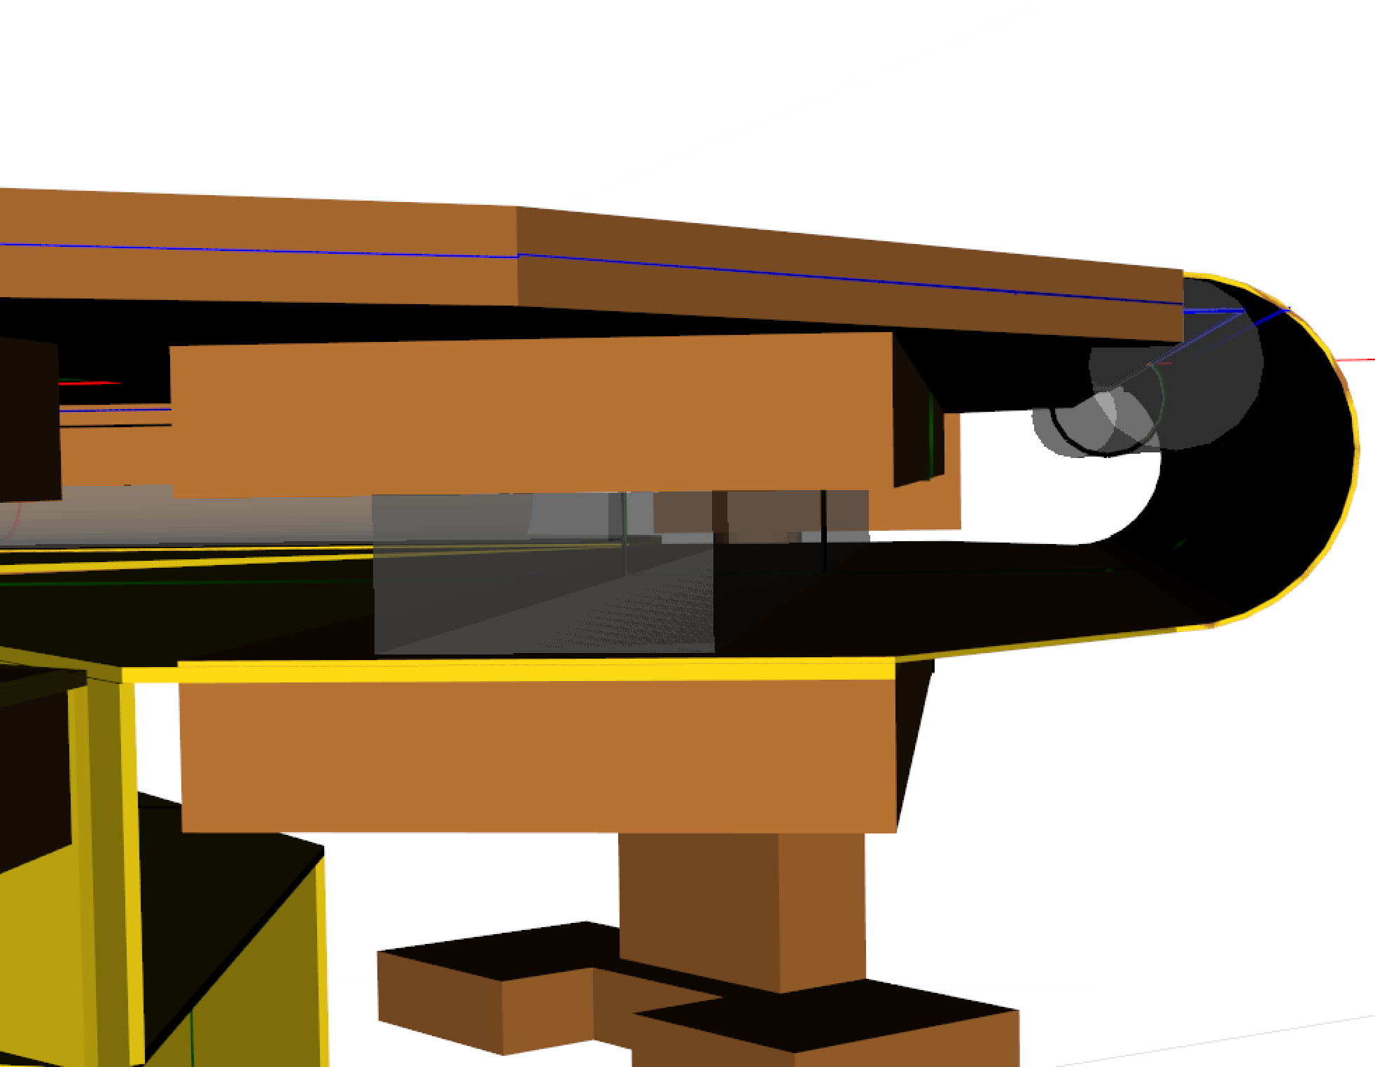
Closing Bracket-limande-mMBoard-mMBase
mMBaseTeflonRoller
mMBase
mMBase (mMBaseBracket)
mMBoardThickness
mMBaseThickness
mMBaseBracketThickness
mMTeflonSpacerPad
Z-axis
mMTeflonSpacerPadThickness
mMBoard
mMBoardThickness
limandeThickness
limandeA/B
mMBaseBracketThickness
mMBaseClosingBracket

Slide 12
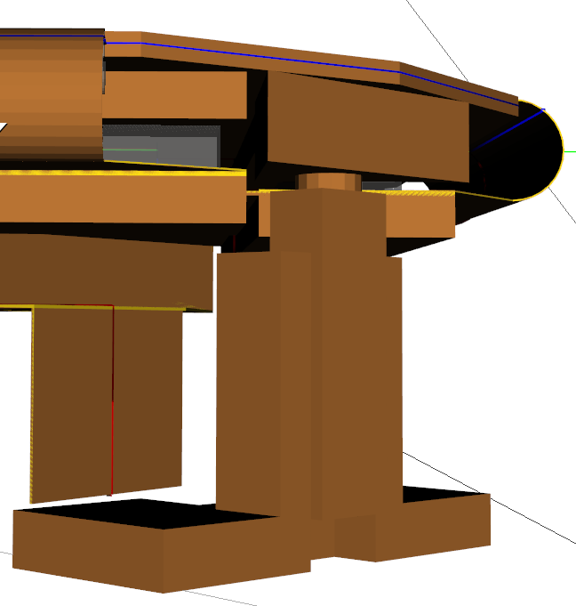
Position (Z) of the micromegas assembly wrt vessel
mMBaseThickness/2
The center of the Micromegas assembly is at the center of the mMBase. So the Micromegas assembly must be placed a distance:
capSupportFinalHeight + mMBaseThickness/2
from the vessel end cap.
Z-axis
capSupportFinalHeight

