Slide 1
VTT7 Intro til mikrosimulering og SUMO
Kursusgang 7

Slide 2
Plan for today
Goals:
Get familiar with definition of timed and traffic responsive traffic lights in SUMO
You have already done:
Go through the solutions to exercise 1 and exercise 2 and prepare questions if something was unclear.
Read SUMO docs about traffic light definition
Lecture 4 - SUMO basics
Re-cap of network and demand generation from last time, review of KG4 Exercises 1 and 2
Definition of timed traffic control and coordination
Exercise 1 - optimize timed traffic control on an intersection
Definition of traffic responsive control
Exercise 2 - add traffic responsive controllers to Exercise 1

Slide 3
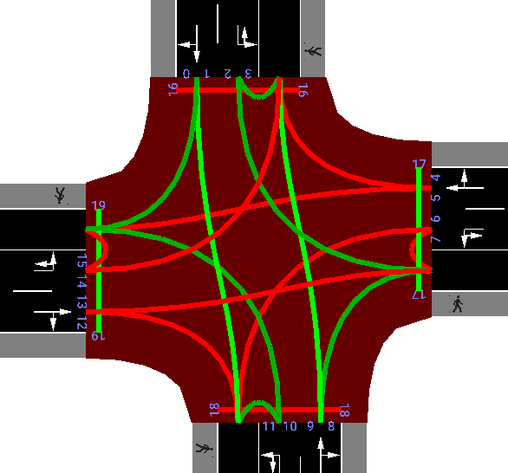
Pre-timed traffic controls
Traffic controls obey a special format: https://sumo.dlr.de/docs/Simulation/Traffic_Lights.html
<!--in program.tll.xml-->
<additionals>
<tlLogic id="C" type="static" programID="0" offset="0">
<phase duration="28" state="rrrrgGggrrrrgGggGrGr"/>
<phase duration="5" state="rrrrgGggrrrrgGggrrrr"/>
<phase duration="3" state="rrrryyggrrrryyggrrrr"/>
<phase duration="6" state="rrrrrrGGrrrrrrGGrrrr"/>
<phase duration="3" state="rrrrrryyrrrrrryyrrrr"/>
<phase duration="28" state="gGggrrrrgGggrrrrrGrG"/>
<phase duration="5" state="gGggrrrrgGggrrrrrrrr"/>
<phase duration="3" state="yyggrrrryyggrrrrrrrr"/>
<phase duration="6" state="rrGGrrrrrrGGrrrrrrrr"/>
<phase duration="3" state="rryyrrrrrryyrrrrrrrr"/>
</tlLogic>
</additionals>
Can be created / saved in netedit or:
netconvert --sumo-net-file network2.net.xml --tls.guess --output-file network3.net.xml

Slide 4
Pre-timed traffic control tools
Plan optimization with tlsCycleAdaptation.py: https://sumo.dlr.de/docs/Tools/tls.html#tlscycleadaptationpy
Will adjust durations based on submitted route files and parameters like yellow time, all red time, minimum green, min / max cycle length, etc.
python "%SUMO_HOME%\\tools\\tlsCycleAdaptation.py" -n network3.net.xml -r routes.rou.xml -o new_tls.add.xml
Offset optimization with tlsCoordinator.py : https://sumo.dlr.de/docs/Tools/tls.html#tlscoordinatorpy
Will adjust offsets based on submitted route files:
python $SUMO_HOME/tools/tlsCoordinator.py -n network3_double.net.xml -r double_routes.rou.xml -o tls_offsets.add.xml
The route files are expected to be defined in terms of vehicle, route tags like here
https://sumo.dlr.de/docs/Demand/Shortest_or_Optimal_Path_Routing.html

Slide 5
Recap: output generation
Method 1 - call sumo-gui with all necessary arguments from a command line
sumogui -n my_net.net.xml -r my_routes.rou.xml --tripinfo-output my_tripinfo.xml
Method 2 - create *.sumocfg file and call it from a command line
<!-- in my_run.sumocfg-->
<configuration>
<input>
<net-file value="my_net.net.xml" />
<route-files value="my_routes.rou.xml" />
</input>
<output>
<tripinfo-output value="my_tripinfo.xml" />
</output>
<time>
<begin value="0" />
<end value="500" />
</time>
</configuration>
And then in terminal: sumogui -c my_run.sumocfg
Which keywords to use for output types?: https://sumo.dlr.de/docs/sumo.html#output

Slide 6
Recap: Working with output
Library of python tools: https://sumo.dlr.de/docs/Tools/
For example xml to csv conversion: https://sumo.dlr.de/docs/Tools/Xml.html
Linux / macOS python $SUMO_HOME/tools/xml/xml2csv.py my_fcd.xml
Windows python %SUMO_HOME%\tools\xml\xml2csv.py my_fcd.xml
Or trip statistics: https://sumo.dlr.de/docs/Tools/Output.html#tripstatisticspy
Linux / macOS python $SUMO_HOME/tools/output/tripStatistics.py my_tripinfo.xml
Windows python %SUMO_HOME%\\tools\\output\\tripStatistics.py my_tripinfo.xml

Slide 7
Recap: Naming dos / donts
https://sumo.dlr.de/docs/Networks/PlainXML.html#edge_descriptions
Caution: there are some constraints about the edge names in the xml file. They must not contain any of the following characters:
'_' underline - used for lane ids
'[' and ']' used for xml enumerations
' ' space - used as xml list element divider
'*' star, used as wildcard for xml query
':' used as marker for internal lanes
Examples:
‘Edge1to2’ - good
‘Edge12’ - also good
‘edge1_2’ - bad, collides with name of lane 1 of edge 1
‘edge from one to two‘ - bad, spaces are not allowed

Slide 8
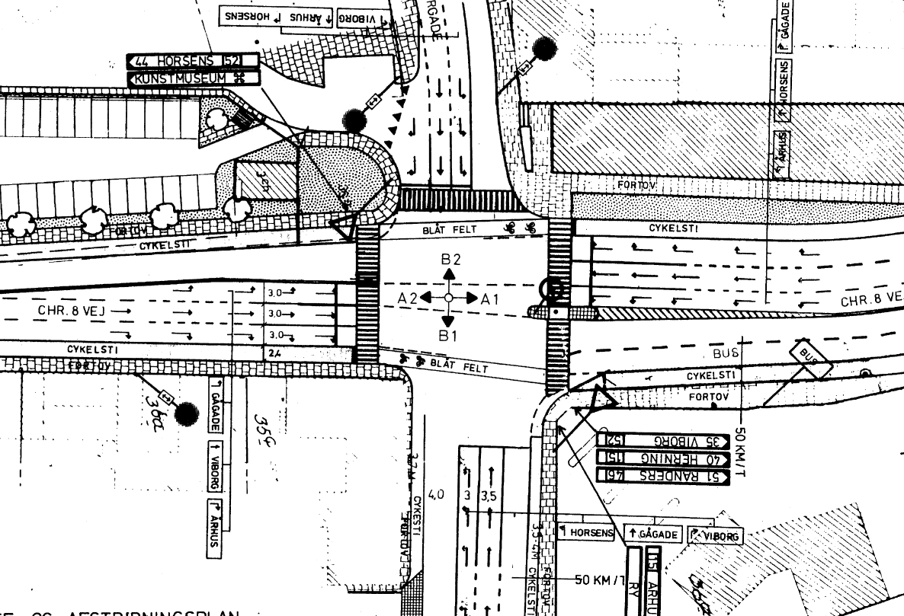
Exercise 1
Model an intersection from an assignment with Rasmus
Generate corresponding demands
Visualize how the intersection functions without TLS
Add a pre-timed TLS to the intersection with your phase and durations times and generate tripinfos-output
Calculate pre-timed TLS with SUMO optimization using https://sumo.dlr.de/docs/Tools/tls.html#tlscycleadaptationpy
Compare those 2 scenarios using the trip statistics tool https://sumo.dlr.de/docs/Tools/Output.html#tripstatisticspy
For the fast:
Model another similar intersection on the western approach 400 meters away
Generate new demand that includes western intersection, make sure most of the traffic happens between the intersections
Experiment with simulating different coordination offsets manually
Calculate optimal coordination offset with https://sumo.dlr.de/docs/Tools/tls.html#tlscoordinatorpy

Slide 9
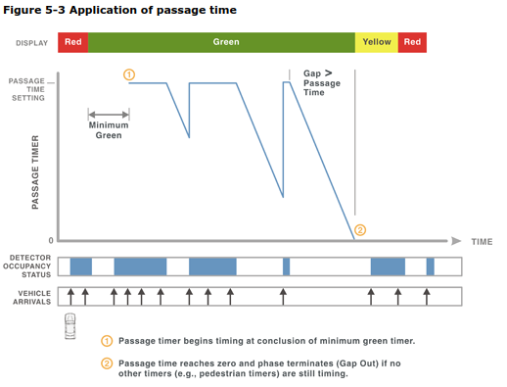
Traffic responsive control - time gap based
Gap based control works by prolonging traffic phases whenever a continuous stream of traffic is detected on point detectors (induction loops) according to https://sumo.dlr.de/docs/Simulation/Traffic_Lights.html#traffic_lights_that_respond_to_traffic
The max-gap and detector gap values can be inserted into the tlLogic with following main parameters:
max-gap: the maximum time gap between successive vehicles that will cause the current phase to be prolonged (within maxDur limit)
detector-gap: determines the time distance between the (automatically generated) detector and the stop line in seconds (at each lanes maximum speed).
show-detectors controls whether generated detectors will be visible or hidden in sumo-gui.
Phases now are kept active by time inbetween minDur and maxDur times
[1]
<tlLogic id="0" programID="my_program" offset="0" type="actuated">
<param key="max-gap" value="3.0"/>
<param key="detector-gap" value="2.0"/>
<param key="show-detectors" value="false"/>
<phase duration="31" minDur="5" maxDur="45" state="GGggrrrrGGggrrrr"/>
...
</tlLogic>

Slide 10


Traffic responsive control - delay based
SUMO time loss / delay control: https://sumo.dlr.de/docs/Simulation/Traffic_Lights.html#based_on_time_loss
Assumptions:
Perfect area detector, any second a speed for each car is known
Without cars, no delay
With cars delay calculation is instantaneous, no movement history accounted for
When traffic on a lane slows down the accumulated delay grows, after it passes a certain threshold the extension of current phase is requested
Similar definition to the gap based controller
<tlLogic id="0" programID="my_program" offset="0" type="delay_based">
<param key="detectorRange" value="100" />
<param key="minTimeLoss" value="1" />
<param key="show-detectors" value="false"/>
<phase duration="31" minDur="5" maxDur="45" state="GGggrrrrGGggrrrr"/>
...
</tlLogic>

Slide 11
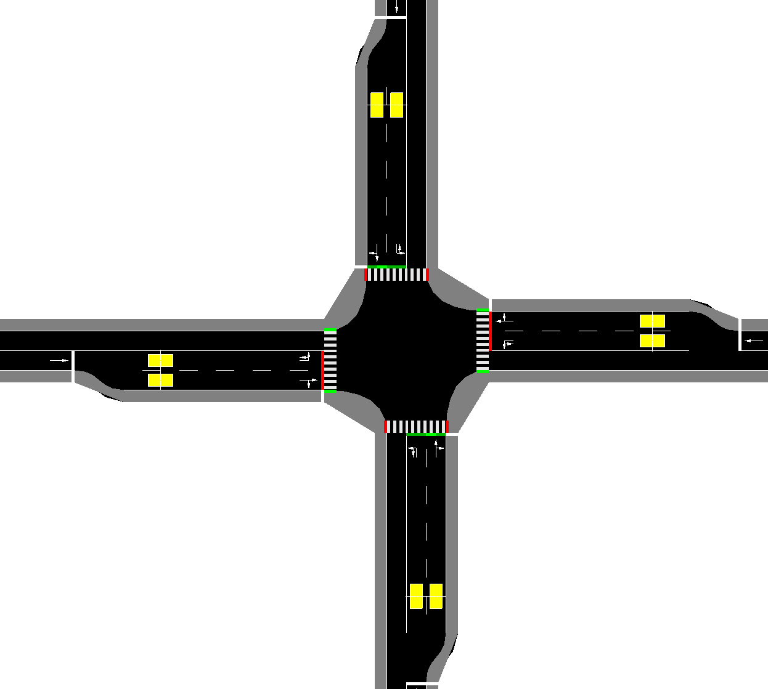
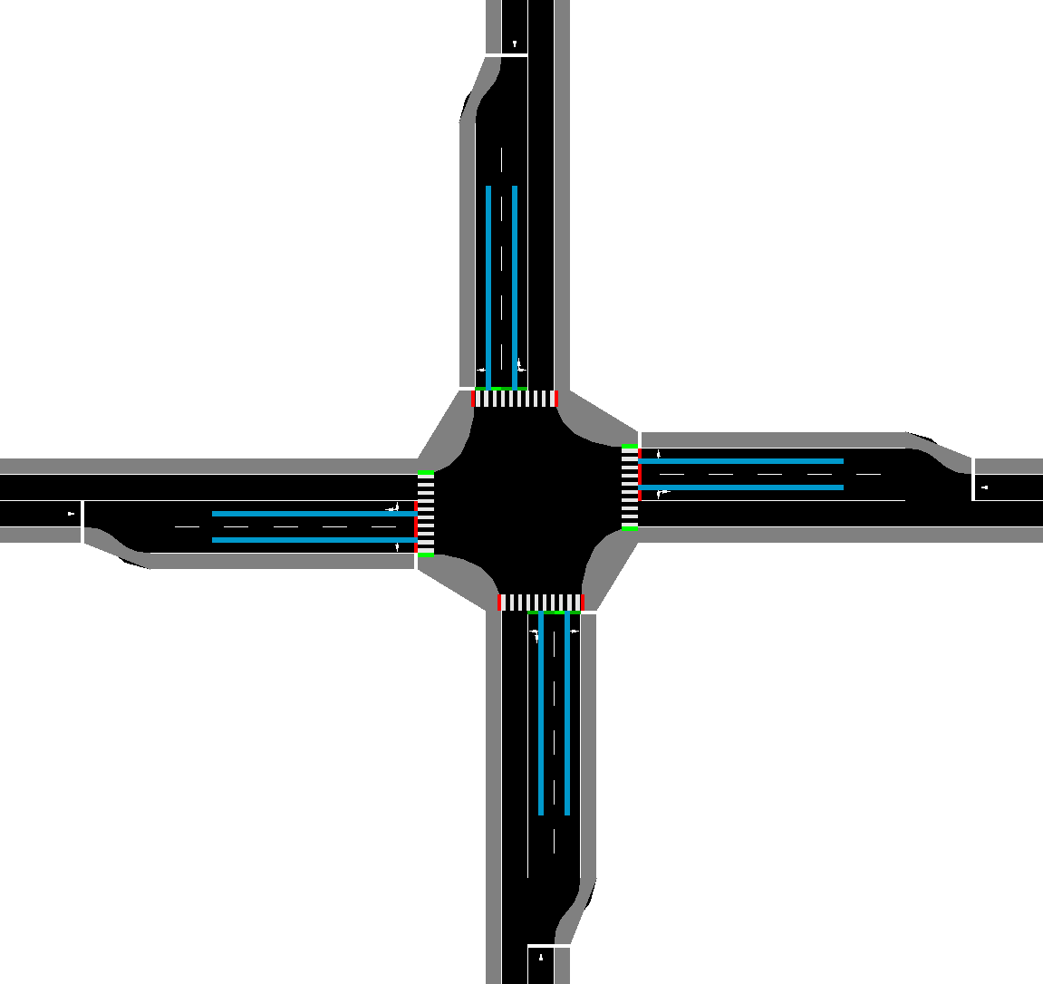
Example detector setups
<tlLogic id="C" type="actuated" programID="a" offset="0">
<param key="max-gap" value="3.0"/>
<param key="detector-gap" value="2.0"/>
<param key="show-detectors" value="true"/>
<tlLogic id="0" programID="my_program" offset="0" type="delay_based">
<param key="detectorRange" value="25" />
<param key="minTimeLoss" value="1" />
<param key="show-detectors" value="true"/>

Slide 12
Exercise 2
Based on the network in the Exercise 1
Change the controller to time-gap based and output trip info
Change the controller to the time loss based and output trip info
Compare them to the results of exercise 1

Slide 13
Summary: What have we learnt today?
How to model and optimize time based traffic lights
How to model and optimize coordination between two traffic lights
How to model a maximum time-gap based and delay based traffic lights

Slide 14
References
[1] https://ops.fhwa.dot.gov/publications/fhwahop08024/chapter5.htm

