Slide 1

TermSheetAI : Validator Tool for Termsheets Validation

Slide 2
MEMBER DETAILS
Sarthak Rastogi(RA2311026010862) Reswant Raja S(RA2311026010835) Mohammad Sufyan(RA231102601858)
THEME:
TERM SHEET VALIDATOR USING AI

Slide 3
PROBLEM STATEMENT
The manual validation of term sheets in post-trade processes is time-consuming, error-prone, and resource-intensive, leading to delays, inaccuracies, and regulatory compliance risks. The Term Sheet Validator using AI project aims to automate data extraction and validation from unstructured and structured term sheets using OCR, NLP, and ML, enhancing efficiency, accuracy, and compliance.

Slide 4
SOLUTION
AI-powered document validation leverages OCR and NLP for accurate text extraction and compliance checks. Blockchain ensures smart contract traceability, while ML models detect risks and anomalies for predictive validation. A template-based system maintains data consistency, and a real-time API enables instant verification. AI automates routine tasks, escalating complex cases to experts (HITL). Continuous learning refines validation rules, and multimodal AI processes text, tables, and images for comprehensive analysis.

Slide 5
SOLUTION
The key solutions are as follows :
AI-Powered Validation: OCR + NLP for automated extraction and compliance.
Blockchain for Compliance: Ensures secure, traceable contract storage.
Risk & Anomaly Detection: ML models for risk classification and predictive validation.
Real-Time & Template-Based Validation: Ensures accuracy, consistency, and instant document verification.
Human-in-the-Loop (HITL) & Continuous Learning: Experts handle complex cases while AI improves with feedback.

Slide 6
METHODOLOGY
Our system extracts and validates term sheet data using OCR, NLP, and ML, ensuring accuracy and compliance. It detects anomalies, provides feedback, and seamlessly integrates with financial systems, including Barclays' infrastructure, for efficient reporting.
Key Elements & Components
Input Handling : Upload PDFs, Word, Emails, Chats.
OCR & NLP Processing : AI extracts & structures data.
ML Validation Engine : Ensures compliance & accuracy.
Error Handling & Feedback : Detects & corrects issues.
System Integration : APIs for seamless validation.
Final Output : Verified term sheets for reporting.

Slide 7
FEASIBILITY
The solution leverages OCR, NLP, and ML for efficient term sheet validation, reducing manual effort and improving accuracy. It is cost-effective with open-source tools and can be integrated into existing workflows.
This feasibility assessment considers technical, operational, and cost factors for effective implementation
Technical : OCR (Tesseract) and NLP (SpaCy, NLTK) are widely supported and easy to integrate with Django and React.
Operational : Automating validation boosts accuracy, compliance, and efficiency.
Cost : Initial development is affordable, with ongoing costs depending on cloud services for large-scale processing.

Slide 8
SCALABILITY
The system supports cloud deployment, microservices, and parallel processing to handle increasing document volumes. It can be enhanced with advanced ML models and expanded to validate diverse financial documents. The feasibility assessment evaluates key aspects, including technical integration, operational efficiency, and cost-effectiveness.
Horizontal : Can scale by deploying multiple backend instances or using microservices.
Cloud : Scalable hosting on cloud platforms (AWS, GCP) to handle increased work loads.
Expansion : Easy to add new features or document formats as user needs grow.

Slide 9
TECH STACK
Frontend – HTML, CSS, JavaScript, and React.js for interactive UI.
Backend & API Framework – FastAPI for high-performance API interactions.
Database – PostgreSQL, MySQL, and MongoDB for structured and unstructured data storage.
AI & Data Processing – OCR (Tesseract), NLP (SpaCy, NLTK), and pandas for document parsing.
Machine Learning – Custom ML models for validation and anomaly detection.
Security & Authentication – JWT, bcrypt for secure access control.
Storage & Caching – Redis, SQLAlchemy for fast, scalable data management.

Slide 10
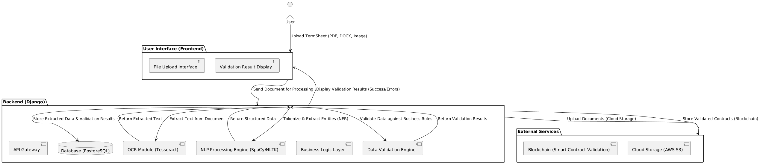
WORKFLOW

Slide 11
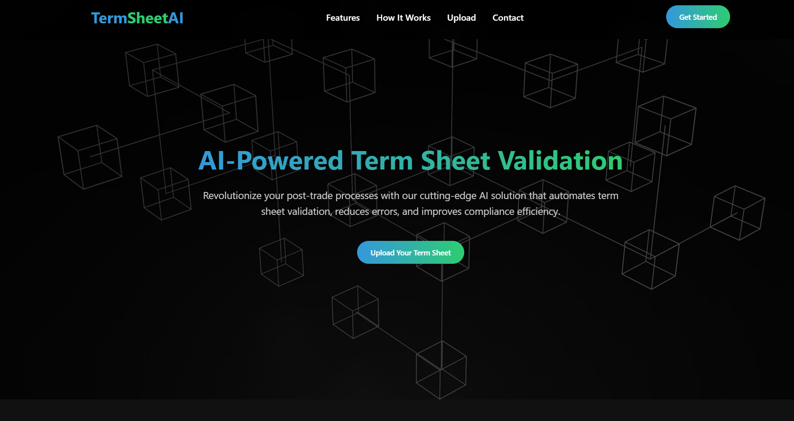
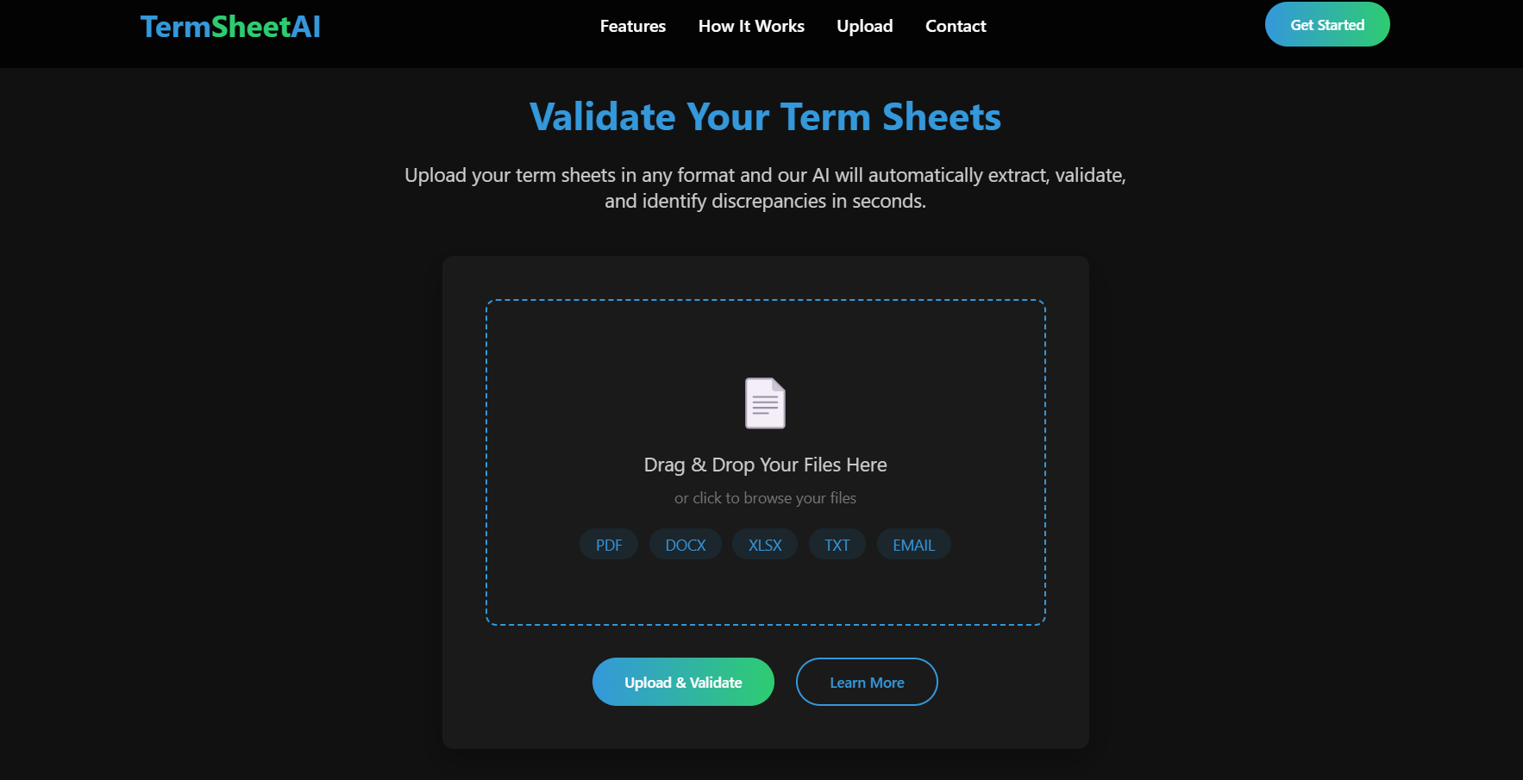
Attachments

Slide 12
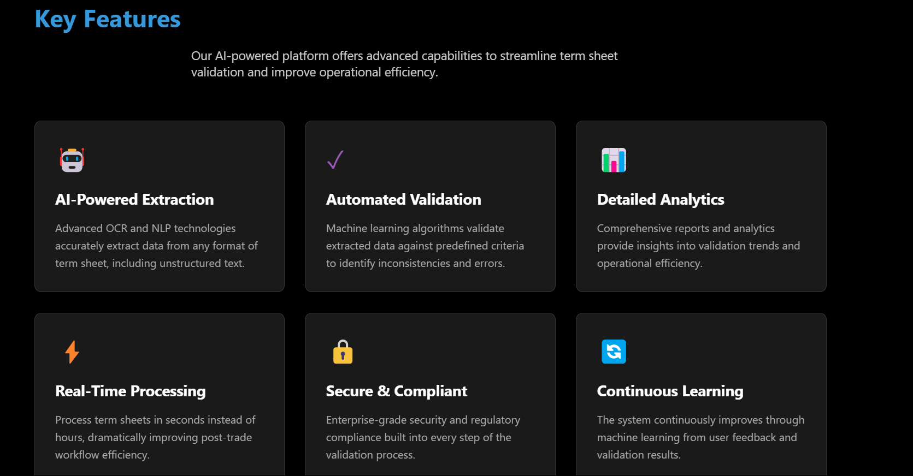
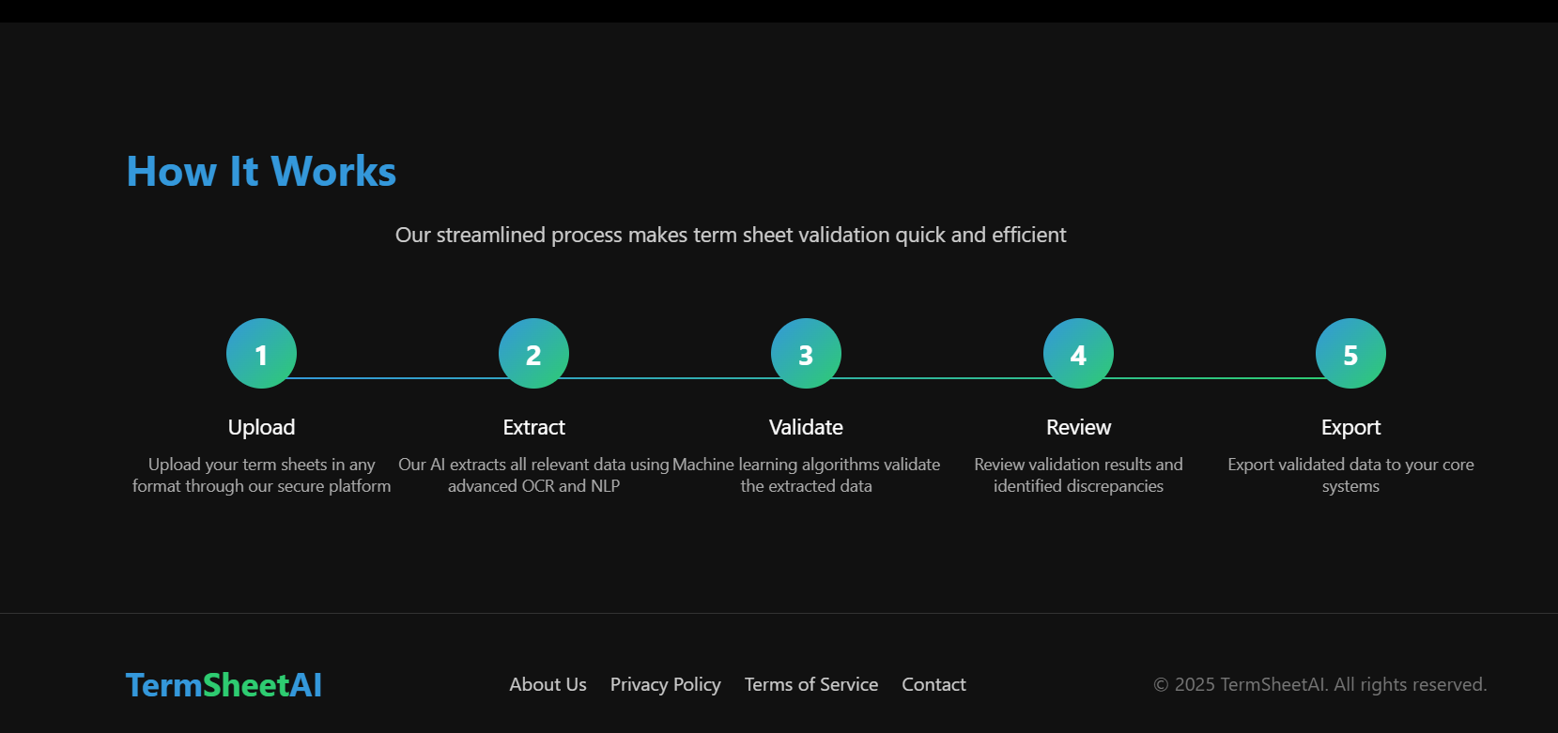
Attachments

Slide 13
WORKING PROTOTYPE
TermSheetAI

