Slide 1
SLAM IoT-based Project using EKF, FastSLAM on Cloud using multiple clients.
Presented By-
Ashish Jacob Sam
Presented To-
Mr. Chaitanya Mahamuni

Slide 2
Presentation Outline
Concept of SLAM
IoT
Applications of IoT
Solving the SLAM Problem
Problem of Simplistic Approach
Extending a Filter
Kalman Filter
Extended Kalman Filter
FastSLAM
Literature Survey
Research Gaps
Problem Statement
Objective of the Work
System Block Diagram
Progress of work till Date
Future Plan and Plan of Action
References

Slide 3
Concept of SLAM
Simultaneous Localization And Mapping (SLAM) is the computational problem of constructing or updating a map of an unknown environment while simultaneously keeping track of an agent's location within it.
SLAM algorithms are tailored to the available resources, hence not aimed at perfection, but at operational compliance.
Published approaches are employed in self-driving cars, unmanned aerial vehicles, autonomous underwater vehicles, planetary rovers, newer domestic robots and even inside the human body.

Slide 4
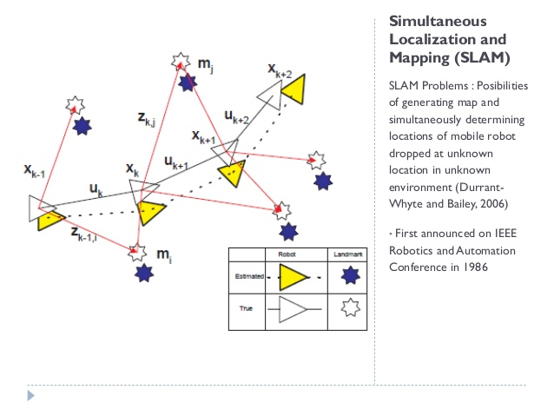
Concept of SLAM
SLAM is a process by which a mobile robot can build a map of an environment and at the same time use this map to deduce it’s location. In SLAM both the trajectory of the platform and the location of all landmarks are estimated on-line without the need for any a priori knowledge of location.
Picture Source : Durrant Whyte and Bailey, 2006

Slide 5
Concept of SLAM
At a time instant k, the following quantities are defined:
• x_{k} : The state vector describing the location and orientation of the vehicle.
• u_{k} : The control vector, applied at time k−1 to drive the vehicle to a state x_{k} at time k.
• m_{i} : A vector describing the location of the i th landmark whose true location is assumed time invariant.
• z_{ik} : An observation taken from the vehicle of the location of the i-th landmark at time k. When there are multiple landmark observations at any one time or when the specific landmark is not relevant to the discussion, the observation will be written simply as z_{k}

Slide 6
IoT
The Internet of Things (IoT) is a system of interrelated computing devices, mechanical and digital machines, objects, animals or people that are provided with unique identifiers (UIDs) and the ability to transfer data over a network without requiring human-to-human or human-to-computer interaction.

Slide 7
Applications of IoT
Consumer Applications
Commercial Applications
Industrial Applications
Infrastructure Applications
Military Applications

Slide 8
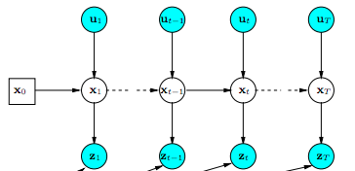
Solving the SLAM Problem
Graph-Based approach: Simplistic approach in solving the problem. For each measurement, store the distances/Observation and move on to observe vicinity.
Picture Source: https://i.stack.imgur.com/n4cnw.png

Slide 9
Problem of Simplistic Approach
The data taken from sensors is usually the differential form of data. For example, typically we use accelerometers to determine position. The actual information is the acceleration (which we can doubly integrate to get position)
It is moderately error prone.
The sensors can not be 100% perfect.
The earlier the errors are made, the further measurements go wrong based on it

Slide 10
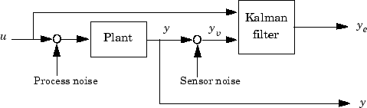
Extending a Filter
Kalman Filter is a mathematical concept of filtering out the errors.
It is an optimal estimation algorithm.
It is an iterative mathematical process that uses a set of equations and consecutive data inputs to estimate the values we are interested in associated with the object.
Given a set of inputs, subject to noise, Kalman Filter can “filter out” the noise and predicts the output.
Image source: https://i.stack.imgur.com/eM2QC.gif

Slide 11
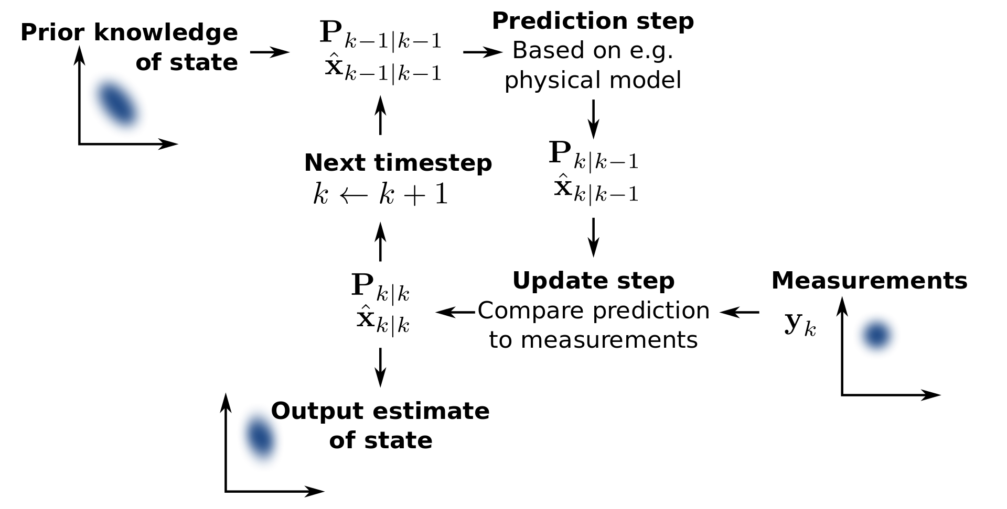
Kalman Filter
Image Source: https://en.wikipedia.org/wiki/Kalman_filter#/media/File:Basic_concept_of_Kalman_filtering.svg

Slide 12
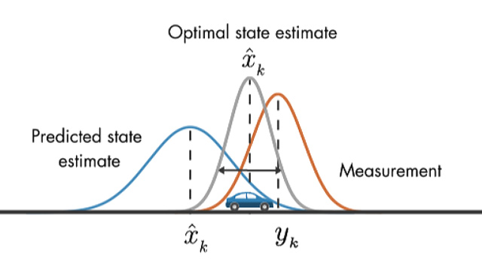
Kalman Filter
Kalman Filter helps to get predictions closer to the actual values.
It is a good option to predict Linear functions.
For the SLAM-process, distances can be predicted using Kalman Filter
Image Source: https://www.mathworks.com/videos/understanding-kalman-filters-part-1-why-use-kalman-filters--1485813028675.html

Slide 13
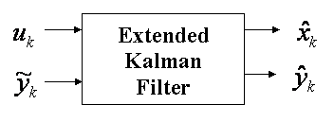
Extended Kalman Filter
For measurements involving angles, the function is non-linear. We need another filter for these values.
Extended Kalman Filter is used for these non-linear functions.
We convert trigonometric functions to linear functions by Taylor’s theorem
Picture Source:http://www.goddardconsulting.ca/imagefiles/KF_EKFfigure2.gif

Slide 14
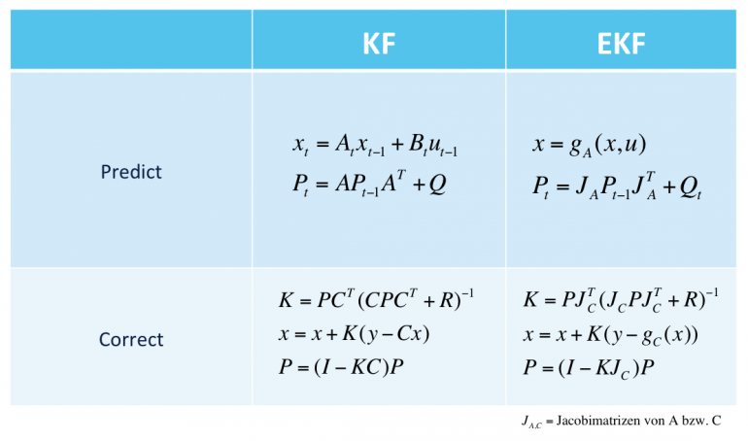
Mathematical representation
Picture source: https://www.cbcity.de/wp-content/uploads/2013/06/Unterschied-Kalman-Filter-Extended-Kalman-Filter-770x454.png

Slide 15
FastSLAM
FastSLAM decomposes the SLAM problem into a robot localization problem, and a collection of landmark estimation problems that are conditioned on the robot pose estimate.
FastSLAM incorporates a mathematical tool called “Particle Filter”. It has an equivalent mathematical impact and usage as Kalman Filter, but it requires more inputs and outputs an exponential amount of states in the probability distribution.
FastSLAM is computationally more expensive than EKF-SLAM

Slide 16
FastSLAM
The distribution P(X t |U t , Z t , x 0 ) is sampled by individual particles, and each distribution P(m k |X t , Z t ) is calculated analytically by an EKF.
Because the observations only depend on the map and the robot pose, the estimations of the landmarks become conditionally independent when the path of the robot is given.
In FastSLAM this means that each EKF is only of size 2 × 2. This implies that FastSLAM only needs to store the diagonal of the covariance matrix P t which is stored in EKF-SLAM, making the SLAM solution linear in the number of landmarks (with a constant depending on the number of particles). This is a big gain compared to the quadratic complexity in EKF-SLAM.

Slide 17
Literature Survey
S.no | Paper Title | Authors | Date of Paper | Work Done | Advantages | Disadvantages | Opinion
1 | FastSLAM: A Factored Solution to the Simultaneous Localization and Mapping Problem | Michael Montemerlo, Sebastian Thrun, Daphne Koller and Ben Wegbreit | 2002 | Solves the SLAM problem more efficiently than the EKF-SLAM | Gives the complexity of O(M log K) as compared to O(K²) of EKF | The given approach uses high storage in form of Tree data structure. | A factored approach for implementation of SLAM
2 | FastSLAM 2.0: An Improved Particle Filtering Algorithm for Simultaneous Localization and Mapping that Provably Converges | Michael Montemerlo, Sebastian Thrun, Daphne Koller and Ben Wegbreit | 2003 | This paper describes a modiﬁed FastSLAM algorithm that is uniformly superior to the FastSLAM algorithms. | The optimization in running time are superior | It takes up more space as the data is re factored | Shows the superiority of FastSLAM 2.0 over its predecessor

Slide 18
Literature Survey
S.no | Paper Title | Authors | Date of Paper | Work Done | Advantages | Disadvantages | Opinion
3 | Simultaneous Localisation and Mapping (SLAM): Part I The Essential Algorithms | Hugh Durrant-Whyte, Fellow, IEEE, and Tim Bailey | 2006 | Review of SLAM algorithms up to that point | Shows FastSLAM as the preferred method of approach as the computation of it is better compared to the rest. | Does not give much details on the implementation in the case of complex environment | Discussed SLAM problem definition and following algorithms: Extended Kalman Filter Rao-Backwellised Filter
4 | A Tutorial on Graph-Based SLAM | Giorgio Grisetti Rainer Kümmerle Cyrill Stachniss Wolfram Burgard | 2009 | Presents a tutorial of Grpah-based SLAM | It is easy to implement in a simple 2D and 3D based mapping by building a dataset | For sufficiently large environment, the constructed Graph requires too much resources. | Discussed implementation of SLAM using Graph-Based approach

Slide 19
Literature Survey
S.no | Paper Title | Authors | Date of Paper | Work Done | Advantages | Disadvantages | Opinion
5 | Cloud-based Parallel Implementation of SLAM for Mobile Robots | Supun Kamburugamuve, Hengjing He, Geoffrey Fox, David Crandall | 2016 | Setting up a client bot sending parallel data to Cloud | The mobile robot does not require much resources as SLAM processing is done by the server | Does not optimise the problem in any way. The server still has to process along with send/receive data | Implementation of IoT-based SLAM to upload data and process it
6 | FastSLAM 2.0 tracking and mapping as a Cloud Robotics service | Shimaa S Ali, Abdallah Hamaad, Adly S. Tag Eldien | 2017 | The SLAM problem is divided into 2 parallel tasks. Mapping and localization are concurrently operated in the cloud | The results show that the computational cost of the tracking process in the Cloud is reduced by 83.6% as compared to its execution on a single robot platform. | The set-up requirements are very High as it uses Big Data | Discussed implementation of SLAM using Graph-Based approach

Slide 20
Literature Survey
S.no | Paper Title | Authors | Date of Paper | Work Done | Advantages | Disadvantages | Opinion
7 | Cloud-based map alignment strategies for multi-robot FastSLAM 2.0 | Shimaa S Ali, Abdallah Hamaad, Adly S. Tag Eldien | 2018 | It proposes an efficient architecture for cloud-based cooperative simultaneous localization and mapping to parallel compute its complex steps via the multiprocessor (computing nodes) and free the robots from all of the computation efforts. | This work improves the map alignment part using hybrid combination strategies, random sample consensus, and inter-robot observations to exploit fully their advantages. | Dependants of clients on servers. The architecture runs on Big-Data and requires lots of resources | Improvements on Client-Server architecture for SLAM process.

Slide 21
Research Gaps
Most of these research work hinges on the Server doing the full process. The clients are reduced to just being a remote sensors.
There is almost no information processing to be done by the clients before sending to the server.
This makes the client-machines completely dependant on the server

Slide 22
Problem Statement
In this project, we intend to utilize the algorithms and set it for multiple bots(clients) sending data to a single server.
Thus we intend to create a novel algorithm to give better results over previous work done on SLAM.
The aim is to generate a reliable Map of the scouted area.
The generated Map is somewhat processed in the client machines as well.
The client should do some data processing on its own in case it is disconnected from the Server.

Slide 23
Objective of the work
To implement a framework for SLAM and generate a map of the scouted area.
To utilize a novel algorithm giving a reduced error rate over previous SLAM algorithms.
To set-up multiple clients to gather information and send the data to a server.
To make the clients to pre-process the data so that client itself can retain and use this data.
To attempt to utilize multiple filters for getting a better approximation of the given data

Slide 24
System Block Diagram
Sensors
Sensors
Client
Sensors
2-way communication between Server and Client
Server
Client
Sensors
Sensors
Sensors

Slide 25
Progress of Work till Date
Worked on Raspberry Pi and sensors.
Made the connection set-up from Pi to Server (on-board Wi-Fi) using Socket Programming
Started with multiple distance sensors and processing

Slide 26
Future Plan and Plan of Action
Working on a mobile set-up for Pi.
Mapping process in the Pi as well as the Server
Multiple client management framework.
Clients semi-independent with Server.

Slide 27
References
https://en.wikipedia.org/wiki/Simultaneous_localization_and_mapping
https://en.wikipedia.org/wiki/Kalman_filter
Julier, S.J.; Uhlmann, J.K. (2004). "Unscented filtering and nonlinear estimation" (PDF). Proceedings of the IEEE. 92 (3): 401–422. doi:10.1109/jproc.2003.823141.
https://en.wikipedia.org/wiki/Extended_Kalman_filter
https://en.wikipedia.org/wiki/Internet_of_things
Rouse, Margaret (2019). "internet of things (IoT)". IOT Agenda. Retrieved 14 August 2019.

Slide 28
Thank You!!

