Slide 1
Winder / Unwinder
Jaouher Romdhane

Slide 2
Control Strategies for Winder/Unwinder Systems

Slide 3
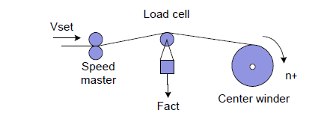
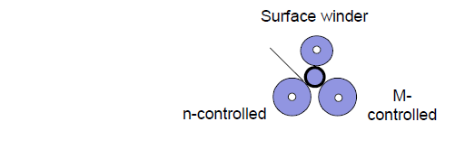
General design:
General design and Winding technique
Winder/Unwinder solution includes
  Winder drive
  Material web
  Possibly sensors
Winding techniques:
Center winder
Surface winder

Slide 4
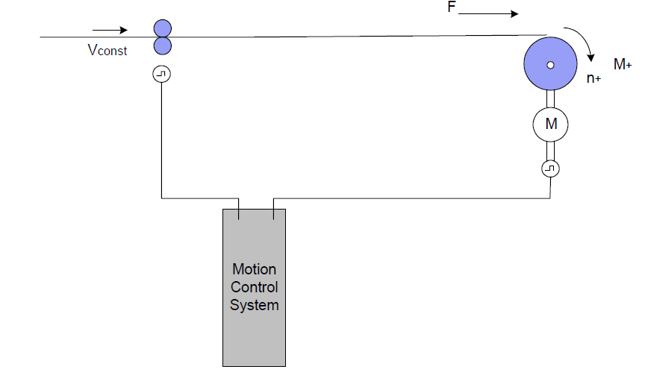
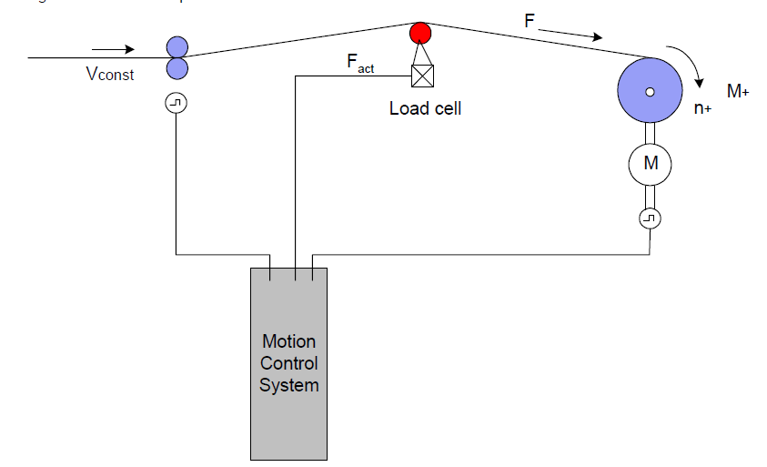
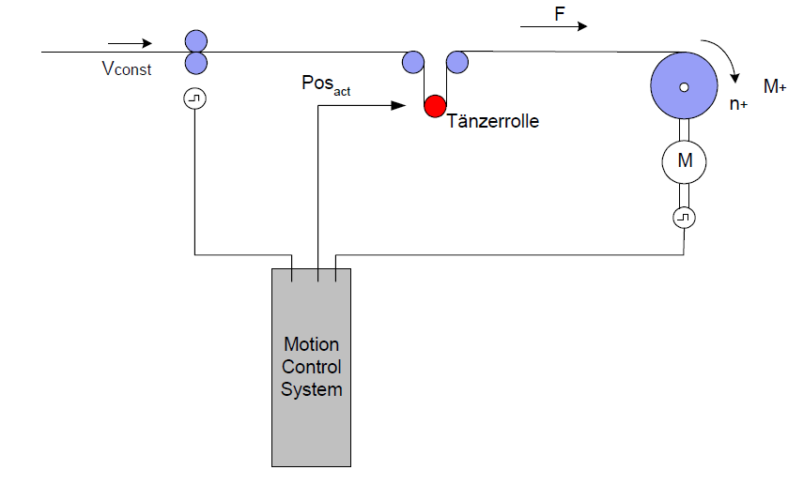
Methods of controlling the tension of web
Methods of controlling the tension of web
Three closed-loop control techniques are mainly used for winders:
Closed-loop dancer roll control
Indirect closed-loop tension control (open-loop torque control)
Closed-loop tension force control
Open-loop Torque control
Closed-loop Tension Control
Closed-loop Dancer Control

Slide 5
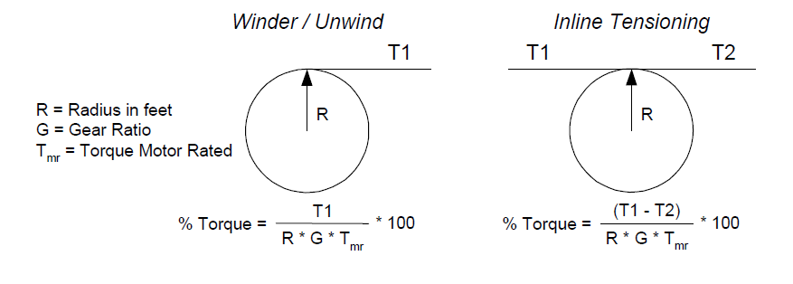
Open Loop Torque Control
Operates without needing feedback devices for tension or position
Calculate he required torque to adjust the tension between rolls.
Advantages:
Cost-effective (no need for expensive sensors)
Simplicity and straightforward implementation
Suitable for basic applications without complex control needs
Limitations:
No feedback leads to reduced precision in tension control
Not suitable for high-performance winding systems

Slide 6
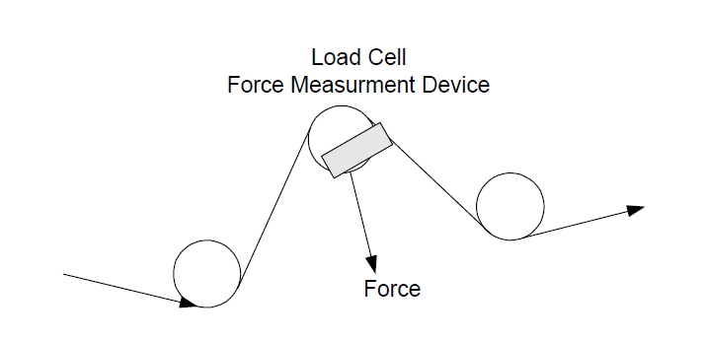
Closed Loop Tension Control
Use force feedback for precise tension control
Especially in cases of wide torque ranges or when external disturbances affect the system.
Advantages:
Improved precision in tension control compared to open-loop control
Ability to adapt to varying torque settings and disturbances
Enhanced performance in complex winding applications
Limitations:
Requires measurement devices, which may increase costs
More complex to implement than open-loop control

Slide 7
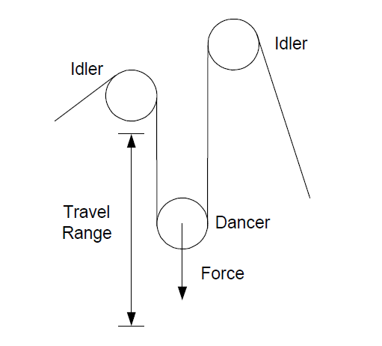
Closed Loop dancer roll Control
Uses a position encoder to determine the dancer roll's position and compare it to a setpoint.
Changes in tension affect the dancer roll's position, which is corrected by adjusting the winder speed.
Advantages:
Absorbs brief tension fluctuations due to the dancer roll's material web storage function
Enhances stability in tension control
Allows for automatic correction of position offsets through speed adjustments
Limitations:
Performance is limited by the mechanical design and dynamic characteristics of the dancer roll
Requires mechanical intervention in the material web, potentially complicating the process

Slide 8
SE Solutions

Slide 9
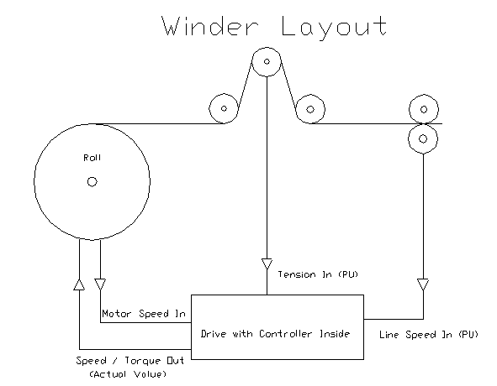
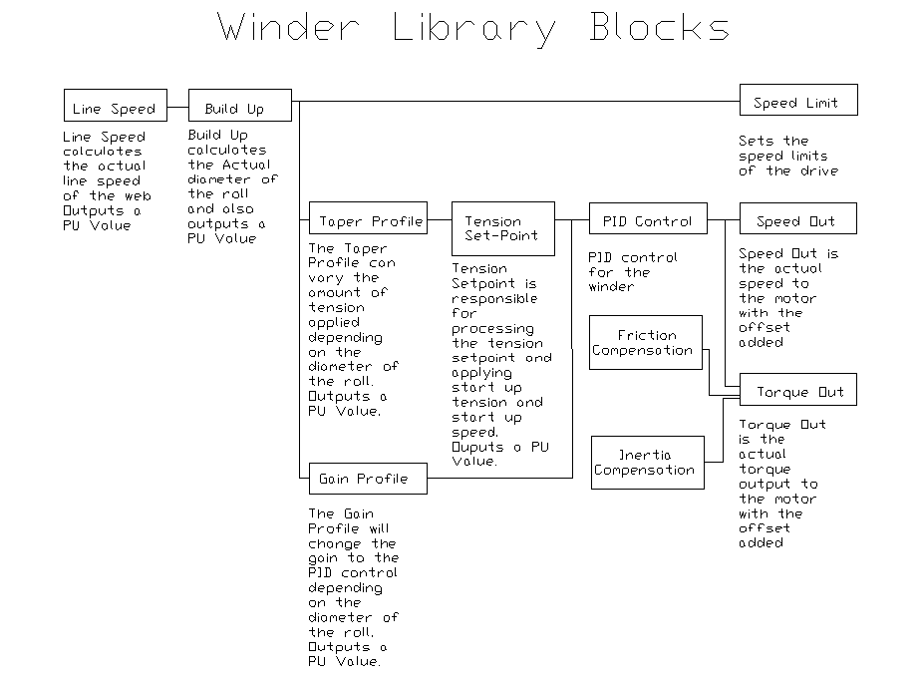
ATV71 with card option VW3A508
Option card VW3 A3 508 available with ATV71
The main features available:
  Operation as a winder or unwinder.
  Radius calculation.
  Tension regulation.
  Function tension profile.
  Tension regulation: tension set point.
  Tension regulation: Speed set point.
  Line speed calculation.
  Compensation for inertia.
  Compensation for frictions.

Slide 10
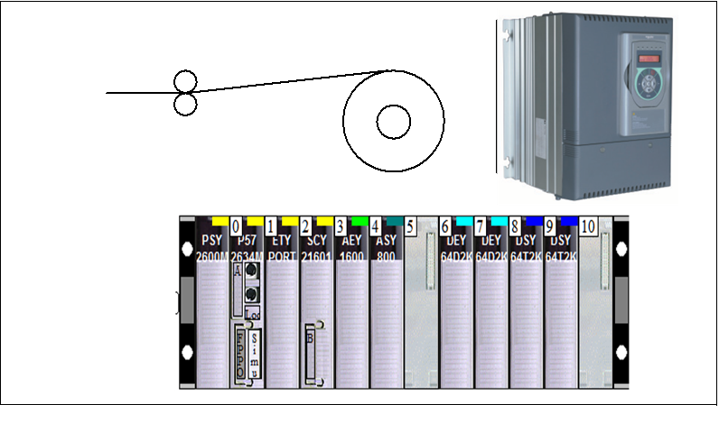
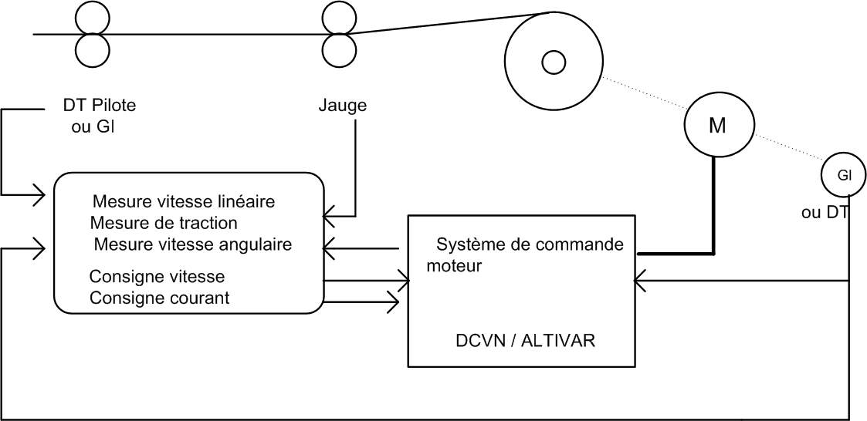
Tractel SE solution
Tractel SE Solution
Automate TSX PREMIUM Unity
DCVN or ALTIVAR CVF Variable Speed Drives
Understanding of Mechanics and Pilot Section
The main features available are:
  Operation as a winder or unwinder.
  Winding or unwinding from the top or bottom.
  Real-time radius calculation.
  Decreasing tension slope based on radius.
  Calculation of spool inertia.
  Calculation of motor and spool acceleration torques.
  Compensation for static and viscous friction
  Tension correction using gauges.
  During the auto-tuning phase, calculation of static and viscous friction, as well as motor and gearbox inertia

Slide 11
ABB Solution

Slide 12
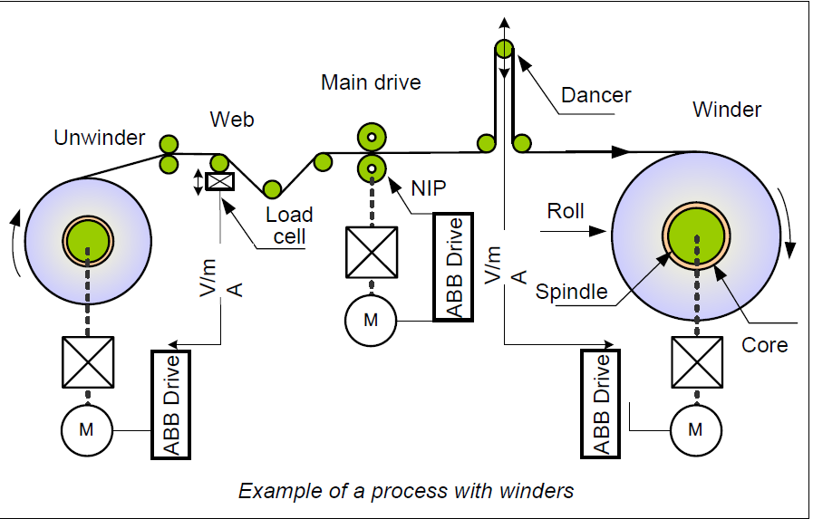
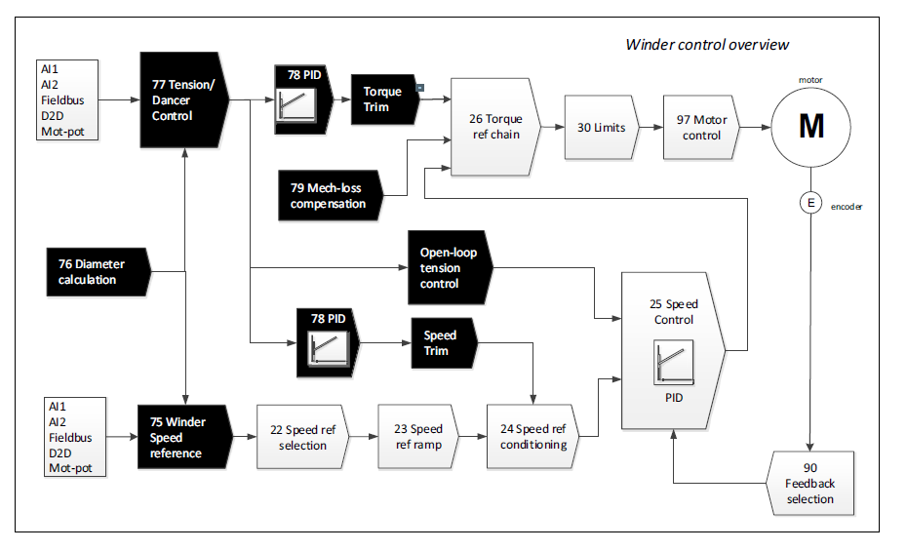
ABB Winder Control
ABB Solution
The solution is proposed in ACS880 winder control program (option +N5000).
The main features available are:
  Diameter calculation.
  Tension/Dancer Control.
  Open Loop Tension Control
  Tension Torque trim Control.
  Tension Speed trim Control.
  Dancer Speed trim Control
  Taper Function
  Friction and Inertia Compensation
  Winder stall function
  Torque memory.
  Automatic Roll change
  Web loss and Virtual roll Control
  Speed control torque limitation
  Tension to torque conversion
  Winder control word logic

Slide 13
Rockwell automation Solution

Slide 14
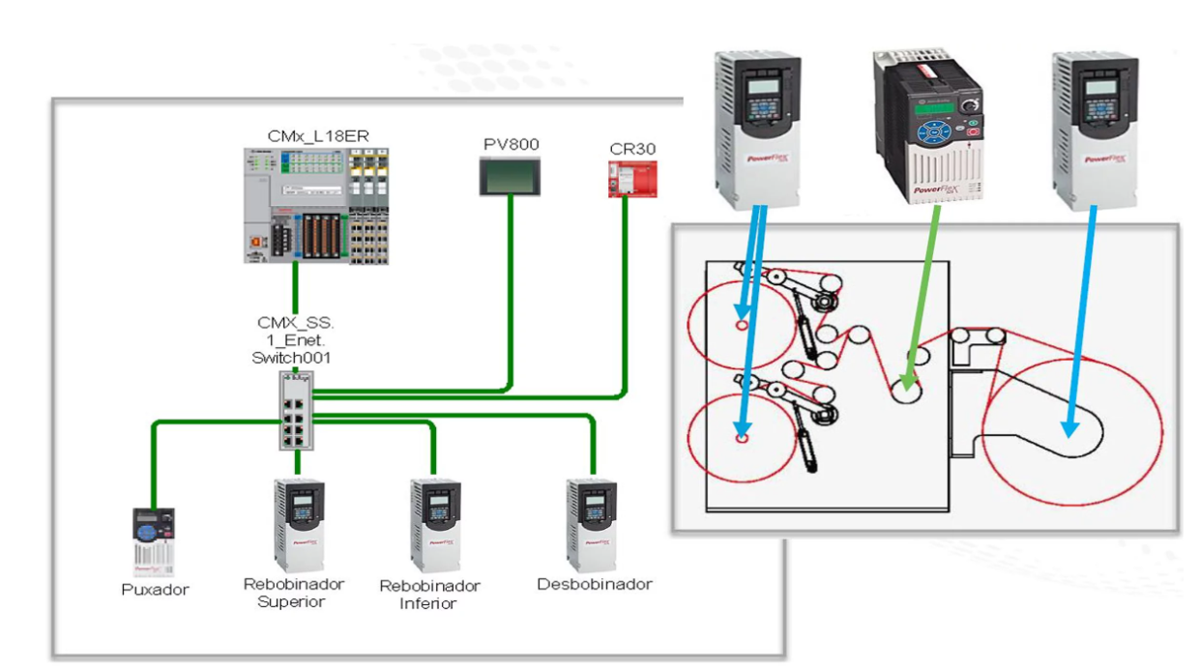
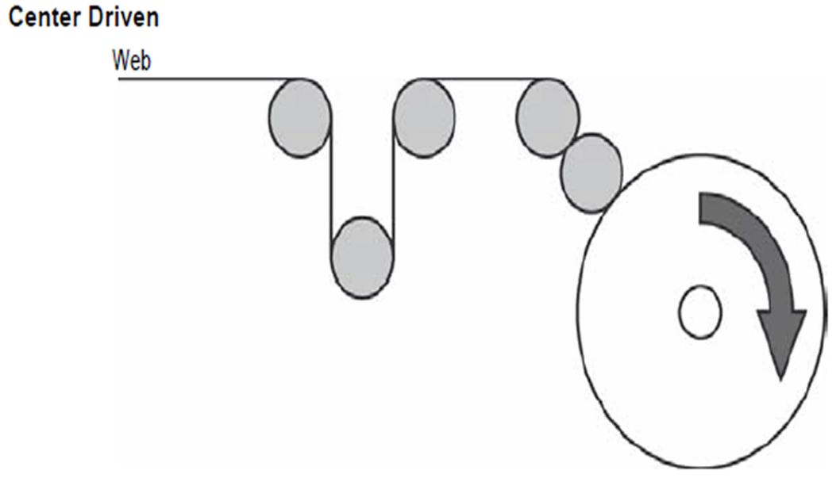
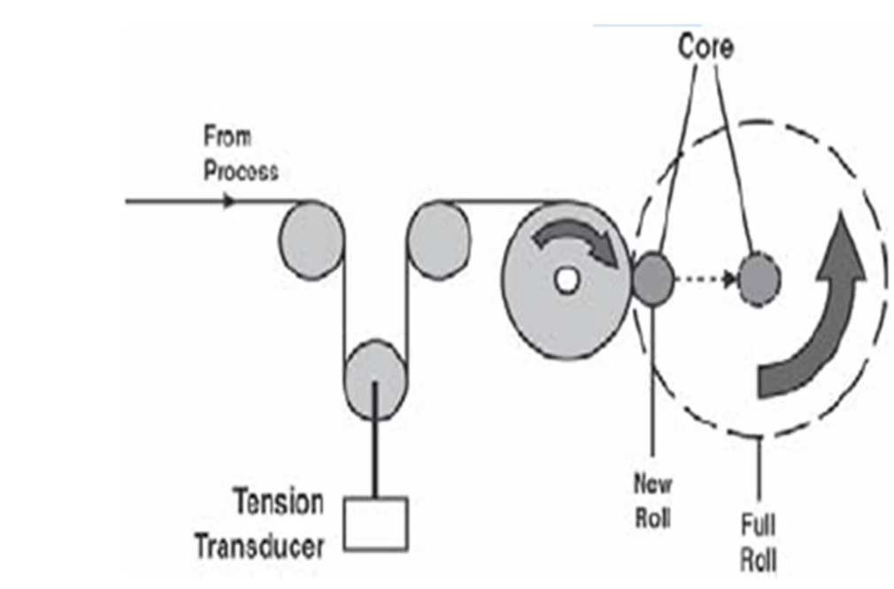
Rockwell automation Winder Control
Rockwell automation Solution
The main features available are:
  Center Driven application.
  Torque control for Winder, Unwinder drives.
  Speed Limited Adjustable Torque
  Speed control for the puller drive.
  Speed follows a virtual axis.
  Tension control at line speed.
  Full tension control when accelerate and decelerate.
  Flexible parameters
    Reference speed of machine.
    Acceleration time.
    Deceleration time.
    Roll Unwind tension control.
    Roll Wind tension control.
    Roll length control.
    Roll diameter control.
  Drive status, Alarms and Faults

Slide 15
Siemens Solution

Slide 16
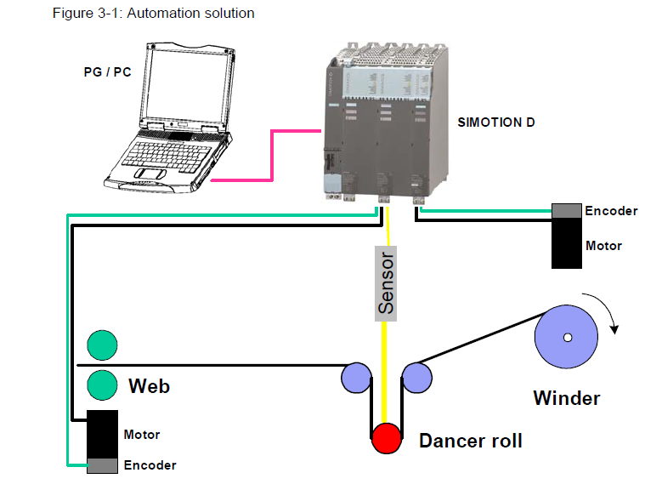
Siemens Winder Control
Siemens Solution
winder function using easily and quickly SIMOTION.
The main features available are:
  Diameter calculator
  Tension Taper characteristic.
  Controller adaptation
  Inertia compensation
They proposed four control strategies:
  Direct closed-loop tension control with dancer roll using speed correction.
  Direct closed-loop tension control using speed correction and a tension measuring transducer.
  Direct closed-loop tension control using torque limiting and load cell.
  Indirect closed-loop tension control.

Slide 17
Lenze Solution

Slide 18
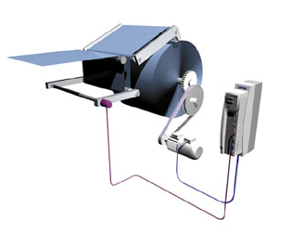
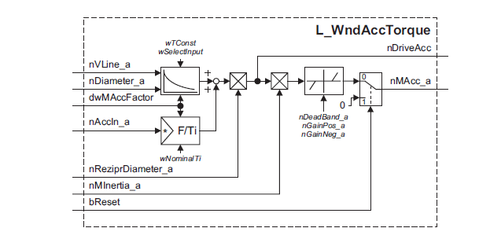
Lenze Winder Control
Lenze Solution
solutions for centre winding machines with dancer control or tensile control.
The Features tension control:
  Internal diameter calculation
  Traction configured via ramp generator
  Open-loop tension control via characteristic curve function
  Automatic identification of the current mass moment of inertia and friction
  Acceleration torque and friction compensation
  Calculation of material density with landing computer
The Features Dancer position control:
  Diameter calculated internally with dancing roller motion compensation
  Teaching of dancing roller end positions
  Tensile force controlled via characteristic curve function using dancing roller
  Automatic identification of the current mass moment of inertia
  Acceleration torque compensation
  Calculation of material density with landing computer

Slide 19
Questions-Answers
Thank you for your attention

