Slide 1
AI4SCIENCE 2026 · SHENZHEN
TRIZª: Guiding Agent Evolution
from Pattern Recognition to Solution Invention
TRIZ (reasoning for direction) + LLM·Agent (execution)
Wenyin Liu (GDUT) · Yiheng Huang (BUPT) · Kai Wang (Denglu.net.cn)
liuwy@gdut.edu.cn
AI4Science 2026, Shenzhen
01
Notes:
I am Wenyin Liu, from Guangdong University of Technology. We are developing a coding agent called TRIZa by introducing TRIZ as a reasoning step to generate ideas, directions and solution plans for agents to execute.

Slide 2
01 · BACKGROUND
What is TRIZ? Теория решения изобретательских задач (ТРИЗ)
Forty named directions, one entry point, one criterion.
Contradiction
You want more of A, and that costs you B. TRIZ asks for the pair of parameters, not wishing for only one side. In our setting the pair is concrete: raise attack recall without raising false positives.
40 principles
Named directions rather than recipes: segmentation, local quality, prior action, parameter change, feedback, intermediary. Forty in total, tabulated in Appendix B.
Ideality
Judge a result by useful function over harm and cost. The ideal final result delivers the function and carries none of the cost.
TRIZ never picks your estimator. It picks the class of change to try, and why that class should help.
Background
03
Notes:
So what is TRIZ? It is Latin acronym for Theory of Inventive Problem Solving, developed by Genrich Altshuller. based on analyses of a large patent corpus. He found that inventive moves recur, and they cluster into a small set of principles. The entry point is a contradiction of a pair of parameters. You want more of A, and that costs you B. You cannot wish only for only one side, you get a pair of contradicting pair of parameters . In our setting, the pair is concrete: raise attack recall without raising false positives. Then come forty named principles, which are directions rather than recipes. Segmentation says split the decision; Local Quality says make behaviour depend on a declared context. And Ideality says judge the result by useful function over harm and cost. TRIZ never tells you which estimator to use. It tells you which class of change to try. That distinction is the reason the rest of the talk, is about records rather than about prompts. A principle is a commitment you can check afterwards, and a prompt is not.

Slide 3
02 · THE GAP
Why TRIZ? Prompting yields code. Principles yield evidence.
PROMPT ONLY
WITH TRIZ
· The raw problem goes straight into the prompt.
· A few rounds may still produce runnable code.
· Nothing forces the model to name the trade-off.
· Different wording next run: not reproducible, no ablation.
· A contradiction is written down before generation.
· Each candidate carries one principle and one parameter pair.
· Ablatable: remove the operator and the effect should vanish.
· Comparable: the protocol is frozen first, so runs line up.
Interpretable: ablatable, comparable, reproducible — or none of the three.
The gap
02
Notes:
Start with the alternative, because it is the default today. If you do not use TRIZ, the raw problem statement goes into the prompt, and a few rounds later you may well have runnable code. That is a real result. But three things are missing. The model's understanding of the problem stays shallow, because nothing forced it to name the trade-off. The solution is not reproducible, because the next run starts from a different phrasing. And you cannot say why this solution rather than another, so you cannot ablate it. But with TRIZ, every candidate traces to one principle and one pair of parameters, which makes it interpretable, ablatable, comparable and reproducible. The difference is not the quality of the code. It is auditability. Two people can take the same candidate, read the same contract, and disagree about the evidence instead of about taste.

Slide 4
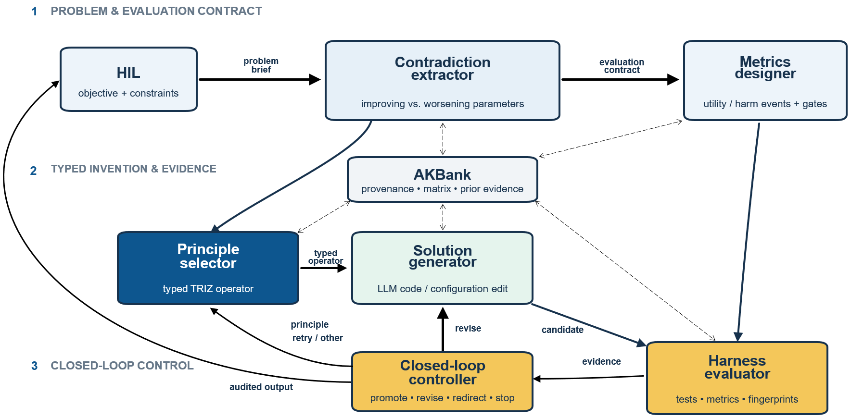
03 · THE LOOP
Four stages, three layers
Human authority sits at both ends; the middle is where the agent works.
Architecture
04
Notes:
Here is the loop: four stages in three layers. Layer one formulates the problem, a human brief, the contradiction, and a protocol that is frozen before anything is generated. Layer two is the core. The agent selects a principle, instantiates its contract, and produces a candidate. Layer three controls: promote, request revision, redirect to another principle, or stop. The knowledge bank keeps source-tagged mappings and prior outcomes, so a recommendation can say where it came from. And high-risk actions need a human operator with the required authority, which is a design decision, not a formality. Nothing in this diagram is a new model. The stages are ordinary engineering; what is unusual is that each stage leaves a record the next one is forced to consume.

Slide 5
04 · STAGE ONE
Fix the question before the answer
Nothing is generated until the protocol is frozen.
Human brief
Contradiction
Target function, operating constraints, and the actions that need a human authority to approve.
The property to improve, the property that may worsen, and a testable criterion for each side.
Frozen protocol
Knowledge bank
Split, metric implementation and evaluation procedure, fixed before any candidate exists.
Source-tagged mappings and prior outcomes, so a recommendation can say where it came from.
If the measurement is chosen after the result, no later claim is safe.
Stage one
05
Notes:
Stage one is about fixing the question before the answer. The brief names the target function and the constraints that cannot move. The contradiction extractor writes down the property we want to improve, the property that may get worse, and a testable criterion for each. Then the protocol is frozen: the split, the metric implementation, the evaluation procedure. That ordering is the whole point. If the measurement is decided after you see the result, no later claim is safe, no matter how good the number looks. In practice this is where most agent projects fail, not in the model. They begin with a measurement they can move, and discover the constraint only after the numbers arrive.

Slide 6

05 · THE OBJECT
A candidate is a typed operator, not an edit
The contract is written before the run; that is what makes ablation possible.
$$π = ( id(s), c, r, τ_{r}, Δ, κ )$$
parent artifact, contradiction, principle, operator, arguments, protocol
$$s^{′} = τ_{r}( s ; Δ )$$
the candidate is that operator applied to the parent
1 Input and output types
2 Permitted operations
3 Protected conditions
4 Required checks
A favourable result cannot retrospectively make an untyped edit TRIZ-guided.
The object
06
Notes:
The central object is the typed proposal. It is a tuple: the parent artifact, the contradiction, the selected principle, the declared operator, its arguments, and the frozen protocol. The candidate is that operator applied to the parent. The contract states four things: input and output types, permitted operations, protected conditions, and required checks. One rule matters more than the rest. A favourable result cannot retrospectively make an untyped edit TRIZ-guided. You commit to the direction before you see the number, and the record keeps every link, so someone else can re-run the decision. This is why we call the object typed. An untyped edit has no operator, so there is nothing to ablate and nothing to compare; you can only report that it worked.

Slide 7
06 · DIRECTIONS
Four principles, one four-step procedure
Segmentation
1
Name the property to improve, the one that may worsen, and what is protected.
partition decisions behind a stable interface
Local Quality
2
Retrieve principles with their source; label a fallback as a fallback.
context-specific behaviour, declared in advance
3
State how the operation helps and how it harms.
Prior Action
reusable state prepared before the critical path
4
Record the principle and the arguments before evaluation.
Parameter Change
a threshold or a weight is moved
No rationale, no claim: the record has to exist before the number does.
Directions
07
Notes:
We illustrate our methods with four exemplar directions guided by four principles, and the procedure that keeps them honest. Segmentation partitions decisions behind a stable interface. Local Quality assigns context-specific behaviour. Prior Action prepares reusable state before the critical path. Parameter Change moves a threshold or a weight. The procedure is four steps. 1. State the property or parameter to improve, the one that may worsen, and what is protected. 2. Retrieve principles with their source, and label a fallback as a fallback, that is, if no matrix hit , just say so. State how the operation helps and how it harms. Record the principle and the arguments before evaluation, because a missing rationale cannot be supplied afterwards. None of this is specific to network intrusion detection. The same four steps applied to a retrieval system would name a different contradiction and reach a different set of principles.

Slide 8



07 · MEASUREMENT
Two quantities, one ordering
Both bounds come from the same reference population, and the protocol id travels with them.
$$I_{U}(s) = −\log_{2} [ \frac{(1 + h_{U}(s))}{(1 + N)} ]$$
Useful FI: how rare the candidate's level is among references at that level.
$$I_{H}(s) = −\log_{2} [ \frac{(1 + h_{H}(s))}{(1 + N)} ]$$
Harm FI: the same construction over false positives, recall loss, leakage, cost.
$$J_{l} = \frac{I_{U}^{LB}}{max(ε, I_{H}^{UB} + λ_{C}·C_{path})}$$
Ideality: a lower bound on useful FI over an upper bound on harm FI plus path cost.
Certification is separate: the highest level whose gates were passed, or −1.
The add-one term keeps the estimate finite when nothing matches. It is not a confidence bound.
Measurement
08
Notes:
How a candidate is scored. Functional information (FI) asks how rare a configuration is among references that pass the same protocol at the same evidence level. Useful FI is minus log base two of the fraction reaching the candidate's useful level; harm FI is the same construction over false positives, recall loss, leakage and resource violations. The add-one correction keeps the estimate finite when nothing matches. It is not a confidence bound. Ideality then divides a lower bound on useful FI by an upper bound on harm FI plus a path cost. And certification is a separate quantity: the highest evidence level whose gates were actually passed, or minus one. A larger ratio cannot buy its way past a safety or replication gate. Both bounds come from the same reference population, and the protocol identifier travels with them, so two numbers are only comparable when that identifier matches.

Slide 9
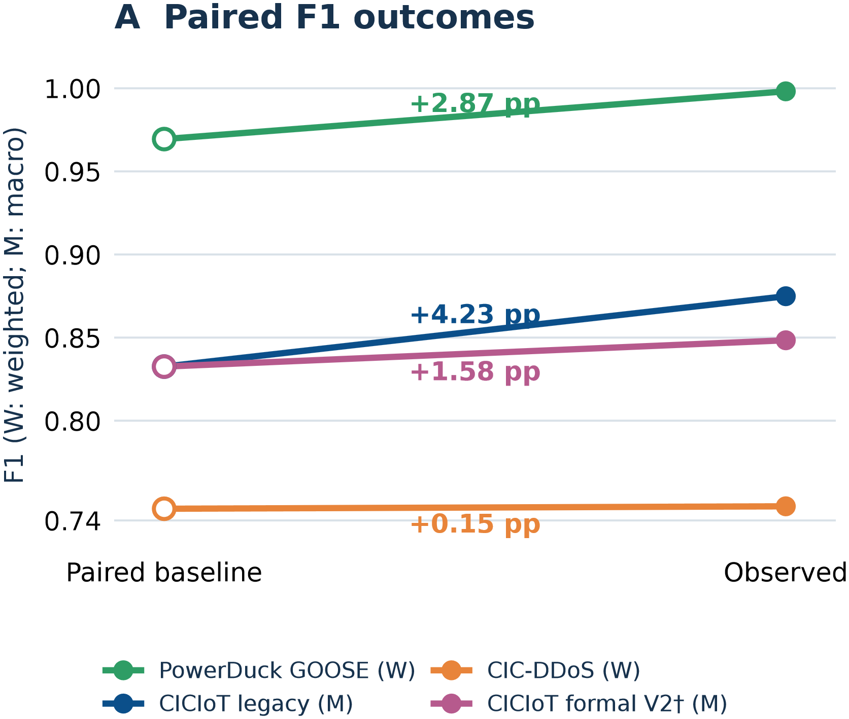
08 · EVIDENCE
Paired outcomes, each inside its own protocol
· PowerDuck GOOSE (W): 0.96943 to 0.99817, +2.87 pp.
· CICIoT legacy (M): +4.23 pp.
· CIC-DDoS (W): +0.15 pp across all ten folds.
· Formal candidate (M): +1.58 pp, and still not promoted.
Two cautions. The sizes are not a ranking across tasks, because the metrics differ; and PowerDuck's margin against its incumbent was +0.22 pp, not +2.87.
Paired evidence
09
Notes:
We use three detection tasks over three datasets to evaluate how our method works.
After many rounds of evolutions, all three tasks got increase on the performance metrics, but some with larger, some smaller increase. Next we explain them in more details.
--pass---
Here are the paired outcomes, and I want to be careful about how to read them. Each row is a baseline and an observed candidate inside its own protocol: PowerDuck weighted-F1, plus two point eight seven points; CICIoT legacy macro-F1, plus four point two three; CIC-DDoS, plus zero point one five over all ten folds; and the formal candidate, plus zero point zero one five eight. Two cautions. The sizes are not a ranking across tasks, because the metrics differ. And PowerDuck's gain is against its paired baseline, not against the incumbent it had to beat, where the margin was zero point two two. Read the fourth row differently from the first three. It is the only row where the candidate was evaluated against gates that were written before the run, and it is the only row that failed them.

Slide 10
09 · THE DECISION
Improved on three measures. Not promoted.
0.83256 → 0.84839
43 / 45 pairs positive
5 / 5 seed blocks positive
+0.01802 recall
−0.00168 false positive rate
macro-F1, exact endpoints
Δ = +0.01584 1.90% relative
Our own gates: relative F1 gain ≥ 3.2277% and FPR reduction ≥ 0.005
Both unmet. A completed evaluation is not an authorisation.
Deltas are computed before rounding; the rounded pair alone would read +0.01583.
Complete evidence, insufficient authorisation.
The decision
10
Notes:
This one we would like to emphasize. The formal campaign completed forty-five family and seed pairs. Macro-F1 rose by one point nine percent. Recall rose, false positive rate fell, forty-three of forty-five pairs were positive, and all five seed blocks moved the same way. But the candidate was not promoted, because our own gates ask for three point two percent relative gain and a zero point zero zero five FPR reduction. Complete evidence, insufficient authorisation.

Slide 11
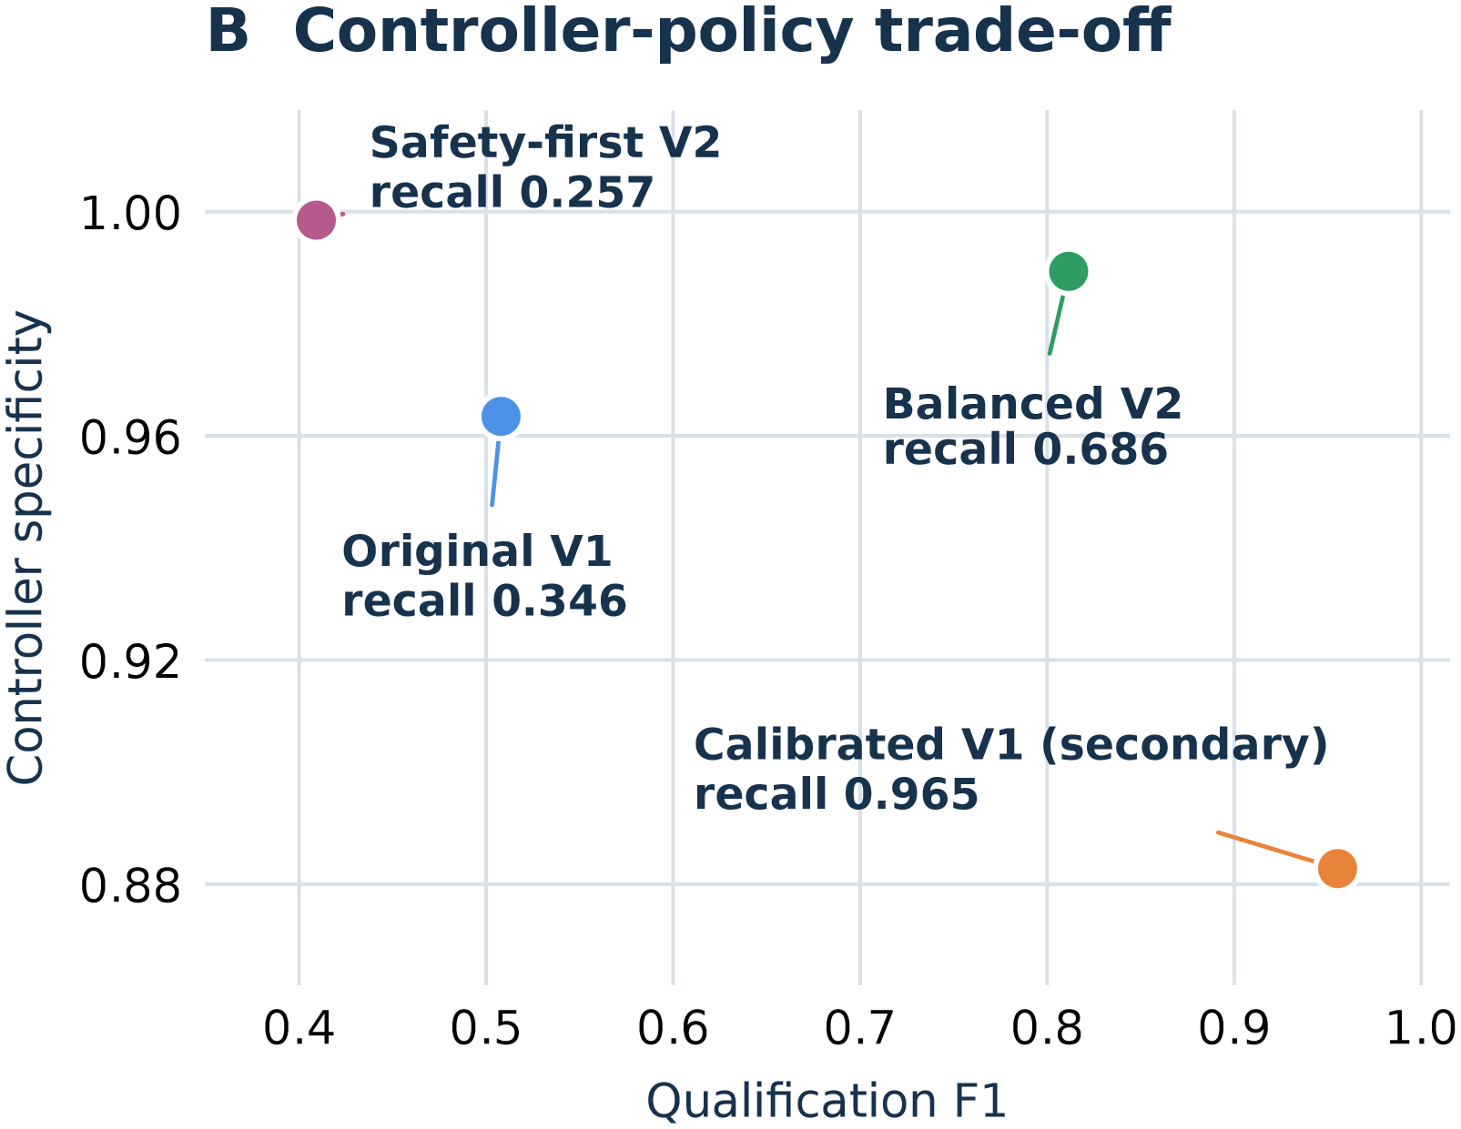
10 · THE CONTROLLER
Qualification is a policy choice, not a winner
Specificity is the rejection rate for unqualified candidates.
· Safety-first: specificity 0.998, qualification F1 0.409.
· Balanced V2: 0.989 and 0.811.
· Original V1, fixed 5%: 0.963 and 0.508.
· Calibrated V1: 0.883 and 0.955.
2,040 decisions over 510 overlapping subsets — reported as a trade-off with stated consequences, not as independent replications.
The controller
11
Notes:
The controller has to decide which candidates are functionally qualified, and that turns out to be a trade-off rather than a winner. On the right axis, specificity is the rejection rate for unqualified candidates. Safety-first sits far right and rejects almost everything, including qualified candidates. Calibrated V1 sits at the top left: it accepts far more, and its recall is much higher. Balanced V2 sits between them. We report this as a policy choice with stated consequences, and we also say that the two thousand and forty decisions come from overlapping subsets, so they are not independent replications. The honest reading is that we have not shown which policy is right. We have shown that the choice changes the outcome, and that it can be stated before the experiment instead of after.

Slide 12
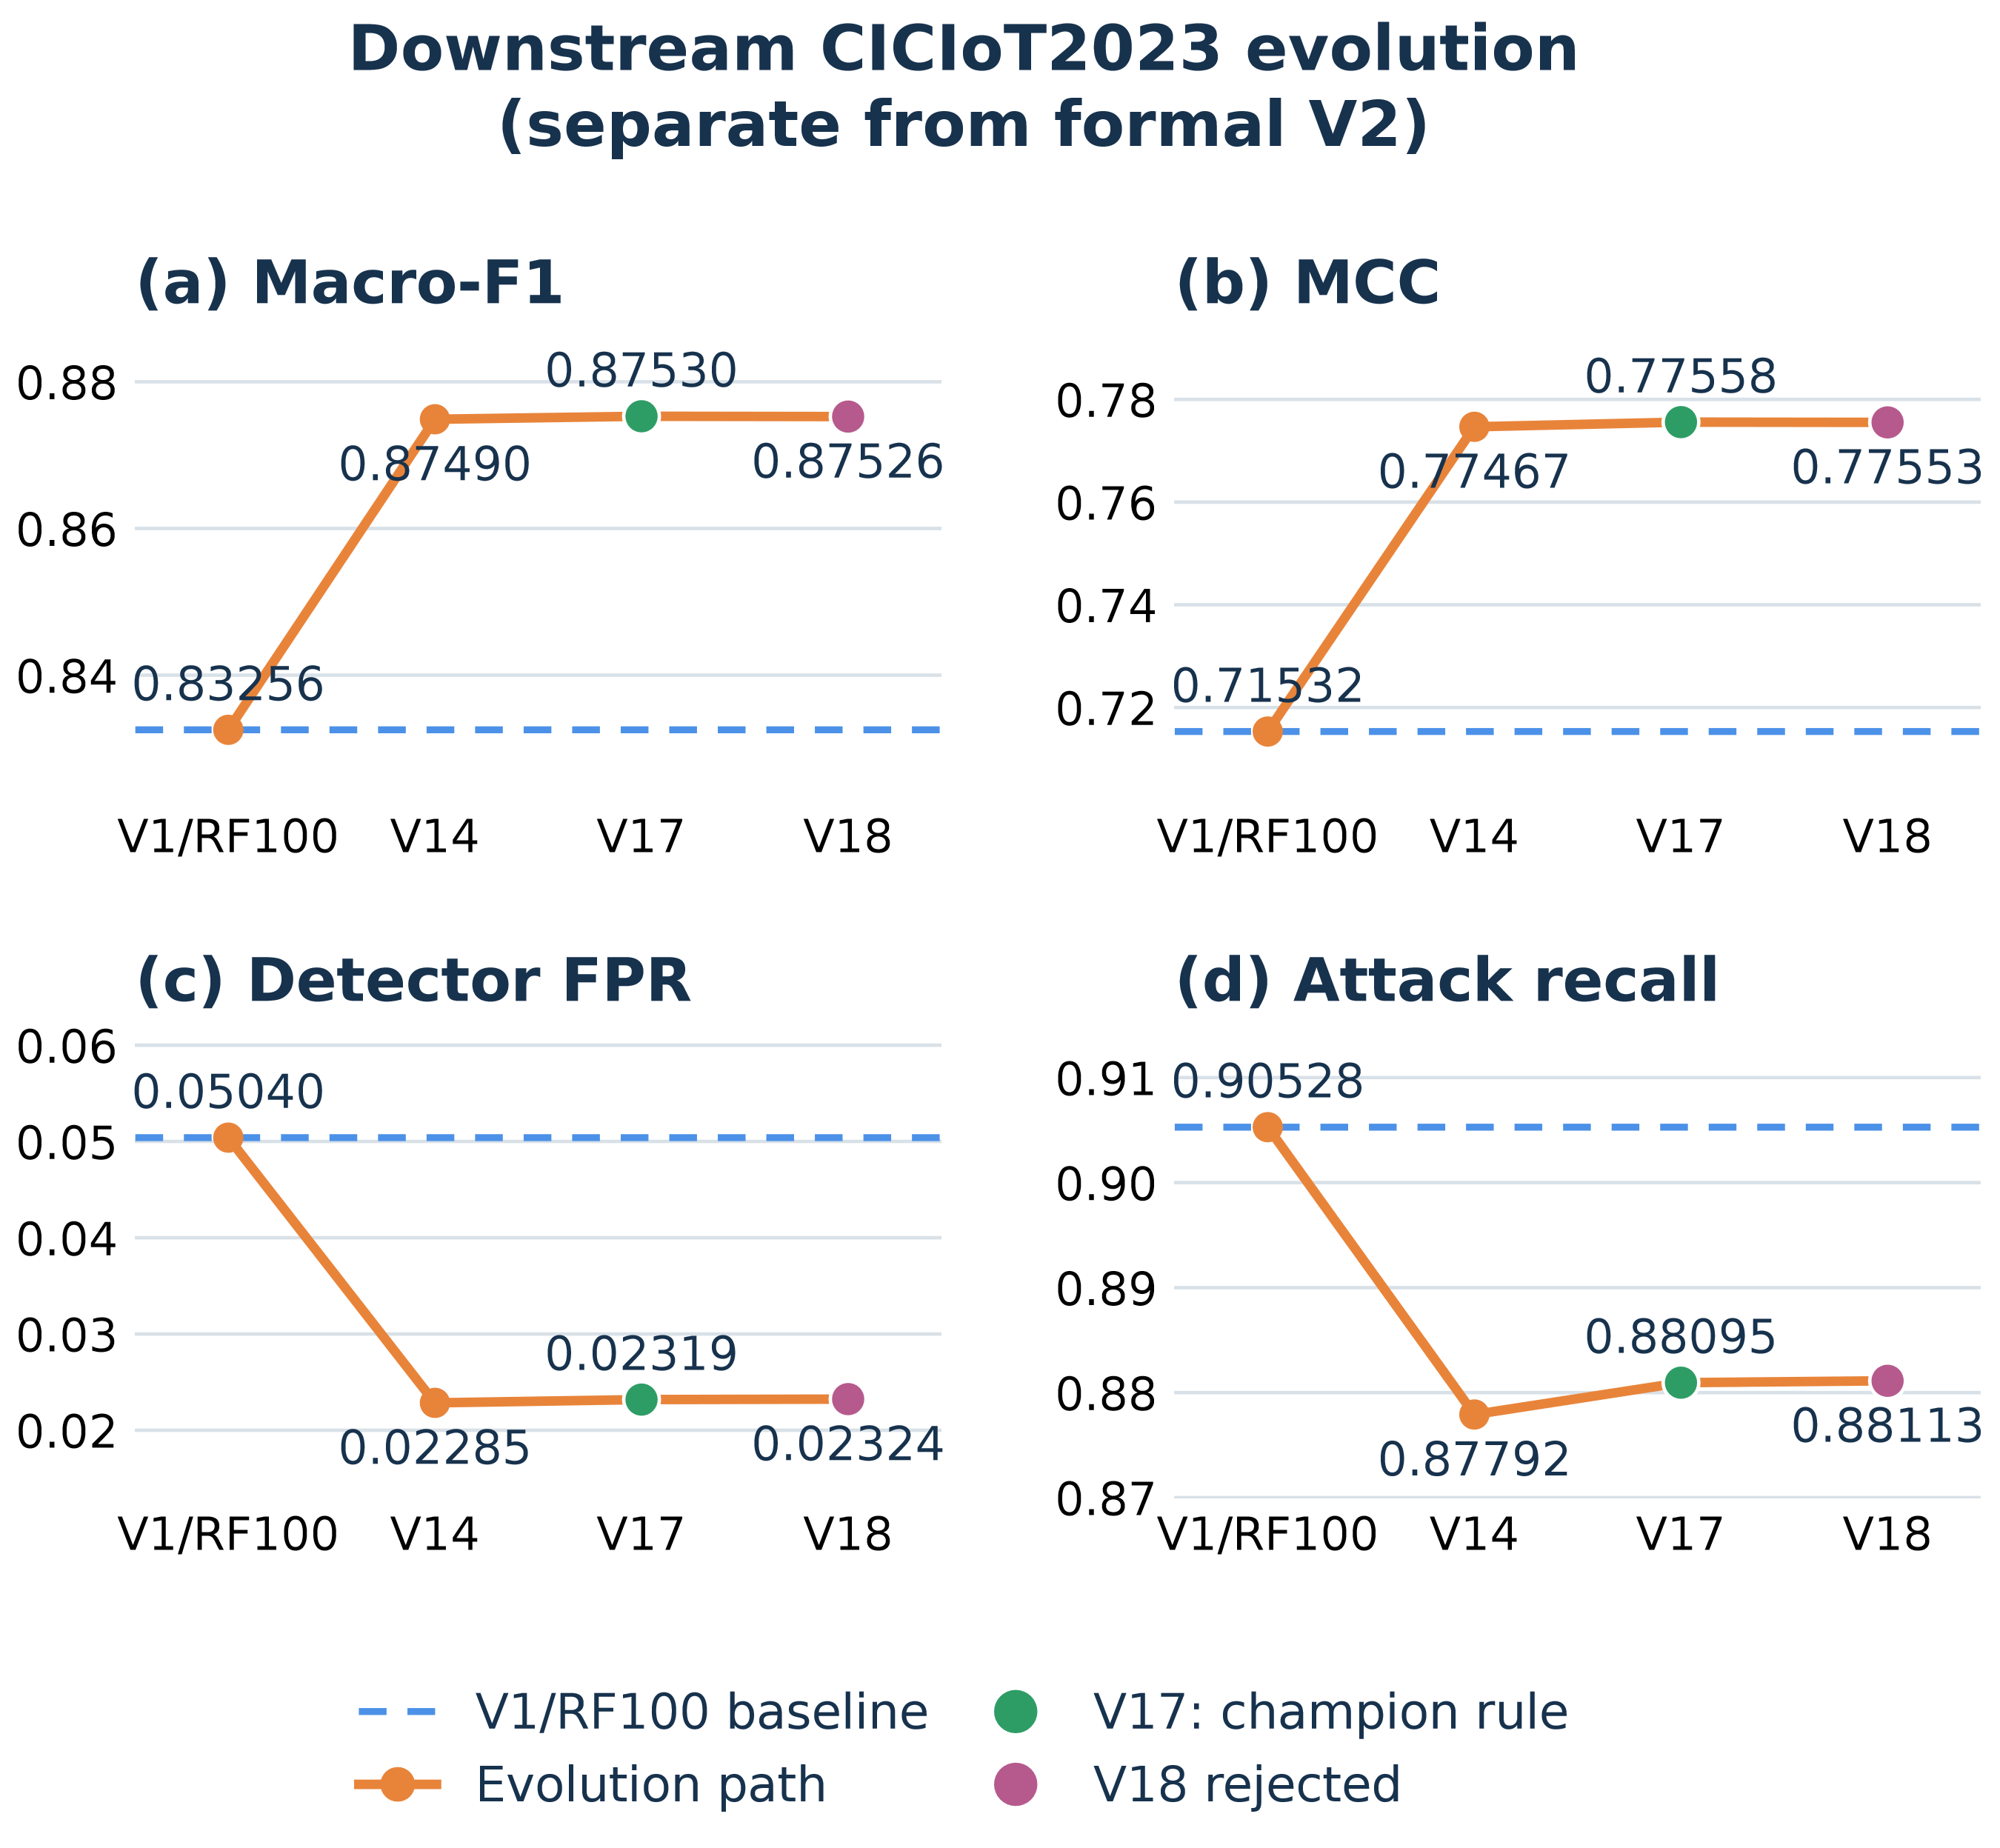
11 · DOWNSTREAM
Where the loop said no
· V14: macro-F1 0.83256 → 0.87490.
· V17: 0.87530, but detector FPR 0.05040 → 0.02319 and recall 2.43 pp below RF100.
· V17 passes its own champion rule, not strict balanced V2.
· V18 was rejected under its retained contract.
· MCC: above the same-fit V17 core, below the older cached V17.
The number did not change. The reference did.
Downstream
12
Notes:
Downstream is where the loop said no, and it deserves a minute. V14 lifts macro-F1. V17 adds a little more, but its detector false positive rate nearly halves, which is the wrong direction. It passes its own champion rule, not strict balanced V2, and its recall stays two point four three points below the RF100 baseline. V18 was rejected under its retained contract. And notice the MCC panel: the value is higher than the same-fit V17 core and lower than the older cached V17. The number did not change. The reference did. For a review this is the more useful result, because a rejected candidate with a complete record tells you where the method stops, and a promoted one rarely does.

Slide 13
12 · SCOPE
What this does not show
Not causal
No matched search
No isolation of TRIZ, FI or the controller: a workflow, not three separable effects.
No matched-budget independent search, and no sensitivity study over reference populations.
Not independent
Reproduction limited
Related candidates and reused caches are not independent confirmations.
Sample-level predictions missing, one specification original missing.
Stated in the paper, not discovered in review.
Scope
13
Notes:
So what does this paper not show? It does not isolate the causal contribution of TRIZ, of functional information, or of the controller. The cases show an executable workflow, not three separable effects. There is no matched-budget independent search and no reference-population sensitivity study. Related candidates and reused caches are not independent confirmations. And reproduction is still limited: sample-level predictions are missing, one specification original is missing, and some historical provenance is incomplete. We would like to do more experiments including a matched-budget search against the same protocol.

Slide 14
13 · Conclusions and contributions
Main Contributions: TRIZ-guided generation and FI/Ideality
Three things worth keeping
1
Type the direction, not only the result: contradiction, principle and contract make the search auditable before the number exists.
2
Treat functional information as an instrument tied to a fixed reference population, not as a universal score.
3
Keep promotion separate from improvement: our most interesting candidate improved three measures and was still not promoted.
Thank you.
14
Notes:
Here are our contributions:
TRIZ-guided solution generation.
Operational Ideality based on functional information.
Evidence-bound promotion
Traceable candidate records.
Layered cybersecurity evidence.
Conclutions: there are three things to take away. Type the direction, not only the result: a contradiction, a principle and a contract make the search auditable before the number exists. Treat functional information as an instrument tied to a fixed reference population, not as a universal score. And keep promotion separate from improvement, because in our runs the most interesting result is a candidate that improved three measures and was still not promoted. The paper, the appendix and the decision records are at the address on the right. Thank you, and I am happy to take questions. If you take one operational rule from this talk, take the ordering: contract first, then the number. Everything else in the method can be renegotiated; that order cannot.
That’s all of my presentations. Thanks.

