Slide 1
Inventory and supplier analysis
Which products matter, which suppliers hurt, and how much stock to hold. Synthetic supply chain data, 2025. SQL, Excel and Power BI.
Notes:
One-line pitch: I analysed a synthetic supply chain dataset to find which products matter, which suppliers cause problems, and how much stock to hold.

Slide 2
The business problem
Stock runs short on some products. The company needs to know which, why, and what to change.
Situation
Question
Who uses it
120 products from 12 suppliers. In 2025 products spent 1,238 days at zero stock, and every supplier delivered slower than planned.
Which products matter most, which suppliers cause the problem, and at what stock level should each product be reordered?
Inventory planning and procurement: where to focus, which suppliers to challenge, and what to change.
Notes:
Why this project: logistics analyst roles ask for inventory, replenishment and supplier analysis. This is one question that covers all three.

Slide 3
Data and approach
A synthetic one-year dataset, built and checked twice: Excel first, then SQL.
120
12
42,204
3,159
products
suppliers
sales lines
purchase lines
Source: Kaggle, synthetic. Imported into MySQL, validated, then analysed in SQL (Excel for the first pass)
Net revenue in USD: prices come in three currencies (EUR, TRY, USD), converted at fixed rates
Every result built in Excel, rebuilt in SQL and matched (revenue within 3 cents). Mistakes caught by sanity checks are logged
Notes:
Stress that the data is synthetic and that the results were verified two ways.

Slide 4
Which products matter
Ranking revenue in USD pushed every lira product into class C. Ranking within each currency fixed it.
All 39 lira products fell into class C: 300 lira is only a few dollars
Within each currency: A 62, B 32, C 26 products. 37 products changed class
Matches the dataset’s own classes for 110 of 120 products; all 10 differences are one class apart
Notes:
Class A is 79% of revenue. The currency effect is a quirk of how the data was generated, not product importance.

Slide 5
Suppliers: slow and unsteady
Four suppliers take 15 to 20 days and vary widely. Every supplier is slower than planned.
Slow four (orange): standard deviation 12 to 14 days, waits up to 45 days
Every supplier is 1.5 to 4.7 days slower than planned, on average
Labels mislead: “Fast/Exp” Supplier X averages 14.3 days, “Slow/Chp” Y 10.2
X’s worst quarter: Q2, only 56% of lines delivered in full
Notes:
Lead time variation matters as much as the average, because it drives safety stock.

Slide 6
Reorder point: product 64
Reorder when stock plus orders on the way falls to about 263 units, at a 98% service level.
105
158
263
+
=
units sold while waiting for delivery
units of safety stock
units: the reorder point
Inputs: demand 15.3 a day (SD 6.4), lead time 6.9 days (SD 4.9)
About 95% of the variance behind the safety stock comes from lead time, not demand
Product 64 never ran out in 2025. The full table, using supplier-level lead time, gives 244
Notes:
Safety stock = Z x square root of (lead time x demand variance + demand squared x lead time variance).

Slide 7
The key finding
Products from the four slowest suppliers run out about nine times as often.
They need 42 days of sales on hand at reorder, against 17 for the rest
All 10 products with the most stockout days have one of these four suppliers
Recommendation: raise their reorder points, and push the four suppliers for steadier deliveries
Link is strong (correlation 0.73) but not proof of cause
Notes:
Be ready to explain correlation versus cause, and that the formula is a benchmark, not a rule.

Slide 8
Recommendations
Four actions in priority order. Trade-off: higher reorder points tie up cash, and that cost is not yet priced.
1
Raise reorder points on the 33 products from suppliers 3, 4, 10 and 12, starting with the 18 class A items
Measure: Days at zero stock
2
Ask the four suppliers for steadier deliveries, and review Supplier X
Measure: Lead time SD, lines in full
3
Plan with actual lead times, not planned ones
Measure: Actual minus planned days
4
Review the scorecard and reorder points monthly
Measure: The dashboard
Notes:
Be ready to explain the trade-off: more stock means more cash tied up. Next step is to estimate holding cost from product cost and holding cost rate.

Slide 9
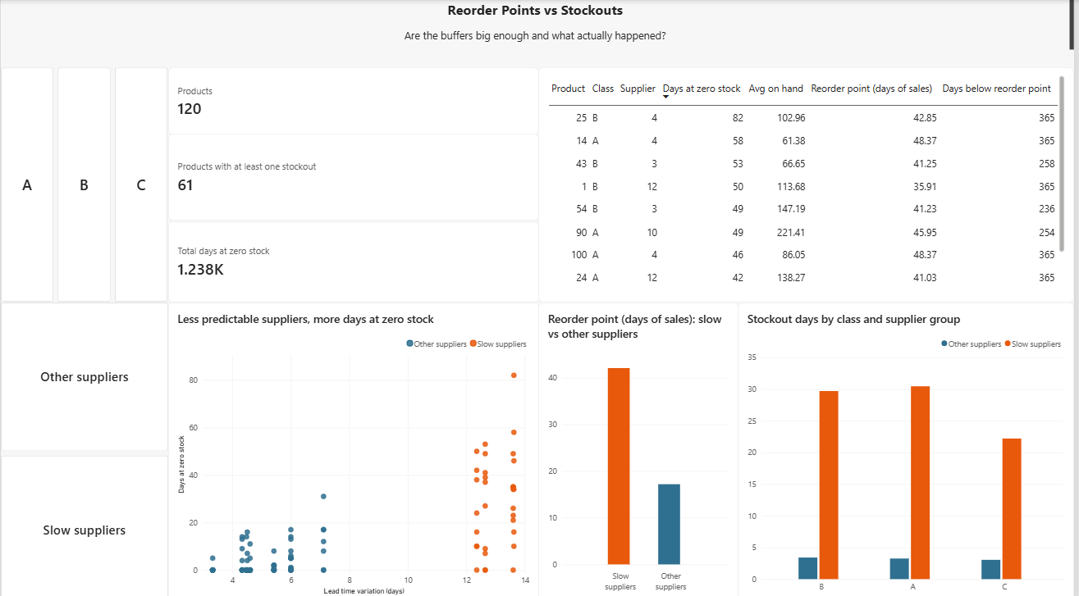
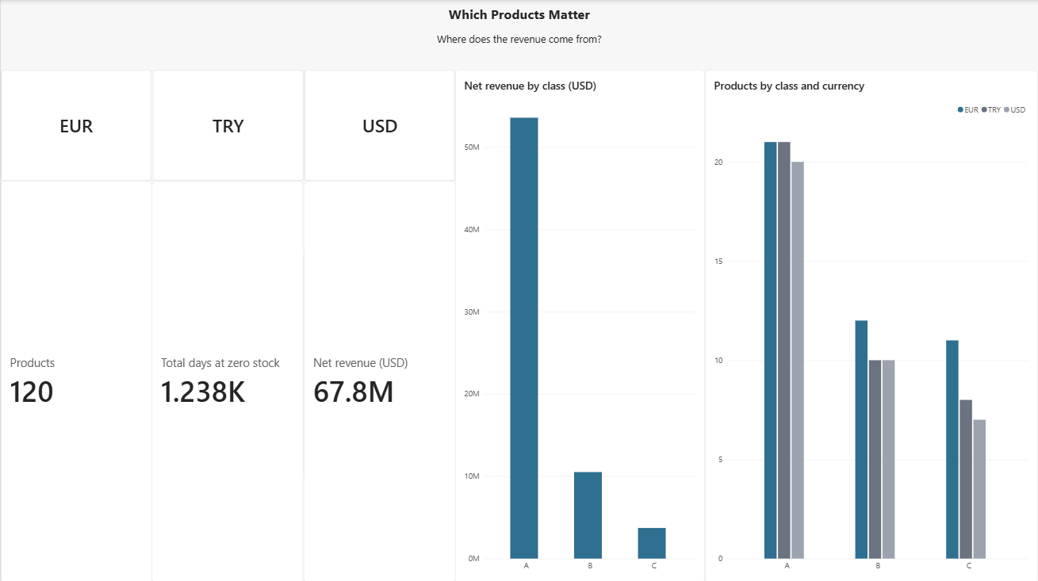
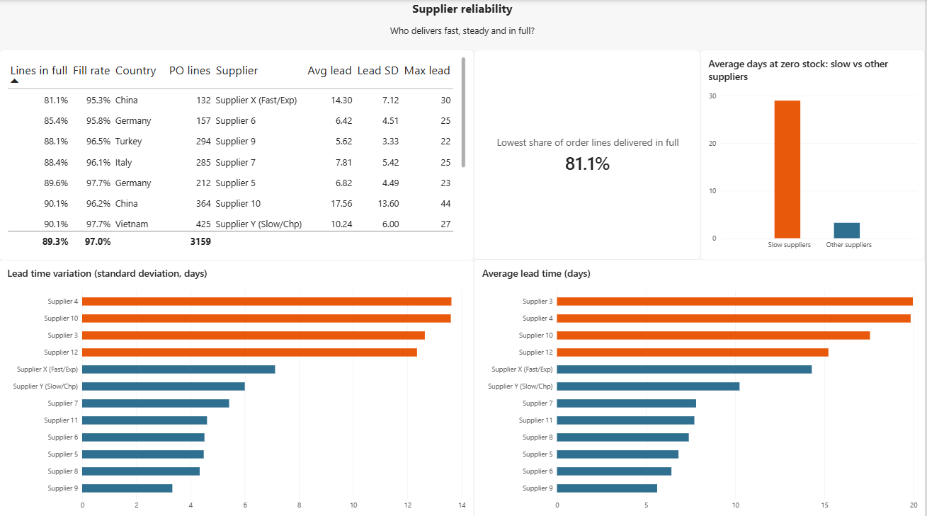
The dashboard
Three Power BI pages answer three questions. The report file is in the repository.
Notes:
Pages: which products matter, supplier reliability, reorder points vs stockouts. Show the live report if asked.

Slide 10
Limits and next steps
Read the results as a worked method, not as facts about a real company. It applies to any business that holds stock.
Limits
Next steps
Synthetic data
One fixed exchange rate per currency
Formula assumes bell-shaped lead times; late deliveries have a long tail
Stockouts are linked to suppliers, not proven caused by them
Estimate the holding cost of the extra stock
Check lead times by quarter for every supplier
Repeat on a real, messier dataset
Reuse it where there are sales, lead times and stock levels
Notes:
Own the limitations first; interviewers respect it.

