Slide 1
TypeScript

Slide 2
TypeScript
Typescript is a typed superset of JavaScript.
It is an open-source and object-oriented programming language that supports classes, interfaces, inheritance, modules, etc., developed by Microsoft.
It can be used to manipulate the DOM for adding or removing elements, similar to JavaScript.
It is portable across browsers, devices, and operating systems.
It supports strong typing or static typing, unlike JavaScript.
TypeScript files are saved with a .ts extension and then compiled into JavaScript using the TypeScript compiler.
TypeScript gets compiled to JavaScript, which can run on any JavaScript runtime environment.(Eg: Node.js)

Slide 3
Setting up Typescript
You can install Typescript using NPM (Node Package Manager) or the TypeScript Visual Studio Plugin.
After installing NPM, run the npm install -g typescript command to install TypeScript.
To check the version, run the tsc -v command in the terminal.
To compile the TypeScript code, run the tsc command, followed by the name of the file you are compiling.
For example, tsc hello.ts.
After compilation, typescript compiler creates a javascript file with the same name (hello.js).
Run the javascript file using node hello.js command in the terminal.

Slide 4
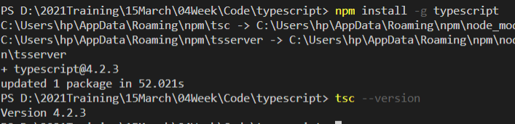
Setting up Typescript

Slide 5


Typescript – Hello World
Open VSCode and create a file named HelloWorld.ts
Compile the code by using tsc HelloWorld.ts
Run the code by using node HelloWorld.js

Slide 6

Variable declaration in TypeScript
TypeScript variables also follow JavaScript variable naming conventions.
Similar to JavaScript, we use var, let, and const keywords to declare variables.
Since TypeScript is a strongly typed programing language, we specify the type when we declare a variable.
The Syntax for declaring a variable in TypeScript –
let [identifier] : [type] = value; .

Slide 7
Datatypes in TypeScript
Boolean
The boolean type is to represent a true or false value.
let isEmpty: boolean = true;
Number
TypeScript uses the number type to store decimal, hexademial, binary and octal literals in a variable.
let a: number = 6;
let b: number = 0xf00d; //hexadecimal
let c: number = 0b1010; //binary
let d: number = 0o744; //octal

Slide 8
Datatypes in TypeScript
String
TypeScript uses a string type that represents text characters enclosed within double quotes (") or single quotes (').
let color: string = "yellow";
color = 'blue';
We can also use template strings, which can span multiple lines and have embedded expressions.
let fullName: string = 'Bob Bobbington';
let age: number = 37;
let sentence: string = `Hello, my name is ${ fullName }. I'm ${ age } years old.`;

Slide 9
Datatypes in TypeScript
Undefined and Null
In TypeScript, both undefined and null have their own types named undefined and null respectively.
By default, null and undefined are subtypes of all other types.
So we can assign null and undefined to number, string, etc.
let u: undefined = undefined;
let n: null = null;
Any
We may need to describe a type of a variable that we do not know when we are writing an application.
In this case, we can label the variable with the any type.
let variable: any = 14;
variable = "maybe a string instead";
variable = false;

Slide 10
Datatypes in TypeScript
void
In TypeScript, the void type is used as the return type of functions that do not return a value.
function sayHello(): void {
console.log("Hello!!!");
}
Declaring variables of type void is not useful, because we can then only assign null or undefined values to them.

Slide 11
Datatypes in TypeScript
Arrays
Like in JavaScript, TypeScript allows you to work with arrays of values.
We can use the type of the elements followed by [] or use a generic array type Array<elemType> for declaring the array type.
let list: number[] = [1, 2, 3];
let list: Array<number> = [1, 2, 3];
let list: any[] = [1, "two", 3];

Slide 12
Datatypes in TypeScript
Tuples
TypeScript introduced a new type called Tuple, which is an array with a fixed number of elements whose types are known.
var employee: [number, string] = [1, "John"];
//Accessing Tuple
employee[0]; // returns 1
employee[1]; // returns "John"
var person: [number, string, boolean] = [1, "Steve", true];
// tuple array
var employee: [number, string][];
employee = [[1, "John"], [2, "Adam"], [3, "Jeff"]];

Slide 13
Datatypes in TypeScript
Enum
TypeScript supports the enum type that allows us to declare a set of named constants.
It is a collection of related values that can be numeric or string values.
enum Color {Red, Green, Blue}
let c: Color = Color.Green;
enum Color {Red = 1, Green, Blue}
let colorName: string = Color[2];
console.log(colorName); // Displays 'Green' as its value is 2 above

Slide 14
Datatypes in TypeScript
Never
The never type represents a type of values that never occur.
For instance, never is the return type for a function that always throws an exception or one that never returns.
// Function returning never must have unreachable end point
function error(message: string): never {
throw new Error(message);
}

Slide 15
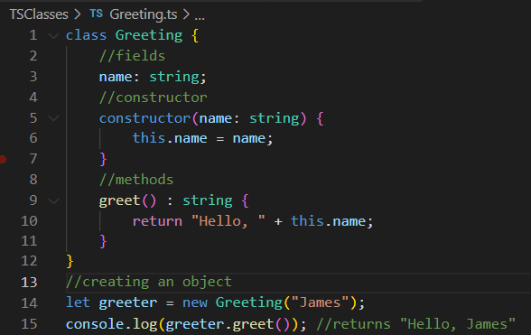
Classes in TypeScript
We know that TypeScript is an object-oriented programming language.
The class keyword is used to declare a class in TypeScript.
An instance of the class can be created using the new keyword.

Slide 16
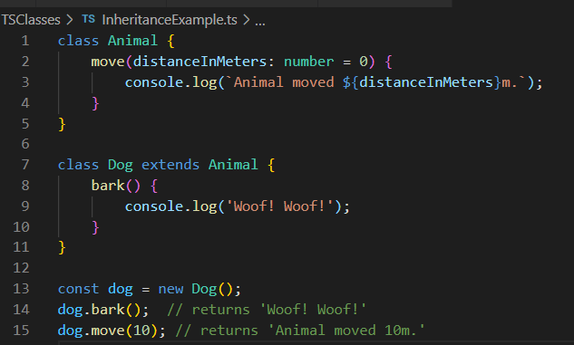
Inheritance
In TypeScript, we can implement an inheritance hierarchy using the extends keyword, similar to other object-oriented programming languages.

Slide 17
Access Modifiers
public - In TypeScript, each member is public by default. We can still mark a member public explicitly.
private - We can mark a member as private that cannot be visible outside of the class.
protected - If a member marked as protected, then the member can be accessed only by its containing class and deriving classes.

Slide 18
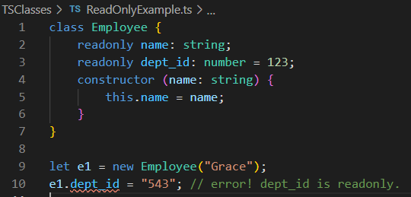
Readonly modifier
We can make properties accessible but immutable by using the readonly keyword.
Readonly properties must be initialized at their declaration or in the constructor.

Slide 19
Modules
In TypeScript, the code we write is globally scoped by default.
TypeScript provides modules and namespaces to restrict scopes and also to organize and maintain a large codebase.
All variables, classes, and functions declared in a module are not accessible outside the module.
A module is created using the export keyword and used in another module using the import keyword.

Slide 20
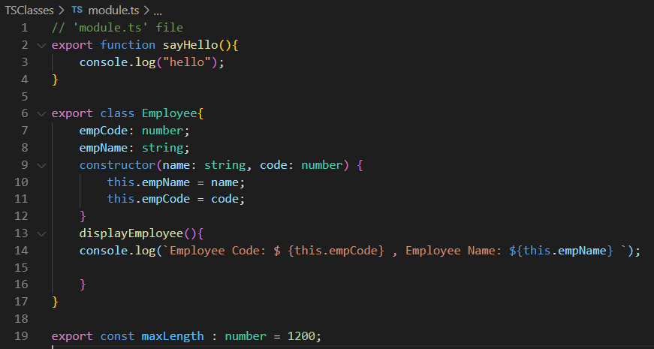
Modules
To export a class, function or variable, add the export keyword at the beginning.

Slide 21
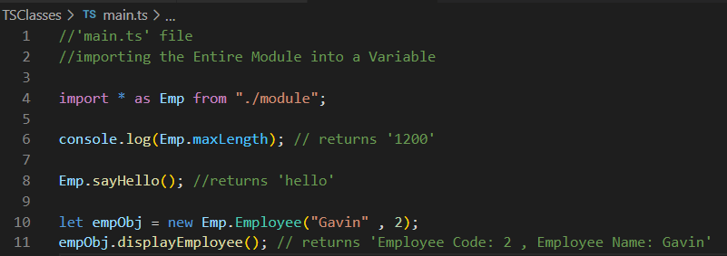
Modules
The syntax for importing a module:
import { export name } from "file path without extension";.
For example , import { Employee } from "./module";

Slide 22
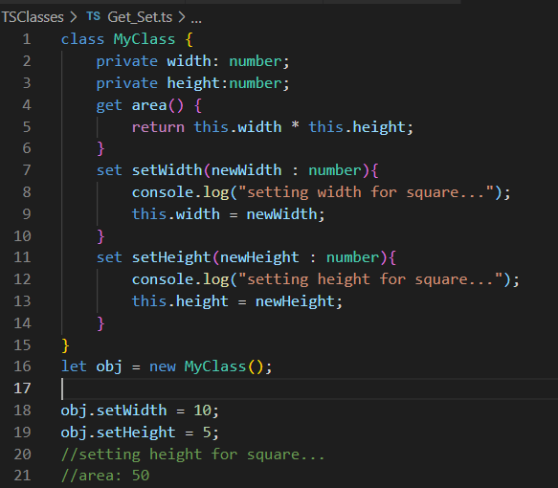
Accessors and Mutators
TypeScript supports getter and setter methods to access and set class members.
The getter and setter methods are created using the get and set keywords

Slide 23

Decorators
A Decorator is a special kind of declaration attached to a class declaration, method, accessor, property, or parameter.
Decorators are defined in the @expression format, where expression evaluates a function that called at runtime.
For the decorator @frozen, we write the frozen function as follows:

Slide 24
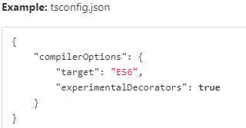
Decorators
In TypeScript, we need to enable experimental support for decorators.
In the tsconfig.json file, we set the experimentalDecorators compiler option property to true, in order to use decorators in our code.
Note: By running tsc --init command, the Typescript compiler automatically creates a tsconfig.json file in our working directory.

Slide 25
Types of Decorators
There are 4 different types of decorators:
Class decorators
Method decorators
Property decorators
Parameter decorators

Slide 26
Interfaces
Interfaces allow us to create contracts that other classes/ objects can implement.
Interfaces are defined using the interface keyword that includes properties and methods.
We can have optional properties, marked with a "?" that do not have to be implemented.
The TypeScript compiler does not convert the interface to JavaScript.
Instead they are only used for type checking.

Slide 27
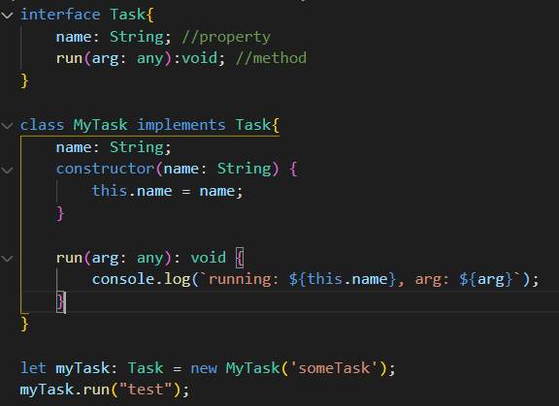
Interfaces

