Slide 1
Pipes & Filtering

Slide 2
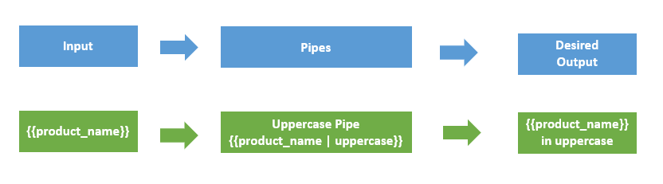
Pipes
Pipes provide a way to transform values in an Angular template.
Pipes are used with a Pipe (|) character, and take integers, strings, arrays, and date as input and returns a desired formatted output which can be displayed in the browser.
Syntax: {{title | uppercase}}

Slide 3
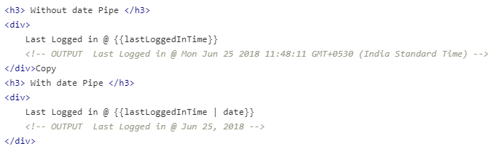
Pipes
Pipes can be easily used in HTML templates

Slide 4

Parameterizing a pipe
Pipes accept the any number of optional parameters to fine-tune their output.
To add parameters to a pipe, follow the pipe name with a colon ( : ) and then the parameter value.

Slide 5

Chaining pipes
We can chain pipe together in effective combinations.

Slide 6
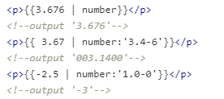
Built-in pipes
Date pipe - Used for formatting dates.
Decimal pipe - Used for formatting numbers.
The syntax for Decimal Pipe:
{{ value_expression | number : digitInfo }} where, digitInfo is optional.
The represntaion of digitInfo: {minIntegerDigits}.{minFractionDigits}-{maxFractionDigits}.
Where,
minIntegerDigits - minimum integers before the decimal point (default is 1).
minFractionDigits - minimum digits after the decimal point (default is 0).
maxFractionDigits - maximum after the decimal point (default is 3).
If minFractionDigits and maxFractionDigits value is 0, then the number is rounded off to nearest value.

Slide 7
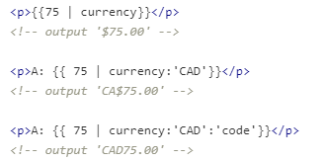
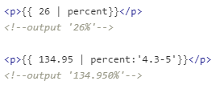
Built-in pipes
Currency pipe - Used for formatting currencies
Percent pipe - Used for formatting percentage values.

Slide 8
Built-in pipes
Slice pipe - Used for Slicing strings
Lowercase pipe - Used for converting strings into lowercase.
Uppercase pipe - Used for converting strings into uppercase
Titlecase pipe - Used for converting strings into title case

Slide 9
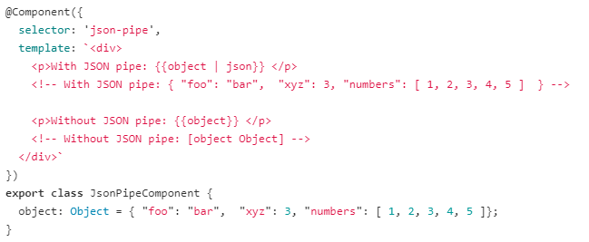
Built-in pipes
Json pipe - Used for Converting values into a JSON-format representation.

Slide 10
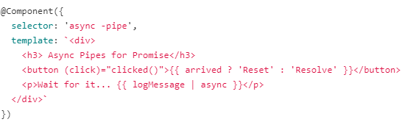
Async Pipe
Used for unwrapping values from an asynchronous primitive.
The async pipe subscribes to an Observable or Promise and returns the latest value it has emitted.
Example: Here, we bind the Promise with the template. Clicking the Resolve button resolves the promise.

Slide 11
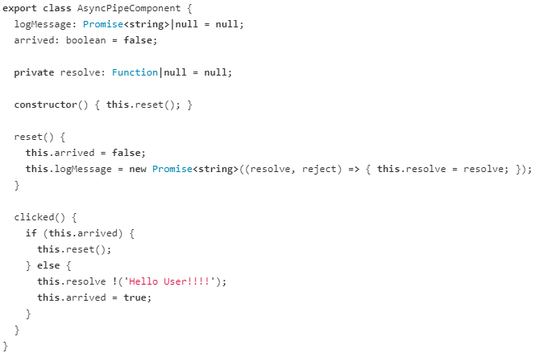
Async Pipe

Slide 12
Custom Pipes
We can create custom pipes using the
ng g pipe <pipe-name>
command in the terminal with the Angular CLI.
we create a custom pipe to count words by running the ng g pipe wordcount command in the terminal.
The CLI creates 2 files –
wordcount.pipe.spec.ts
wordcount.pipe.ts

Slide 13
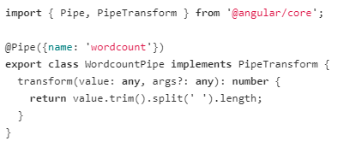
Custom Pipes
We import the @Pipe decorator from the core Angular library. If the Class is decorated with the @Pipe decorator, Angular knows that class is a pipe.
In the @Pipe decorator, we define the pipe name that used within template expressions.
The pipe class implements the PipeTransform interface to perform a transformation.
There is a transform method that accepts an input value followed by optional parameters and returns the transformed value.

