Slide 1
Angular Forms

Slide 2
Angular Forms
The Angular forms are used to collect the data from the user.
The data entry forms can be very simple to very complex.
It can contain large number of input fields, Spanning multiple tabs.
Forms may also contain complex validation logic interdependent on multiple fields.
Some things forms are expected to do
Initialize the forms fields and present it to the user
Capture the data from the user
Track changes made to the fields
Validate the inputs
Display helpful errors to the user

Slide 3
Angular Forms Module
Angular forms module provides all the above services out of the box.
It binds the form field to the Angular component class.
It tracks changes made to the form fields so that we can respond accordingly.
The Angular forms provide the built-in validators to validate the inputs.
It encapsulates all the input fields into an object structure when the user submits the form.

Slide 4
Angular Forms
Angular takes two approaches to build the forms.
Template-driven forms
Reactive forms or model-driven forms

Slide 5
Template-driven forms
In Template-driven approach is the easiest way to build the Angular forms.
The logic of the form is placed in the template.

Slide 6
Model-driven forms
In Reactive Forms or Model-driven approach, the logic of the form is defined in the component as an object.
The Model-driven approach has more benefits as it makes the testing of the component easier.

Slide 7
Building Blocks of Angular Forms
The Angular Forms module consists of three Building blocks, irrespective of whether you are using Template-driven or Reactive forms approach.
FormControl
FormGroup
FormArray

Slide 8

FormControl
A FormControl represents a single input field in an Angular form.
The FormControl is an object that encapsulates all information related to the single input element.
It Tracks the value and validation status of each of these control
The FormControl is just a class.
A FormControl is created for each form field.
We can refer them in our component class and inspect its properties and methods

Slide 9
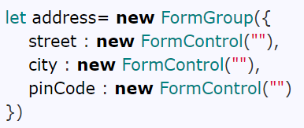
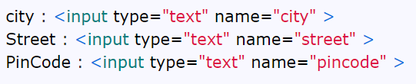
FormGroup
FormGroup is a collection of FormControls .
Each FormControl is a property in a FormGroup with the control name as the key.
Often forms have more than one field.
It is helpful to have a simple way to manage the Form controls together.

Slide 10
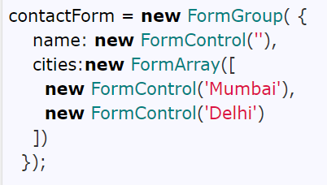
FormArray
FormArray is an array of form controls.
It is similar to FormGroup except for one difference.
In FormGroup each FormControl is a property with the control name as the key.
In FormArray is an array of form controls.

Slide 11
Angular Template-driven Forms

Slide 12
Angular Template-driven forms
Angular Template-driven Forms is one of the two ways of building forms in Angular.

Slide 13
What is Template-driven form
In Template Driven Forms we specify behaviors/validations using directives and attributes in our template and let it work behind the scenes.
All things happen in Templates hence very little code is required in the component class.
This is different from the reactive forms, where we define the logic and controls in the component class.

Slide 14
What is Template-driven form
The Template-driven forms
The form is set up using ngForm directive
controls are set up using the ngModel directive
ngModel also provides the two-way data binding
The Validations are configured in the template via directives
Template-driven forms are
Contains little code in the component class
Easier to set up
While they are
Difficult to add controls dynamically
Unit testing is a challenge

Slide 15
ngForm
The ngForm directive is what makes the Angular template-driven forms work.
The ngForm does the following
Binds itself to the <Form> directive
Creates a top-level FormGroup instance
Creates FormControl instance for each of child control, which has ngModel directive.
Creates FormGroup instance for each of the NgModelGroup directive.

Slide 16
Angular Reactive Forms

Slide 17
What are Reactive Forms
Reactive forms are forms where we define the structure of the form in the component class. I,e we create the form model with Form Groups, Form Controls, and Form Arrays.
How to use Reactive Forms
Import ReactiveFormsModule
Create Form Model in component class using Form Group, Form Control & Form Arrays
Create the HTML Form resembling the Form Model.
Bind the HTML Form to the Form Model

