Slide 1
Services and Dependency Injection

Slide 2
Services
Services are used to organize and share business logic, models, data, or functions with different components of an Angular application.
An Angular service is a singleton instance that can be injected into multiple components, where the component utilizes the functions defined in a service class.
This allows us to reuse the code.

Slide 3
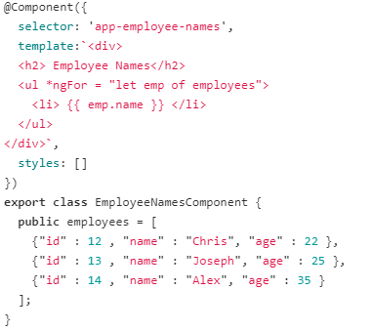
Services
consider an EmployeeNames component that displays the employee names.
Here we declare the employees object array in the class and display the name in the template.

Slide 4
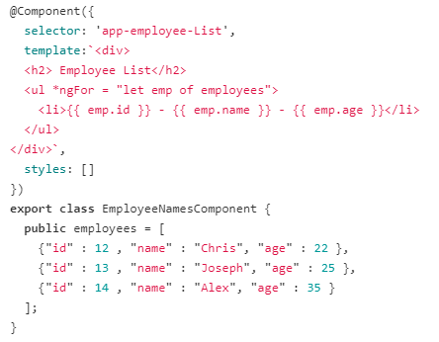
Services
if we need another component to display the employee list with id, name and age.
To do so, we create an EmployeeList component and in that component also, we'll have the employees object array to display each employee's id, name and age.

Slide 5
Services
Here, we are repeating the same employees object code in the two components.
Also, the component is only responsible for controlling the view's logic, but in our case, it is also responsible for creating data employees object.
So, components can delegate these tasks to services.
A service is a class that is used to share data across the multiple components, to implement the application logic, and for external communication.

Slide 6
Services
In Angular, we have a file with *.service.ts extension where we define the service class.
In that class, we can have a employees object code, which later can be injected into the components.
We use a Dependency Injection framework to inject the service into components in our application.

Slide 7
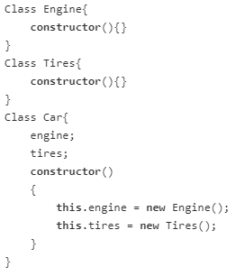
Dependency Injection (DI)
DI as a design pattern –
Consider, we have three classes Engine, Tires, and Car.
Let's assume, we need an Engine instance and a Tires instance to create a Car instance.
So, the Car class has two dependencies - Engine and Tires.

Slide 8
Dependency Injection (DI)
The Engine and Tires are tightly coupled to the Car.
For instance, Whenever we change the Engine and Tires class definition, then we need to manually change the Car Class definition.
This problem can be solved by using the Dependency Injection design pattern.
Have a look at this code making use of the Dependency Injection design pattern.
Instead of creating an instance of the Engine and Tires classes inside the Car constructor, we assign references to passed-in Engine and Tires objects.

Slide 9
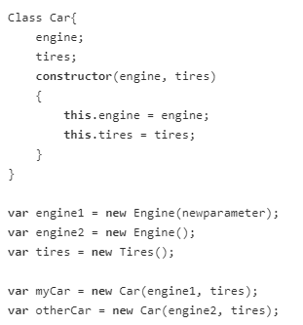
Dependency Injection (DI)

Slide 10
Dependency Injection (DI)
Dependency Injection allows the class to receive its dependencies from external sources rather than creating them itself.
With DI, we create a Car instance by passing the dependencies as parameters.
Here the Car has only 2 dependencies (Engine and Tires), but what if the Car 10 or 20 dependencies? Then, we would have to create an instance for each of those dependencies before passing them as parameters.
And if these dependencies in turn had dependencies on something else then we would have to create those dependencies.
As the number of dependencies grows, it rapidly becomes difficult to manage the code.

Slide 11
Dependency Injection (DI)
To overcome this, we use Dependency Injection as a Framework in Angular.
A DI framework uses an Injector where we register all those dependencies to be managed.
If we need a Car instance, the injector will provide the Car instance.
The injector is responsible for creating service instances and injecting them into components.
In Angular, dependencies are typically services.

Slide 12
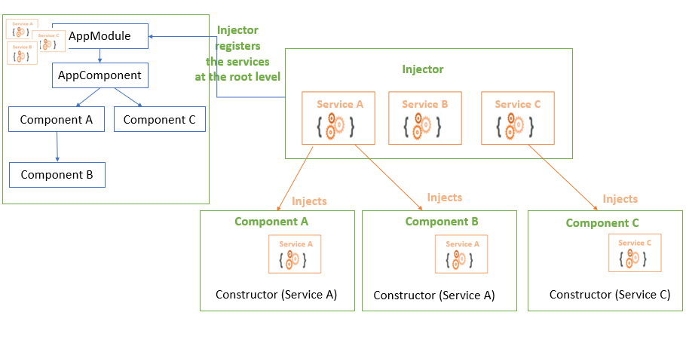
Using a Service

Slide 13
Using a Service
The Injector holds all the services, and registers them at the NgModule or component level based on their provider.
A provider tells where in our application to register the service. The registered service can be accessed using a DI token.
A DI token is a lookup key for the registered services.
The @Injectable() decorator marks a class as a service class that can be injected.
The @Injectable() decorator has a providedIn property where we specify the provider of the decorated service class with the 'root' as a default, or any other module of our application.

Slide 14
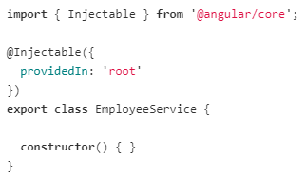
Creating Service
Run the ng g s employee command in the CLI, which creates employee.service.ts file and employee.service.spec.ts file

Slide 15
Creating Service
An injector provides a singleton instance of a service, and can inject this same instance into multiple components.
A hierarchy of injectors at the NgModule and component level can provide different instances of a services to their own components and child components.
We can configure injectors with different providers that can provide different implementations of the same services.

Slide 16
Creating Service
If we register the service in the EmployeeListComponent, then the service can be used by EmployeeListComponent and its child components.
Other components in our application, can't use this service. If we register the service in the AppModule, then the service can be used by all the components in our application.
To register the service, we use providedIn property in the @Injectable() decorator.
By default, AngularCLI sets the providedIn to 'root' registers the service at the module level

Slide 17
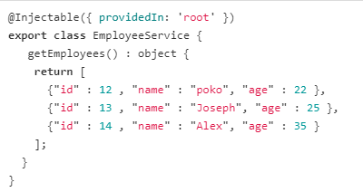
employee.service.ts
Here we return the employee object array in the getEmployees().
After injecting this service into the EmployeeListComponent and EmployeeNamesComponent, both can call the getEmployees() method which returns employee object array

Slide 18
Creating Service
When we create an instance of EmployeeService class,
Angular injects the EmployeeService into that commponent. Here, _employeeService is used as a lookup key for the EmployeeService.
In the EmployeeNamesComponent, we return the employee object array by calling _employeeService.getEmployees() method definied inside the EmployeeService.
Similarly we can access the employee object array in the EmployeeListsComponent.
By doing so, EmployeeNamesComponent and EmployeeListsComponent controls only the view logic.

Slide 19
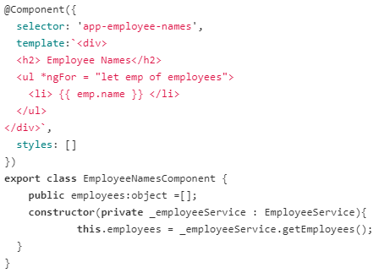
Using Service

