Slide 1
Observables Promise RxJS

Slide 2
Observables
Observables provide support for passing messages between parts of your application.
We can use observables for event handling, asynchronous programming, and handling multiple values.
The observer pattern is similar to the publish/subscribe design pattern.
Observables define a function for publishing values, but it is not executed until a consumer subscribes to it.
The subscribed consumer then receives notifications until the function completes, or until they unsubscribe.

Slide 3
Observables
An observable can deliver multiple values of any type (literals, messages, or events).
The API for receiving values is the same whether the values are delivered synchronously or asynchronously, and the setup and the logic are both handled by the observable.
We'll only concentrate on subscribing to consume values, and when done, unsubscribing.
The observer subscribes to the observable to receive the value.
To execute the observable, we have created and begin receiving notifications, we call its subscribe() method, passing an observer.
The unsubscribe() method is called to stop receiving notifications.

Slide 4
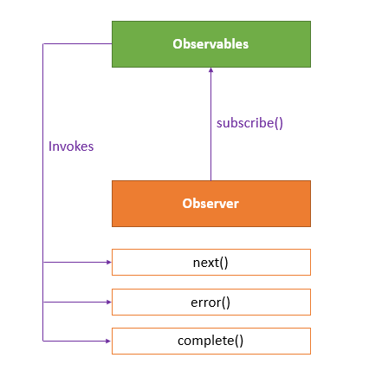
Observables

Slide 5
Observables
The observer defines three callback methods – next(), error(), and complete().
The observable invokes the next() callback whenever the value arrives in the stream.
It passes the value as the argument to the next callback.
If the error occurs, then the error() callback is invoked.
It invokes the complete() callback when the stream completes.

Slide 6
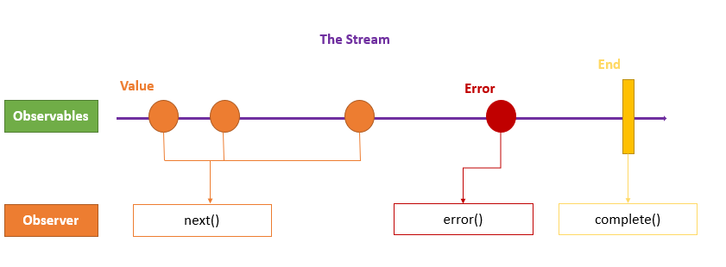
Observables

Slide 7
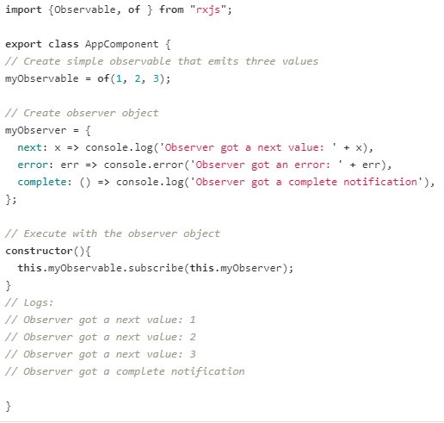
Observables
The of(...items)returns an Observable instance that synchronously delivers the values provided as arguments

Slide 8
Promises vs Observables
In Angular, we can use either Promises or Observables for handling asynchronous data.
The difference is - a Promise emits a single value while Observable can emit multiple values.
So, while handling a HTTP request, a Promise can manage a single response for the same request, but if there are multiple responses to the same request, then we have to use an Observable.

Slide 9
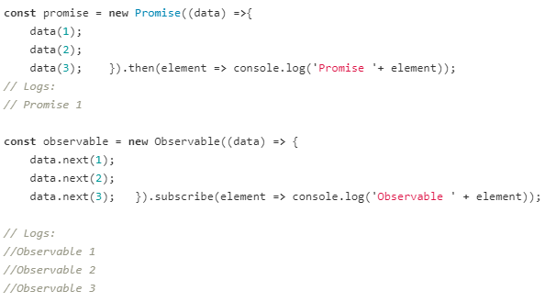
Promises vs Observables

Slide 10
RxJS - Subjects
Reactive Extensions for JavaScript(RxJS) is a framework for reactive programming using observables that makes it easier to write asynchronous code.
An RxJS Subject is a special type of Observable that allows values to be multicasted to many Observers.
By default an RxJS Observable is unicast, i.e. each subscribed observer has an independent execution of the Observable, whereas multicast means that the Observable execution is shared by multiple Observers.

Slide 11
RxJS - Subjects
Every Subject is an Observer.
It is an object with the methods next(v), error(e), and complete().
To feed a new value to the Subject, just call next(theValue), and it will be multicast to the Observers registered to listen to the Subject.
We subscribe to the Subject to recieve values normally.

Slide 12
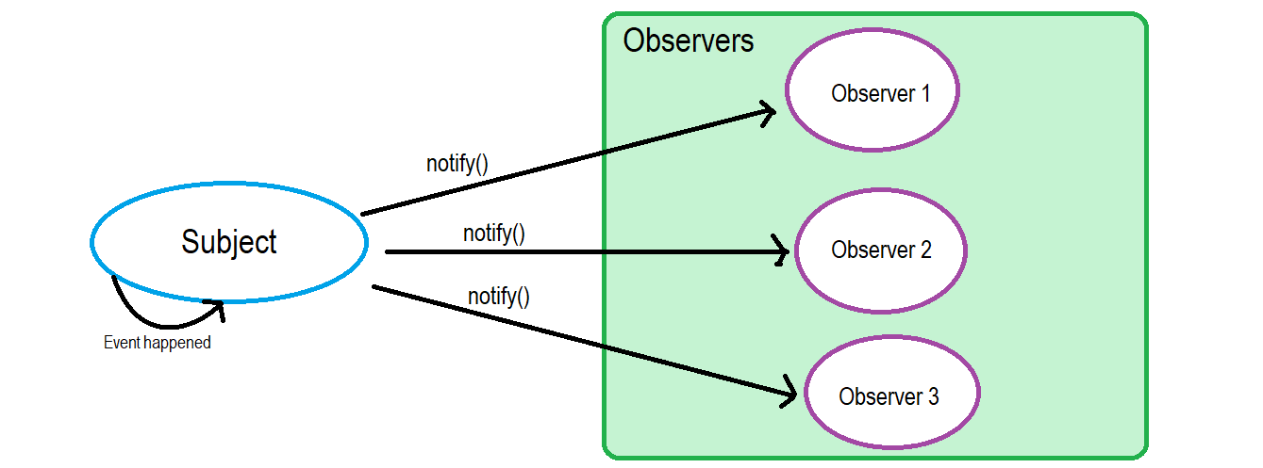
RxJS - Subjects

Slide 13
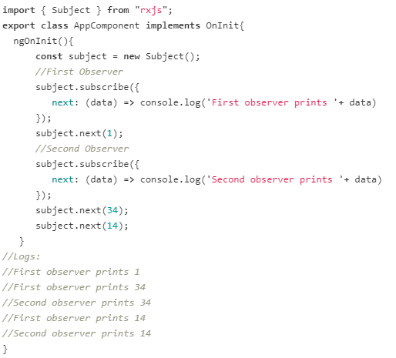
RxJS - Subjects
In this example, we have two observers for the subject that returns data values.
If we notice, the second observer did not receive the very first next value because the subject simultaneously holds and efficiently distributes the values according to scope and definition.

Slide 14
Subject Variants
There are 3 subject variants:
Behavior subject
It used to temporarily store the current data value of any observer declared before it
Replay subject
Replay Subject provides a option to choose how many values we want to emit from the last observer. This subject stores and then passes the last specified option values to the new observer.
Async subject
A Async Subject emits the last value to observers when the sequence is completed.

Slide 15
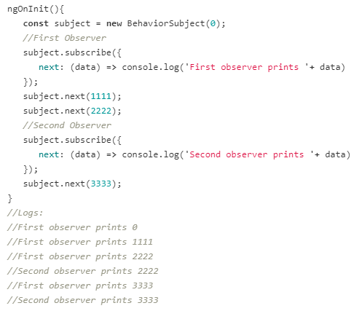
Behavior subject
Here, subject stores last data value '2222' and then reports by the new observer even though it was defined after the reference to it.
Also, the new constructor takes an initial value.

Slide 16
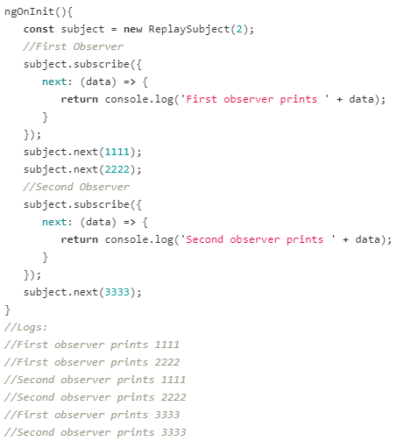
Replay subject
Here, subject stores last 2 data values ('1111' & '2222') and then reports them to the new observer.

Slide 17
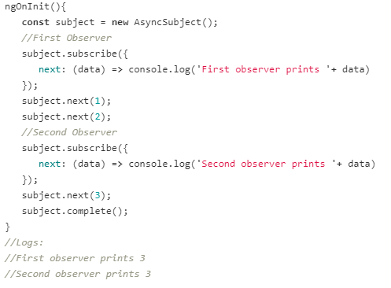
Async subject
Here, we execute the subject only after a complete method is called.

