Slide 1
Publisher/Subscriber Design Pattern

Slide 2
Publisher/Subscriber Design Pattern
The Publisher/Subscriber design pattern describes the flow of messages between applications, devices, or services.
A message is published by Publishers to a Channel, that will be consumed by all Subscribers monitoring that channel.
When the Publisher pushes messages to a channel (live-feed data streams), the subscribers who subscribed to this channel are immediately notified.
Any publisher may also be a subscriber.
Messages can be text, sensor data, audio, video, or other digital content.

Slide 3
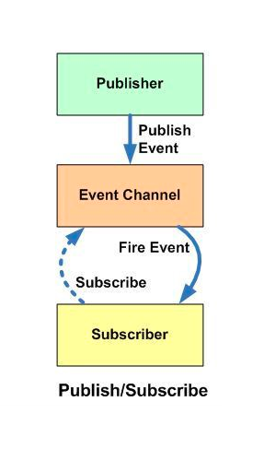
Publisher/Subscriber Design Pattern
The Pub-Sub pattern is usually implemented in an asynchronous way.
In the Observer pattern the observers are aware of the observable, but in Pub-Sub pattern, publishers and subscribers don’t need to know each other.
They simply communicate with the help of message queues.

Slide 4
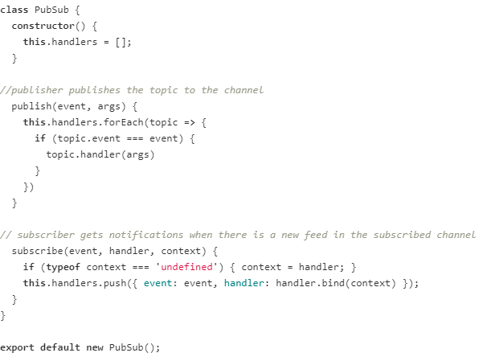
Example - Pub-Sub pattern

