Slide 1
Node.js
Node.js is an open-source, cross-platform run-time environment built on Chrome's V8 JavaScript engine.
Node.js is used to execute JavaScript code outside of a web browser.
It provides a library of various JavaScript modules, which simplifies the development of web applications.
Global companies like Netflix, Facebook, Walmart Linkedin, Uber, etc., use Node.js for building their applications.
It has helped companies create various applications like social media apps, video and text chat engines, real-time tracking apps, online games, and collaboration tools.

Slide 2
npm - Node Package Manager
npm is a package manager for the JavaScript programming language.
It is the default package manager for the JavaScript runtime environment -Node.js.
npm consists of three components –
The website - The website discovers packages, set up profiles, and manage access to public or private packages.
The Command Line Interface (CLI) - The CLI runs from a terminal and allow us to interact with npm.
The registry - The registry is a public database of JavaScript packages comprised of software and metadata.

Slide 3
Why we need Node.js for
We use Node.js and npm as tools for building Angular or React apps.
Angular is a front-end framework used to create a web application and is written in Typescript.
The browser only understands JavaScript code, so we need to compile Typescript (.ts file) to plain JavaScript (.js file).
We use Node.js and npm to perform this compilation, then we can deploy them in production.

Slide 4
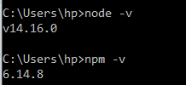
Installation of Node and npm
We need to add Node.js and an npm package manager to our development environment.
Download Node.js from nodejs.org and install it.
To check the version, run node -v in a terminal.
The npm CLI gets installed with Node.js by default.
To check that you have installed npm, run npm -v in a terminal. npm can install packages in a node_modules folder in our working directory.

Slide 5
package.json file
All npm packages contain a file, usually in the project root, called package.json.
This file is used to give information to npm that allows it to identify the project as well as handle the project's dependencies.
This file contains metadata relevant to the project, such as project description, the version of the project, license information, etc.,
Node.js generates a package.json file by running the npm init command in the terminal.
The generated package.json file contains a name, version, description, main (entry point), any scripts, the author, and license type of our project.

Slide 6
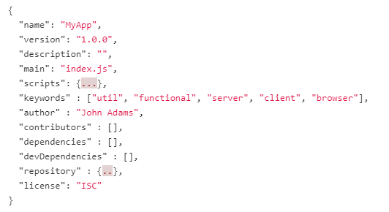
structure of package.json file

Slide 7
structure of package.json file
dependencies - The Dependencies section in the package.json file is essential for running applications.
It contains a list of packages or modules installed using npm that are required to run the project.
devDependencies - The DevDependencies section in the package.json file is used only for developing applications.
It contains a list of packages or modules that are required only for development.
These packages are installed only on the developer's machine and will not be run for a production build.

Slide 8
Webpack
In our web application, we use many javascript files that are added into the HTML pages via <script> tags.
For each user request, the browser loads these bunch of script files inside the HTML page.
This is inefficient as it reduces the page speed since the browser requests each script file separately.
This can be solved by bundling several files together into one file to be downloaded by the browser in one single request.
Module bundlers are used to bundle a group of JavaScript modules with their dependencies and merge them into a single file in the correct order, which can be executed by the browser.

Slide 9
Webpack
Webpack is a powerful static module bundler for JavaScript applications that packages all modules in our application into a bundle and serves it to the browser.
Webpack builds a dependency graph when it processes the application.
It starts from a list of modules defined in its config file (webpack.config.js) and recursively builds a dependency graph that includes every module our application needs, then packages all of those modules into a small bundle that can be loaded by the browser.

