Slide 1
TypeScript Introduction

Slide 2
TypeScript
Typescript is a typed superset of JavaScript.
It is an open-source and object-oriented programming language that supports classes, interfaces, inheritance, modules, etc., developed by Microsoft.
It can be used to manipulate the DOM for adding or removing elements, similar to JavaScript.
It is portable across browsers, devices, and operating systems.
It supports strong typing or static typing, unlike JavaScript.
TypeScript files are saved with a .ts extension and then compiled into JavaScript using the TypeScript compiler.
TypeScript gets compiled to JavaScript, which can run on any JavaScript runtime environment.(Eg: Node.js)

Slide 3
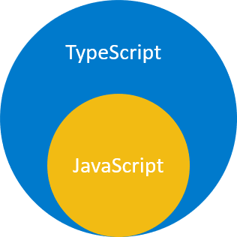
TypeScript
TypeScript uses the JavaScript syntaxes and adds additional syntaxes for supporting Types.
If you have a JavaScript program that doesn’t have any syntax errors, it is also a TypeScript program.
It means that all JavaScript programs are TypeScript programs.
This is very helpful if you’re migrating an existing JavaScript codebase to TypeScript.

Slide 4
Why TypeScript
The main goals of TypeScript are:
Introduce optional types to JavaScript.
Implement planned features of future JavaScript, a.k.a. ECMAScript Next or ES Next to the current JavaScript.

Slide 5
Setting up Typescript
You can install Typescript using NPM (Node Package Manager) or the TypeScript Visual Studio Plugin.
After installing NPM, run the npm install -g typescript command to install TypeScript.
To check the version, run the tsc -v command in the terminal.
To compile the TypeScript code, run the tsc command, followed by the name of the file you are compiling.
For example, tsc hello.ts.
After compilation, typescript compiler creates a javascript file with the same name (hello.js).
Run the javascript file using node hello.js command in the terminal.

Slide 6
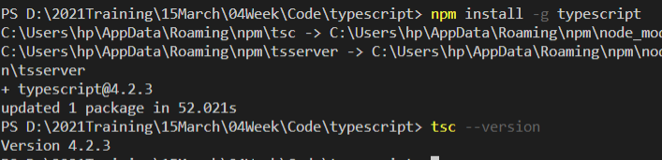
Setting up Typescript

Slide 7


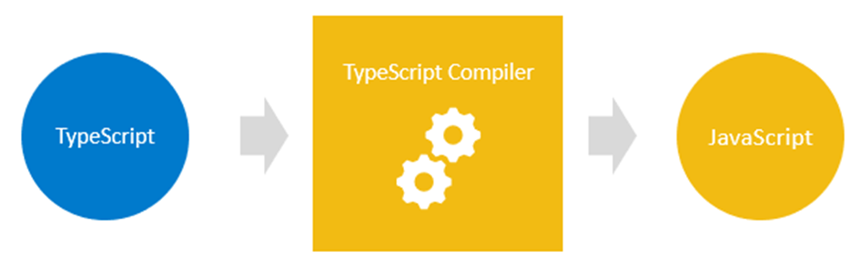
Typescript – Hello World
Open VSCode and create a file named HelloWorld.ts
Compile the code by using tsc HelloWorld.ts
Run the code by using node HelloWorld.js

Slide 8
Features of TypeScript:
TypeScript Code is converted into Plain JavaScript Code: TypeScript code can’t be natively interpreted by browsers. So if the code was written in TypeScript, it gets compiled and converted into JavaScript.
JavaScript is TypeScript: Whatever code is written in JavaScript can be converted to TypeScript.
Use TypeScript anywhere: TypeScript can be compiled to run on any browser, device, or operating system. TypeScript is not specific to any single environment.
TypeScript supports JS libraries: With TypeScript, developers can use already existing JavaScript code, incorporate popular JavaScript libraries, or call the TS Code from native JavaScript code.

Slide 9
TypeScript Vs JavaScript
TypeScript is known as an Object-oriented programming language whereas JavaScript is a prototype based language.
TypeScript has static typing, but JavaScript does not support this feature.
TypeScript supports Interfaces but JavaScript does not.

Slide 10
Why Should I Use Typescript
When you have a large codebase
When your team’s developers are already accustomed to statically-typed languages
If you or the majority of the team come from a strongly typed language like C# or Java, and don’t want to go all-in on JavaScript, TypeScript is a good alternative.

