Slide 1
TypeScript Types

Slide 2
TypeScript Types
In TypeScript, a type is a convenient way to refer to the different properties and functions that a value has.
A value is anything that you can assign to a variable e.g., a number, a string, an array, an object, and a function.
TypeScript inherits the built-in types from JavaScript. TypeScript types is categorized into:
Primitive types
Object types

Slide 3
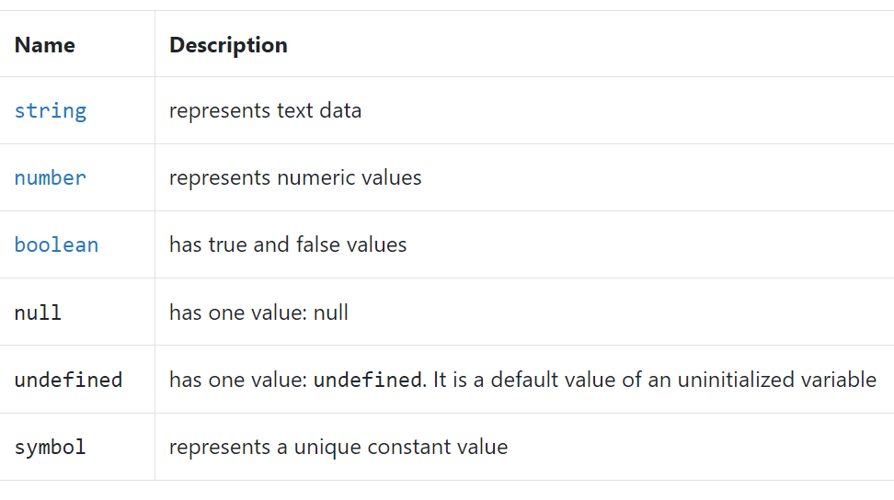
Primitive types

Slide 4
Simple and Special Types
Simple Types
boolean - true or false values
number - whole numbers and floating point values
string - text values like "TypeScript Rocks“
Special Types
any : any is a type that disables type checking and effectively allows all types to be used
unknown : unknown is a similar, but safer alternative to any
never : effectively throws an error whenever it is defined.
undefined & null : undefined and null are types that refer to the JavaScript primitives undefined and null respectively.

Slide 5
Object types
Object types are functions, arrays, classes, etc.

Slide 6
Purposes of types in TypeScript
There are two main purposes of types in TypeScript:
First, types are used by the TypeScript compiler to analyze your code for errors
Second, types allow you to understand what values are associated with variables.

Slide 7
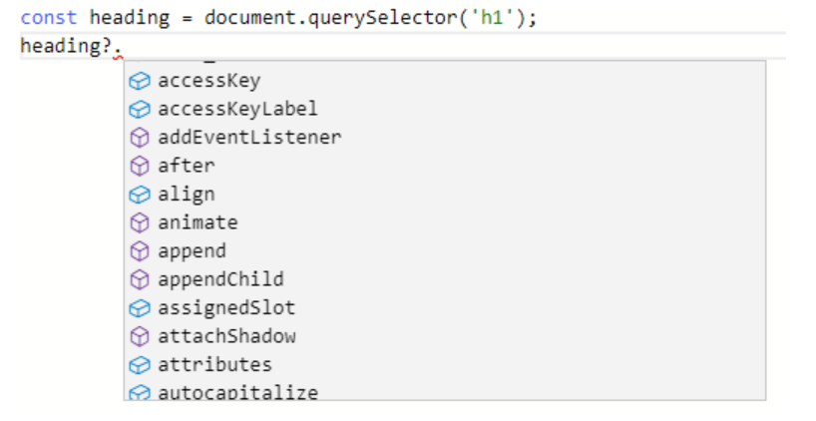

Examples of TypeScript types
The TypeScript compiler knows that the type of heading is HTMLHeadingElement
And it has a list of methods of the HTMLHeadingElement type that heading can access
If you try to access a property or method that doesn’t exist, the TypeScript compiler will show an error.

Slide 8
Type Annotations

Slide 9
What is Type Annotation in TypeScript
TypeScript uses type annotations to explicitly specify types for identifiers such variables, functions, objects, etc.
TypeScript uses the syntax : type after an identifier as the type annotation, where type can be any valid type.
Once an identifier is annotated with a type, it can be used as that type only. If the identifier is used as a different type, the TypeScript compiler will issue an error.

Slide 10
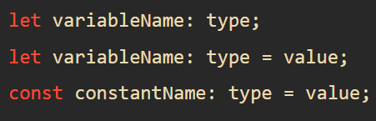



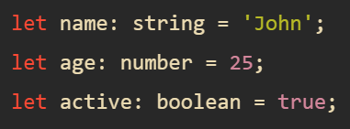
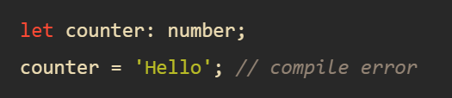
Type annotations in variables and constants
The type annotation comes after the variable or constant name and is preceded by a colon (:).

Slide 11

Arrays
To annotate an array type you use a specific type followed by a square bracket : type[] :

Slide 12
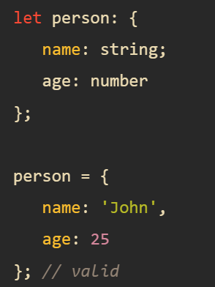
Objects
To specify a type for an object, you use the object type annotation. For example

Slide 13

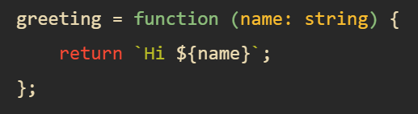
Function arguments & return types
The following shows a function annotation with parameter type annotation and return type annotation

Slide 14
TypeScript Type Inference
When you declare a variable, you can use a type annotation to explicitly specify a type for it. For example:
let counter: number;
However, if you initialize the counter variable to a number, TypeScript will infer the type the counter to be number. For example:
let counter = 0;
It is equivalent to the following statement:
let counter: number = 0;
Likewise, when you assign a function parameter a value, TypeScript infers the type of the parameter to the type of the default value. For example:
function setCounter(max=100) {
// ...
}

Slide 15
TypeScript Number
TypeScript uses the number type to store decimal, hexadecimal, binary and octal literals in a variable.
let a: number = 6;
let b: number = 0xf00d; //hexadecimal
let c: number = 0b1010; //binary
let d: number = 0o744; //octal
The big integers represent the whole numbers larger than 253 – 1.
A Big integer literal has the n character at the end of an integer literal
let big: bigint = 9007199254740991n;

Slide 16
TypeScript String
TypeScript uses a string type that represents text characters enclosed within double quotes (") or single quotes (').
let color: string = "yellow";
color = 'blue';
We can also use template strings, which can span multiple lines and have embedded expressions.
let fullName: string = 'Bob Bobbington';
let age: number = 37;
let sentence: string = `Hello, my name is ${ fullName }. I'm ${ age } years old.`;

Slide 17
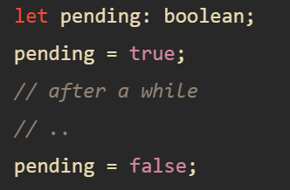
TypeScript Boolean
The TypeScript boolean type allows two values: true and false. It’s one of the primitive types in TypeScript.

Slide 18
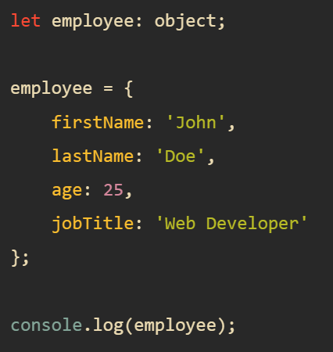
TypeScript object Type
The TypeScript object type represents all values that are not in primitive types.
The following are primitive types in TypeScript:
number
bigint
string
boolean
null
undefined
symbol

Slide 19
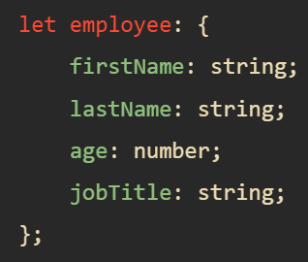
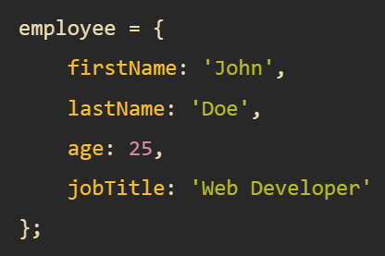
TypeScript object Type
To explicitly specify properties of the employee object, you first use the following syntax to declare the employee object
And then you assign the employee object to a literal object with the described properties

Slide 20
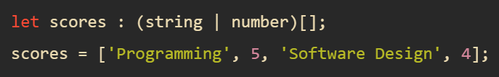
TypeScript Array Type
A TypeScript array is an ordered list of data. To declare an array that holds values of a specific type, you use the following syntax:
let arrayName: type[];
For example, the following declares an array of strings:
let skills: string[];
TypeScript arrays can access the properties and methods of a JavaScript.
Storing values of mixed types
The following illustrates how to declare an array that hold both strings and numbers:
let scores = ['Programming', 5, 'Software Design', 4];
In this case, TypeScript infers the scores array as an array of string | number.

Slide 21
TypeScript Tuple
A tuple works like an array with some additional considerations:
The number of elements in the tuple is fixed.
The types of elements are known and need not be the same.
For example, you can use a tuple to represent a value as a pair of a string and a number:
let skill: [string, number];
skill = ['Programming', 5];
The order of values in a tuple is important. If you change the order of values of the skill tuple to [5, "Programming"], you’ll get an error:
let skill: [string, number];
skill = [5, 'Programming'];
For this reason, it’s a good practice to use tuples with data that is related to each other in a specific order.

Slide 22
Optional Tuple Elements
Since TypeScript 3.0, a tuple can have optional elements specified using the question mark (?) postfix.
For example, you can define an RGBA tuple with the optional alpha channel value:
let bgColor, headerColor: [number, number, number, number?];
bgColor = [0, 255, 255, 0.5];
headerColor = [0, 255, 255];

Slide 23
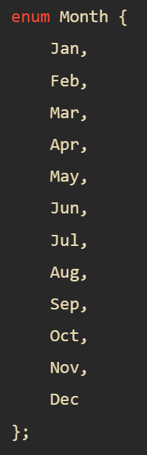
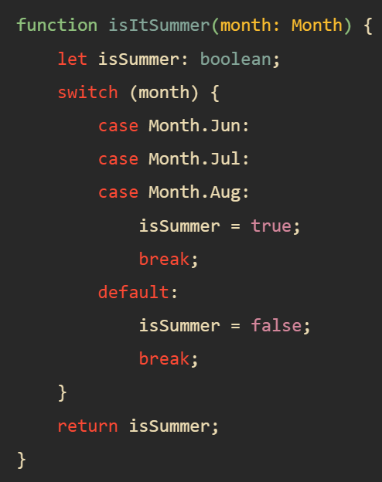
TypeScript Enum
An enum is a group of named constant values. Enum stands for enumerated type.
To define an enum, you follow these steps:
First, use the enum keyword followed by the name of the enum.
Then, define constant values for the enum.
The following shows the syntax for defining an enum:
enum name {constant1, constant2, ...};
In this syntax, the constant1, constant2, etc., are also known as the members of the enum.

Slide 24
TypeScript any Type
Sometimes, you may need to store a value in a variable. But you don’t know its type at the time of writing the program. And the unknown value may come from a third party API or user input.
In this case, you want to opt-out of the type checking and allow the value to pass through the compile-time check.
To do so, you use the any type. The any type allows you to assign a value of any type to a variable:
The any type provides you with a way to work with existing JavaScript codebase. It allows you to gradually opt-in and opt-out of type checking during compilation. Therefore, you can use the any type for migrating a JavaScript project over to TypeScript.

Slide 25
TypeScript any Type
If you declare a variable without specifying a type, TypeScript assumes that you use the any type.
This feature is called type inference. Basically, TypeScript guesses the type of the variable. For example:
let result;
In this example, TypeScript infers the type for you. This practice is called implicit typing.

Slide 26
TypeScript void Type
The void type denotes the absence of having any type at all. It is a little like the opposite of the any type.
Typically, you use the void type as the return type of functions that do not return a value. For example:
function log(message): void {
console.log(messsage);
}
It is a good practice to add the void type as the return type of a function or a method that doesn’t return any value. By doing this, you can gain the following benefits:
Improve clarity of the code: you do not have to read the whole function body to see if it returns anything.
Ensure type-safe: you will never assign the function with the void return type to a variable.

Slide 27
TypeScript never Type
The never type is a type that contains no values. Because of this, you cannot assign any value to a variable with a never type.
Typically, you use the never type to represent the return type of a function that always throws an error. For example:
function raiseError(message: string): never {
throw new Error(message);
}

Slide 28
TypeScript union Type
The union type allows you to combine multiple types into one type.
For example, the following variable is of type number or string:
let result: number | string;
result = 10; // OK
result = 'Hi'; // also OK
result = false; // a boolean value, not OK
A union type describes a value that can be one of several types, not just two.
For example number | string | boolean is the type of a value that can be a number, a string, or a boolean.
A TypeScript union type allows you to store a value of one or several types in a variable.

Slide 29
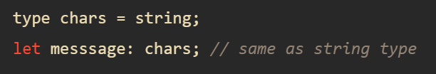
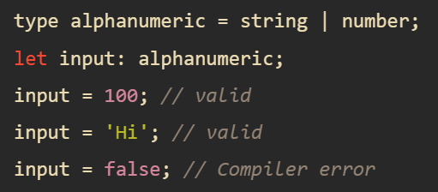
TypeScript Type Aliases
Type aliases allow you to create a new name for an existing type. The following shows the syntax of the type alias:
type alias = existingType;

Slide 30
TypeScript String Literal Types
The string literal types allow you to define a type that accepts only one specified string literal.
The following defines a string literal type that accepts a literal string 'click':
let click: 'click';
The click is a string literal type that accepts only the string literal 'click'. If you assign the literal string click to the click, it will be valid:
click = 'click'; // valid
However, when you assign another string literal to the click, the TypeScript compiler will issue an error. For example:
click = 'dblclick'; // compiler error

Slide 31
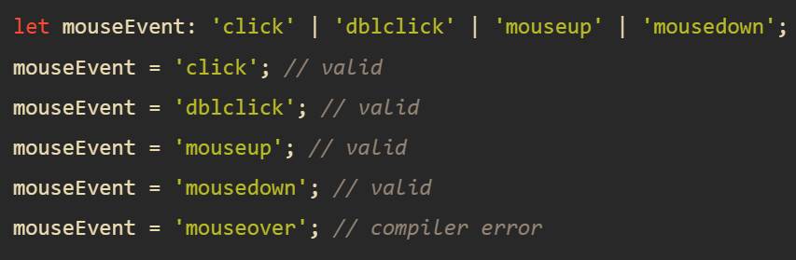
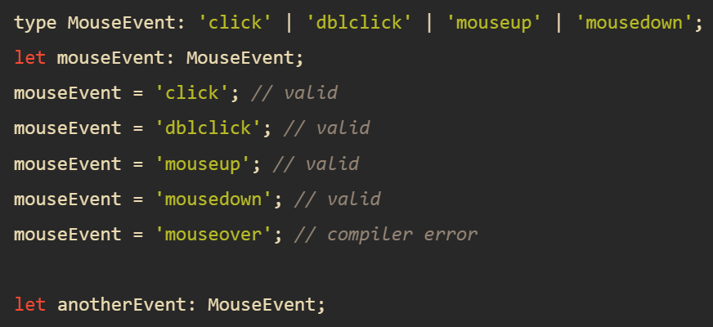
TypeScript String Literal Types
The string literal types can combine nicely with the union types to define a finite set of string literal values for a variable
If you use the string literal types in multiple places, they will be very verbose.
To avoid this, you can use the type aliases.

