Slide 1
CONTROL FLOW STATEMENTS

Slide 2
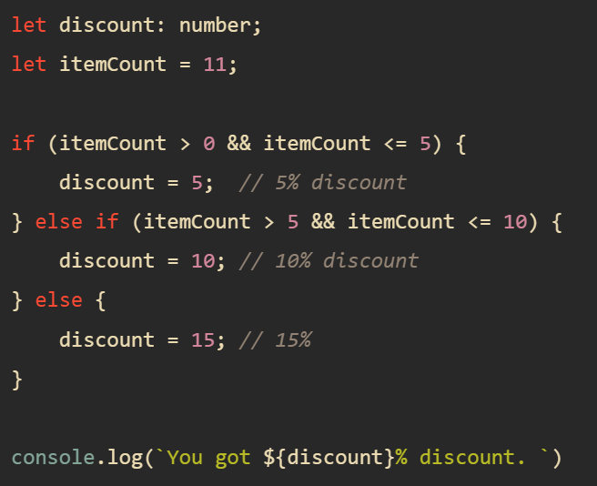
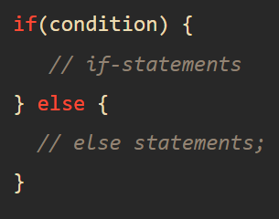
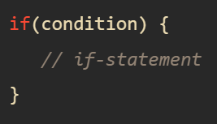
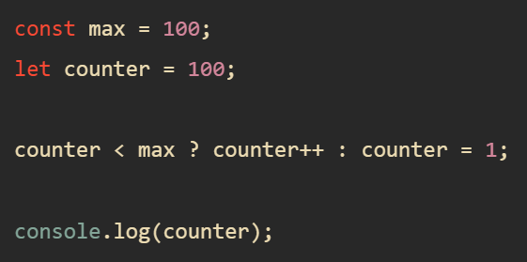
TypeScript if else
An if statement executes a statement based on a condition.
If the condition is truthy, the if statement will execute the statements inside its body:

Slide 3
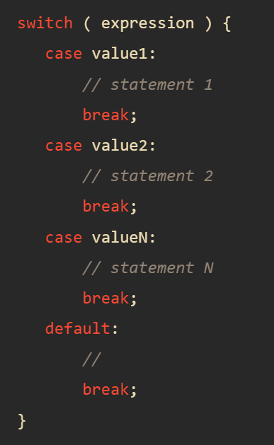
TypeScript switch case

Slide 4
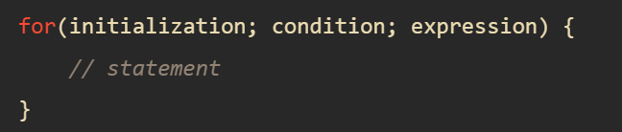
TypeScript for

Slide 5
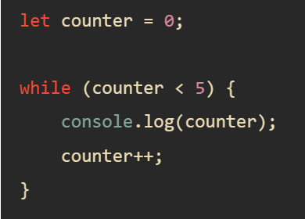
TypeScript while

Slide 6
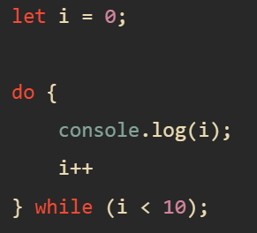
TypeScript do while

Slide 7
TypeScript break
The break statement allows you to terminate a loop and pass the program control over the next statement after the loop.
You can use the break statement inside the for, while, and do...while statement.

