Slide 1
FUNCTIONS

Slide 2
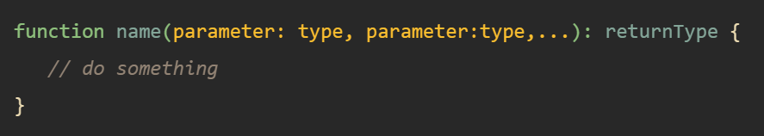
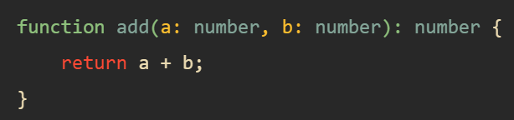
TypeScript Functions
TypeScript functions are the building blocks of readable, maintainable, and reusable code.
Like JavaScript, you use the function keyword to declare a function in TypeScript
If a function does not return a value, you can use the void type as the return type. The void keyword indicates that the function doesn’t return any value.

Slide 3

TypeScript Function Types
A function type has two parts: parameters and return type. When declaring a function type, you need to specify both parts with the following syntax
The following example shows how to declare a variable which has a function type that accepts two numbers and returns a number

Slide 4
TypeScript Optional Parameters
In JavaScript, you can call a function without passing any arguments even though the function specifies parameters. Therefore, JavaScript supports the optional parameters by default.
In TypeScript, the compiler checks every function call and issues an error in the following cases:
The number of arguments is different from the number of parameters specified in the function.
Or the types of arguments are not compatible with the types of function parameters.
Because the compiler thoroughly checks the passing arguments, you need to annotate optional parameters to instruct the compiler not to issue an error when you omit the arguments.
To make a function parameter optional, you use the ? after the parameter name.
The optional parameters must appear after the required parameters in the parameter list.

Slide 5
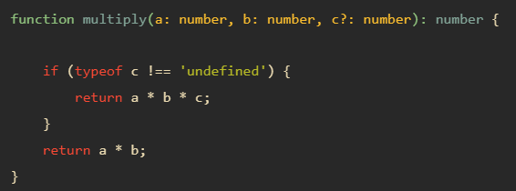
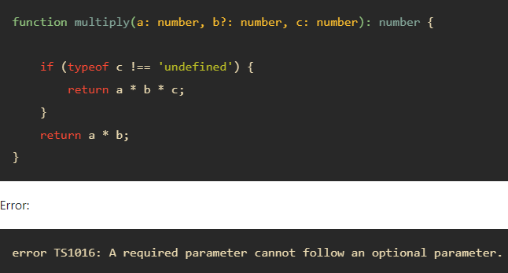
TypeScript Optional Parameters

Slide 6
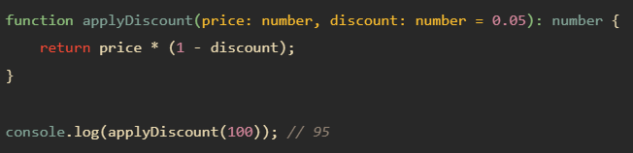
TypeScript Default Parameters
Similar to JavaScript, you an use default parameters in TypeScript.

Slide 7
Default parameters and Optional parameters
Like optional parameters, default parameters are also optional. It means that you can omit the default parameters when calling the function.
Optional parameters must come after the required parameters.
However, default parameters don’t need to appear after the required parameters.

Slide 8
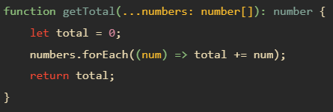

TypeScript Rest Parameters
A rest parameter allows you a function to accept zero or more arguments of the specified type.
In TypeScript, rest parameters follow these rules:
A function has only one rest parameter.
The rest parameter appears last in the parameter list.
The type of the rest parameter is an array type.
To declare a rest parameter, you prefix the parameter name with three dots and use the array type as the type annotation

